Slide 1
Tom Elder, FIT Lead
April 25, 2024
Oregon Framework
16 themes that form the foundation for an authoritative seamless statewide GIS

Slide 2
Addresses and Buildings Theme
New Theme to the Framework Program
Formed from Two Related Major Framework Elements
Address Points
Building Footprints
Both Need –
Standards
Statewide Public Datasets
Statewide Oregon Address geocoder
Notes:
You can be involved in one, the other, or both

Slide 3
Statewide Public Datasets
A parcel can have multiple buildings
A building can have multiple addresses
An address can have multiple locations

Slide 4
FIT At a Glance
FIT Listserv – 24 members
Held the first Meeting on 3/18/2024 with 20 attendees
Address Points
Membership is always open to anyone who has an interest in address points or building footprints – State, Local, Private
Two co-leads (to be voted on at the next meeting)
Tom Elder - Address Points
Matt Williams – Building Footprints
FIT Hub page
Sign up for the listserv
Listen and view the meeting recordings and handouts
Become familiar with the address standards

Slide 5
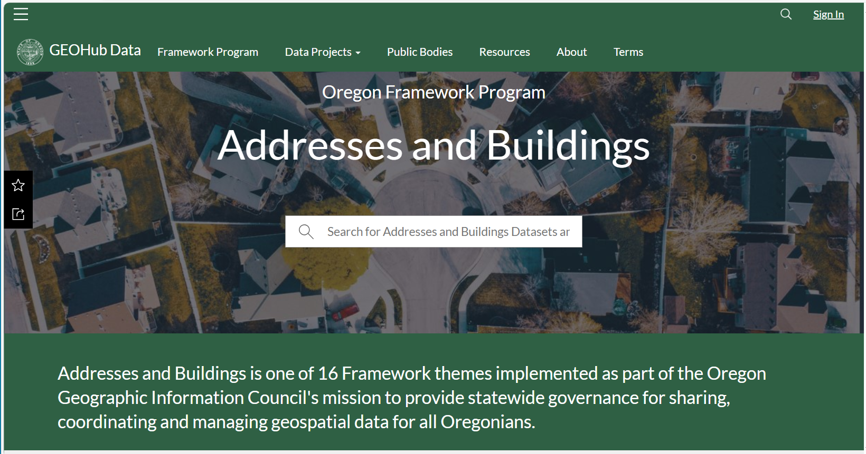
GEOHub FIT Hub Page
https://geohub.oregon.gov – Framework Program heading

Slide 6
So Far…
OEM has removed previous restrictions for sharing 911 address points
Over two million address points collected statewide
Published and maintain the Oregon Address statewide geocoder service
Statewide building footprints

Slide 7
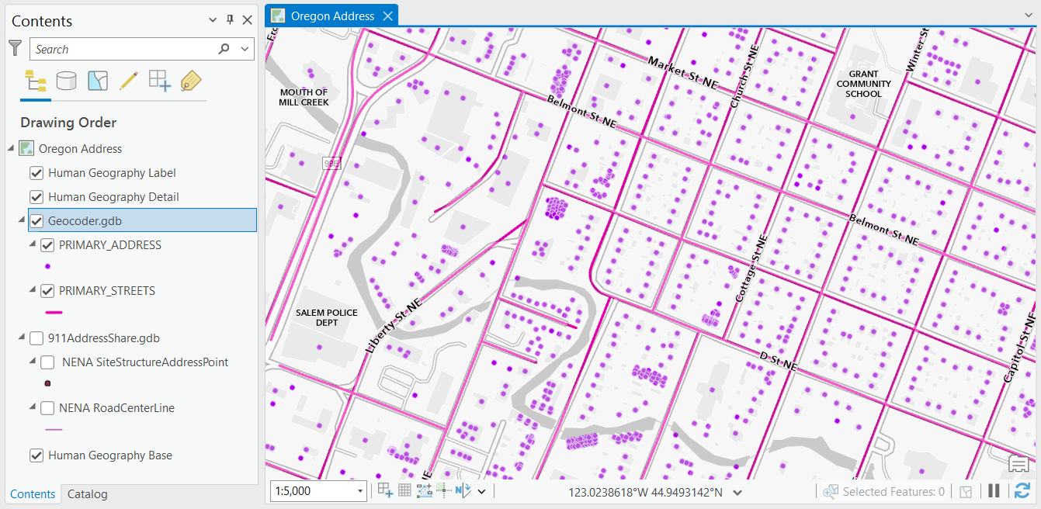
Oregon Address Locator
April 2024
Over Two Million
Address Points
Over 288,000
Street Centerlines

Slide 8
What’s Next
Hold the second FIT meeting of the year
In May/June
Vote on co-leads
Building Footprints
Standards
Workplans
Workgroups

Slide 9
Goals for 2024
OGIC endorsed address standard
Publish authoritative public address point datasets
Contribute statewide address points to the National Address Database
Building Footprints standard

Slide 10
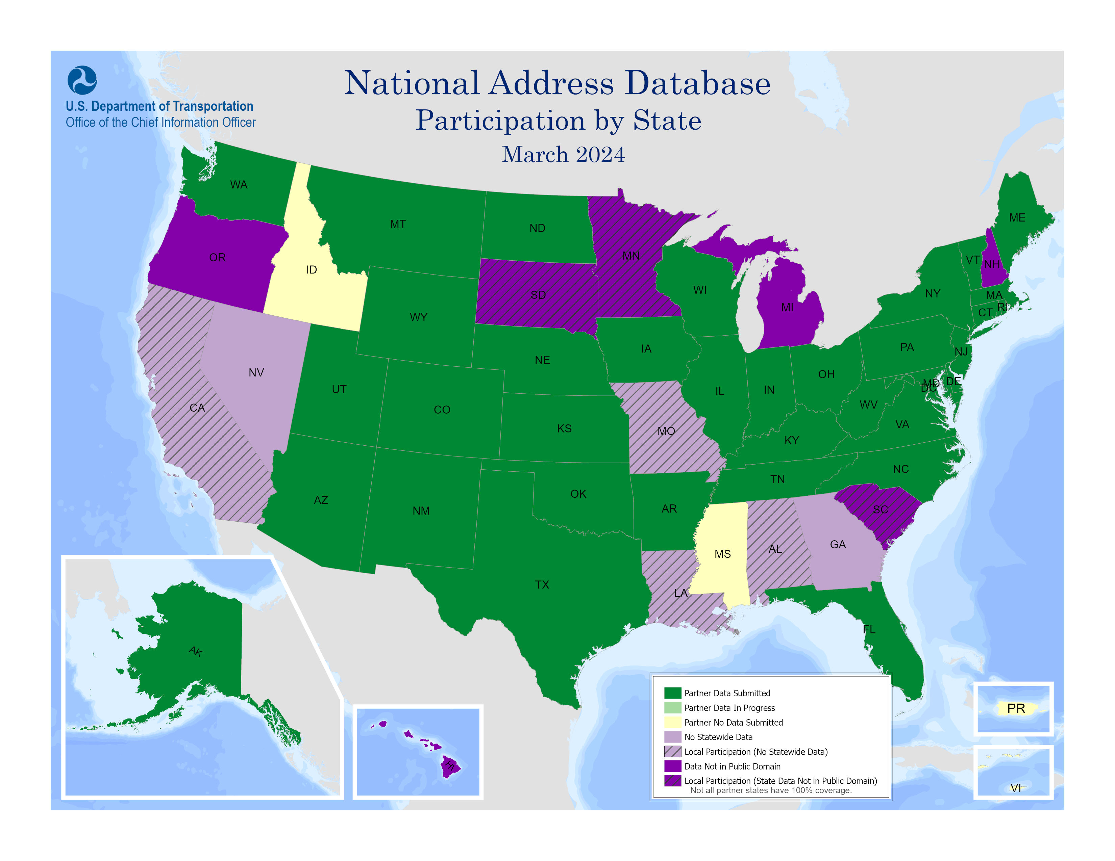
National Address Database (NAD)
7 of 53 states/territories are not in the Public Domain including Oregon

Slide 11
Partnerships & Collaborations
Oregon Geographic Information Council
Oregon Next Generation 911 Technical Advisory Committee
Adopt NENA Standard for all Public Safety Answering Points
National
NSGIC National States Geographic Information Council
FGDC Address Subcommittee
National Address Database
Other Related Framework Themes
Cadastral, Preparedness, Transportation, Administrative Boundaries

Slide 12
Goals – Authoritative, Reliable, Convenient Data
Complete Seamless Statewide Coverage
Publicly Available – No Cost
Sustainable Maintenance
Accurate – Address and Location
Flexible Design – Multi-Purpose
Offer Many Products Basic, Enhanced, Specialized
In Many Formats NENA, NAD, USPS, Census, others or custom
For Many Uses
Notes:
Complete
All Numbered Thoroughfare address points in Oregon
Including all unit numbers
Houses, apartments, mobile homes, accessory dwelling units, condominiums
Commercial, government
Offices, retail, manufacturing, farm
Schools, public facilities.
Residential, non-residential, group quarters
NOT
Residential addressees, tenants, no personal information
Landmarks, points of interest, mileposts, intersections
Infrastructure, machinery only

Slide 13
Many Uses
Census
Elections & Voting
Public Safety & Emergency Management
Housing
Broadband
Outreach & Mailing
Public Health
Many others

Slide 14
Four Major National Address Standards
FGDC Federal Geographic Data Committee
NENA National Emergency Number Association
NAD National Address Database
USPS US Postal Service
Links for each standard are on the GEOHub Addresses and Buildings Framework page.
FGDC, NENA, NAD
Are related and have a similar format
Notes:
FGDC current OGIC-endorsed standard (2014)
Numbered Thoroughfare class
FGDC, NENA, NAD
Less familiar
similar in the way they -
Parse street number
Parse street name
Separate city categories
USPS
More familiar
Single street number field
Single street name field
Single city field
OPTIONS
Keep FGDC
Choose another standard
Choose another standard with modified or added fields
Choose none – Completely custom
Combine standards
Combine standards with modified or added fields

Slide 15
FGDC Standard
National
Oldest (2011)
OGIC Endorsed in 2014
Covers Several Address Classes
Numbered Thoroughfare (123 E Main St Unit 4)
Intersection
Unnumbered Thoroughfare
Landmark
Address Ranges
Postal Delivery, PO Boxes, Rural Route Boxes
Any spatial standard – Specify the Spatial Reference
Also latitude and longitude
Formats the Street Number, Street Name, City into separate elements

Slide 16
FGDC Standard
Formats the Street Number into separate Elements
Address Number Prefix
Address Number
Address Number Suffix
Formats The Street Name into separate elements
Street Name Pre Modifier
Street Name Pre Direction
Street Name Pre Type
Street Name Pre Separator
Street Name
Street Name Post Type
Street Name Post Direction
Street Name Post Modifier
City/Jurisdictions stored in separate elements
Incorporated Municipality
Unincorporated
Neighborhood
Postal
MSAG – Master Street Address Guide

Slide 17
FGDC Standard
Pros
Most Comprehensive
Already OGIC Endorsed (2014)
Cons
Most Abstract, Most Complicated, Most Difficult to Implement

Slide 18
NENA Standard
National, International
Based on FGDC
Covers Two Address Classes
Site Structure Address Points
Landmark
WGS84 (4326) latitude and longitude spatial standard
Formats the Street Numbers and Names the same way as FGDC

Slide 19
NENA Standard
Pros
Current used for most NG911 input address datasets for Oregon
Used by at least 13 other states
Less Abstract, Less Complicated, Easier to Implement than FGDC
Cons
Specialized for 911 public safety answering points
Unit not required nor conditionally required

Slide 20
NAD Standard
National
Based on NENA
Two Address Point Classes
Numbered Thoroughfare
Landmark
WGS84 (4326) spatial standard
Formats the Street Numbers and Names the same way as FGDC

Slide 21
NAD Standard
Pros
Broader applicability, Less specialized than NENA
Format needed to contribute Oregon addresses to the NAD
Less Abstract, Less Complicated, Easier to Implement than FGDC
Cons
Only used by one other state and the NAD

Slide 22
USPS Standard
National
Not Based on FGDC, NENA, or NAD
Single Address Class
Authoritative source for ZIP Code, ZIP+4 add-on
Full Street Name (not parsed)
Full Street Number (not parsed)
Abbreviations for pre/post direction, street type
Separate Unit Type, Unit Number
Single City Field - Based on preferred city name assigned to the ZIP Code

Slide 23
USPS Standard
Pros
Most Familiar, Simple to Implement
Well established, Most widespread use
Source – Local Address Authorities
Validate with known authoritative source data (CASS)
Cons
Attributes only, not a spatial standard
Not every address receives mail

Slide 24
Custom Standard
FGDC
NENA
Combination of all four major standards
60% match
40% match on three fields
20% match on two fields
Most states still use custom formats
Most flexible to accommodate many
Input formats
Output formats
NAD
Core
OR
USPS

Slide 25
In General, Oregon Addresses Are…
Vast majority are not complicated and are very typical
Do not need a complicated standard
Very few variant street naming exceptions
Very few foreign names – Only 54 have Spanish, Italian, French spellings
Very few parsed street name elements (FGDC, NENA, NAD)
Only 0.8% of all street names (0.4% are “Highway ##”)
Do not need to accommodate every national regional variation

Slide 26
Address Standards – Consider All Options
Keep current OGIC-Endorsed FGDC standard
Select another standard
Many states use NENA or custom, a few use others
Possibly with additional fields
Select elements from multiple standards
Combine elements from all standards
Create a completely new and unique Oregon standard
Other options??

Slide 27
Address Standards - Priorities
Compare Major Standards
Identify the priorities for the address elements in each standard
Core Most important or mandatory minimum fields, must be supplied
Street Number, Street Name, Unit Number, City, X, Y
Important Recommended, can be derived from core
Useful Optional or nice to have, can be derived from core or location
Not important nor relevant
Add any other necessary fields

Slide 28
Thank You!
Tom.Elder@das.oregon.gov
Matt.Williams@dgmi.oregon.gov

