Slide 1
Oregon Address Point Data Standard
Tom Elder
2025 Spring Framework Forum
May 15, 2025

Slide 2
Agenda
Present the OGIC-endorsed Address Point Standard
  Starter Kit
Next Steps
  NENA Changes
  Stewardship Plan
Coming Soon
  Next Generation 9-1-1
  National Address Database (NAD)
  Census 2030 Local Update of Census Addresses (LUCA)

Slide 3
We have a new standard! Version 1.0
Received OGIC unanimous endorsement April 30, 2025
Now available on the GEOHub Addresses and Buildings theme page
https://geohub.oregon.gov/pages/addresses-and-buildings
https://ogic-geo.hub.arcgis.com/pages/standards
Includes all the comments, corrections, and clarifications received

Slide 4
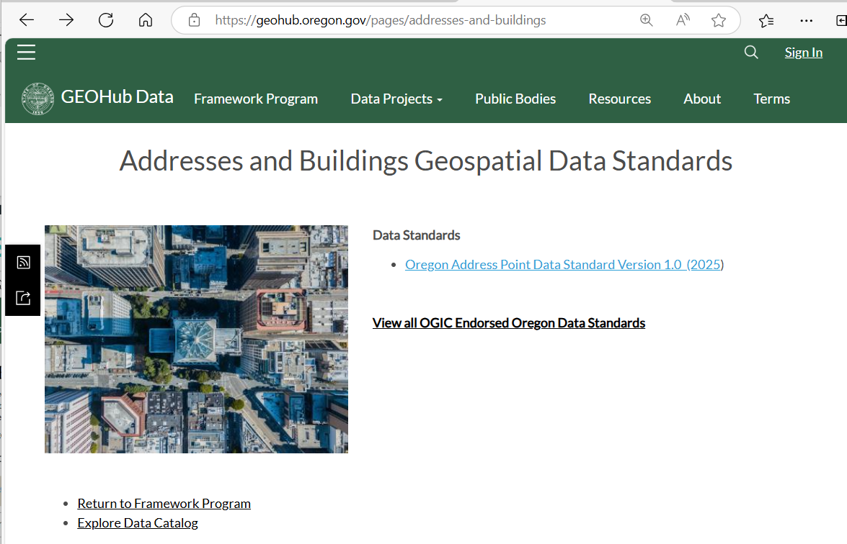
Addresses and Buildings Theme Page

Slide 5
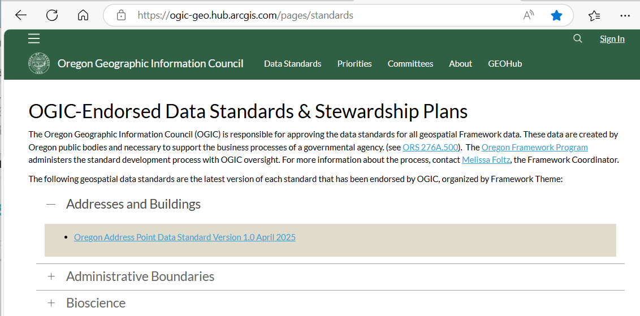
All OGIC-Endorsed Standards

Slide 6
Standards Process at a Glance
May 2024 – April 2025
20 Workgroup Participants (state, local, federal, university, PSAP)
  Several other reviewers
2 FIT Meetings
7 Address Point Workgroup Meetings
2 Framework Forums Presentations
1 OGIC Presentation

Slide 7
Quick Look at the Standard
84 pages
  3 – 16 Introduction, background, reference
  16 – 18 Table of fields (handout)
  19 – 33 Detailed data dictionary, examples
  34 – 39 Appendices
  40 – 84 Domain lists, lookup tables
58 fields – 45 NENA, 13 Added
  Address – Full and parsed
  Localities – City, county, state, ZIP
  Location – Shape, ObjectID, longitude, latitude
  Additional
13 Domains – Incorporated cities, ZIP Codes, counties, others

Slide 8
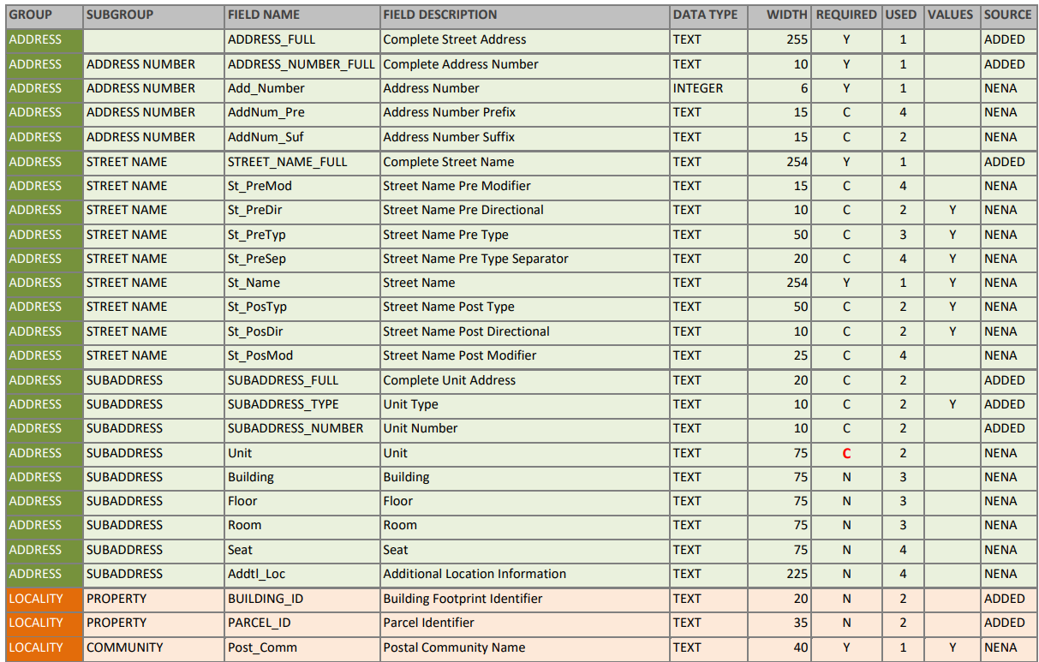
Standard Fields
Required
Y = Required always
C = Required if present
N = Optional
Used
1 = Always
2 = Often
3 = Occasionally
4 = Rarely
Values
Y = Has domain

Slide 9
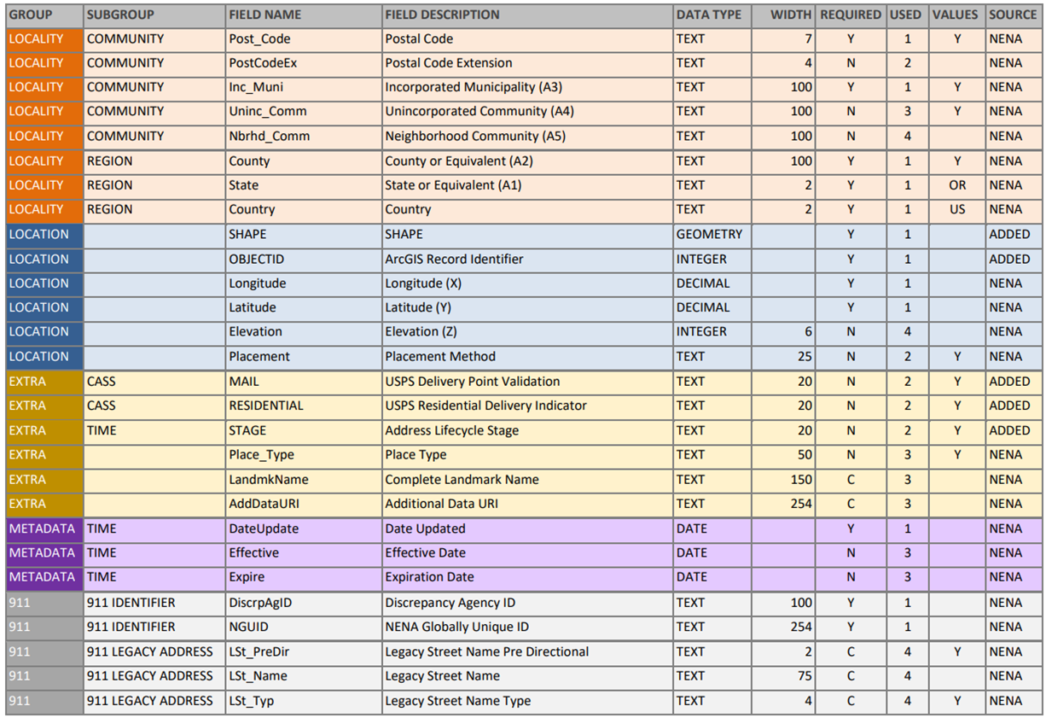

Slide 10
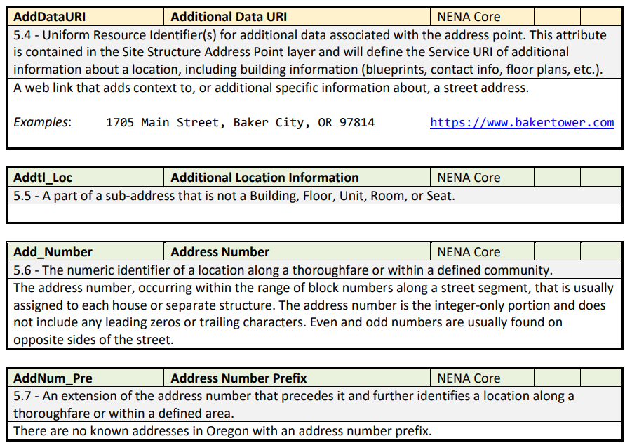
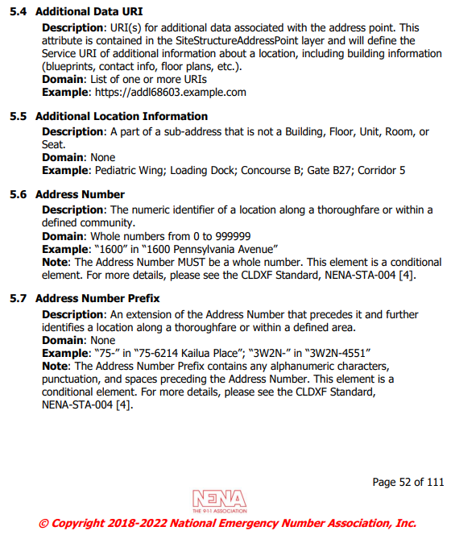
Data Dictionary

Slide 11
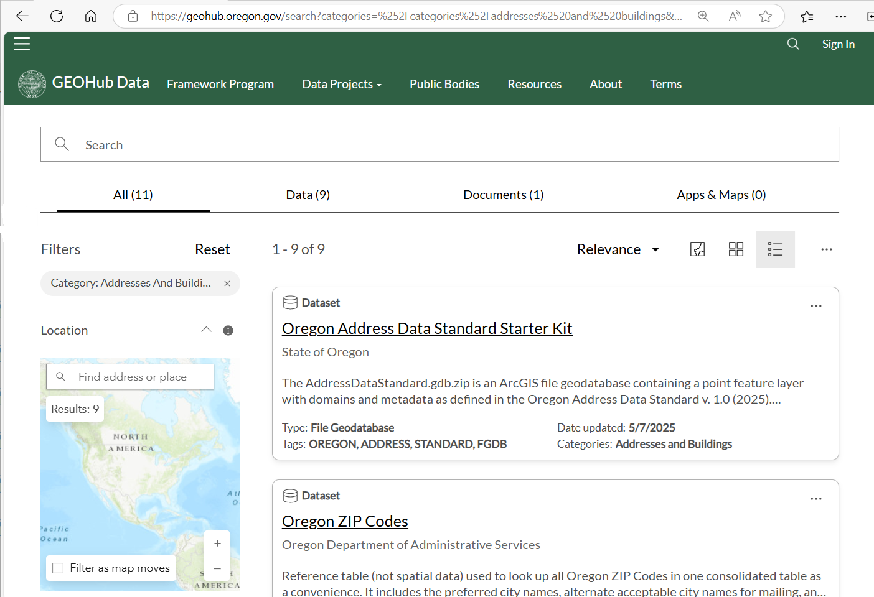
Address Points Starter Kit on GEOHub
Search Category:
Addresses and Buildings
File Geodatabase with
Point Feature Class Template
  Predefined Fields
Domains
Metadata

Slide 12
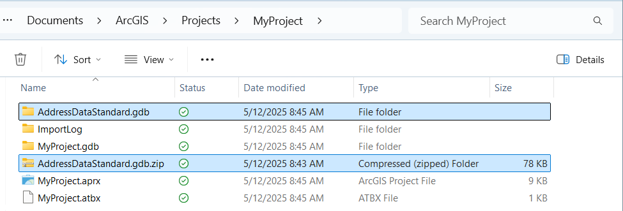
Download and Unzip the File Geodatabase

Slide 13
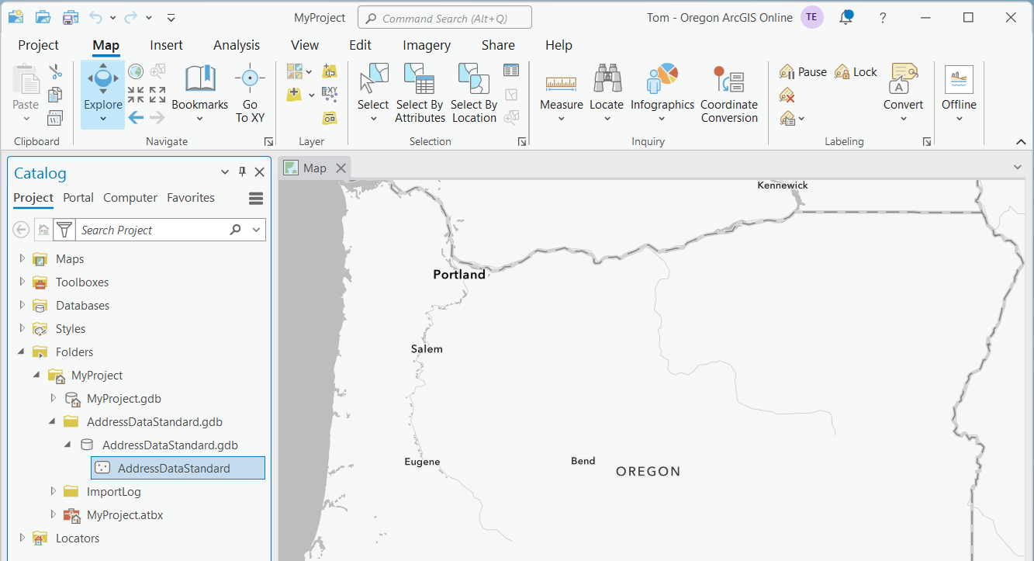
Starter Kit Feature Class

Slide 14
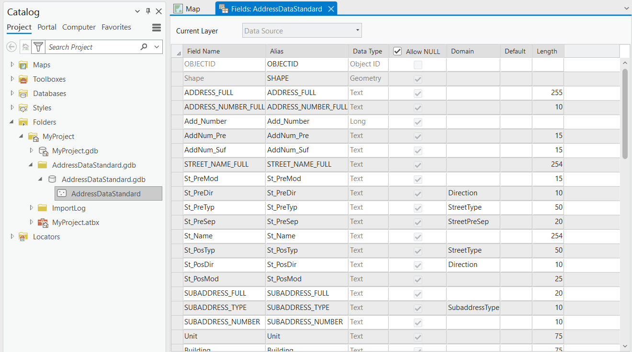
Starter Kit Fields

Slide 15
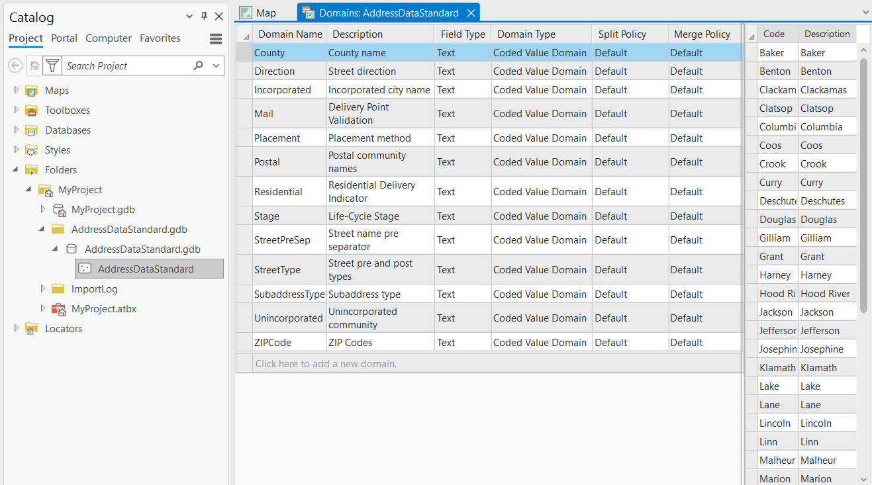
Starter Kit Domains

Slide 16
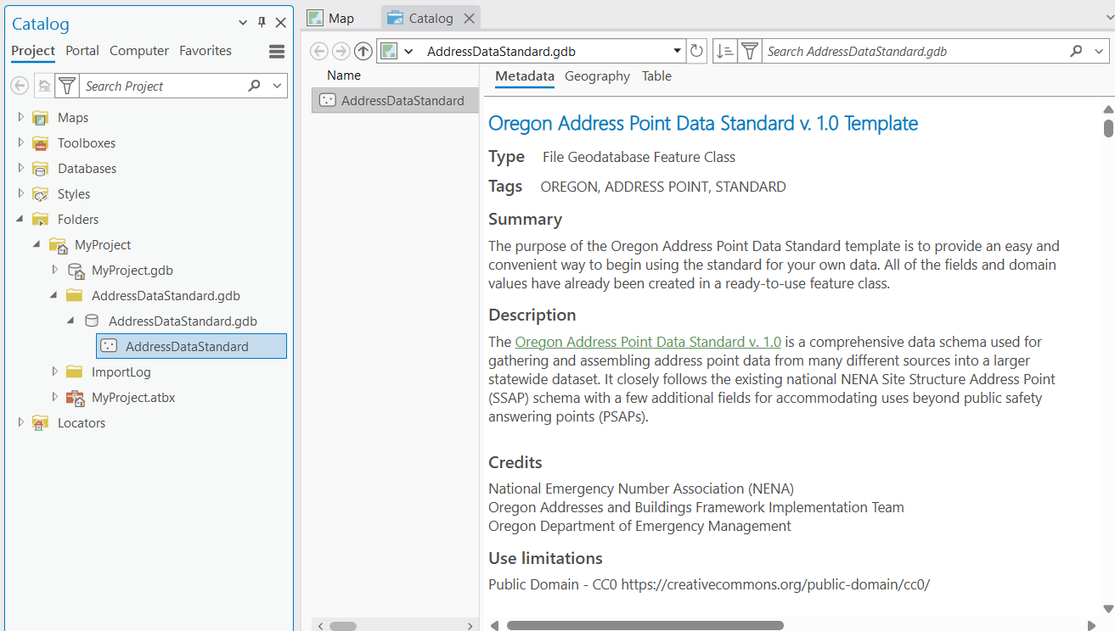
Starter Kit Metadata

Slide 17
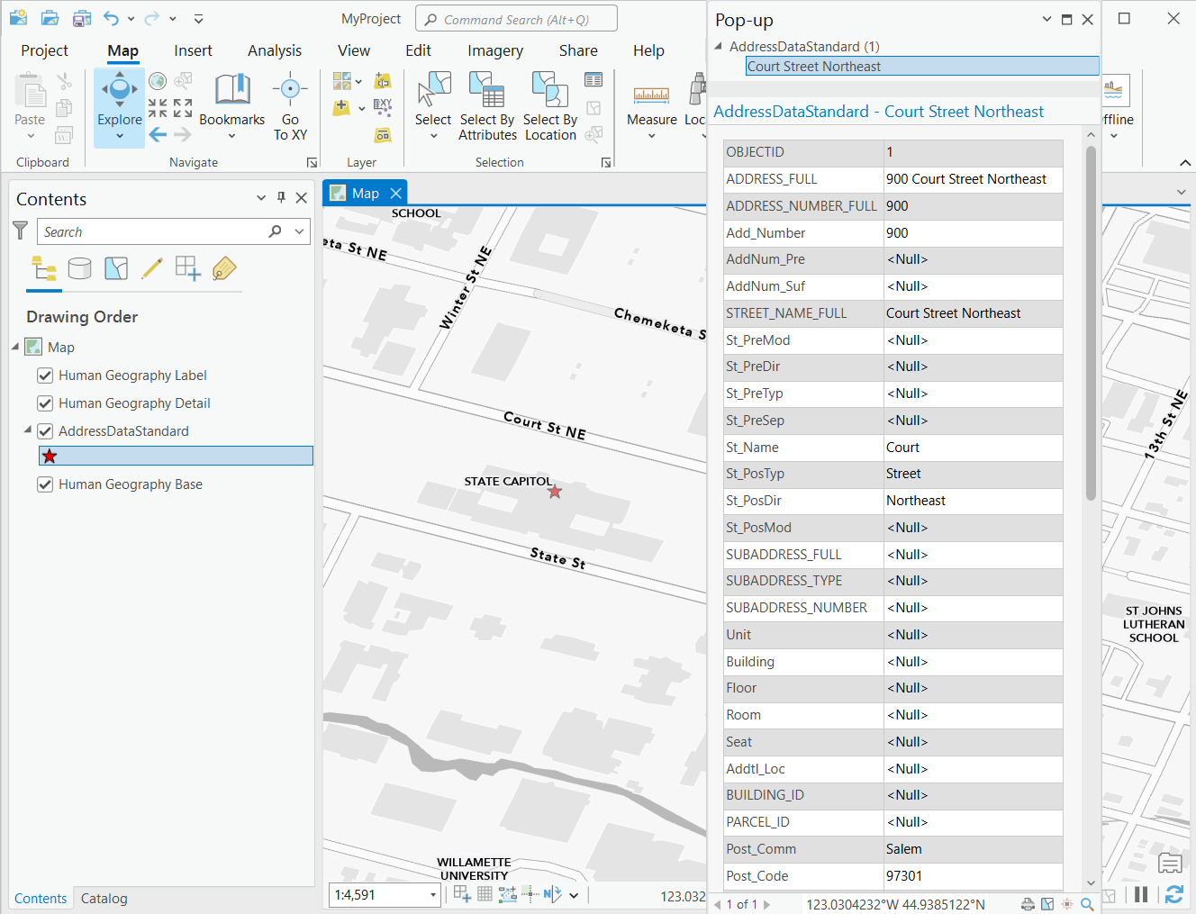
Starter Kit Example
All Values – NENA style
Fully Spelled
Title Case (upper and lower case)

Slide 18
Next Steps
Review future NENA changes
  Complete Address Number, Unit Conditional!, Unit Type, Unit Number
Add or change fields as needed for any new business requirements
Stewardship plan
  How to build and maintain a statewide seamless dataset
Dataset will be needed for big projects coming up soon
  Dataset improvements

Slide 19
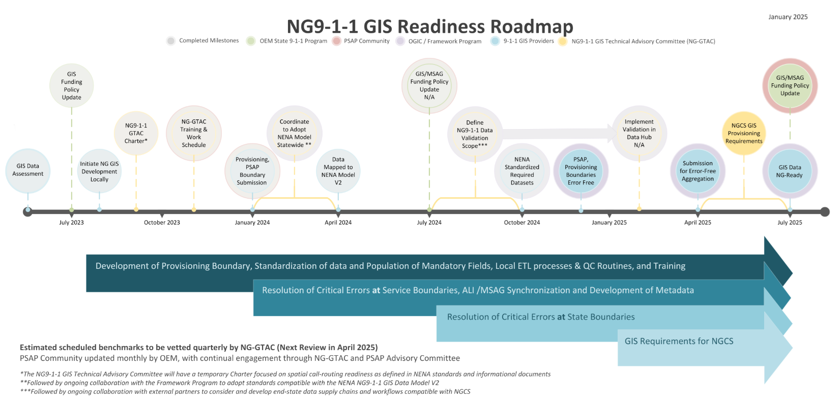
Next Generation 9-1-1
July

Slide 20
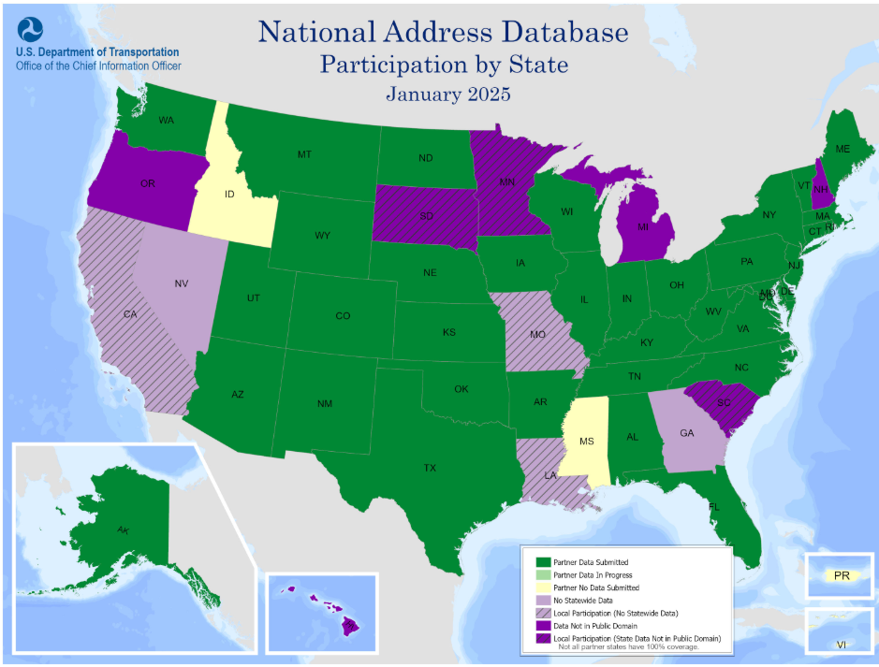
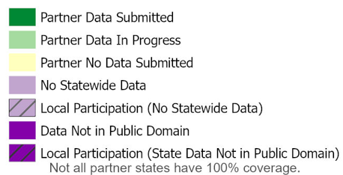
National Address Database

Slide 21
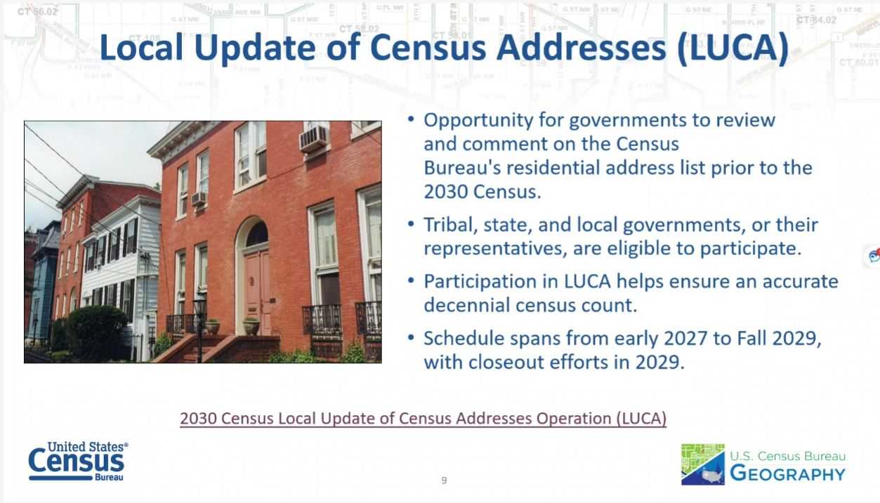
Census 2030 LUCA Program

Slide 22
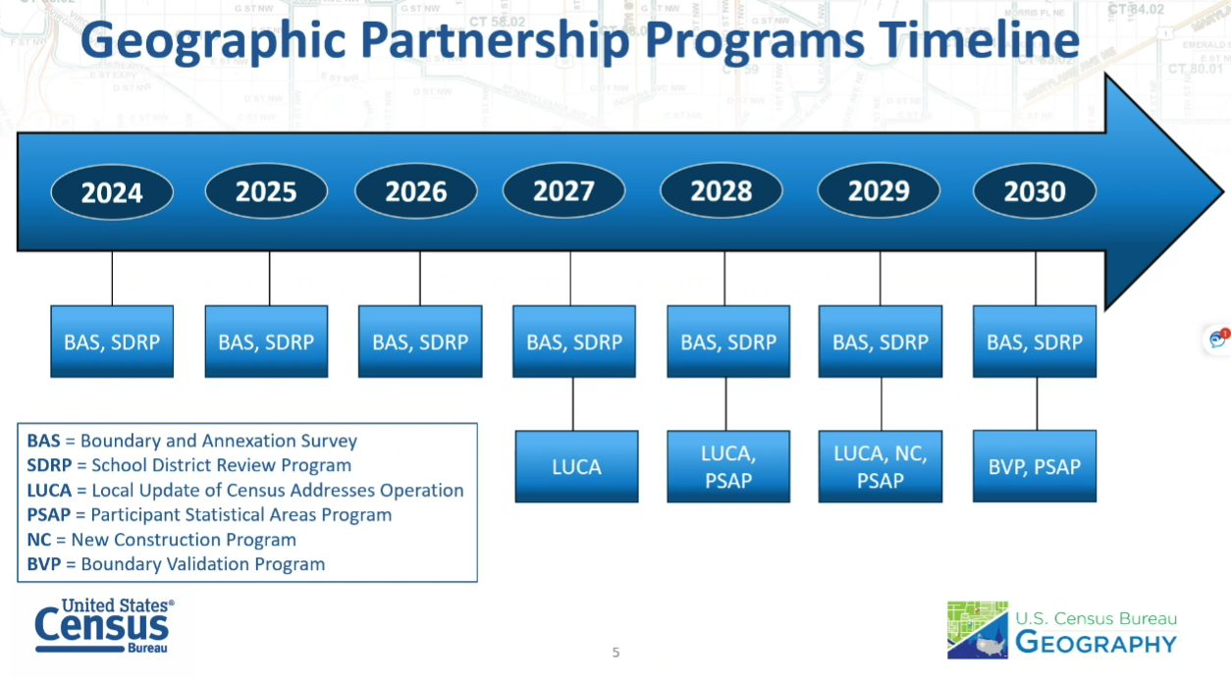
Census 2030 Timeline
4/1/2030

Slide 23
Improvements Needed
Missing Units – Residential and Commercial
  Census Housing Units
  Census Group Quarters
  FCC 9-1-1 Dispatchable Locations
  https://www.fcc.gov/911-dispatchable-location
    Units
    Floor
    Building
    Room

Slide 24
Get Involved!
Anyone with the time and interest can participate.
  Local – cities, counties, regional, tribal, PSAP
  State
  Federal
  University
  Private, Non-Profit
  If you are interested just contact Tom or Melissa!
  Work also continues on the Building Footprints Data Standard.
  Contact Matt Williams if you are interested in participating.

Slide 25
Thank You!
Tom.Elder@das.oregon.gov
Melissa.Foltz@das.oregon.gov
Matt.Williams@dogami.oregon.gov

