Slide 2
2019-2020 Estimate of Membership and Revenue
Welcome to the WebEx Training!!
How many new business managers?
Notes:
Welcome to the Estimate of Membership and Revenue Webex
Introduce myself

Slide 3
Goals of the Presentation
How to access collection and where to get additional help
Charter School Submission tips
Explanation of Collection Fields
Common Errors
How to Submit the Collection

Slide 4
USER GUIDES if you are not familiar with Consolidated Collections
  Consolidated Collections Student-Level User Guide
https://district.ode.state.or.us/apps/info/docs/cc_studentlevel_ug.doc
  Consolidated Collections Institution-Level User Guide
https://district.ode.state.or.us/apps/info/docs/cc_instlevel_ug.doc
Notes:
Before we get started with our particular collection here are some places you can go for help with all consolidated collections.
These resources are great for looking up specific issues and getting more information on them.

Slide 5

2019-20 Estimate of Membership & Revenues Collection Timeline:
  Opens: October 25, 2018
  Closes: December 17, 2018
Notes:
Collection Dates
Open: When you can start to enter data.
close: When you can no longer enter data.
Is the Close the end of the world as we know it?
No. I can still open for corrections and changes.
I want to open for corrections and changes.

Slide 6
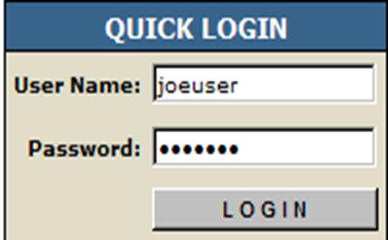
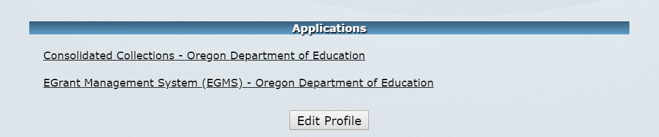
HOW DO YOU ACCESS THE COLLECTION?
Log onto district website at the following URL: https://district.ode.state.or.us/
Access the collection under the Institutions Collections in your Consolidated Collections

Slide 7
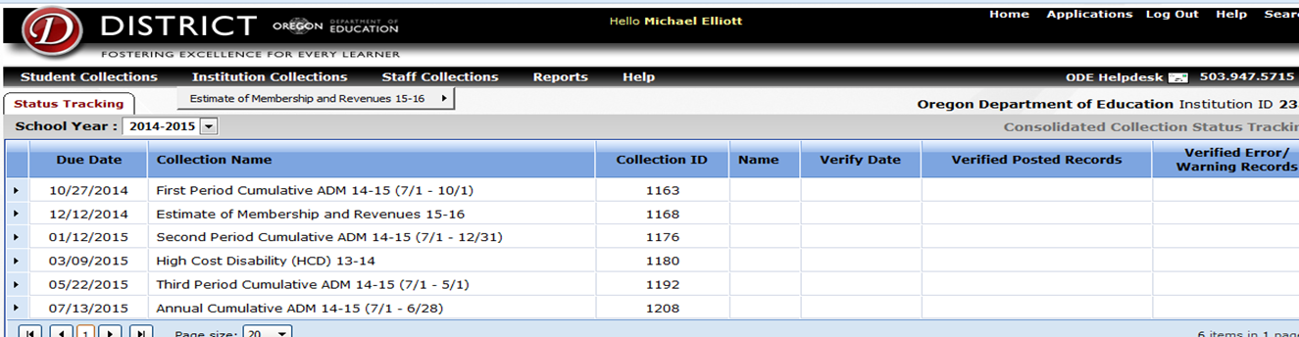
Select the collection from the Institutions Collections drop-down list…

Slide 8
Keep in mind..
Charter School Reminder
  Charter school data will be combined with the rest of the district’s data
Full Day Kindergarten Reminder
  If your district is offering full day kindergarten then enter kindergarten students at 1.0 ADM
  If your district is not offering full day kindergarten then enter kindergarten students at 0.5 ADM
Notes:
581-022-2320
Required Instructional Time
(1) Each school district shall ensure that at least 92% of all students in the district and at least 80% of all students at each school operated by the district are scheduled to receive annually the following minimum hours of instructional time:
(a) Grade 12 — 966 hours;
(b) Grades 9–11 — 990 hours; and
(c) Grades K–8 — 900 hours.
(2) If a school district chooses to offer less than 900 hours of instructional time for kindergarten students, the kindergarten program shall be considered a half-day program for purposes of ORS 327.006(1) and the school district shall ensure that every kindergarten student is scheduled to receive a minimum of 450 hours of instructional time per year.
(3) Upon approval by the local school board, a district may include in its calculation of instructional time required by subsection (1) of this rule the following:
(a) For kindergarten programs offering 900 hours or more of instructional time, up to 60 hours of recess;
(b) For kindergarten programs offering less than 900 hours of instructional time, up to 30 hours of recess;
(c) For grades 1–3, up to 60 hours of recess;
(d) Up to 30 hours for staff professional development;
(e) Up to 30 hours for parent teacher conferences;
Here is the language from the manual regarding FTE:
Students who are scheduled to participate in more than one-half of the full day are given an FTE of 1.0. Those students who are scheduled to participate in one-half or less of the full-day program are given an FTE of 0.5. FTE for students on block schedules is determined by looking at the student’s entire schedule. If the student attends more than half of the day, every day of the schedule, they would be reported as 1.0 FTE. If the student attends half the day or less, every day of the schedule, they would be reported as 0.5 FTE.
Student accounting manual section on days present:
For a student assigned an FTE of 1.0, he/she must be present for more than half of the morning to be counted as present for the morning, and present for more than half of the afternoon to be counted as present in the afternoon. If a 0.5 FTE student attends at any time during the day, the student is counted as present for the full day. Kindergarten students in half time programs (Program Type Code 15) should be reported as whole days present/absent and are counted as present for the entire day if they are present for any portion of that day. Starting in 2015-16, Kindergarten students attending Full-Time programs should be reported under Program Type 1 with the same FTE and Days Present/Absent rules as other grades.

Slide 9
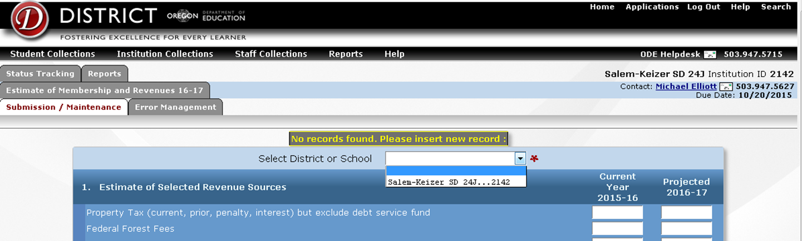
Step 1: Choose your institution
Use the pull down menu to choose the district institution ID
  You should not see your charter schools
Once you have chosen the institution fill in the questions on the collection
Notes:
District that are single district charter schools should enter data twice. Once for the charter school and once for the district totals.

Slide 10
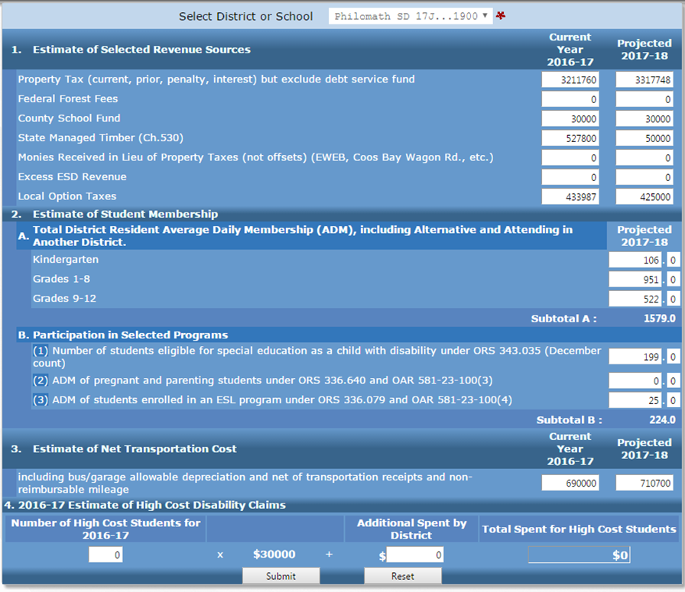
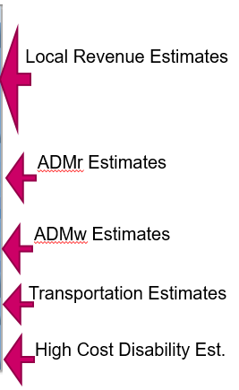
Step 2. Enter Data
Notes:
What do each of these questions mean?
Property taxes: make sure to include penalties, interest and any prior property taxes for any prior years.
Federal Forest Fees: We are expecting Federal Forest fees for 2019-20
County School Fund
State Managed Timber: This may also be hard to predict so if you need to reopen you can.
Monies in lieu of Property Taxes: includes payments from SIPs and urban renewal refunds
Excess ESD revenue: This is not revenue the ESD provides in lieu of services
Local Option Taxes
Student Membership:
If you have full-day kindergarten, then make sure to count kindergarteners at the full-time level. If you are going to offer half-time programs, then be sure to divide your kindergarten ADM by 2 to get the correct ADM. This applies to charter schools as well.
If any of these numbers change as you get more information, I can reopen to allow updates. Usually wait till end of September.
Section B – is student count not weighted. I use the number to calculate weights.
Transportation Costs: Include all eligible transportation costs. We will apply the ratio. Includes new buses, bus garage, payroll.
High Cost Disability: Best predictor of the future costs is using the past year’s actual costs Make sure you predict eligible costs for 2019-20
One more note. This is a chance for you to review your estimated revenues from the current year, 2018-19. If you believe that you need to make adjustments, then please make adjustments to your current revenue amounts as well so that we can make adjustments while you are still receiving payments for the 2018-19 school year. Do not enter 0 for local revenue even if you don’t have changes.

Slide 11

NOTE: Saving and submitting your data
After you have entered your data, click the Submit button at the bottom of the page and your estimates will be uploaded to the ODE. If you need to make a correction, simply enter your new data, click on the Submit button and your previous data will be overwritten.
The Reset button will erase all data updates entered after the last time the Submit button was selected.

Slide 12
A few things to note:
1. Make sure you enter data in every field – blank
fields are automatically converted to zeroes
2. Make sure you are properly counting kindergarteners
3. Submit 100% of estimated eligible
transportation costs – I’ll take care of
the ranking and reimbursement rates
4. Watch those zeroes…
5. Use your 2017-18 High Cost Students actuals
data for your 2019-20 estimate
6. Charter data is included with the rest of the
district data.

Slide 13
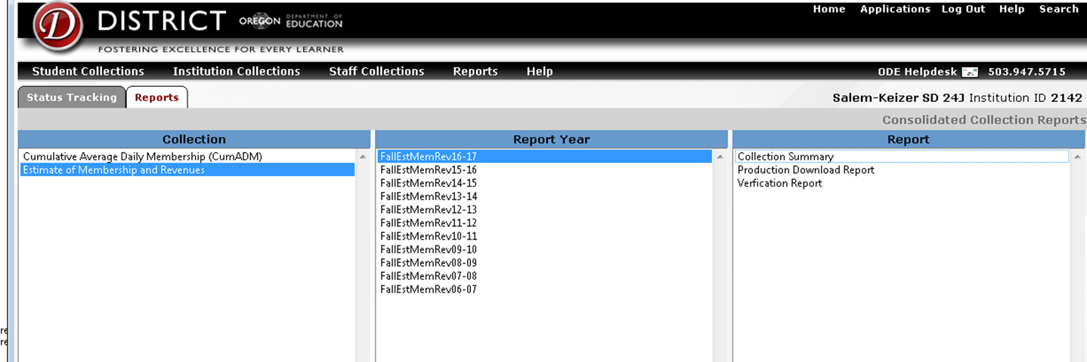
Reports section of Consolidated Collections
Reports Menu
  Verification Reports
  Summary Report
  Production Download
Notes:
Verification Reports: These reports indicate what errors you have and when you last posted an update.
Summary report: This provides you with a printout of the all data you just entered.
Production Download: Lets you know when the data is ready for download. This report is the actual data that you submitted.

Slide 14
Who to contact if you experience challenges with the website?
Technical Issues
  ODE Helpdesk
  (503) 947-5715
  ode.helpdesk@state.or.us

Slide 15
Estimate of Membership and Revenues
Contact Info
  Adam Krein
  503-947-5678
  Adam.Krein@ode.state.or.us

Slide 16

Thank you for your hard work!

