Slide 1
Cyber Disruption Workgroup – Nationwide Cybersecurity Review (NCSR)
Emily Sochia – Manager, Maturity Services
October 12, 2022

Slide 2
What is the Nationwide Cybersecurity Review (NCSR)?
Benefits:
Receive metrics to identify your organization’s cybersecurity maturity gaps.
Measure your results anonymously against your peers.
Fulfill the NCSR assessment requirement for the Homeland Security Grant Program (HSGP).
View & Outline Recommended Next Steps and Priorities:
Federally funded services and resources to get started with
Cyber activities and open source tools to implement
Policy templates ready to customize and adopt
Help drive federal and ISAC action
TLP:WHITE

Slide 3
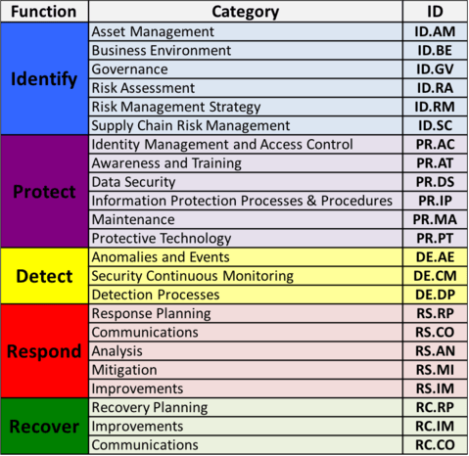
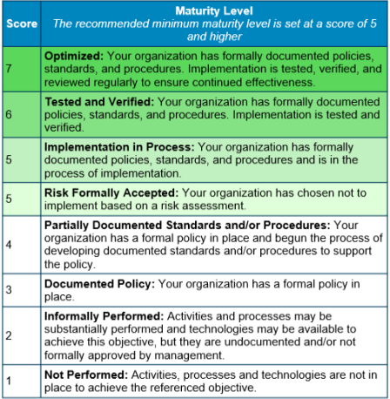
NCSR Question Set & Answer Scale
NIST Cybersecurity Framework
https://www.nist.gov/cyberframework/framework
TLP:WHITE

Slide 4
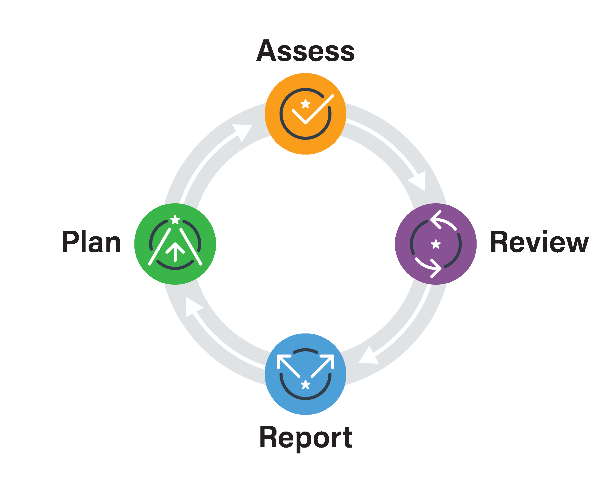
NCSR Lifecycle
TLP:WHITE

Slide 5
Assess
Take the NCSR
Assessment has 140 questions
2-3 hours to complete the first time
Pre-population available each year after
Does not need to be completed in one sitting
Help text included to describe each question
Resources available to guide the process
https://www.cisecurity.org/ms-isac/services/ncsr/
TLP:WHITE

Slide 6
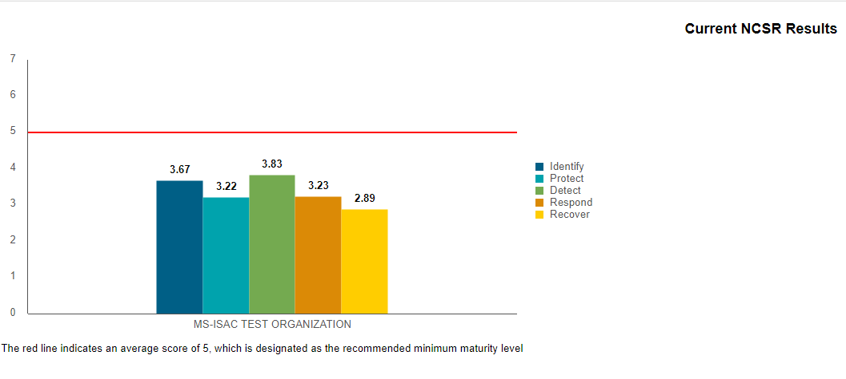
Review
Look at Your Results
Peer Profiles
Current NCSR Results
Year-to-Year Results
HIPAA Compliance Report
Cybersecurity Resources Report
CIS Controls v8 Report
Cybersecurity Framework Library
TLP:WHITE

Slide 7
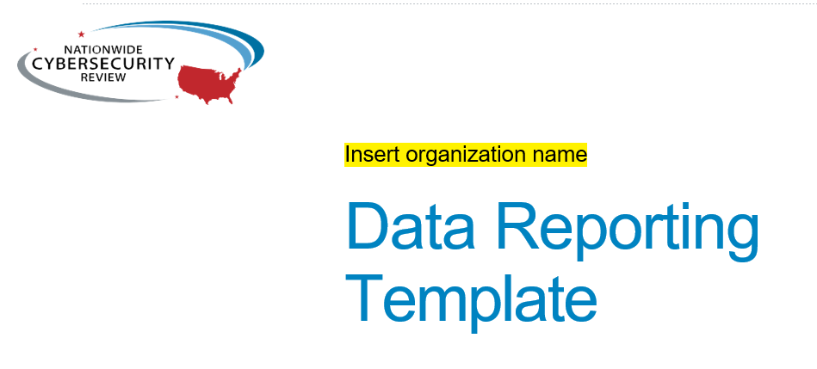
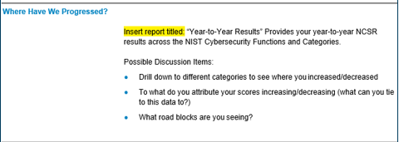
Report
Show Your Executives
In order to make improvements, it’s critical to present your findings to your executives.
Key questions/considerations:
Identify lower scoring areas (1-2 maturity level)
Do you have policies in place?
What is the highest priority action?
TLP:WHITE

Slide 8
Plan
Draft Your 2022 Cybersecurity Plan
Use a policy template and implement an Incident Response Plan
Sign up for free resources
Malicious Domain Blocking and Reporting (MDBR)
MS-ISAC Working Groups
Set up recurring meetings with your executives
Take the NCSR again to assess progress
TLP:WHITE

Slide 9
How to Communicate Your Cybersecurity Plan
Look at your Year to Year Results
Note your progress areas and sections that still need improvement
Highlight some of the resources MS & EI-ISAC along with CISA offer at no cost to get started and justify where continued or new funding is needed
Building a cybersecurity roadmap
Set up a maturity review with the NCSR team
Review your results one-on-one with a team member who can directly point to available low or no cost services
Present to Key Stakeholders
Report lowest scoring categories to key stakeholders representing need for funding
NCSR Data Reporting Template
Using Cybersecurity Metrics to Inform Stakeholders Guidance
TLP:WHITE

Slide 10
Notable Findings – Oregon Locals 2021
43 local entitles from Oregon participated in the 2021 NCSR
Supply Chain Risk Management was the lowest scoring category – this is the lowest for all SLTTs
Supply Chain Cybersecurity Resources Guide
51% reported they have Not Implemented Baseline Configuration-Change Control
CIS SecureSuite available at no cost for all SLTT entities
TLP:WHITE

Slide 11
Notable Findings – All SLTT
Security Budgeting
Organizations stating that they had dedicated at least 3% of their IT budget to cybersecurity activity scored 21% higher, on average, than those stating that they did not have a dedicated cybersecurity budget.
Security Framework Adoption Correlates to Higher Scores
Entities that currently employ a security framework, such as the CIS Controls, the NIST CSF, or ISO 27000 series, scored 48% higher than those organizations that do not.
Cybersecurity Executive Reporting
Organizations that have mandated cybersecurity reporting to executives scored 65% higher than those with non-existent reporting.
TLP:WHITE

Slide 12
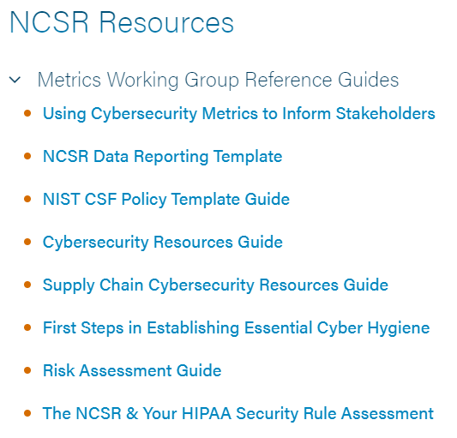
End-User Resources
Located Here: https://www.cisecurity.org/ms-isac/services/ncsr/
TLP:WHITE

Slide 13
Register Now!
October 1, 2022 – February 28, 2023
https://www.cisecurity.org/ms-isac/services/ncsr
TLP:WHITE

Slide 14
Multi-State Information Sharing & Analysis Center (MS-ISAC)
Contact: NCSR@cisecurity.org
Emily Sochia – Emily.Sochia@cisecurity.org

