Slide 1
Finding Funds
For Oregon Students
Beyond High School Network
Lane County
January 2025
Presenter: Nomi Pearce

Slide 2
Key
Topics
FAFSA/ORSAA
Grant Programs
Scholarships
Questions
Notes:
Notes:
Thank you for inviting me to talk with you this morning, to make sure we are all on the same page here is a what we are planning on talking about today: We are going to talk about FAFSA/ORSAA, Quick updates to OSAC Grant Programs, updates to the OSAC Scholarship, and take time for your questions.

Slide 3
Overview
FAFSA/ORSAA
Only Submit 1
If you are unsure which form to complete use the OSAC FAFSA/ORSAA filter tool
FAFSA:
U.S. Citizens or eligible non-citizens
Used to access Federal and State financial aid, and many scholarships
FAFSA
ORSAA
ORSAA:
Oregon students who are undocumented, or have DACA/TPS status
Used to access state financial aid, and many scholarships
Notes:
Notes-
FAFSA- Stands for Free Application for Federal Student Aid
ORSAA- Stands for Oregon Student Aid Application
Both the FAFSA and ORSAA are free applications and students should never pay to complete these forms
Many scholarship and grant applications, including the OSAC scholarship require completing a FAFSA or ORSAA application. Scholarships may require a FAFSA or ORSAA even if it’s not a need-based scholarship.
Both the FAFSA and the ORSAA will open in January, but students only need to complete one of the applications. Complete the FAFSA if you are a U.S. Citizen or eligible non-citizen and complete the ORSAA if you are undocumented, have DACA, or TPS status. If you are unsure which form to complete you can use the quiz on the OregonStudentAid.gov website.

Slide 4
Getting To Know The
Oregon Opportunity Grant
Supports roughly 30,000 low-income undergraduate students each year attending an eligible Oregon college
or university
Maximum award for 2024-25 (full time)
Community College
$3,900
BAS Program at Community College
$5,904
4-Year College/University
$7,524
Open to Oregon residents who meet SAI limit and FAFSA/ORSAA submission deadline
No additional application, students only need to submit a FAFSA or ORSAA as soon as possible after the application open
Notes:
Notes:
Oregon Opportunity Grant is Oregon’s largest need-based grant program for undergraduate Oregon students. Students are eligible to receive this grant up to four years. Eligibility is reviewed each academic year (no automatic renewal).
Eligibility:
Open to Oregon residents who attend an eligible postsecondary school in Oregon
Haven’t already earned a baccalaureate degree
Enrolled at least half-time (award will be prorated for half-time enrollment)
Maintain satisfactory academic progress
Priority goes to those with financial need
Must meet SAI limit and FAFSA/ORSAA cutoff date
Additional eligibility requirements for ORSAA students (must meet tuition equity criteria)
Submit the FAFSA/ORSAA: all FAFSA and ORSAA filers are automatically considered for the Oregon Opportunity Grant and are notified via email if they are eligible.
File as soon as possible once the application (usually October 1). OOG funds are first-come, first-served and are awarded until funds are depleted.
Resolve any errors as quickly as possible, OSAC cannot award OOG to FAFSA/ORSAA with error codes
OOG is not available for out of state and for-profit schools
OOG does not award funds for summer term
Priority: goes to those with financial need, based on the applicant’s SAI. Applying does NOT guarantee an award.
See the OSAC website for additional details. https://oregonstudentaid.gov/grants/oregon-opportunity-grant/
Funds are only disbursed for the fall, winter, and spring terms each year. OOG does not disburse grant funds during the summer.
OOG eligible students who are enrolled in eligible BAS program at a community college will receive a slightly higher award amount.

Slide 5
The OSAC
Create a Student Account
Student Portal
Applications and Awards:
Oregon Promise Grant
Chafee Grant
Child Care Grant
Oregon Tribal Student Grant
OR National Guard State Tuition Assistance
OSAC Scholarships
OregonStudentAid.Gov
Notes:
Optional
Notes-
Creating an account on the OSAC student portal is the first step for students to access any of our grant and scholarship programs including things like: Oregon Promise, Chafee Grant, Child Care Grant, Oregon Tribal Student Grant, and the OSAC Scholarships.
If you’ve logged onto the portal already this year you may have noticed that it looks a little different… it had a bit of a makeover recently.

Slide 6
Create An
OSAC Student Portal Account
Tips for Students
HS & ASPIRE Staff/Volunteers
Create your own “test account”:
Create an OSAC Student Portal account.
In the Profile "About Me" section, select “This is a test application” under Applicant Type.
Complete your Profile using “test” data. You may complete test applications for OSAC Scholarships in addition to Oregon Promise, Oregon Tribal Student Grant, and other OSAC Grant programs.
(Note: Test applications will not be reviewed by OSAC.)
Use your legal name. Use the same name on your FAFSA/ORSAA
Password must be 12 characters
Recommended: Use a personal email address (not school)
https://app.oregonstudentaid.gov/
Notes:
General Scholarship Presentation- Yes
OSAC Scholarship Presentation- Yes
OSAC Scholarship Workshop- Yes
Notes-
Creating an OSAC portal account is easy, but a few things can be tricky.
Make sure to use your legal name and the name that matches your FAFSA or ORSAA application
Remember your password is 12 characters and has specific requirements
Students should sign up with a personal email account, not a high school or college-operated email account, so that they will have access to their portal account indefinitely. Students are encouraged to check their email and portal account regularly during the spring to check for any award notifications.
Remember to stay organized, it is hard to reset a username and password so make sure to keep track of your username and password

Slide 7
Getting To Know The
Oregon Promise Grant
Helps pay tuition costs at an Oregon Community College
Must begin community College immediately, within 6 months of HS/GED® graduation
$
New HS or GED® test graduates
2.0 cumulative GPA
145+ on all GED tests
SAI may be considered, and SAI criteria is subject to change
Notes:
Notes:
Oregon Promise helps pay tuition at an Oregon community college up to 90 credits for recent high school and GED test graduates
Eligibility:
Be a recent Oregon high school graduate or Oregon GED Test graduate
Have documentation for a cumulative high school GPA of 2.0 or higher (or pass all GED tests). Transcript is either provided by student or though the high school registrar completing the GPA verification process in the OSAC partner portal.
Be enrolled at least half-time at an Oregon community college within 6 months of high school graduation or GED completion (typically the next college term excluding summer)
Be an Oregon resident for at least 12 months prior to college attendance
Keeping Eligibility:
Maintain good satisfactory academic progress with community college
Be enrolled in at least 6 credits per term
Have no gaps in enrollment (except summers)
No more than 90 college credits attempted or completed (includes credits attempted while in HS and dual enrollment)
Submit FAFSA/ORSAA by June 1 each year
EFC Disclaimer:
Your eligibility may be determined by your Expected Family Contribution (EFC) and this criteria is subject to change. The EFC limit would typically be much higher than the limit for the OOG or Federal Pell Grant. OSAC encourages all interested students to apply by their deadline, regardless of their income level or EFC. EFC limits are determined in the spring prior to the new academic year.
Even if there is a tentative EFC limit set and the application is still open, STILL APPLY. The application will not stop a student from submitting their application if they are over an EFC limit since the EFC limit can change later after the application closes when OSAC re-evaluates total applicant pool and available funds.

Slide 8
Deadlines
Oregon Promise Grant
I am graduating from: | I am graduating during this time: | Deadline to complete both: Oregon Promise App and FAFSA/ORSAA | You must start community college by this term:
High School or Home School | March 1 – June 30 | June 1 | Fall
 | July 1 – Nov. 30 | Nov. 1 | Winter
 | Oct. 1 – Feb. 29 | Feb. 1 | Spring
GED® Program | March 1 – June 30 | July 10 | Fall
 | July 1 – Nov. 30 | Dec. 10 | Winter
 | Oct. 1 – Feb. 29 | March 10 | Spring
You must apply DURING senior year before graduation
or immediately after GED® test completion
Notes:
Notes:
Most students (high school seniors graduating in May or June) will have an Oregon Promise deadline of June 1. This means that students should complete their application and FAFSA/ORSAA before graduation. High school students graduating in May or June only need at least one term of completed senior grades to be reviewed for the grant.
GED Test graduates must submit immediately after completing their fourth and final test.
The application for students graduating between July 1, 2022 – and June 30, 2023 will open October 1.

Slide 9
More Information About The
Oregon Promise Grant
How to Apply:
File your FAFSA/ ORSAA, list an Oregon Community College
AND
Complete the Oregon Promise application in the OSAC Student Portal
Amount:
In 2024-2025
Full-time students: $2,124-$4,422
Oregon Promise award amount depends on several factors
Notes:
Notes:
OSAC encourages every eligible student to apply for the Oregon Promise, even if they feel confident that they will not be attending an Oregon community college. Students who are unsure of their postsecondary plans should definitely be applying.
For full-time students, awards range from $2,124 for the year up to the average cost of tuition across all community colleges at 12 credits per term. Students’ award amount depend on their financial need and other state and federal grants that they have been awarded, as the grant is a “last dollar grant”.
OPG app and FAFSA/ORSAA can be done in any order, however both must be submitted by the applicant’s deadline.

Slide 10
Part 1
OSAC Grant Programs
Chafee Training
Grant:
For foster youth under 26 years old
Oregon Tribal Student Grant:
For members of Oregon’s
Federally recognized tribes
Oregon National Guard State Tuition Assistance:
For current and drilling members of Air/Army Guard
Deceased/ Disabled Public Safety Officer Grant:
For dependents of officers harmed in the line of duty
Notes:
Notes:
Chafee Education & Training Grant: federal grant (FAFSA required) for current and former foster youth under 26 years old
Funding: Award amounts may vary and will be awarded based on availability of funds. Students can use funds for up to 5 years of postsecondary education or until the term in which they turn 26, whichever comes first. The program is federally-funded, but OSAC disburses the funds and foster status is confirmed by the Oregon Dept of Human Services: https://www.oregon.gov/dhs/
Application is available in the Student Portal from November 1 to March 1. the application deadline is based on the term you plan to start college please see our website for additional information: https://oregonstudentaid.gov/grants/chafee-education-and-training-grant/
Eligibility: currently be in child welfare foster care OR had been in child welfare foster care for at least 180 days after your 14th birthday and exited substitute care at age 16 or older OR be a former foster youth who was adopted or entered into a guardianship on or after your 13th birthday AND your adoption/guardianship was finalized after 9/1/15. Must also be enrolled at least half-time and maintain satisfactory academic progress.
Oregon Tribal Student Grant: A state grant, FAFSA or ORSAA required for individuals who are members of one of Oregon’s nine Federally recognized tribes
Funding: Award amounts vary, but will cover up to the cost of attendance at Oregon Public institutions for students pursuing their first Associate, Bachelor’s, or Master’s degree
Application: The final deadline to apply is April 5th 2024
Eligibility: Must be an enrolled member of one of Oregon’s 9 Federally recognized tribes
ONGSTA (Oregon National Guard State Tuition Assistance)
Overview: To provide funding for tuition (at in-state residency rates) for Oregon community colleges (up to 90 credits) and public universities (up to 180 credits) for current Oregon National Guard members.
Guard Qualifications: Complete any military basic training, be currently drilling, have a current passing Annual Physical Fitness Test (APFT) score, be a member of the Oregon National (air or army) Guard, and not currently the subject of any adverse actions.
Education Qualifications: Not have achieved a prior baccalaureate degree, not be default/owe a refund on any federal Title IV loan, be enrolled and in good standing in an associate/baccalaureate degree program at an eligible Oregon institution, accept any other federal and state grants offered, and complete your guard-specific tuition-assistance application. (The GI Bill is not considered in the ONGSTA calculation.)
Application Deadlines: Sept 13 (fall term), Nov 28 (winter term), Mar 20 (spring term), Apply before first day of summer term at your institution (summer term)
Deceased or Disabled Public Safety Officer Grant Applicants for awards must be dependents of a public safety officer in the state of Oregon who was killed or disabled in the line of duty (as defined by ORS 243.954).
Eligible dependents include: the natural child, adopted child, or stepchild of eligible public safety officers.
Eligible public safety officers include: Corrections officers, Fire service professionals, Parole and probation officers, Police officers, Reserve officers, and Youth correction officers.
Award can be for up to full tuition and fees, depending on the applicant’s financial resources and the cost of attendance.
Timeline: There is no formal application deadline, but students should file the Application and Certification at the same time that you file the FAFSA or ORSAA.

Slide 11
Part 2
OSAC Grant Programs
Barber & Hairdresser
Grant:
For students with financial need attending participating programs
Student Child
Care Grant:
For students with children age
12 and under
For ethnically diverse and/or a heritage speakers of a language other than English in the final two years of an approved Oregon preliminary teacher licensure program.
Oregon Teacher Scholars Grant:
Notes:
Notes:
Barber & Hairdresser Grant
Application: Students apply by completing the FAFSA and attending an eligible school. You can apply any time. However, your information must be received by the school you plan to attend no later than February 1 of the award year.
Eligibility: students who have financial need and chosen by their school’s financial aid office. A list of eligible intuitions is on our website: https://oregonstudentaid.gov/grants/oregon-barber-and-hairdresser-grant-program/
Student Child Care Grant: The application process will open from January to May 31.
Children: awards based on the number of and ages of children. Children must be age 12 and under (or, if over 12, satisfy requirements for special needs). Must utilize a registered Oregon childcare provider
Priority goes to prior-year recipients who continue to meet all eligibility criteria, and subsequently to new applicants based on need, credits earned to-date, and enrollment status. Student cannot not be in default on any federal Title IV loans.
Oregon Teacher Scholars Grant
Awarded to ethnically diverse and/or a heritage speakers of a language other than English who are enrolled in an Oregon preliminary teacher or other preliminary school professional license program, registered or certified by the Teacher Standards and Practices Commission.
Students must complete an application in addition to the FAFSA or ORSAA each year.

Slide 12
$
OSAC Scholarship App
Select Scholarships:
Search for scholarships & select ones that are a good match.
Profile & Educational Info:
Contact info, high school, college history & plans, etc.
Activities Chart:
A breakdown of your school, volunteer/community and work activities
Transcripts:
List of classes and grades, can be uploaded to the portal
Personal Statements:
Three required essays and one optional essay that helps you tell your story
One application…up to 600 different scholarships!
Notes:
Notes-
One application for up to 600 scholarships… work smarter not harder
The OSAC Scholarship has five sections:
Student Profile- Which contains background and student demographic questions including questions about where you are intending to go to school and what you are considering studying.
Personal Statements- Three or more essays that help describe who you are and what makes you unique. More information on the essays in a few slides
Transcripts- Transcripts are a list of your classes and grades, these must be uploaded into the portal to have a complete application. More information on transcripts in a few slides
Activities Chart- A list of important or interesting things you’ve done outside of class-time. More information on the Activities Chart in a few slides
Other Documentation- Some scholarship might require additional information like letters of recommendation or additional essays. It is important to read these instructions carefully

Slide 13
OSAC Scholarship Application
Select Scholarships
$
Many students will see scholarships that are automatically added for them when they arrive to this section, based on their high school. They cannot remove these scholarships.
All applicants are encouraged to search & add multiple scholarships in Section 2 (even if there are automatically added ones there to start).
Students will ONLY be considered for scholarships that are selected on their list in Section 2.
It can be time-consuming and challenging to search and save scholarships in this section – this is a great area for you to support your students through this process!
Tip
You can submit your app and go back in to select more scholarships up until the final deadline.

Slide 14
Scholarship Search
Scholarship Catalog
Use the OSAC Scholarship Catalog to search for scholarships
& review additional requirements (essays, etc.)
Select “Full PDF Version” to view the full Catalog
Download the OSAC Catalog and browse through the scholarship listings. Highlight scholarships of interest.
Use CTRL + F (find text) to search for specific words.
PDF Catalog
Notes:
General Scholarship Presentation- Yes
OSAC Scholarship Presentation- Yes
OSAC Scholarship Workshop- Optional
Notes:
As you find scholarships make sure to write down the scholarship number and name. You will need this information on your scholarship application.
Here are some ways to search the OSAC Scholarship Catalog:
Keyword Search
You can use the online OSAC Scholarship Catalog to search for specific keywords including activities, major, county, and other characteristics unique to you.
For Example: Use “sports” in the keyword search to generate a list of scholarships appropriate for student athletes.
For Example: Use “Marion” in the keyword search to generate a list of scholarships open to residents of Marion county.
Another way to find scholarships in the OSAC Scholarship Catalog is to download and save the entire catalog as a PDF document.
Once you download a PDF copy of the catalog you can
Read through the entire document looking for scholarships that you qualify for
Save the document to your computer and use the “find text” search box to complete keyword searches of the PDF document.
You should complete a variety scholarship searches to ensure that you apply for as many scholarships as possible.

Slide 15
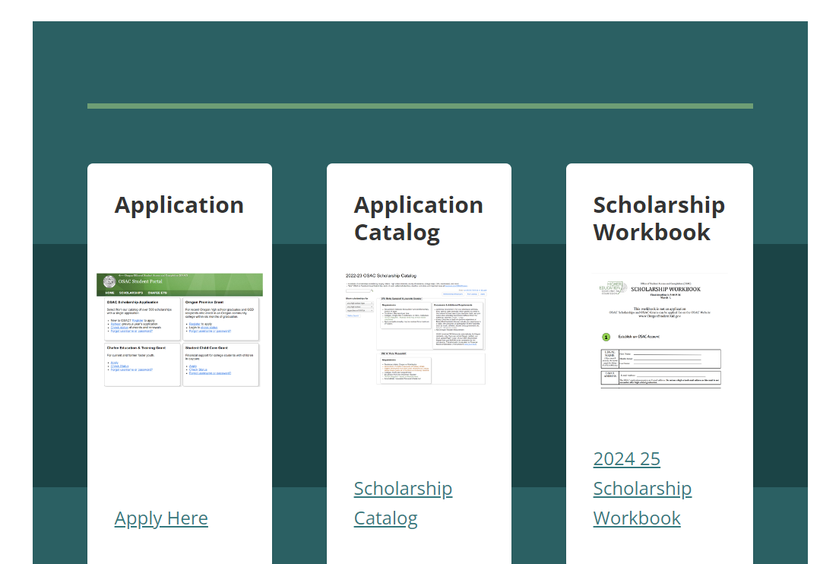
OSAC Scholarship Application Tips:
How to Search for Scholarships
Pro-Tip!
Search for scholarships outside of the Application
Highlight any community service you’ve done
Feature sports, clubs, & activities you engage in
Share your unique skills or accomplishments
OregonStudentAid.gov
Notes:
General Scholarship Presentation- Yes
OSAC Scholarship Presentation- Yes
OSAC Scholarship Workshop- Hide

Slide 16
Scholarship Search
Scholarship Catalog
Use CTRL + F in the PDF catalog to do a keyword search.
Example: Use “Sports” to find scholarships related to athletics
Example: Use “Marion” to find scholarships open to residents of Marion County
Example: use “trade” / “vocational” / “career and technical education”
Keyword Search
Membership or Employer-Based Funds
Select the “Memberships/Employers” button at top of online catalog
Think about affiliations with your parents/caregivers/family members or yourself
Example: A union your parent/caregiver belongs to
Notes:
General Scholarship Presentation- Yes
OSAC Scholarship Presentation- Yes
OSAC Scholarship Workshop- Optional
Notes:
Finding Scholarships:
The OSAC Scholarship Application includes hundreds of scholarships based on varying criteria - high school attended, county of residence, college major, GPA, need-based, and more!
Before submitting your scholarship application it is important to review the OSAC Scholarship Catalog and identify scholarships you qualify for.
As you find scholarships make sure to write down the scholarship number and name. You will need this information on your scholarship application.
Here are some ways to search the OSAC Scholarship Catalog:
Search by High School-
You can use the online OSAC Scholarship Catalog to search for scholarships based on school type and the name of your high school.
You can search by Traditional High schools, Alternative High Schools, Community college high schools, GED Programs, Home school, Home School and GED, Non of the above
For Example: Search for GED Programs to create a list of scholarships that are appropriate for GED recipients
For Example: Search for Aloha High School to create a list of scholarships for students who graduated from Aloha HS
Search by Membership or Employer
Another way to search the online OSAC Scholarship Catalog is to search by memberships and employers affiliated with your parents/caregivers/family members or yourself.
For Example: Search for a union your parents/caregivers/ or family members were a part of to create a list of scholarships sponsored by that employer/union
For Example: Search for Bob’s Red Mill if your parents/caregivers/ or grandparents worked there.

Slide 17
Scholarship Search
Scholarship Catalog
Students must be attending a Title IV eligible school in the US.
Not all OSAC Scholarship funds permit usage at private, for-profit institutions. Look at the eligibility criteria in Catalog.
If a scholarship is only for US citizens, then it will state that explicitly in the Catalog. (If it does not list this restriction, then undocumented/DACA students are welcome to apply.)
You will see “preference” listed for some criteria such as major, college choice, demographics, etc.
Interpreting Scholarship Details & Criteria
Notes:
General Scholarship Presentation- Yes
OSAC Scholarship Presentation- Yes
OSAC Scholarship Workshop- Optional
Notes:
Finding Scholarships:
The OSAC Scholarship Application includes hundreds of scholarships based on varying criteria - high school attended, county of residence, college major, GPA, need-based, and more!
Before submitting your scholarship application it is important to review the OSAC Scholarship Catalog and identify scholarships you qualify for.
As you find scholarships make sure to write down the scholarship number and name. You will need this information on your scholarship application.
Here are some ways to search the OSAC Scholarship Catalog:
Search by High School-
You can use the online OSAC Scholarship Catalog to search for scholarships based on school type and the name of your high school.
You can search by Traditional High schools, Alternative High Schools, Community college high schools, GED Programs, Home school, Home School and GED, Non of the above
For Example: Search for GED Programs to create a list of scholarships that are appropriate for GED recipients
For Example: Search for Aloha High School to create a list of scholarships for students who graduated from Aloha HS
Search by Membership or Employer
Another way to search the online OSAC Scholarship Catalog is to search by memberships and employers affiliated with your parents/caregivers/family members or yourself.
For Example: Search for a union your parents/caregivers/ or family members were a part of to create a list of scholarships sponsored by that employer/union
For Example: Search for Bob’s Red Mill if your parents/caregivers/ or grandparents worked there.

Slide 18
Scholarship Search
Scholarship Catalog
“One-time award” = Only available for 1 year
“Apply-compete annually” = Student may receive funds for multiple years. They must complete a full OSAC application each year. They “compete” among other applicants and are not guaranteed an award each year.
“Automatically renewable” = Student may receive funds for multiple years. They must complete the annual renewal application* They will continue to receive the award if they meet all eligibility criteria.
*They may need to submit the FAFSA/ORSAA as well.
Apply Type
Notes:
General Scholarship Presentation- Yes
OSAC Scholarship Presentation- Yes
OSAC Scholarship Workshop- Optional
Notes:
Finding Scholarships:
The OSAC Scholarship Application includes hundreds of scholarships based on varying criteria - high school attended, county of residence, college major, GPA, need-based, and more!
Before submitting your scholarship application it is important to review the OSAC Scholarship Catalog and identify scholarships you qualify for.
As you find scholarships make sure to write down the scholarship number and name. You will need this information on your scholarship application.
Here are some ways to search the OSAC Scholarship Catalog:
Search by High School-
You can use the online OSAC Scholarship Catalog to search for scholarships based on school type and the name of your high school.
You can search by Traditional High schools, Alternative High Schools, Community college high schools, GED Programs, Home school, Home School and GED, Non of the above
For Example: Search for GED Programs to create a list of scholarships that are appropriate for GED recipients
For Example: Search for Aloha High School to create a list of scholarships for students who graduated from Aloha HS
Search by Membership or Employer
Another way to search the online OSAC Scholarship Catalog is to search by memberships and employers affiliated with your parents/caregivers/family members or yourself.
For Example: Search for a union your parents/caregivers/ or family members were a part of to create a list of scholarships sponsored by that employer/union
For Example: Search for Bob’s Red Mill if your parents/caregivers/ or grandparents worked there.

Slide 19
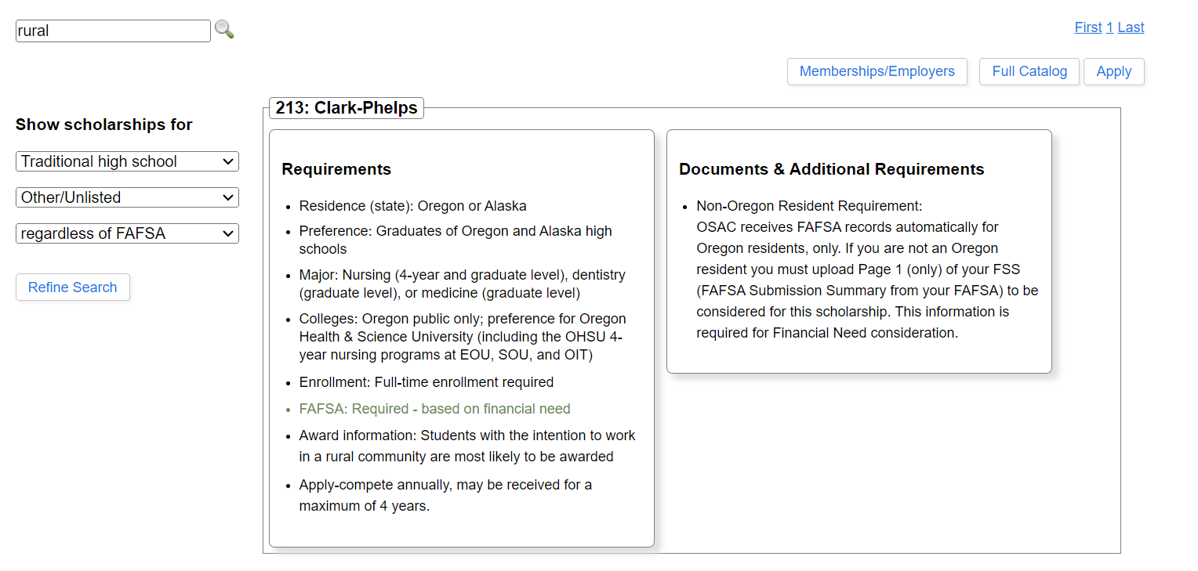
OSAC Scholarship Application Tips:
Example
Keep track of the name and number of the scholarship. Return to the application to search and add to your application.
Notes:
General Scholarship Presentation- Yes
OSAC Scholarship Presentation- Yes
OSAC Scholarship Workshop- Hide

Slide 20
Mark Your Calendars
OSAC Scholarship Timeline
Nov 1
Feb 18
OSAC Scholarship Opens
Students can start the OSAC scholarship application
Early Bird Deadline
Submit error free application and you could be eligible to win a $1,000 scholarship
Dec
March 3
FAFSA/ORSAA Opens
Students and families can start the FAFSA or ORSAA
Final Deadline
Application and all required documents
Submitted by March 3rd
Notes:
Notes-
Mark your calendars, here is the OSAC Scholarship Timeline for 2025-26 cycle
November 1st- The OSAC scholarship opens and students can start their application
December- The FAFSA will likely open on December 1st and the ORSAA will likely open in December as well.
February 18th – Is the Early Bird deadline
March 3rd- Is the final deadline.
All deadlines are 11:59 p.m (PT)

Slide 21
Mark Your Calendars
OSAC Scholarship – March Timeline
March 10, 2025
March 31, 2025
Deadline for Appeal Requests
For students who encountered a significant barrier to submitting by the March 3 deadline
Corrections Deadline
Final date for students with a rejected app to submit corrections (transcripts).
March 14, 2025
High School Staff - Transcript Upload
HS staff are encouraged to upload transcripts by this date on behalf of students in OSAC Partner Portal
Notes:
All deadlines are 11:59 p.m (PT)

Slide 22
Follow Us On
Social Media
OSAC Oregon
OSACOregon
OregonStudentAid
@OSAC

Slide 23
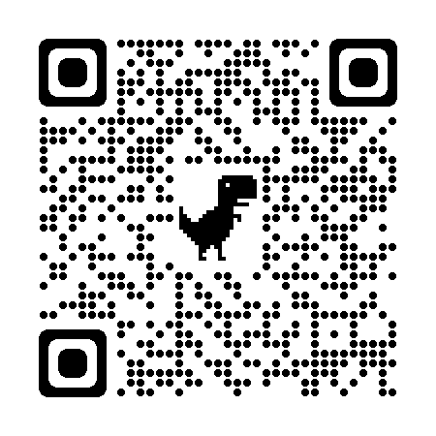
Contact
Information
Name: Nomi Pearce
Email: nomi.pearce@hecc.oregon.gov
Mobile: 971-375-7665
More information at: OregonStudentAid.Gov

