Slide 1


Federal Government Shutdown and H.R. 1 Impacts to the Supplemental Nutrition Assistance Program (SNAP) in Oregon
December 2025

Slide 2
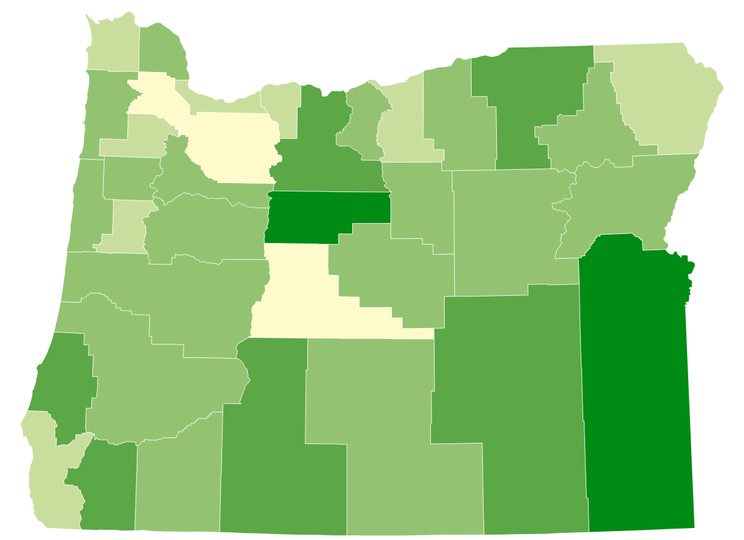
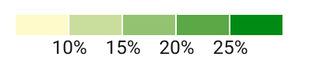
1 in 6 Oregonians participate in SNAP
Percentage of households receiving SNAP
by county
757,000 individuals*
76,343
Age 60+*
47,786
have a disability**
Map graphic based on American Community Survey 5-Year data (2017-2021) as presented by the Food Research & Action Center.
*Based on ODHS caseload data
**As defined by Food and Nutrition Services
Notes:
The Supplemental Nutrition Assistance Program (SNAP) is the nation’s most effective anti-hunger program. It plays a critical role in reducing poverty, improving health and economic outcomes, supporting people who are paid low wages, and serving as the first line of defense against hunger during economic downturns.
In Oregon, SNAP helps 757,700 Oregonians put food on their tables – that’s about 18% of the population or 1 in every 6 people in our state.
Those 757K Oregonians are part of 450K households across the state. You can see, the majority of Oregonians receiving SNAP benefits are in rural or frontier areas of the state.
More than 54% of Oregon SNAP participants are in households with children.
More than 37% are in households with members who are older adults or have disabilities.
35% of participating Oregon households have income at or below 50% of the poverty line

Slide 3
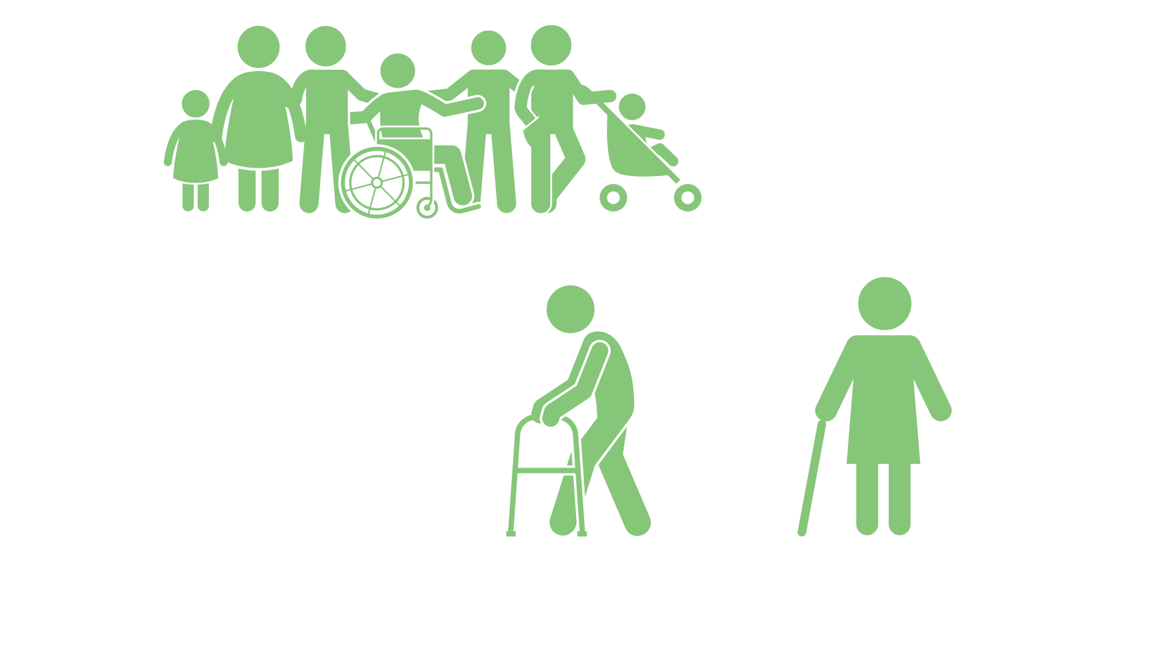
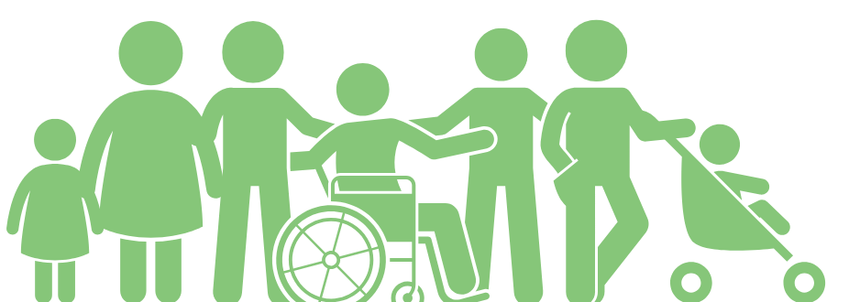
SNAP monthly snapshot
$313
$183
210k+
130k+
Average
benefit per household
Average
benefit per person
Participating children
Participating adults 65+
Source: Oregon Department of Human Services caseload data, March 2025.
Notes:
In Oregon, an average of $183 per month in SNAP is issued out to each individual participant, which includes over 130,000 people ages 65 and older.

Slide 4


Oregon SNAP operating normally
December SNAP is currently being distributed on the regular schedule
SNAP funded through September 30, 2026
4
Notes:
During the shutdown, food benefits were stopped for 1 in 8 people across the U.S.—the first time this had happened in SNAP’s 60-year history. In Oregon, where 1 in 6 people rely on SNAP to buy food, this created an urgent need.
Governor Tina Kotek acted quickly to make sure Oregonians didn’t go hungry. In a very short window between federal court rulings, she directed ODHS to issue full November SNAP benefits to all eligible Oregonians on November 7. Her fast and decisive leadership made Oregon one of the first states in the nation to get food benefits out during the shutdown, helping families keep food on the table.
As of Thursday, Nov. 13 SNAP has resumed normal operations
On Nov. 13, ODHS also received a federal memo from the Food and Nutrition Service confirming that full federal funding for SNAP was restored.
It’s important to mention that the recent shutdown did not change new federal SNAP rules about eligibility or work requirements. Those rules are still going into effect. Some may have seen a reduction or loss of food benefits in November because of the new eligibility rules and thought the change was related to the shutdown. Anyone who thinks they did not get the right amount of November SNAP needs to contact ODHS.

Slide 5

Hunger emergency continues
Governor confirmed on Nov. 7 that the emergency declaration remains in place
ODHS incident management team (IMT) coordinating statewide response
  $5M to Oregon Food Bank network
  $1M distributed equally across Nine Federally Recognized Tribes
  Statewide food donation campaign
5
Notes:
The Governor’s emergency declaration from our governor is still currently in place through December:
In response to the emergency declaration:
ODHS' incident management team has been coordinating a statewide response to the food emergency
The Governor’s Office directed ODHS to distribute $1 million in emergency food assistance, to be equitably allocated among the Nine Federally Recognized Tribes of Oregon. This funding is in addition to the $5 million being allocated to the Oregon Food Bank to support broader food access efforts statewide.
A statewide food donation campaign is underway and continuing as an additional layer of support
With the emergency declaration came also an encouragement for communities across Oregon to continue supporting food banks and pantries with donations and mobilizing together to help our community members with additional food support in this time of need.
Thank you to each of you (and all those within your organizations) for the ways you are helping to make sure our communities remain fed

Slide 6
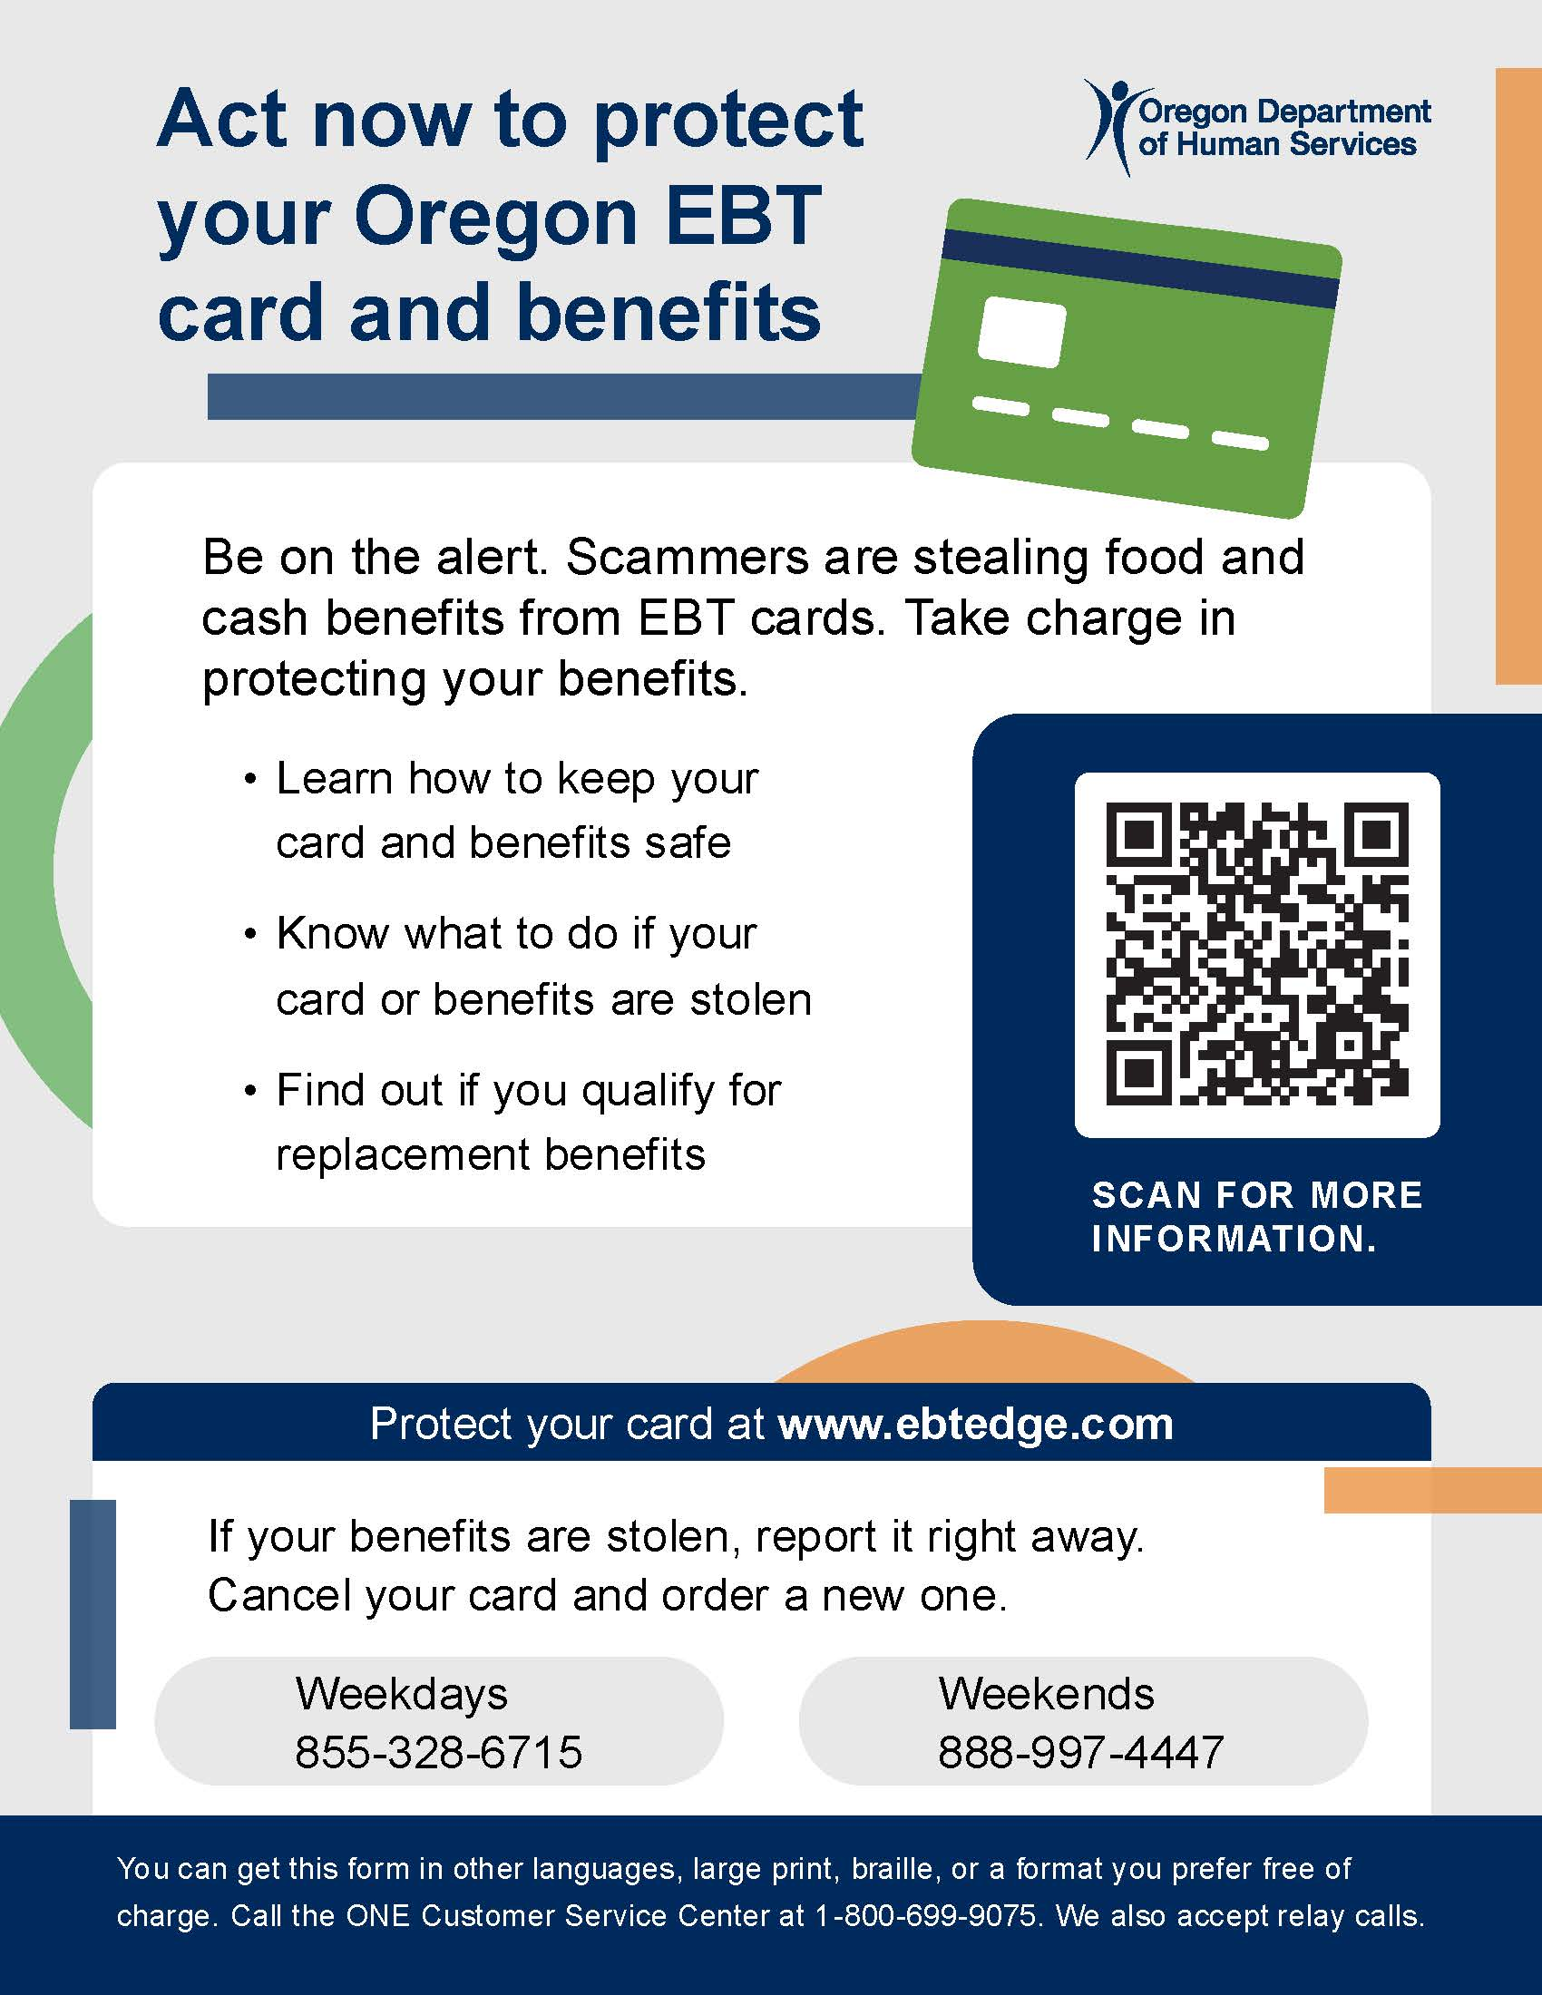
Protecting EBT Cards and Benefits
Electronic theft of benefits is on the rise nationwide
Stolen SNAP benefits can't be replaced. TANF benefits can be replaced.
Safety tips for cardholders and downloadable resources for partners in many languages at www.oregon.gov/odhs/benefits/pages/protect.aspx
Notes:
When November benefits went out, we received many reports of upticks in electronic benefit theft.
Criminals are using methods like skimming devices, internet scams and fake websites to steal card numbers and personal identification numbers (PIN). Once they have this information, they can drain food and cash benefits from a person’s card.
ODHS recommends that everyone with an EBT card take steps to keep their benefits secure. You can find simple tips on our website.
The federal funding to replace benefits ran out on Dec. 21, 2024, and ODHS is no longer authorized to replace stolen SNAP benefits.
ODHS can replace Temporary Assistance for Needy Families (TANF) benefits that are lost due to fraud. TANF families who believe benefits have been stole from their EBT card should contact ODHS to request replacement benefits within 30 days of the benefits being stolen.
Again, information about how to protect EBT cards and benefits is on our website at https://www.oregon.gov/odhs/benefits/pages/protect.aspx. The webpage includes a downloadable wallet card, flyer and brochure in several languages for partners to share in your own communications.

Slide 7


Sample title
Sample content
H.R.1 and SNAP

Slide 8
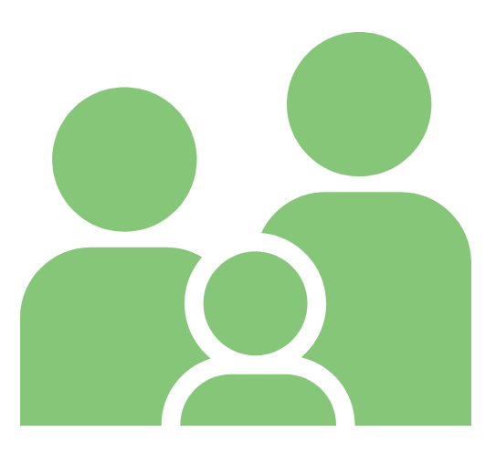
H.R.1 SNAP notices sent Oct. 15
Notice was sent to all individuals who may be required to participate in able-bodied adults without dependents (ABAWD) federal work rules.
  Visit the ODHS website to learn more about SNAP work rules. including a list of ABAWD work rule exemptions under the “Exemptions” tab.
Notices were also sent to:
  Lawfully present non-citizens facing reduction or ending of their benefits
  People impacted by new federal limits on energy assistance-based Standard Utility Allowance.

Slide 9
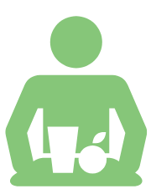
Able-bodied adults without dependents work rules
Effective ate | Description
July 4, 2025 | Changes able-bodied adults without dependents (ABAWD) age range to 18 through 64 (previously 18 through 54) Changes dependent child exception to those under the age of 14 (previously 18). Limits ABAWD waivers to only be permissible if an area (city, county, Tribal Land, etc.) has an unemployment rate above 10%. Removed option to request waivers based on lack of sufficient jobs.
Estimated population
impact
Effective date
Description
~310,000 adults
will need to be reviewed for ABAWD work requirements
or exceptions.
Notes:
ABAWD stands for “able-bodied adult without dependents.” Federal law requires ABAWDs to meet additional work requirements to receive SNAP benefits for more than three months in a 36-month period.
They must participate in qualifying work activities for at least 80 hours a month, be granted an exclusion or reside in an area with a waiver approved by the USDA.
HR1 implementation in Oregon is affecting these SNAP work rules in the following areas:
More individuals subject to work rules: The upper age threshold would increase to 65, meaning many currently exempt adults aged 55–64 would now need to comply. The age of dependents is also decreasing to no children under 14 years of age (from the prior 18)
Harder for the state to waive requirements: Removal of “insufficient jobs” criterion and shift to county-level unemployment assessments reduces flexibility for rural or economically distressed counties.
Reduced state flexibility and administrative burden: Fewer discretionary exemptions allowed and no rollover—less ability to adapt strategically.
How ABAWD will work
Starting December 1, every person with an ABAWD status across Oregon must meet work requirements to keep SNAP for longer than three months.
No Oregon county currently is exempt
Applying the work rules
Case by case screening - Reassure partners that ODHS will screen each adult that connects with ODHS in the ABAWD age range, for possible exemptions.
If someone does not meet an exemption and the ABAWD Work Rules apply, they are required to do 80 hours of work activities a month through:
Paid employment (including self-employment)
Unpaid work activities (such as bartering or volunteering)
Participating in the ABAWD program with Oregon Employment Department
A combination of work and other activities
Each month a counting month is added to a case, the individual will receive a notice informing them:
Which counting month they have received
information on how to meet the work requirements
Ways to meet an exemption
How to contact ODHS
Encourage partners to tell clients to stay engaged with ODHS, renew on time, and respond to notices so their exemption or activity status can be verified.
ABAWD exemptions remain on the case for the full certification period or until a change is reported that impacts the eligibility for the exemption.
Opportunities for people with ABAWD Status
When a SNAP participant with an ABAWD status goes to their Oregon Employment Department appointment at a local WorkSource Center, they will be assigned a dedicated Employment Specialist who will help create their ABAWD case plan.
Case plans may include working with STEP providers or other workforce partners.
Oregon Employment Department offers a vast array of employment, training, and educational services at no charge to individual.
Each person will receive individualized support to be successful in their employment goals, which may include access to virtual services, transportation support, tuition, and other items as needed.

Slide 10
SNAP eligibility limitations
Eligible Groups | Eligibility Timing
Non-citizen U.S. nationals Cuban and Haitian entrants Compacts of Free Association (COFA) citizens | Eligible immediately, with no waiting period, as long as they meet all other SNAP financial and non-financial eligibility requirements.
Lawful permanent residents (LPR), also known as Green Card holders Source: USDA FNS at https://www.fns.usda.gov/snap/obbb-alien-eligibility | Eligible after a 5-year waiting period, as long as they meet all other SNAP financial and non-financial eligibility requirements. LPRs may still be eligible for SNAP without a waiting period if they meet one or more of the following conditions: Are under 18 years old Have 40 qualifying work quarters Are blind or disabled Were lawfully residing in the U.S. and 65 or older on August 22, 1996 Have a U.S. military connection Are admitted to the United States as an Amerasian immigrant Are an American Indian born abroad Certain Hmong or Highland Laotian tribal members
Notes:
House Resolution 1 made sweeping changes to the SNAP program.
States are still working to get clear guidance from FNS on the changes made to noncitizen SNAP eligibility, however, we estimate it will cause about 3,000 people in Oregon to lose SNAP. These people are here with documentation and were eligible for SNAP on July 3, 2025, including children, those with a disability, and older adults.
SNAP eligibility limitations (source: https://www.fns.usda.gov/snap/obbb-alien-eligibility)
HR1 limited eligibility for SNAP to the following groups: U.S. citizens, U.S. nationals, lawful permanent residents (LPRs), Cuban and Haitian entrants¹, and Compact of Free Association (COFA) citizens.
Prior to the change, certain lawfully present immigrants, as defined by the Personal Responsibility and Work Opportunity Act (PRWORA) were eligible to receive SNAP benefits, provided they met all other SNAP eligibility requirements and completed a 5-year waiting period, unless exempted by PRWORA.
Today, some immigrant groups previously eligible for SNAP are no longer eligible. They continue to be subject to a 5-year waiting period, unless exempted by PRWORA. This chart from the USDA summarizes eligibility.
This change was effective July 4, 2025 and Oregon implemented it on Oct. 1. After Oct. 1, the new eligibility criteria applied to new applicants at initial certification. For households already receiving SNAP, we must review household circumstances and apply these policies at recertification.

Slide 11

SNAP work rule impacts for older adults and people with disabilities
SNAP work-requirement exemptions:
People ages 55-64 added to who must meet 80 hour per month work rules to get more than 3 months of SNAP
Removed exemptions for veterans, people experiencing homelessness, and former foster youth
People with a disability remain exempt
Work rules will not impact individuals with I/DD, behavioral health or physical disability
Will not apply to individuals receiving long-term services and supports.
Notes:
Older adults
Explain why ODHS must screen each older adult individually rather than assuming they are exempt or non-exempt.
Emphasize that ODHS will have a conversation about a person’s ability to obtain or maintain employment. This may include physical, mental or behavior challenges.
In most situations, verification will not be required and ODHS will accept the individual’s statement.
ODHS encourages individuals to connect with ODHS about being eligible for exemptions.

Slide 12
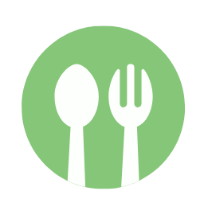
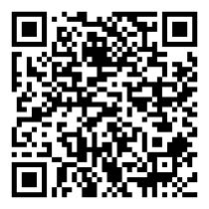
Resources for finding food
Visit ODHS’ free food events listings.
Visit ODHS’ food resource webpage at needfood.oregon.gov
Notes:
Free food events: https://www.oregon.gov/odhs/food/pages/free-food-events.aspx
Needfood.oregon.gov

Slide 13

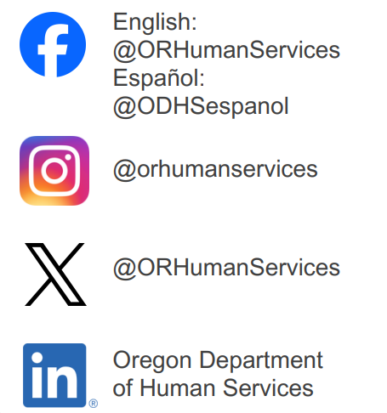



Stay in touch
Sign up for our partner newsletter.
Sign up for news alerts from ODHS.
Email the Community Engagement team.
Follow us on social media.
www.oregon.gov/odhs
Notes:
Partner newsletter: https://public.govdelivery.com/accounts/ORDHS/subscriber/new?topic_id=ORDHS_833
News alerts: https://www.oregon.gov/odhs/news/pages/default.aspx
Email community engagement team: communitypartners@odhsoha.oregon.gov

Slide 14
Thank you
www.Oregon.gov/odhs

