Slide 1


Federal Actions Coordination Team (FACT)
December updates
December 2025
Notes:
Welcome, introductions

Slide 2
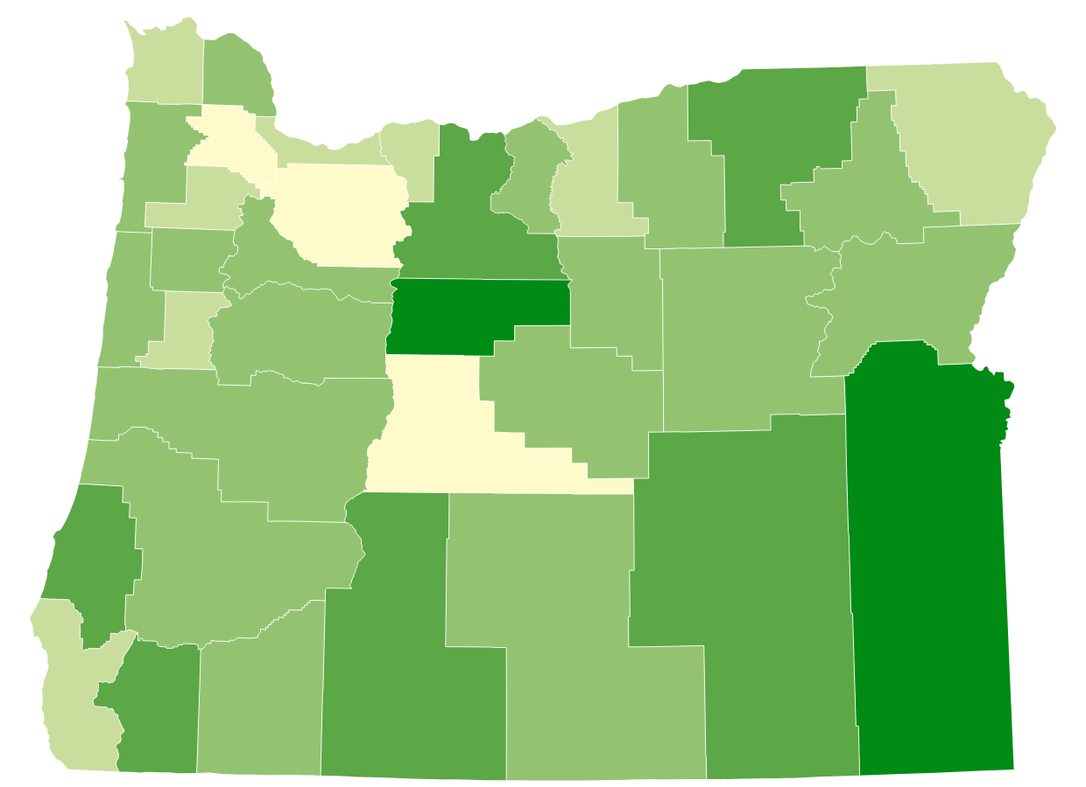
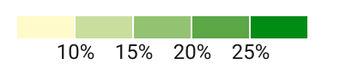
1 in 6 people in Oregon participate in SNAP
Percentage of households receiving SNAP by county
757,000 individuals*
76,343
Age 60+*
47,786
have a disability**
Map graphic based on American Community Survey 5-Year data (2017-2021) as presented by the Food Research & Action Center.
*Based on ODHS caseload data
**As defined by Food and Nutrition Services
Notes:
The Supplemental Nutrition Assistance Program (SNAP) is the nation’s most effective anti-hunger program. It plays a critical role in reducing poverty, improving health and economic outcomes, supporting people who are paid low wages, and serving as the first line of defense against hunger during economic downturns.
In Oregon, SNAP helps 757,700 people put food on their tables – that’s about 18% of the population or 1 in every 6 people in our state.
Those 757K people are part of 450K households across the state. The majority of folks receiving SNAP benefits are in rural or frontier areas of the state.
More than 54% of Oregon SNAP participants are in households with children.
More than 37% are in households with members who are older adults or have disabilities.
35% of participating Oregon households have income at or below 50% of the poverty line

Slide 3
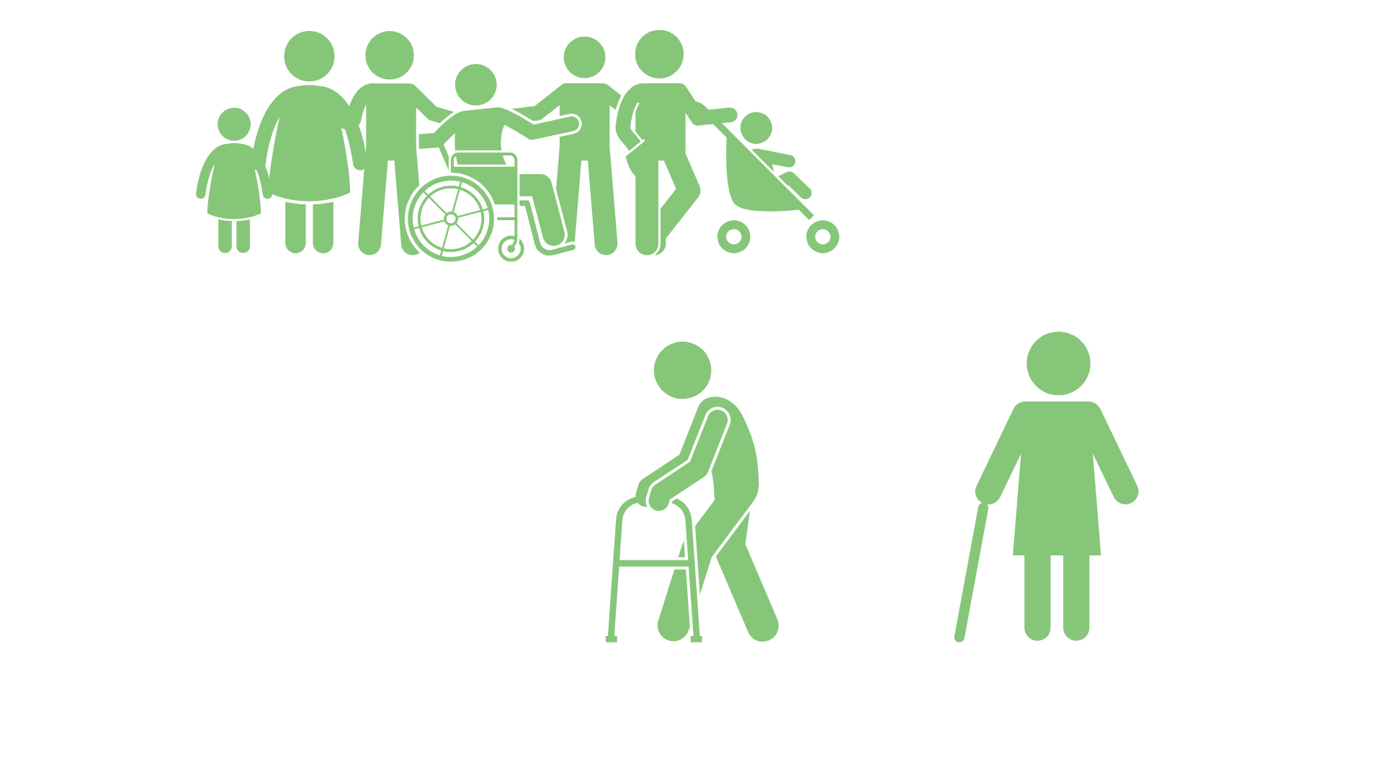
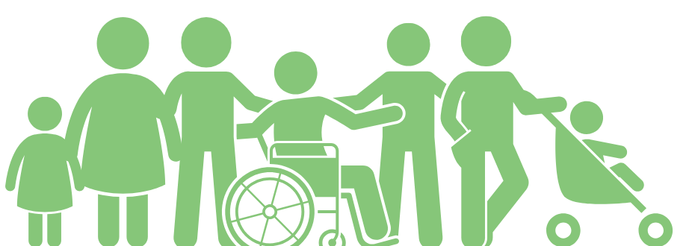
SNAP monthly snapshot
$313
$183
210k+
130k+
Average benefit per household
Average benefit per person
Participating children
Participating adults 65+
Source: Oregon Department of Human Services caseload data, March 2025.
Notes:
In Oregon, an average of $183 per month in SNAP is issued out to each individual participant, which includes more than 130,000 people ages 65 and older.

Slide 4
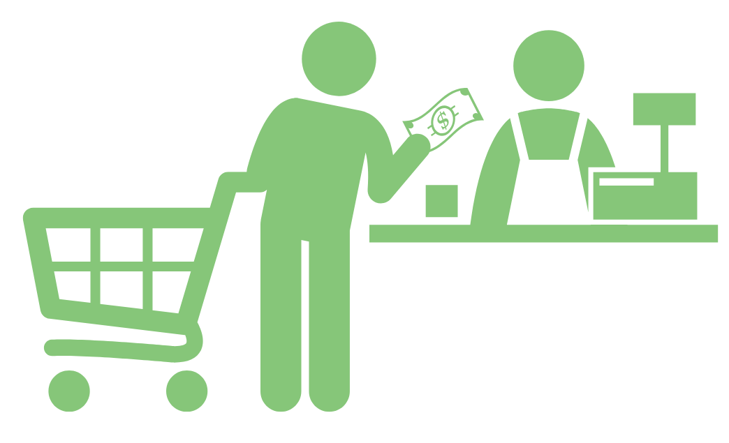

Oregon SNAP operating normally
December SNAP was distributed on the regular schedule.
January 2026 SNAP on schedule.
SNAP funded through Sept. 30, 2026.
4
Notes:
During the shutdown in October and early November 2025, food benefits were stopped for 1 in 8 people across the U.S.—the first time this had happened in SNAP’s 60-year history. In Oregon, where 1 in 6 people rely on SNAP to buy food, this created an urgent need.
Governor Tina Kotek acted quickly to make sure people in Oregon didn’t go hungry. In a very short window between federal court rulings about SNAP during the shutdown, she directed ODHS to issue full November SNAP benefits to all eligible in Oregon on November 7. Her decision made Oregon one of the first states in the nation to get food benefits out during the shutdown, helping families keep food on the table.
After the shutdown ended on Nov. 12, SNAP resumed normal operations the next day
SNAP is funded through the fiscal year - through Sept. 30, 2026. If there is another shutdown between now and Sept. 30, SNAP will not be disrupted.

Slide 5
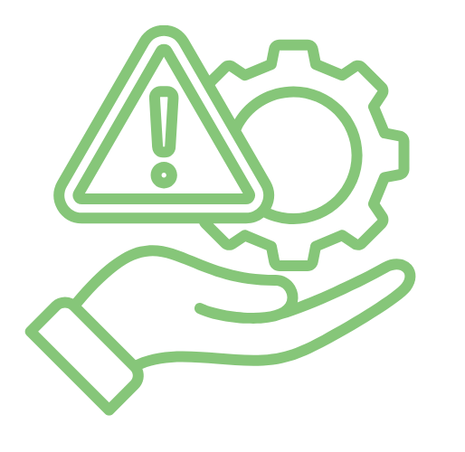
Hunger emergency continues
Governor issued an emergency declaration on hunger October 29, and it remains in place.
ODHS Office of Resilience and Emergency Management (OREM) coordinating statewide response:
$5M to Oregon Food Bank network
$1M distributed equally across Nine Federally Recognized Tribes
1,500 food boxes to ODHS offices
5
Notes:
During the shutdown, the Governor also issued an Emergency Order for hunger prevention to drive extra supports into communities most impacted by the delay in November SNAP. The emergency order remains in place through at least December.
In response to the emergency declaration:
ODHS’ coordinated a statewide response to the food emergency
The Governor’s Office directed ODHS to distribute $1 million in emergency food assistance, to be equally allocated among the Nine Federally Recognized Tribes of Oregon. This funding is in addition to the $5 million being allocated to the Oregon Food Bank to support broader food access efforts statewide.
We also delivered 1500 food boxes to local ODHS offices to give to customers
Thank you to each of you (and all those within your organizations) for the ways you are helping to make sure our communities remain fed
ODHS continues to monitor the stability of Oregon’s food banks and pantries to create a clear picture of food security statewide to understand the demand and identify areas needing ongoing support.

Slide 6


Sample title
Sample content
H.R.1 changes
to SNAP eligibility

Slide 7
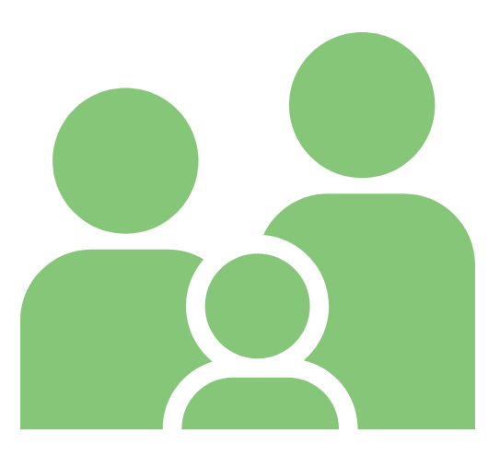
Notices on federal changes to SNAP eligibility started going out October 15
A notice was sent to all individuals who may be required to participate in Able-bodied Adults without Dependents (ABAWD) federal work rules.
Visit the ODHS website to learn more about SNAP work rules, including a list of exemptions.
Notices were also sent to:
Lawfully present non-citizens facing reduction or the end of their benefits.
People who may see a reduction in benefits from new federal limits on energy assistance-based Standard Utility Allowance.
Notes:
House Resolution 1 made sweeping changes to the SNAP program.
Availability of Standard Utility Allowances based on receipt of energy assistance: Only households with an older adult or member with a disability can exclude energy assistance from countable income; delinks energy assistance programs and SNAP for all but these households.

Slide 8
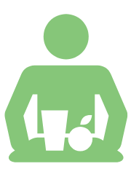
Able-bodied Adults Without Dependents (ABAWD) work rules
Effective ate | Description
July 4, 2025 | Changes able-bodied adults without dependents (ABAWD) age range to 18 through 64 (previously 18 through 54). Changes dependent child exception to those under the age of 14 (previously 18). Limits ABAWD waivers to only be permissible if an area (city, county, Tribal Land, etc.) has an unemployment rate above 10%. Removed option to request waivers based on lack of sufficient jobs.
Estimated population impact
Effective date
Description
~310,000 adults will need to be reviewed for ABAWD work requirements or exceptions.
Notes:
ABAWD stands for “able-bodied adult without dependents.” Federal law requires ABAWDs to meet additional work rules to get SNAP benefits for more than three months in a 36-month period.
They must participate in qualifying work activities for at least 80 hours a month, be granted an exclusion or reside in an area with a waiver approved by the USDA. These can be paid or unpaid activities.
HR1 implementation in Oregon is affecting these SNAP work rules in the following areas:
More individuals subject to work rules: The upper age threshold would increase to 65, meaning many currently exempt adults aged 55–64 would now need to comply. The age of dependents is also decreasing to no children under 14 years of age (from the prior 18)
Harder for the state to waive requirements: Removal of “insufficient jobs” criterion and shift to county-level unemployment assessments reduces flexibility for rural or economically distressed counties.
Reduced state flexibility and administrative burden: Fewer discretionary exemptions allowed and no rollover—less ability to adapt strategically.

Slide 9

SNAP work rule impacts
Work rules will not impact individuals with I/DD, behavioral health or physical disability.
Will not apply to individuals receiving long-term services and supports.
People ages 55 to 64 who do not have a child under age 14 on their SNAP case must work 80 hours each month to get SNAP for more than three months.
Exemptions for veterans, people experiencing homelessness, and former foster youth have been removed.
There is a new exemption for Native American individuals who qualify under rules in the Indian Health Care Improvement Act.
Notes:
In June 2025, 310,626 Oregonians were aged 18-65 without a child under age 14 in their SNAP group. We do not know how many will meet an exemption or ABAWD work requirements. We estimate that AT LEAST 90,888 individuals will be at risk of losing their SNAP benefits if they do not meet ABAWD Work Requirements.
ODHS will screen each person to see if they are:
Already meeting work rules
Are exempt from work rules
Need to create a plan to meet work rules. In these situations, ODHS will refer them to the Oregon Employment Department to create a plan and access supports.

Slide 10
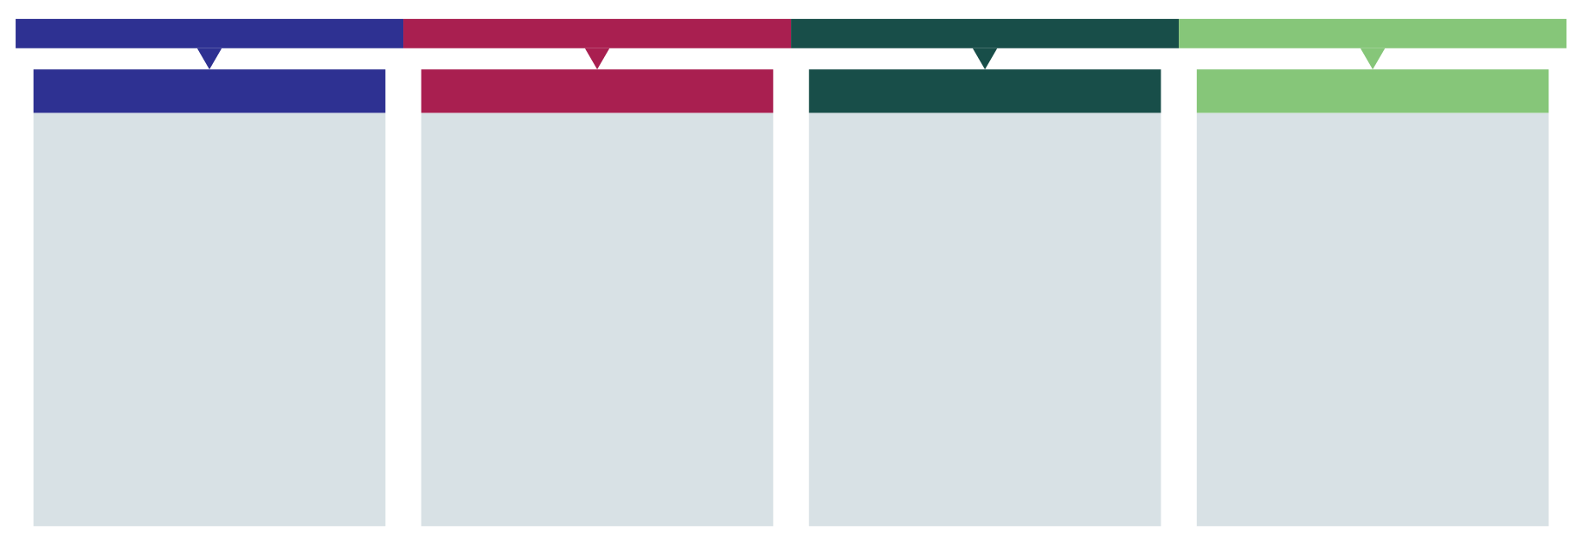
Oregon SNAP work rules timeline
January - August 2025
September 2025
October 2025
December 2025
Discretionary exemptions.
No one is required to meet ABAWD work rules.
ABAWD work rules restart in six counties:
Benton, Clackamas, Hood River, Multnomah, Washington and Yamhill.
HR1 changes implemented in Oregon.
New applications, renewals and when reporting changes.
ABAWD work rules start statewide.
Notes:
Starting December 1, every person with an ABAWD status across Oregon must meet work requirements to keep SNAP for longer than three months.
Pending ongoing litigation. People should continue to apply for SNAP.
*unless they live on approved waived Tribal Lands

Slide 11
Activities that meet work requirements
80 hours of
work activities required
per month.
Requirement can be met by one or a combination of activities:
Working
Volunteering
Bartering
Participating in an ABAWD case plan developed by OED
Some may already be meeting the work rules
and only need to provide proof.
Notes:
80 hours of work activities per month averages to about 20 hours per week.
See the webpage for details:

Slide 12
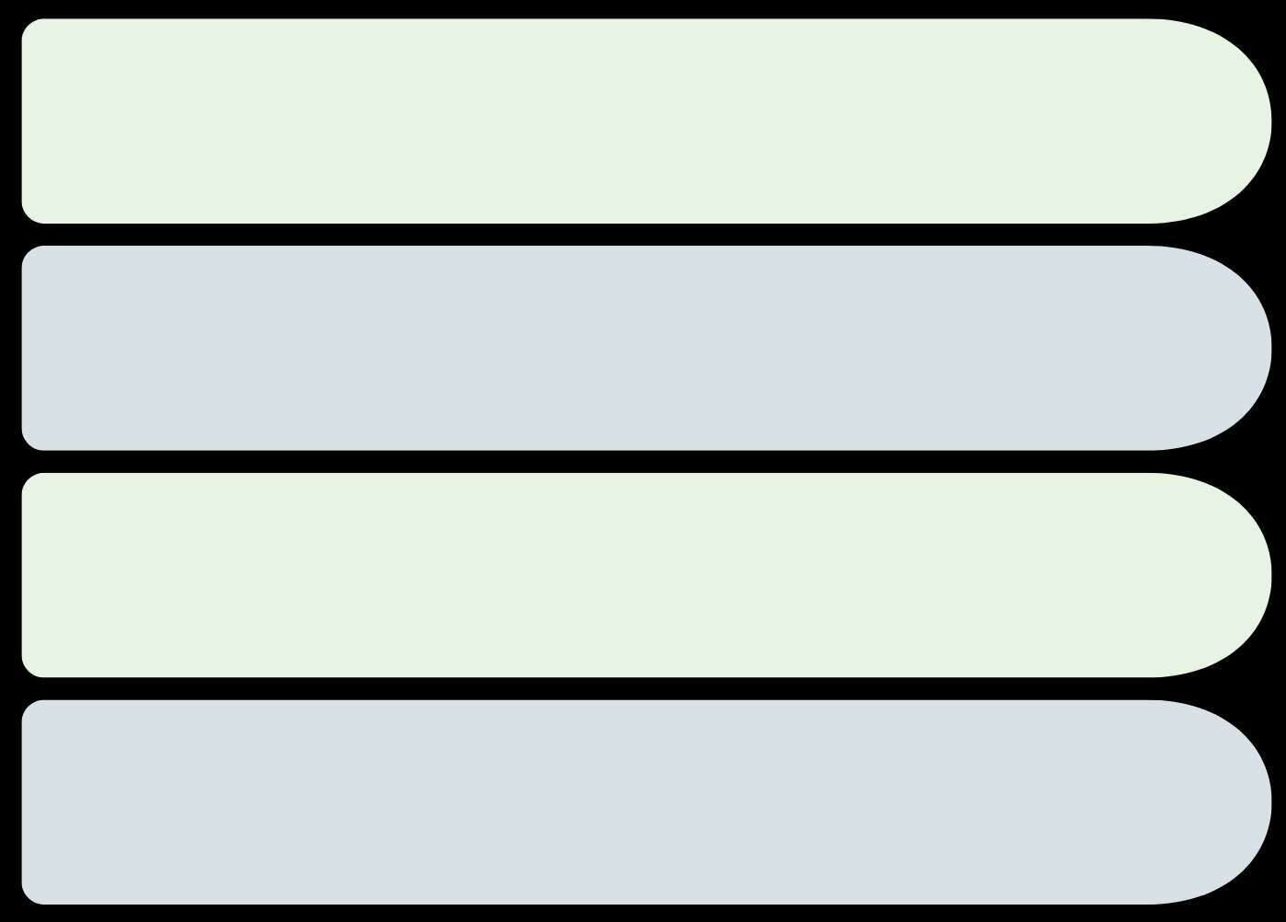



People who don’t have to meet ABAWD work rules
Face barriers to work like health issues, attend school half time or care for a person with a disability.
Live in a waived area.
Have a discretionary exception.
Notes:
There are people who do not have to follow ABAWD work rules. Groups include:
People who have problems or hardships that make working hard
People who do other things that count the same as work
People who live in an area where ABAWD rules do not apply
People who are given an extra excuse from the ABAWD rules
Examples of barriers to work:
Health problems
Physical, behavioral, or mental health (temporary or permanent)
Pregnancy
Receiving money due to a disability
Attending an alcohol or drug treatment program
Inpatient or outpatient Note: May qualify as health issue.
Caring for a person with a disability
Note: Not required to reside together.
Attending school at least half-time
High school and/or GED programs
Higher Education (community college, university, graduate programs etc)
Trade/vocational programs
Training programs
Participating in a training plan with a federal refugee resettlement program
Immigrant and Refugee Community Organization (IRCO),
Corvallis for Refugees etc
Examples of equivalent work activities
Unemployment benefits (UC) – Verbal Attestation
Applied for unemployment and has not been denied
Receiving unemployment benefits.
Temporary Assistance for Needy Families – (ONE system verified)
Participates in the TANF Jobs program
Working for pay (Proof of hours is required)
At least 30 hours a week.
Earning at least $935.25 a month.
Earning at least $935.25 from self-employment and have no business costs
Earning at least $1,870.50 and has business costs.
Discretionary exemption
Current Discretionary Exemptions in Oregon:
Foster care parents who do not include foster children in SNAP case. Verbal attestation.
SNAP eligible non-citizens not authorized to work. Verbal attestation

Slide 13
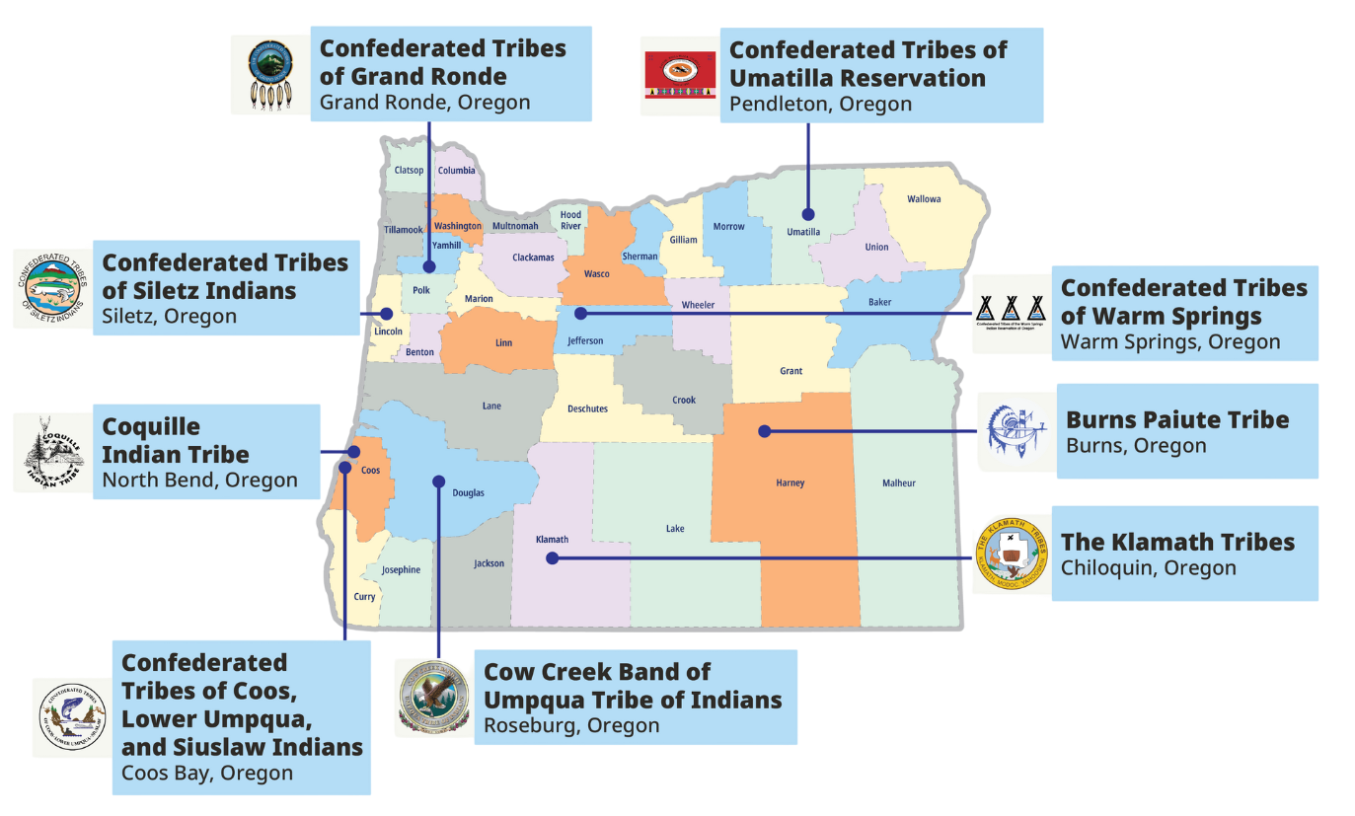

Five Tribal lands are waived from SNAP work rules due to high unemployment rates
Notes:
Starting December 1
No Oregon county is exempt
Only five tribal lands are exempt due to high unemployment rates:
Burns Paiute Tribe Reservation and off-Reservation Trust Land
Coquille Indian Tribe Reservation and off-Reservation Trust Land
Cow Creek Band of Umpqua Tribe of Indians Reservation
Klamath Tribes Reservation
Confederated Tribes of Siletz Indians Reservation and off-Reservation Trust Land

Slide 14


SNAP time limit
If a SNAP participant with ABAWD status does not meet work requirements for three months, they will reach the time limit and lose SNAP for three years.
Notes:
If a SNAP participant with ABAWD status does not meet their work requirements for three months, they will reach the three-year time limit for SNAP.
When that happens, they cannot get SNAP benefits for the rest of that three-year period.
The current three-year period is Jan. 1, 2025, through Dec. 31, 2027.
Each month a counting month is added to a case, the individual will receive a notice informing them:
Which counting month they have received
information on how to meet the work requirements
Ways to meet an exemption
How to contact ODHS

Slide 15



Contact ODHS to see if work rules apply
Call the ABAWD team:
1-833-947-1694
Email:
SNAP.ABAWDTeam@odhsoha.oregon.gov
ODHS may connect people to:
Oregon Employment Department
Notes:
Take action: Contact ODHS
If someone gets a notice — or thinks — they may need to follow new work rules to keep SNAP benefits, they should contact ODHS as soon as possible.
We know these notices can feel stressful or confusing.
ODHS will check to see if customers already meets the work rules, including giving credit for any verified work activities they’ve completed.
ODHS will look for any exemptions that might mean the customer does not have to meet work rules.
OED may also offer training, job search help, education programs, or other services to help the person get and keep a job.
If needed, ODHS will connect customers with the Oregon Employment Department so they can make a plan to meet the work requirements.

Slide 16


After an ODHS referral: OED offers support for meeting work rules
An OED Employment Specialist will be assigned to help create a case plan based on the person’s skills and interests.
Notes:
These work rules also open the door to more support.
After ODHS reviews someone’s information, the agency may refer people who need a case plan to meet the work rules to the Oregon Employment Department (OED).
They will get an appointment at a local WorkSource Center.
An Employment Specialist will be assigned to them. This person will help create a case plan based on the person’s skills and interests. The case plan lists the work-related activities they need to do each month.
OED may also offer training, job search help, education programs, or other services to help the person get and keep a job.
If needed, ODHS will connect customers with the Oregon Employment Department so they can make a plan to meet the work requirements.

Slide 17




What people can do right now
Open and read all mail from ODHS
Respond quickly if ODHS reaches out for information
Visit benefits.oregon.gov for ways to connect with ODHS in person, by phone or online through the ONE Eligibility system
Make sure ODHS has current phone number and mailing address
Notes:
What SNAP participants can do right now:
Make sure ODHS has their current phone number and mailing address.
Open and read all mail from ODHS.
Respond quickly if we reach out for information.
Visit benefits.oregon.gov to learn how to connect with ODHS in person, by phone or online.
ODHS encourages people to have a ONE Online account and consider using the Oregon ONE Mobile app for faster service from anywhere.

Slide 18
Non-citizen SNAP eligibility
Effective ate | Description
July 4, 2025 | Non-citizen SNAP eligibility: Limits eligibility to U.S. citizens or nationals, Lawful Permanent Residents, certain Cuban and Haitian entrants, and Compact of Free Association (COFA) citizens.
Effective date
Description
Estimated population impact
~3,000 lawfully present individuals, including refugees, asylees and other conditionally allowed individuals, will lose benefits.
Notes:
H.R. 1 changed who can get SNAP. Before this change, some other immigrants with legal status could get SNAP if they met all eligibility rules. Many had to wait five years before getting SNAP unless they were exempt under federal law.
Today, some immigrant groups who were eligible before are no longer eligible.
Some groups who are Lawful Permanent Residents still have a five-year waiting period unless exempt. USDA has a chart that shows which groups are eligible.
This change took effect July 4, 2025. It affects people with legal status who were eligible for SNAP on July 3, 2025, including children, people with disabilities and older adults.
Oregon began using the new rules Oct. 1, 2025. After October 1, new applicants had to meet the new rules.
For people already on SNAP, ODHS must check these rules at their next recertification.
States are still waiting for clear guidance from USDA’s Food and Nutrition Service (FNS) about how to apply some parts of the new rules.
States recently received new guidance from USDA. ODHS is reviewing that guidance and developing an implementation plan. When that is known and communicated to staff, we’ll update our resources.

Slide 19

Non-citizens eligible for SNAP
Eligible immediately, with no waiting period, if they meet all other SNAP financial and non-financial eligibility requirements.
Non-citizen U.S. nationals
Cuban and Haitian Entrants
COFA Citizens
Source: USDA FNS at https://www.fns.usda.gov/snap/obbb-alien-eligibility
Notes:
Now, SNAP is limited to the following groups:
U.S. citizens
U.S. nationals
Lawful permanent residents (LPRs)
Cuban and Haitian entrants¹
Citizens of Compact of Free Association (COFA) nations

Slide 20

Non-citizens eligible for SNAP with conditions
Lawful Permanent Residents (LPR)
also known as Green Card holders.
Eligible after a five-year waiting period if they meet all other SNAP financial and non-financial eligibility requirements.
There are exceptions…
Notes:
Prior to the change, certain lawfully present immigrants, as defined by the Personal Responsibility and Work Opportunity Act (PRWORA) were eligible to receive SNAP benefits, provided they met all other SNAP eligibility requirements and completed a 5-year waiting period, unless exempted by PRWORA.
Today, some immigrant groups previously eligible for SNAP are no longer eligible. They continue to be subject to a 5-year waiting period, unless exempted by PRWORA.

Slide 21

Some LPRs may not need a 5-year waiting period
LPRs may still be eligible for SNAP without a waiting period if they meet one or more of the following conditions:
Are under 18 years old
Have 40 qualifying work quarters
Are blind or disabled
Were lawfully residing in the U.S. and 65 or older on August 22, 1996
Have a U.S. military connection
Are admitted to the United States as an Amerasian immigrant
Are an American Indian born abroad
Certain Hmong or Highland Laotian tribal members
Notes:
Some lawful permanent residents are exempt from the 5-year waiting period.
Folks need to meet one of these conditions.
Are under 18 years old
Have 40 qualifying work quarters
Are blind or disabled
Were lawfully residing in the U.S. and 65 or older on August 22, 1996
Have a U.S. military connection
Are admitted to the United States as an Amerasian immigrant
Are an American Indian born abroad
Certain Hmong or Highland Laotian tribal members

Slide 22
May 2025: USDA orders states to share personal data on people applying for and receiving SNAP
Oregon has not yet shared SNAP data with USDA from this order.
July 28, 2025
Oct. 15, 2025
Nov. 24, 2025
Dec. 8, 2025
U.S. District Court issues temporary order stopping USDA from cutting SNAP funding while the lawsuit continues.
This order is not final.
Oregon Department of Justice (DOJ) joined 22 other states in a lawsuit against USDA.
USDA sends another letter asking states to follow the order. Response deadline Dec. 8, 2025.
Oregon and the other states in the lawsuit sent a letter saying they did not agree. Litigation is pending.
Notes:
In May 2025, the U.S. Department of Agriculture (USDA) told all states to give the federal government five years of personal information about every person who applied for or received SNAP.
This included Social Security numbers and home addresses.
Oregon has not shared any SNAP data with USDA from this order.
On July 28, 2025, the Oregon Department of Justice (DOJ) joined 22 other states in a lawsuit against USDA.
The lawsuit says USDA’s request breaks privacy laws and asks for more information than it is allowed to have. SNAP already has strong checks in place, and states have never had to give this kind of personal data to USDA before.
USDA also said it might cut funding from states that did not follow the order. This put Oregon and other states in a difficult position: share people’s private information and break the law or protect people’s data and risk losing SNAP funding.
On Oct. 15, 2025, a U.S. District Court gave a temporary order that stopped USDA from cutting SNAP funding while the lawsuit continues. This order is not final.
On Nov. 24, 2025, USDA sent another letter asking states again to follow the order. States had until December 8 to agree or to send a letter saying they did not agree.
On Dec. 8, 2025, Oregon and the other states in the lawsuit sent a letter saying they did not agree. We are awaiting a response.

Slide 23

SNAP data ODHS shares with the federal government
Small samples from people who were getting SNAP, not from everyone who applied.
The federal government has not collected or stored all applicants’ personal information.
Notes:
Historically, the federal government checked SNAP data by looking at small samples from people who were getting SNAP, not from everyone who applied. They did not collect or store all applicants’ personal information. Federal law states that SNAP data can only be used for running the SNAP program, with limited exceptions.
(If needed, when data is provided for studies, it is required to be de-identified)

Slide 24

Public charge
When people are applying for a green card or seeking to enter the U.S. from outside the country, immigration officials may look at whether they will mostly depend on the government for support in the future. This is called the “public charge rule."
This rule does not apply to everyone. Some people are exempt under federal law.
Notes:
When people are applying for a green card or seeking to enter the U.S. from outside the country, immigration officials may look at whether they will mostly depend on the government for support in the future. This is called the “public charge rule."
This rule does not apply to everyone. Some people are exempt under federal law.

Slide 25

Public charge rule has not yet changed
Federal government proposed a new rule in November 2025. Nothing has changed yet.
Public comments are due Dec. 19, 2025.
Only two ODHS programs count today:
Medicaid-funded long-term care in a nursing home
Monthly cash through TANF
People can submit their comments online:
https://www.federalregister.gov/documents/2025/11/19/2025-20278/public-charge-ground-of-inadmissibility
Notes:
The public charge rule has not changed. A new rule has been proposed at the federal level, but the 2022 rule is still in effect. Families can keep using medical, food, cash, and child care benefits without new immigration consequences.
Most ODHS programs do not count toward public charge. Only two programs count today: Medicaid-funded long-term care in a nursing home and monthly cash through TANF. This has not changed.
Some families may feel scared or confused. In the past, misinformation caused immigrant and mixed-status families to stop using important programs. Partners can help by sharing clear information and connecting families to trusted legal and community resources.
The U.S. Department of Homeland Security (DHS) has proposed a new public charge rule that would replace the current rule from 2022.
Public comment: https://www.federalregister.gov/documents/2025/11/19/2025-20278/public-charge-ground-of-inadmissibility

Slide 26
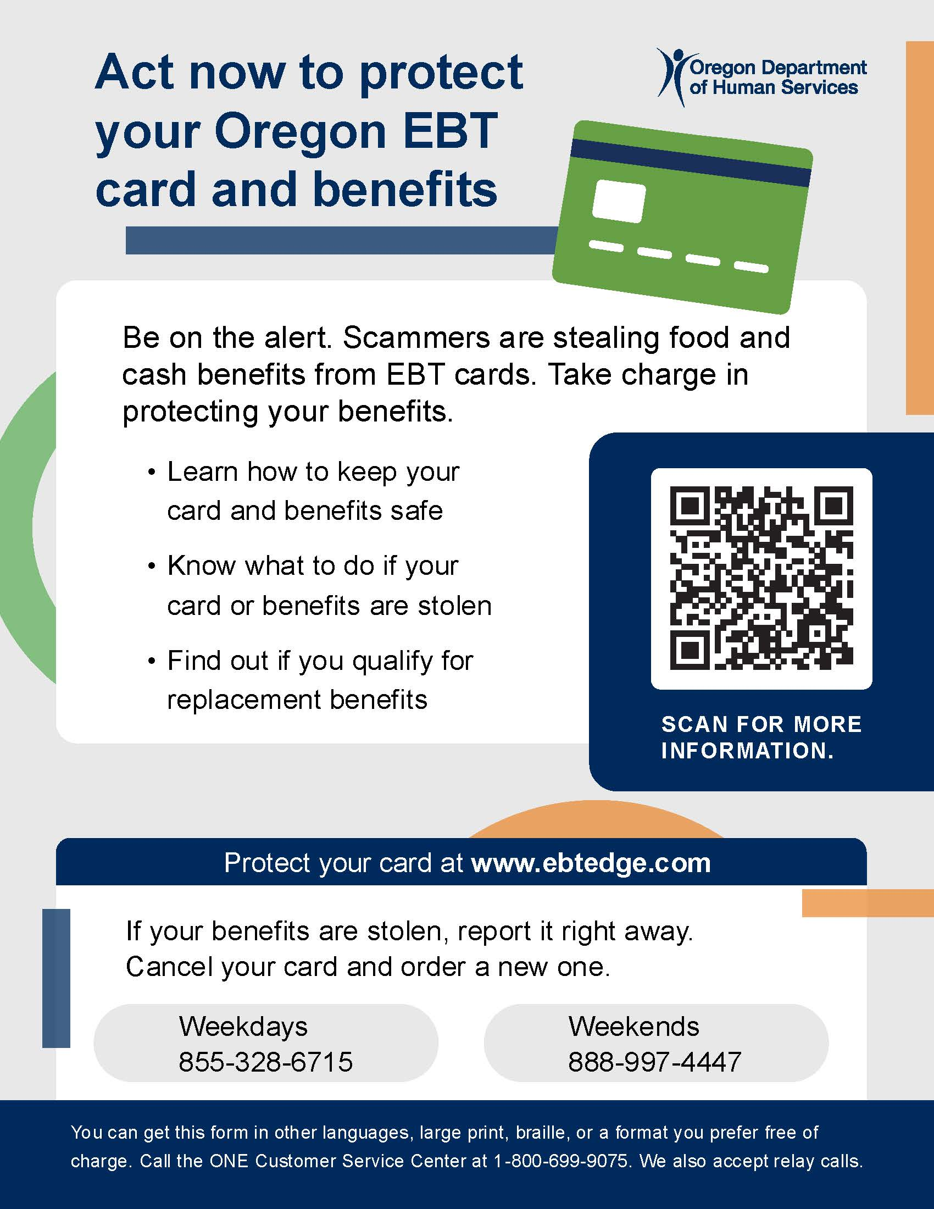
Protecting EBT Cards and Benefits
Electronic theft of benefits is on the rise nationwide.
Stolen SNAP benefits can't be replaced. TANF benefits can be replaced.
Safety tips for cardholders and downloadable resources for partners in many languages at www.oregon.gov/odhs/benefits/pages/protect.aspx
Notes:
Electronic benefit theft is on the rise. Criminals are using methods like skimming devices, internet scams and fake websites to steal card numbers and personal identification numbers (PIN). Once they have this information, they can drain food and cash benefits from a person’s card.
ODHS recommends that everyone with an EBT card take steps to keep their benefits secure. You can find simple tips on our website.
The federal funding to replace benefits ran out on Dec. 21, 2024, and ODHS is no longer authorized to replace stolen SNAP benefits. ODHS can replace Temporary Assistance for Needy Families (TANF) benefits that are lost due to fraud.
Again, information about how to protect EBT cards and benefits is on our website at https://www.oregon.gov/odhs/benefits/pages/protect.aspx. The webpage includes a downloadable wallet card, flyer and brochure in several languages for partners to share in your own communications.

Slide 27

Recently, ODHS turned off 1,300 compromised EBT cards because of theft
The agency issued a news release about the compromised cards on Dec. 5, 2025.
Most theft happens right after benefits are issued.
Encourage people to take recommended actions to protect their cards and benefits.
Notes:
ODHS is taking action to protect people from EBT card skimming. Recently, more than 1,300 compromised cards in the Coos Bay and North Bend area were turned off and replaced to prevent theft. New cards were mailed automatically. People who need an EBT replacement card can ask for one at any ODHS office. If an EBT card suddenly stops working or the balance looks wrong, check ebtEDGE.com or call the ONE Customer Service Center. Most theft happens right after benefits are issued, so we encourage people to stay alert to scams and skimming devices.
News release:
https://apps.oregon.gov/oregon-newsroom/OR/ODHS/Posts/Post/december-snap-update-benefits-issued-like-normal-compromised-cards-turned-off-replaced

Slide 28
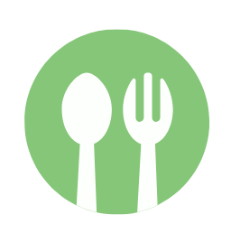
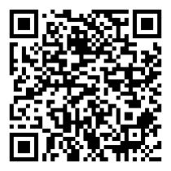
Resources for finding food
Visit ODHS’ free food events listings.
Visit ODHS’ food resource webpage at needfood.oregon.gov
Notes:
During the federal government shutdown, ODHS updated and expanded its Need Food web resource.
It now also includes Free food events
The site is also available in Spanish
Multi-language promotional flyers and wallet cards will be added soon

Slide 29

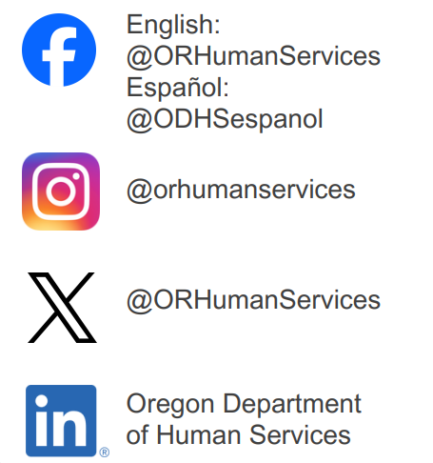



Stay in touch
Sign up for our partner newsletter.
Sign up for news alerts from ODHS.
Visit our federal updates webpage.
Email the Community Engagement team.
Follow us on social media.
www.oregon.gov/odhs
Notes:
Partner newsletter: https://public.govdelivery.com/accounts/ORDHS/subscriber/new?topic_id=ORDHS_833
News alerts: https://www.oregon.gov/odhs/news/pages/default.aspx
Email community engagement team: communitypartners@odhsoha.oregon.gov

Slide 30
Thank you
www.Oregon.gov/odhs

