Slide 1


Federal Actions Coordination Team (FACT)
March updates
March 2026
Notes:
Welcome, introductions

Slide 2

Table of Contents
SNAP Overview
HR1 SNAP Eligibility Changes
SNAP Work Rules
Non-Citizen Limitations
SNAP Data Sharing
Sanctuary State
Public Charge
Resources

Slide 3
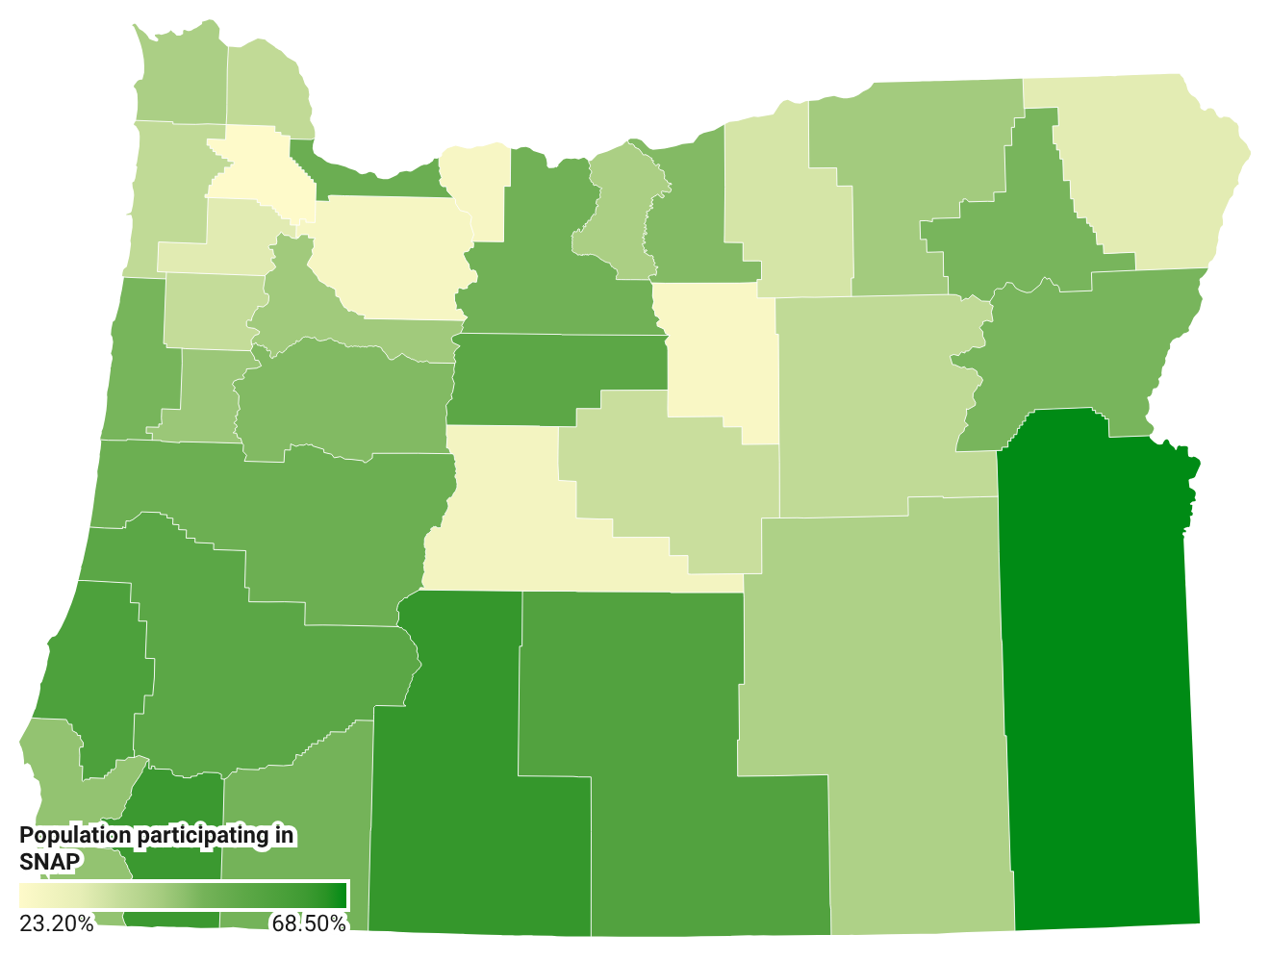
1 in 6 people in Oregon participate in SNAP
Percentage of households receiving SNAP
by county
757,000 individuals*
76,343
Age 60+*
47,786
have a disability**
Map graphic based on ODHS caseload from the Office of Reporting, Research, Analytics and Implementation
*Based on ODHS caseload data
**As defined by Food and Nutrition Services
Notes:
In Oregon, SNAP helps 757,700 people put food on their tables – that’s about 18% of the population or 1 in every 6 people in our state. Many of these are older adults, children and people with disabilities.
SNAP continues to operate normally, and benefits are being issued on schedule.
People receiving SNAP are part of 450,000 households across the state. Many people receiving SNAP benefits are in rural areas of the state.
More than 54% of Oregon SNAP participants are in households with children.
More than 37% are in households with members who are older adults or have disabilities.
35% of participating Oregon households have income at or below 50% of the poverty line
The map shown used data from October 2025 courtesy the ODHS Office of Reporting, Research, Analytics and Implementation (ORRAI)

Slide 4
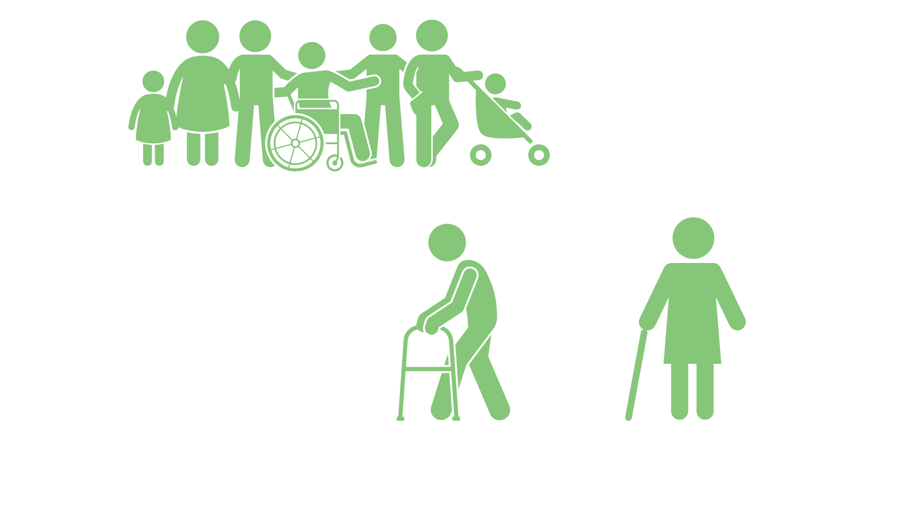
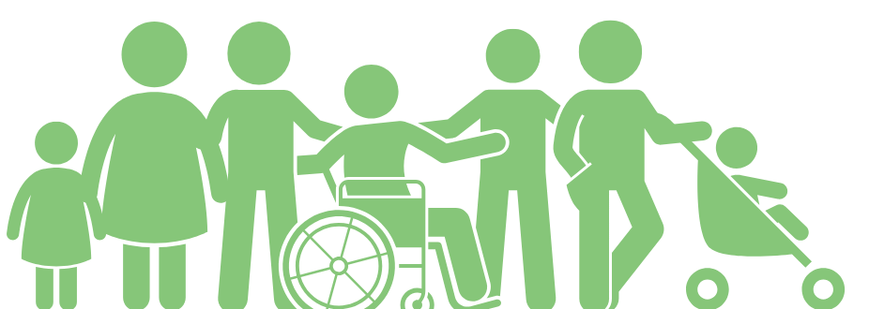
SNAP monthly snapshot
$313
$183
Average
benefit per household
Average
benefit per person
Source: Oregon Department of Human Services caseload data, March 2025.
Notes:
in Oregon, an average of $183 per month in SNAP is issued out to each individual participant

Slide 5


Sample title
Sample content
H.R.1 changes
to SNAP eligibility
Notes:
In July 2025, the federal government made major changes to SNAP under H.R.1
Many people have received notices describing changes mandated by the new federal law.

Slide 6
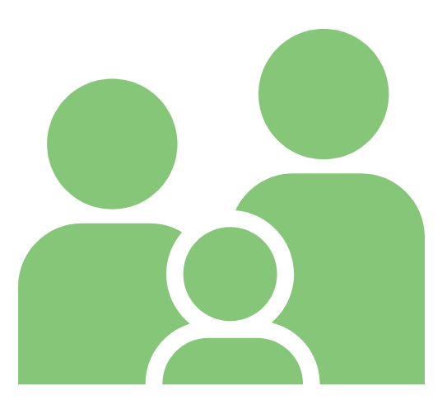
SNAP eligibility changes
People may be required to participate in Able-bodied Adults without Dependents (ABAWD) federal work rules.
Many lawfully present non-citizens facing reduction or the end of their benefits.
People may get less SNAP because of changes in how energy assistance is counted.
Notes:
These changes may reduce benefits for some households, expand their work requirements, or remove them from benefit eligibility.
People may be required to participate in Able-bodied Adults without Dependents (ABAWD) federal work rules.
Lawfully present non-citizens facing reduction or the end of their benefits.
People may have a reduction in SNAP benefits from federal limits on energy assistance-based Standard Utility Allowance.
Some people who receive energy assistance may see a reduction in SNAP. They may have received a deduction for paying utilities that is now federally limited
Partners may see increased confusion, fear or requests for help from community members.

Slide 7
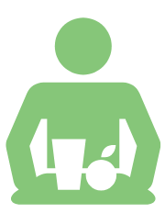
Able-bodied Adults Without Dependents (ABAWD) work rules
Effective ate | Description
July 4, 2025 | Changed able-bodied adults without dependents (ABAWD) age range to 18 through 64 (previously 18 through 54). Changed dependent child exception to those under the age of 14 (previously 18). Limits ABAWD waivers to only be permissible if an area (city, county, Tribal Land, etc.) has an unemployment rate above 10%. Removed option to request waivers based on lack of sufficient jobs.
Estimated population
impact
Effective date
Description
~310,000 adults
will need to be reviewed for ABAWD work requirements
or exceptions.
Notes:
Resource: https://www.oregon.gov/odhs/food/pages/snap-time-limits.aspx
Individuals classified as Able-bodied Adults Without Dependents (ABAWD) must meet work rules or qualify for an exemption to keep SNAP for more than three months in a three-year period. Our current three-year period will end December 2027.
HR1 implementation in Oregon is affecting these SNAP work rules in the following areas:
More individuals subject to work rules: The upper age threshold would increases to through 64, meaning many currently exempt adults aged 55–64 would now need to comply. The age of dependents is also decreasing to no children under 14 years of age (from the prior 18)
Harder for the state to waive requirements: Removal of “insufficient jobs” criterion and shift to county-level unemployment assessments reduces flexibility for rural or economically distressed counties.
Reduced state flexibility and administrative burden: Fewer discretionary exemptions allowed and no rollover—less ability to adapt strategically.

Slide 8

SNAP work rule impacts
Work rules will not impact individuals with I/DD, behavioral health or physical disability.
Will not apply to individuals receiving long-term services and supports.
People ages 55 through 64 who do not have a child under age 14 on their SNAP case must work 80 hours each month to get SNAP for more than three months.
Exemptions for veterans, people experiencing homelessness, and former foster youth have been removed.
There is a new exemption for American Indian/Alaska Native individuals who qualify under rules in the Indian Health Care Improvement Act.
Notes:
In June 2025, 310,626 Oregonians were aged 18-65 without a child under age 14 in their SNAP group. We do not know how many will meet an exemption or ABAWD work requirements. We estimate that AT LEAST 90,888 individuals will be at risk of losing their SNAP benefits if they do not meet ABAWD Work Requirements.
ODHS will screen each person to see if they are:
Already meeting work rules
Are exempt from work rules
Need to create a plan to meet work rules. In these situations, ODHS will refer them to the Oregon Employment Department to create a plan and access supports.

Slide 9


SNAP time limit
If a SNAP participant with ABAWD status* does not meet the work rules for three months in a three-year period, they reach their time limit.
After that, they cannot receive benefits for the rest of the three-year period. The current three-year period ends Dec. 31, 2027.
People can restart SNAP during the three-year period if they start meeting the work requirement or become exempt.
*Unless the person has an exemption
Notes:
If a SNAP participant with ABAWD status (unless they have an exemption) does not meet their work requirements for three months, they will reach the three-year time limit for SNAP.
When that happens, they cannot get SNAP benefits for the rest of that three-year period.
The current three-year period is Jan. 1, 2025, through Dec. 31, 2027.
Each month a counting month is added to a case, the individual will receive a notice informing them:
Which counting month they have received
information on how to meet the work requirements
Ways to meet an exemption
How to contact ODHS

Slide 10

Oregon SNAP work rules: Timeline 2025
SNAP work rules restarted in six counties: Benton, Clackamas, Hood River, Multnomah, Washington and Yamhill
September 2025​
Oct. 1, 2025
HR1 SNAP changes implemented in Oregon
Dec. 1, 2025
SNAP work rules start statewide except for waived areas
Notes:
September 2025
ABAWD work rules restarted in six Oregon counties using the pre HR1 rules (ABAWD = 18-54 with no child under 18): Benton, Clackamas, Hood River, Multnomah, Washington and Yamhill.
October 2025
Oregon began using the expanded ABAWD definition under HR 1. The ABAWD work rules now apply to individuals 18-64 with no child under 14. The expanded definition applies when someone:
Applies for SNAP
Renews their SNAP benefits
Reports a change that requires a recalculation of their SNAP benefits
December 2025
The Food and Nutrition Services ended Oregon’s ABAWD waiver in 30 counties resulting in an expansion of the ABAWD work rules statewide.
Individuals meeting the old and new definition are lumped together in these counties. Adults without dependents must meet work requirements to receive SNAP for more than three months, unless they qualify for an exemption.

Slide 11

Oregon SNAP work rules: Timeline 2026
People who do not meet new work rules in the initial six counties could see their benefits end as early as January
Benton, Clackamas, Hood River, Multnomah, Washington and Yamhill Counties
January 2026
Discretionary exemptions for people living in seven counties begin because their county doesn’t have a WorkSource center:
Crook, Gilliam, Jefferson, Lake, Morrow, Sherman, Wheeler
Feb. 1, 2026
First month of benefit closures for people who do not meet work rules in the 23 counties in the last implementation phase
April 2026
Notes:
Impact to SNAP recipients
SNAP has a three-month time limit for people who do not meet the work requirements. Benefits do not end right away.
In the initial six counties, people who do not meet new work rules could see their benefits end as early as January and each month a new group of individuals will lose benefits due to reaching their third countable month. ABAWD work rules restarted in six Oregon counties using the pre HR1 rules (ABAWD = 18-54 with no child under 18): Benton, Clackamas, Hood River, Multnomah, Washington and Yamhill.
Those impacted by the HR1 changes and the expanded counties, could start to see their benefits end as early as April 2026, if work requirements are not met.
As of Feb. 1, 2026, discretionary exemption begins
For people who live in the following counties can report an exemption because their county doesn't have a WorkSource Center:
Crook, Gilliam, Jefferson, Lake, Morrow, Sherman, Wheeler
April 2026
Those impacted by the HR1 changes and the expanded counties, could start to see their benefits end as early as April 2026, if work requirements are not met.

Slide 12
Activities that meet work rules
80 hours of
work activities required
per month.
Requirement can be met by one or a combination of activities:
Working
Volunteering
Bartering
Participating in an ABAWD case plan developed by Oregon Employment Department (OED)
Some may already be meeting the work rules
and only need to provide proof.
Notes:
80 hours of work activities per month averages to about 20 hours per week.
See the webpage for full details:
https://www.oregon.gov/odhs/food/Pages/snap-time-limits.aspx

Slide 13




People who may not need to meet SNAP work rules
Face barriers to work like health issues, attend school half-time or care for a person with a disability. Must meet with staff to review exemption options.
Live in a waived area.
Have a discretionary exception.
Notes:
There are people who do not have to follow ABAWD work rules. Groups include:
People who have problems or hardships that make working hard
People who do other things that count the same as work
People who live in an area where ABAWD rules do not apply
People who are given an extra excuse from the ABAWD rules
Examples of barriers to work:
Health problems
Physical, behavioral, or mental health (temporary or permanent)
Pregnancy
Receiving money due to a disability
Attending an alcohol or drug treatment program
Inpatient or outpatient Note: May qualify as health issue.
Caring for a person with a disability
Note: Not required to reside together.
Attending school at least half-time
High school and/or GED programs
Higher Education (community college, university, graduate programs etc)
Trade/vocational programs
Training programs
Participating in a training plan with a federal refugee resettlement program
Immigrant and Refugee Community Organization (IRCO),
Corvallis for Refugees etc
Examples of equivalent work activities
Unemployment benefits (UC) – Verbal Attestation
Applied for unemployment and has not been denied
Receiving unemployment benefits.
Temporary Assistance for Needy Families – (ONE system verified)
Participates in the TANF Jobs program
Working for pay (Proof of hours is required)
At least 30 hours a week.
Earning at least $935.25 a month.
Earning at least $935.25 from self-employment and have no business costs
Earning at least $1,870.50 and has business costs.
Discretionary exemption
Current Discretionary Exemptions in Oregon:
Foster care parents who do not include foster children in SNAP case. Verbal attestation.
SNAP eligible non-citizens not authorized to work. Verbal attestation

Slide 14
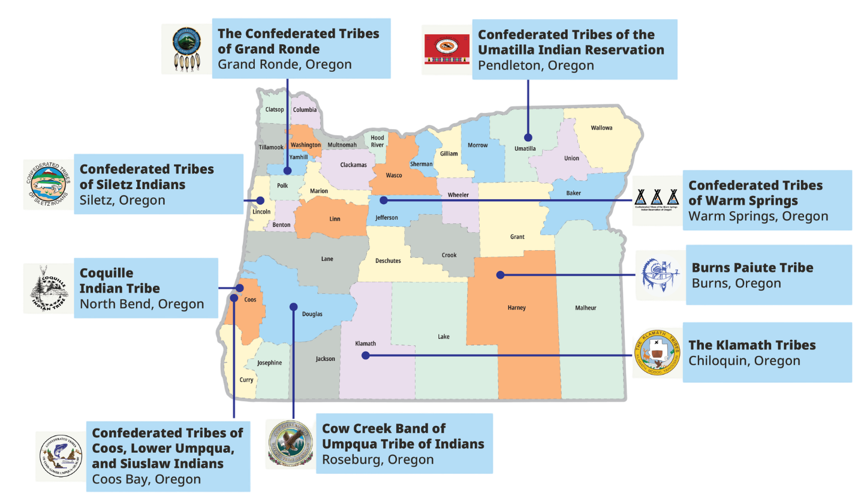

Five Tribal lands are waived from SNAP work rules due to high unemployment rates
Notes:
As of December 1
No Oregon county is exempt
Only five tribal lands are exempt due to high unemployment rates:
Burns Paiute Tribe Reservation and off-Reservation Trust Land
Coquille Indian Tribe Reservation and off-Reservation Trust Land
Cow Creek Band of Umpqua Tribe of Indians Reservation
Klamath Tribes Reservation
Confederated Tribes of Siletz Indians Reservation and off-Reservation Trust Land

Slide 15



Contact ODHS to see if work rules apply
Call the ABAWD team:
1-833-947-1694
Email:
SNAP.ABAWDTeam@odhsoha.oregon.gov
ODHS may connect people to:
Oregon Employment Department
Notes:
Take action: Contact ODHS
If someone gets a notice — or thinks — they may need to follow new work rules to keep SNAP benefits, they should contact ODHS as soon as possible.
We know these notices can feel stressful or confusing.
ODHS will check to see if customers already meets the work rules, including giving credit for any verified work activities they’ve completed.
ODHS will look for any exemptions that might mean the customer does not have to meet work rules.
OED may also offer training, job search help, education programs, or other services to help the person get and keep a job.
If needed, ODHS will connect customers with the Oregon Employment Department so they can make a plan to meet the work requirements.

Slide 16


After an ODHS referral: OED offers free support for meeting work rules
An OED Employment Specialist will be assigned to help create a case plan based on the person’s skills and interests.
OED provides free language assistance and interpretive services for customers.
Notes:
These work rules also open the door to more support.
After ODHS reviews someone’s information, the agency may refer people who need a case plan to meet the work rules to the Oregon Employment Department (OED).
They will get an appointment at a local WorkSource Center.
An Employment Specialist will be assigned to them. This person will help create a case plan based on the person’s skills and interests. The case plan lists the work-related activities they need to do each month.
OED may also offer training, job search help, education programs, or other services to help the person get and keep a job.
If needed, ODHS will connect customers with the Oregon Employment Department so they can make a plan to meet the work requirements.
All Employment Department offices have access to language assistance and interpretive services which are provided to our customers at no cost.
https://www.oregon.gov/employ/Agency/Pages/Equity-And-Inclusion.aspx

Slide 17




What people can do right now
Open and read all mail from ODHS
Respond quickly if ODHS reaches out for information
Visit benefits.oregon.gov for ways to connect with ODHS in person, by phone or online through the ONE Eligibility system
Make sure ODHS has current phone number and mailing address
Notes:
What SNAP participants can do right now:
Make sure ODHS has their current phone number and mailing address.
Open and read all mail from ODHS.
Respond quickly if we reach out for information.
Visit benefits.oregon.gov to learn how to connect with ODHS in person, by phone or online.
ODHS encourages people to have a ONE Online account and consider using the Oregon ONE Mobile app for faster service from anywhere.

Slide 18

If SNAP work requirements are not met
A person may be able to get them back.
Advise them to reapply and complete 80 hours of work or approved activities within 30 days.
Contact ODHS with questions.
Notes:
If a person's SNAP benefits closed because work requirements were not met, they may still be able to get them back.
Advise the person to reapply and, if they choose to participate, complete 80 hours of work or approved activities within 30 days.
We understand that life circumstances can make this difficult. If more time is needed, or the person thinks they may qualify for an exemption, please let ODHS know. Staff are there to talk through situations and help people understand their options.

Slide 19
Non-citizen SNAP eligibility
Effective ate | Description
July 4, 2025 | Limited eligibility to U.S. citizens or nationals, Lawful Permanent Residents, certain Cuban and Haitian entrants, and Compact of Free Association (COFA) citizens.
Effective date
Description
Estimated population
impact
~3,000 lawfully present individuals, including refugees, asylees and other conditionally allowed individuals, will lose benefits.
Notes:
H.R. 1 changed who can get SNAP. Before this change, some other immigrants with legal status could get SNAP if they met all eligibility rules. Many had to wait five years before getting SNAP unless they were exempt under federal law.
Today, some immigrant groups who were eligible before are no longer eligible.
Some groups who are Lawful Permanent Residents still have a five-year waiting period unless exempt. USDA has a chart that shows which groups are eligible.
This change took effect July 4, 2025. It affects people with legal status who were eligible for SNAP on July 3, 2025, including children, people with disabilities and older adults.
Oregon began using the new rules Oct. 1, 2025. After October 1, new applicants had to meet the new rules.
States recently received new guidance from USDA Dec. 10, 2025.
ODHS updated noncitizen policies, reviewed October noncitizen eligibility changes, and restored benefits as needed
For people already on SNAP, ODHS must check these rules at their next recertification.
States are still waiting for clear guidance from USDA’s Food and Nutrition Service (FNS) about how to apply some parts of the new rules.

Slide 20

Non-citizen SNAP eligibility
HR1 limited SNAP eligibility for some lawfully present immigrant groups
July 4, 2025
Oct. 1, 2025
October 2025
Dec. 10, 2025
December-January
Federal law changes SNAP eligibility for some lawfully present immigrants.
Original guidance said many lawfully present humanitarian immigrants were not eligible for SNAP.
USDA issued new guidance saying that some humanitarian entrants who now have Lawful Permanent Resident (LPR) status can qualify for SNAP.
Oregon applies original federal guidance.
ODHS identified who qualifies, how benefits are restored, and how to apply guidance to new applicants.
Notes:
When HR1 was signed in July 2025, federal guidance made changes to SNAP eligibility for some lawfully present immigrant groups.
Oregon implemented the original guidance in October 2025.
It is important to note that this original FNS guidance released, excluding many lawfully present humanitarian entrant immigrants from SNAP
On Dec. 10, 2025, the USDA issued new information that clarifies who can get SNAP under current federal law. Several groups who became ineligible when HR1 passed in July 2025 can qualify for SNAP if they have or obtain a Lawful Permanent Resident (LPR) status.
In December and January, Oregon identified who will qualify for their benefits to be restored, how they were restored and how to apply the recent guidance to applicants. ODHS estimates a small number of people will qualify for retroactive or new SNAP benefits under the revised guidance.

Slide 21

Non-citizens eligible for SNAP
Eligible immediately, without a five-year waiting period, if they meet all other SNAP financial and
non-financial eligibility requirements.
Non-citizen U.S. nationals
Cuban and Haitian Entrants
COFA Citizens
Lawful permanent residents who meet exceptions
Source: USDA FNS at https://www.fns.usda.gov/snap/obbb-alien-eligibility
Notes:
Now, SNAP is limited to the following groups:
U.S. citizens
U.S. nationals
Lawful permanent residents (LPRs)
Cuban and Haitian entrants¹
Citizens of Compact of Free Association (COFA) nations

Slide 22

Non-citizens eligible for SNAP with conditions
Lawful Permanent Residents (LPR)
also known as Green Card holders.
Eligible after a five-year waiting period if they meet all other SNAP financial and non-financial eligibility requirements.
There are exceptions…
Notes:
Prior to the change, certain lawfully present immigrants, as defined by the Personal Responsibility and Work Opportunity Act (PRWORA) were eligible to receive SNAP benefits, provided they met all other SNAP eligibility requirements and completed a 5-year waiting period, unless exempted by PRWORA.
Today, some immigrant groups previously eligible for SNAP are no longer eligible. They continue to be subject to a 5-year waiting period, unless exempted by PRWORA.

Slide 23

Some LPRs may not need a 5-year waiting period
If they meet one or more of the following conditions:
  Are under 18 years old
  Have 40 qualifying work quarters
  Are blind or disabled
  Lawfully resided in the U.S. & 65 or older on Aug. 22, 1996
  Have a U.S. military connection
  Are admitted to the United States as an Amerasian immigrant
  Are an American Indian born abroad
  Certain Hmong or Highland Laotian tribal members
Notes:
Some lawful permanent residents are exempt from the 5-year waiting period.
They must still meet income and other SNAP rules.
Are under 18 years old
Have 40 qualifying work quarters
Are blind or disabled
Were lawfully residing in the U.S. and 65 or older on August 22, 1996
Have a U.S. military connection
Are admitted to the United States as an Amerasian immigrant
Are an American Indian born abroad
Certain Hmong or Highland Laotian tribal members
https://www.oregon.gov/odhs/food/Pages/snap.aspx#noncitizens
https://www.oregon.gov/odhs/transmittals/oeptransmittals/pt25043.pdf

Slide 24

LPRs who may be exempt from the 5-year waiting period if they had this previous status
Refugees
People granted asylum
People with deportation withheld
Iraqi & Afghan Special Immigrant Visa (SIV) holders
Certain Afghan parolees (July 31, 2021–Sept. 30, 2023)
Certain Ukrainian parolees (Feb. 24. 2022–Sept. 30, 2024)
Victims of severe trafficking
Important to remember: These statuses alone do not make someone SNAP-eligible — they remove the 5-year wait after the person becomes a lawful permanent resident.
Notes:
Exempt from the 5-Year Waiting Period (once they become Green Card holders)
Refugees
People granted asylum
People with deportation withheld
Iraqi & Afghan Special Immigrant Visa (SIV) holders
Certain Afghan parolees (7/31/2021–9/30/2023)
Certain Ukrainian parolees (2/24/2022–9/30/2024)
Victims of severe trafficking
Important: These statuses alone do not make someone SNAP-eligible — they remove the 5-year wait after the person becomes a lawful permanent resident.
Folks need to meet one of these conditions.
https://www.oregon.gov/odhs/food/Pages/snap.aspx#noncitizens
https://www.oregon.gov/odhs/transmittals/oeptransmittals/pt25043.pdf

Slide 25
Medicaid work rules
Beginning
January 2027
People ages 19-64 in “adult expansion group” and some YSHCN
Renewal will generally happen every six months​
When some adults apply or renew, they will need to show:​
​
An exemption, or​
Qualifying activity (one or in combination)​
  Work​
  Volunteer activities​
  Education or training​
For more, visit OHAs webpage https://www.oregon.gov/oha/HSD/OHP/Pages/Federal-Changes.aspx
Notes:
Beginning with January 2027 renewals, adults ages 19-64 who are eligible for Medicaid will need to comply with federal requirements through work or another qualifying activity, or some combination. ​
Some Young Adults with Special Health Care Needs will also be subject to work requirements.​
The rules will not apply to people who qualify for OHP programs that are based on disability, parent, or caretaker status or to people who have both Medicare and OHP. ​
For people who are subject to these requirements, there are exemptions. CMS will release more information about those exemptions in June this year.
​
​
Notes on timing: ​
This will first apply to new applications on Jan 1 2027, checking that the applicant met the requirement in December 2026.​
This will first apply to renewals sent in January 2027 that need a response by March 2027.​
Members in the expansion group (and MAGI Healthier Oregon, and YSHCN) will receive a notice in October 2026, informing them that at their next renewal they will need to show an exception or meet the requirements.​
​
Get more information from the Oregon Health Authority on its webpage at https://www.oregon.gov/oha/HSD/OHP/Pages/Federal-Changes.aspx

Slide 26

USDA SNAP data request
USDA asked states to share detailed personal information about people who have received SNAP food benefits
Notes:
In 2025, the U.S. Department of Agriculture (USDA) asked states to share more detailed personal information about people who received SNAP food benefits
Oregon is challenging this request to protect people’s privacy. A court order is currently in place that blocks the data from being shared while the case continues.

Slide 27

Timeline: USDA demands data
Oregon has not yet shared SNAP data with USDA from this order.
July 28, 2025
Oct. 15, 2025
Nov. 24, 2025
December 2025
January 2026
Oregon Department of Justice (DOJ) joined 22 other states in a lawsuit against USDA.
U.S. District Court issues temporary order stopping USDA from cutting SNAP funding while the lawsuit continues.
This order is not final.
USDA sends another letter to states repeating the data demand. Response deadline Dec. 8, 2025.
Oregon and other states objected to USDA’s latest data request and raised ongoing concerns.
States file new motion to enforce temporary order. Motion pending.
Notes:
In May 2025, the U.S. Department of Agriculture (USDA) told all states to give the federal government five years of personal information about every person who received SNAP since Jan. 1, 2020.
This included Social Security numbers and home addresses.
Oregon has not shared any SNAP data with USDA from this order.
On July 28, 2025, the Oregon Department of Justice (DOJ) joined 22 other states in a lawsuit against USDA.
The lawsuit says USDA’s request breaks privacy laws and asks for more information than it is allowed to have. SNAP already has strong checks in place, and states have never had to give this kind of personal data to USDA before.
USDA also said it might cut funding from states that did not follow the order. This put Oregon and other states in a difficult position: share people’s private information and break the law or protect people’s data and risk losing SNAP funding.
On Oct. 15, 2025, a U.S. District Court gave a temporary order that stopped USDA from cutting SNAP funding while the lawsuit continues. This order is not final.
On Nov. 24, 2025, USDA sent another letter repeating the demand for data. States had until December 8 to agree or to send a letter saying they did not agree.
On Dec. 8, 2025, Oregon and the other states in the lawsuit sent a letter saying they did not agree.
USDA responded Dec. 23, 2025, with new details about data elements and data sharing protocol and the expectation that states comply by early January.
January 2026: Oregon and other plaintiff states notified USDA of its remaining concerns with the data demand and filed a motion to enforce the U.S. District Court’s previously issued temporary order.
This motion is pending with the court.

Slide 28

SNAP data ODHS shares with the federal government
Small samples from people getting SNAP.
Information that does not personally identify someone. Like age, gender, household size, income and the amount of benefits a household gets.
The federal government has not collected or stored all applicants’ personal information.
Notes:
Historically, the federal government checked SNAP data by looking at small samples from people who were getting SNAP.
Information that does not personally identify someone. Like age, gender, household size, income and the amount of benefits a household gets.
The federal government did not collect or store all applicants’ personal information. Federal law states that SNAP data can only be used for running the SNAP program, with limited exceptions.
(If needed, when data is provided for studies, it is required to be de-identified)

Slide 29
Sample title
Sample content
Oregon is a Sanctuary State
Notes:
We follow Oregon’s Sanctuary Laws
Our staff does not help with immigration activities
Immigration officers can’t request customer information or enter areas closed to the public unless they have a signed court order, subpoena or warrant.
When legal papers are presented, we make sure they are real and valid.
People can also connect with us by phone or online. Visit benefits.oregon.gov to learn all the ways you can connect with us about medical, food, cash and child care benefits.

Slide 30
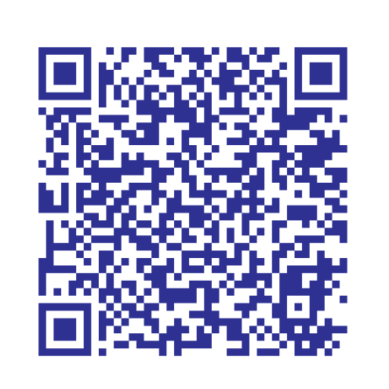
Oregon Department of Justice Community Toolkit
Scan the QR code for the DOJ toolkit
“Everyone in Oregon can live, work, play, go to school, report a crime to police, go to court and access government services without fear that a state or local government employee will report you to ICE.”
https://www.doj.state.or.us/oregon-department-of-justice/civil-rights/sanctuary-promise/community-toolkit/
Notes:
The Civil Rights Unit at the Oregon Department of Justice has a free, online community resource for anyone seeking to understand Oregon’s sanctuary laws and help make sure our communities are safe for everyone. This toolkit covers the essential information needed to understand, report and combat violations of Oregon’s Sanctuary Promise Laws.
Scan the QR code or visit their webpage for more information
https://www.doj.state.or.us/oregon-department-of-justice/civil-rights/sanctuary-promise/community-toolkit/

Slide 31
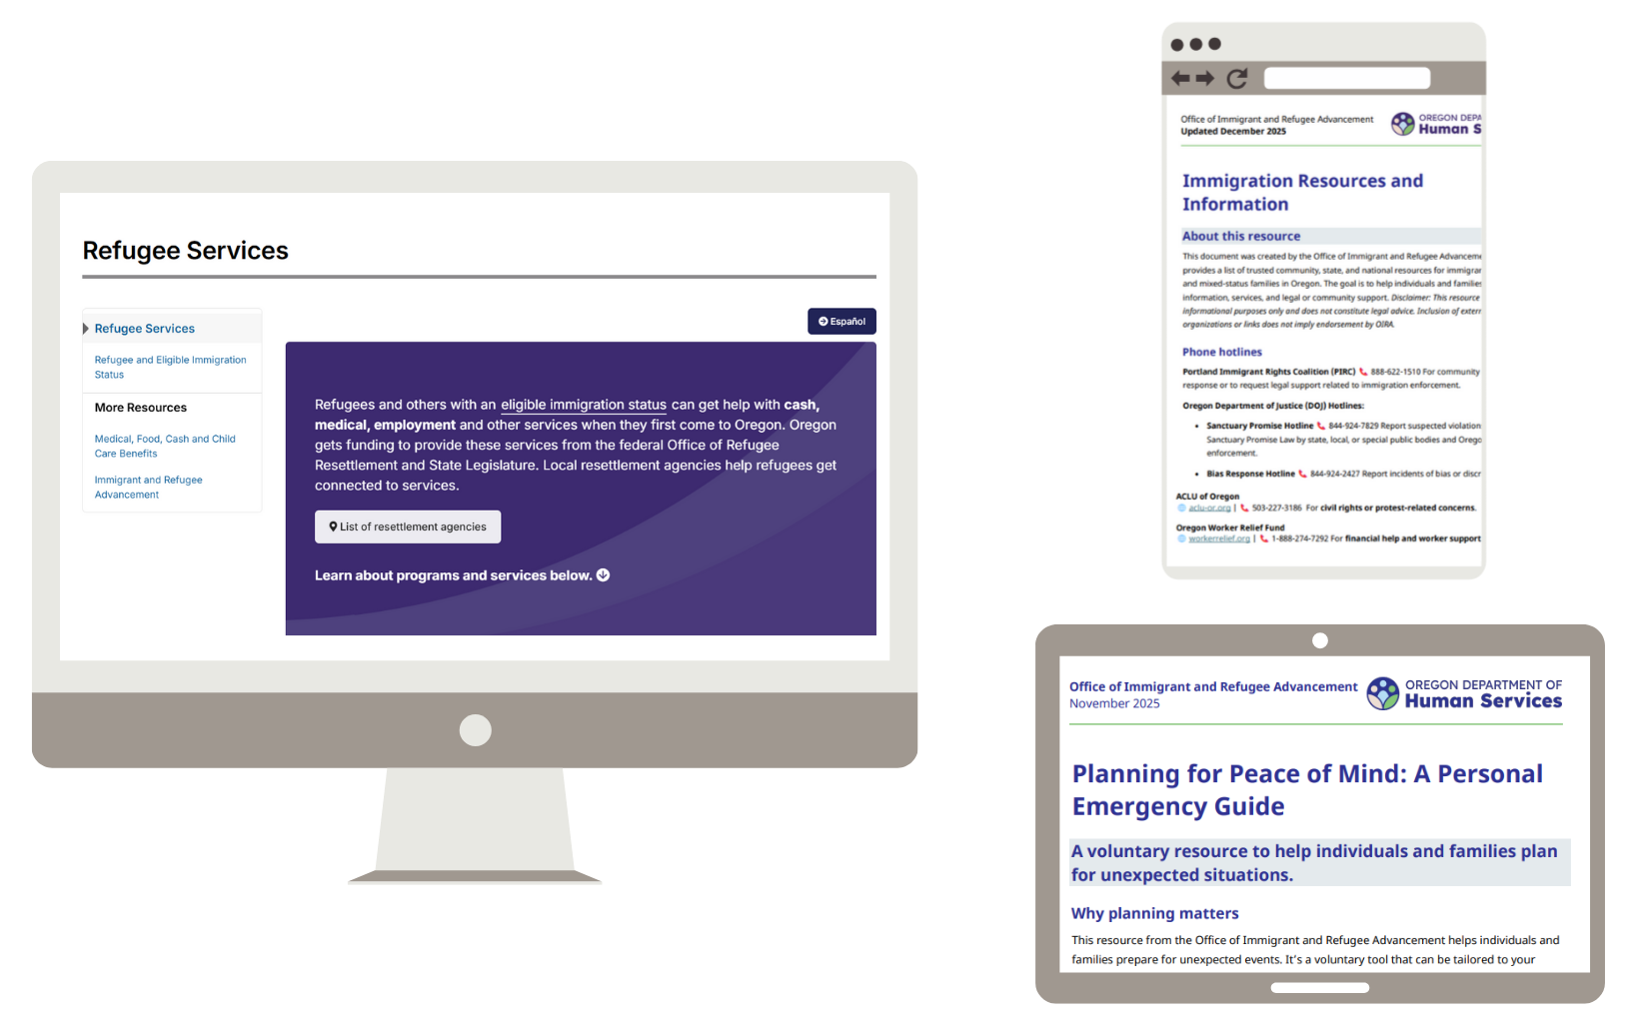
Office of Immigrant and Refugee Advancement online resources
Refugee Services
Immigration Resources & Info
Emergency Planning
Legal directory
https://www.oregon.gov/odhs/about/pages/oira.aspx
Notes:
The Office of Immigrant and Refugee Advancement (OIRA) serves as the bridge between ODHS, OHA, and other state agencies.
Coordinating policy, research, and communication to ensure immigrant and refugee communities are centered in Oregon’s systems.
OIRA has trusted community, state, and national resources listed on their webpage for immigrants, refugees, and mixed-status families in Oregon.
These tools are available online – visit https://www.oregon.gov/odhs/about/pages/oira.aspx

Slide 32
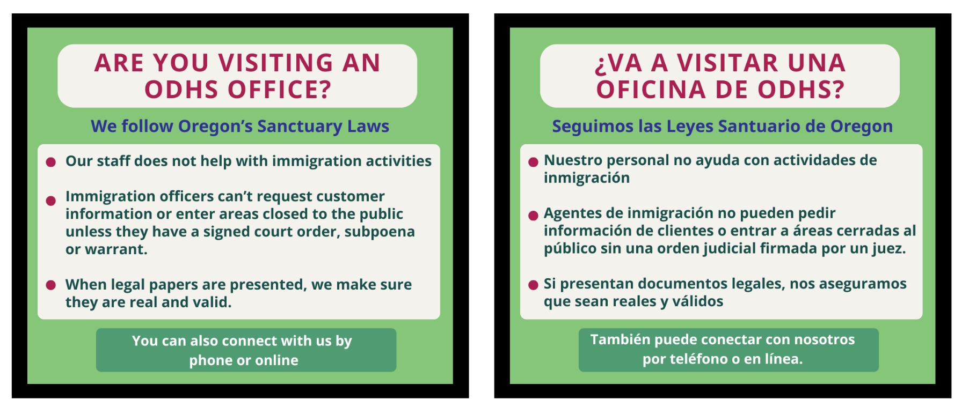
ODHS message to community about Oregon’s Sanctuary Law
Notes:
In February, ODHS shared a message with our Spanish Facebook followers about Oregon’s Sanctuary Law.
National events and local immigration enforcement activity are creating fear and uncertainty in our communities. During these challenging times ODHS remains committed to our Equity North Star and to follow Oregon’s Sanctuary Law at our offices for the people we serve and our staff.
Under Oregon’s Sanctuary Law, ODHS staff are not allowed to help with immigration enforcement, and immigration enforcement officers can’t request customer information and are not allowed to enter areas closed to the public unless they have a signed judicial order, subpoena, or warrant.
Any legal documents presented to staff will be reviewed to confirm they are valid.
It is also important to know that while our staff cannot assist with immigration enforcement without a judicial order, they also cannot intervene in interactions involving federal immigration officers.

Slide 33
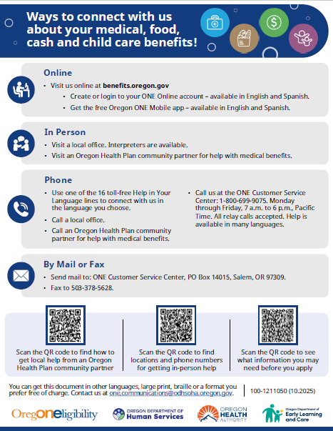
How to connect with
ODHS
People can connect with ODHS in the way that feels best for them including:
  Online
  By phone 1-800-699-9075
  By mail or fax
Help is available in multiple languages.
Notes:
Please share how people can connect with ODHS. Especially if someone prefers to not visit an office in person.
Options include calling a local office by phone, apply for and manage benefits through a ONE Online account, or call the ONE Customer Service at 800-699-9075 for support and information about services and benefits.
Help is available in multiple languages. https://www.oregon.gov/odhs/benefits/Pages/languages.aspx
Visit benefits.oregon.gov to learn more.

Slide 34
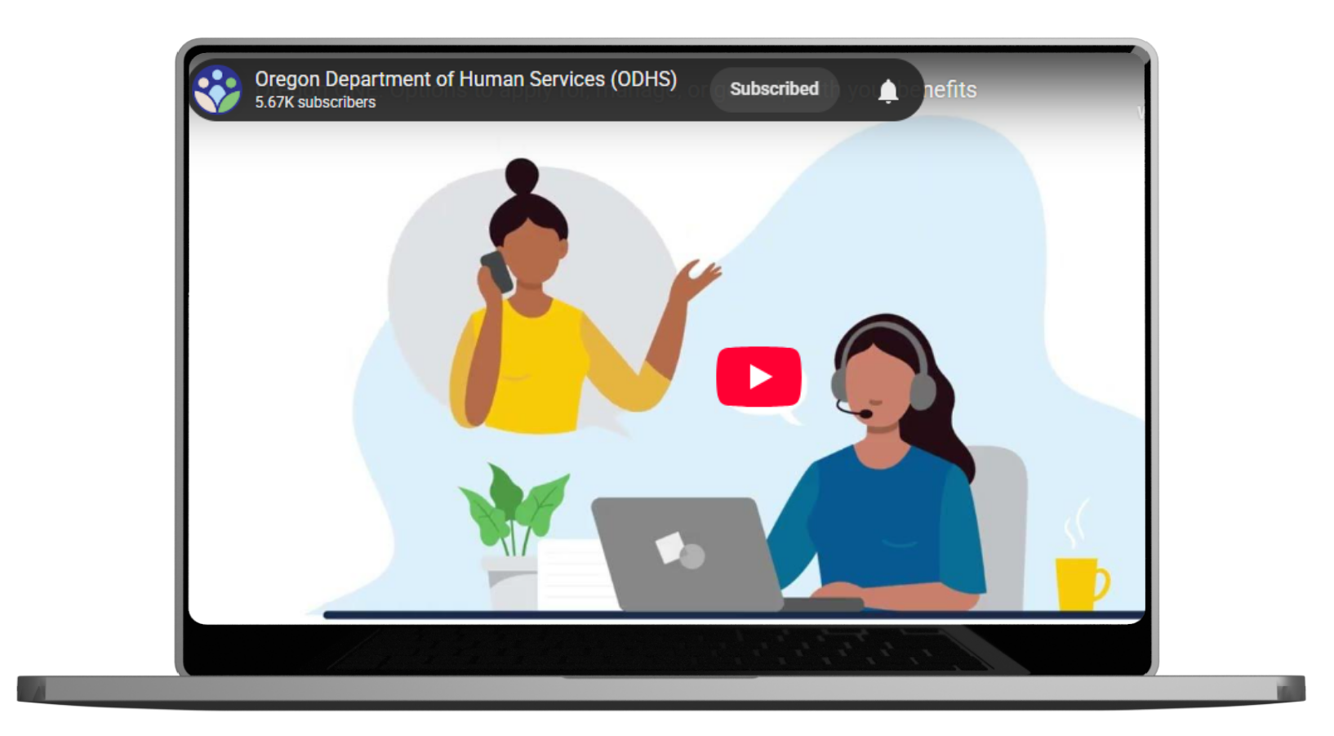
New video shows choices for how people can apply and manage benefits
Notes:
The Oregon Department of Human Services (ODHS) has previously shared flyers in English and Spanish that explain how people can apply for and manage benefits like medical, food, cash and child care.
We’re now introducing a new short video, also available in English and Spanish, to help people find and use the support that works best for them.
These resources are part of how ODHS supports people in navigating benefits — whether online, by phone or in person. We know people may:
Prefer the convenience of online tools
Be caring for family or working and unable to visit an office
Feel uneasy or unsafe leaving their homes
Need information in English, Spanish or another language
Our goal is to make benefits easier to understand and easier to access — in a way that respects people’s needs and preferences.
These tools don’t just support customers — they support you. Clear, easy self-service options can help lower call volume, reduce errors and ease pressure on staff during complex policy changes.
Be sure to review all the How-To Videos in our library.
Please continue sharing the flyers and begin sharing the new video when you:
Talk with customers about applying or renewing benefits
Explain how to submit documents
Respond to questions about online options
These resources are available on the public-facing benefits.oregon.gov webpage.
The flyers guide customers to:
Manage benefits anytime using self-service options, Spanish.
Connect with ODHS for help or updates, Spanish.
How to send ODHS information, Spanish.
Using the Oregon ONE Mobile App — with versions for SNAP, Temporary Assistance for Needy Families (TANF) and Employment Related Day Care (ERDC) programs.
Thank you for helping connect people to tools that make accessing benefits simpler and more flexible.

Slide 35

Public charge
When people are applying for Lawful Permanent Resident (LPR) status or seeking to enter the U.S. from outside the country, immigration officials may look at whether they will mostly depend on the government for support in the future. This is called the “public charge rule."
This rule does not apply to everyone. Some people are exempt under federal law.
Notes:
When people are applying for Lawful Permanent Resident (LPR) status (also called a green card) or seeking to enter the U.S. from outside the country, immigration officials may look at whether they will mostly depend on the government for support in the future. This is called the “public charge rule."
This rule does not apply to everyone. Some people are exempt under federal law.

Slide 36

Public charge rule has not yet changed
Federal government proposed a new rule in November 2025. Nothing has changed yet.
Only two ODHS programs count today:
Medicaid-funded long-term care in a nursing home
Monthly cash through TANF
Notes:
The public charge rule has not changed. A new rule has been proposed at the federal level, but the 2022 rule is still in effect. Families can keep using medical, food, cash, and child care benefits without new immigration consequences.
Most ODHS programs do not count toward public charge. Only two programs count today: Medicaid-funded long-term care in a nursing home and monthly cash through TANF. This has not changed.
The U.S. Department of Homeland Security (DHS) has proposed a new public charge rule that would replace the current rule from 2022.
Once DHS reviews all comments, they will decide on a final rule. Families can keep using medical, food, cash, and child care benefits without new immigration consequences.
Lost clarity is what creates fear and confusion for families. However, this is not in effect. Oregon and other states submitted comments before the federal deadline in December 2025.
Partners can help by sharing clear information and connecting families to trusted legal and community resources.

Slide 37
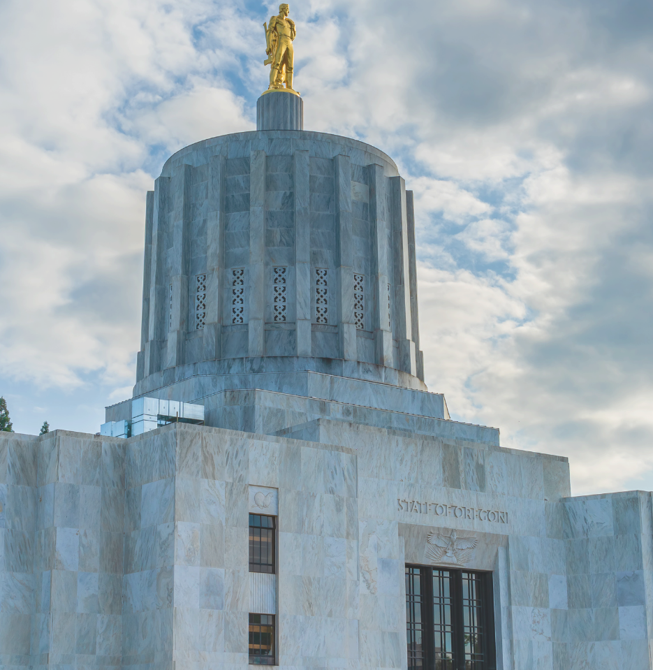
2026 Oregon
Legislative Session
Session ended March 6
ODHS and OHA secured additional resources to comply with new federal SNAP and Medicaid rules
Prevents people from losing benefits wherever possible
EBT cards will be updated with chip technology
Notes:
Our top priority heading into the 2026 session was to secure the funding and positions we need to absorb these changes and minimize harm to the people we serve. Lawmakers understood the urgency and, as part of their statewide budget bill (House Bill 5204), approved $111 million General Fund and 392 positions to begin HR 1 implementation. The dollars will cover:
More eligibility staff along with technology upgrades to handle increased SNAP screening and verification requirements while improving accuracy.
Staffing and other resources to handle verifications and exemptions related to new Medicaid work requirements.
Higher SNAP administrative costs that HR1 requires states to take on.
Updating SNAP EBT cards using smart chip technology — a much-needed security improvement that will help protect Oregonians’ essential food benefits.1 Expect to launch in Sepetmeber

Slide 38
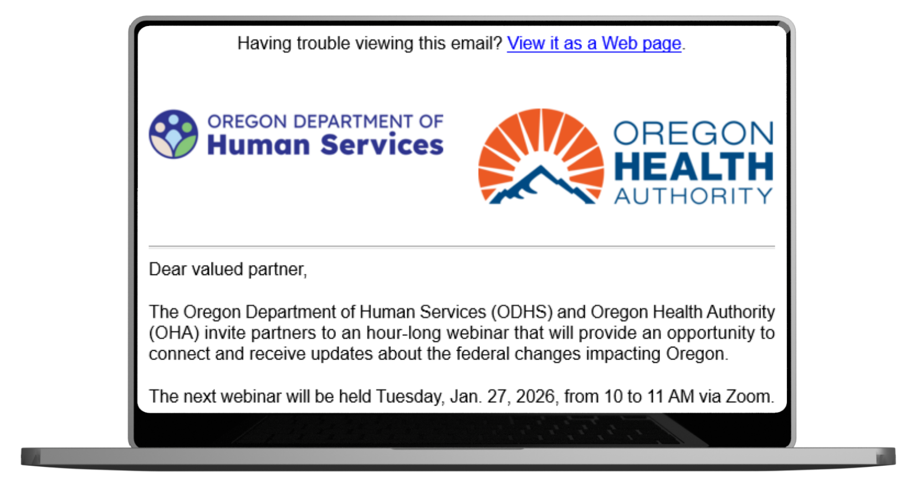
ODHS and OHA 2026 Forward Together Oregon webinar schedule
Tuesdays from 10 to 11 a.m., PT:
March 24, 2026
May 19, 2026
July 28, 2026
Sept. 22, 2026
Nov. 17, 2026
2026 Zoom Series Registration Link:
https://www.zoomgov.com/webinar/register/WN_-Q6HyPQoR76PxkMFSXcQ2Q#/registration
Notes:
ODHS and Oregon Health Authority will continue the Forward Together Oregon webinar series throughout 2026.
These sessions are offered in English and Spanish
The purpose is to provide partners an opportunity to connect with us and receive updates about federal changes impacting Oregon.
English messaging
Dear valued partner,
Oregon Department of Human Services (ODHS) and Oregon Health Authority (OHA) warmly invite you to a webinar series that will provide an opportunity to connect with us and receive updates about federal changes impacting Oregon.
Details:
Tuesday, 10 to 11 a.m. Pacific Time:
Mar 24, 2026
May 19, 2026
Jul 28, 2026
Sep 22, 2026
Nov 17, 2026
Virtual via Zoom
2026 Series Registration Link:
https://www.zoomgov.com/webinar/register/WN_-Q6HyPQoR76PxkMFSXcQ2Q#/registration
What to expect:
All participant microphones will be muted.
There will be an option to submit written questions.
This webinar series will not be recorded.
Materials and links shared during the webinars will be e-mailed to all registrants. You can also find information on the ODHS web page and the OHA web page. Questions? Email feedback@odhsoha.oregon.gov.
Spanish language and ASL Interpretation along with Real-time captioning (CART) will be available.
For people who speak or use a language other than English, people with disabilities or people who need additional support, we can provide free help. Some examples are:
Sign language and spoken language interpreters
Written materials in other languages
Braille
Real-time captioning (CART)
Large print
Virtual platform change
Audio and other formats
This meeting will be virtual-only. This meeting will screen share and use PowerPoint slides.
Please contact Fabiola Herrera at mayra.f.herrera-hernandez@oha.oregon.gov or 503-979-6984 (voice or text), at least 48 hours before the start of the webinar to request an accommodation. We will make every effort to provide services requested after the 48-hour deadline. We accept all relay calls. If you need an accommodation, please contact us right away, even if you are only considering attending. The earlier you make a request the more likely we can meet the need.

Slide 39
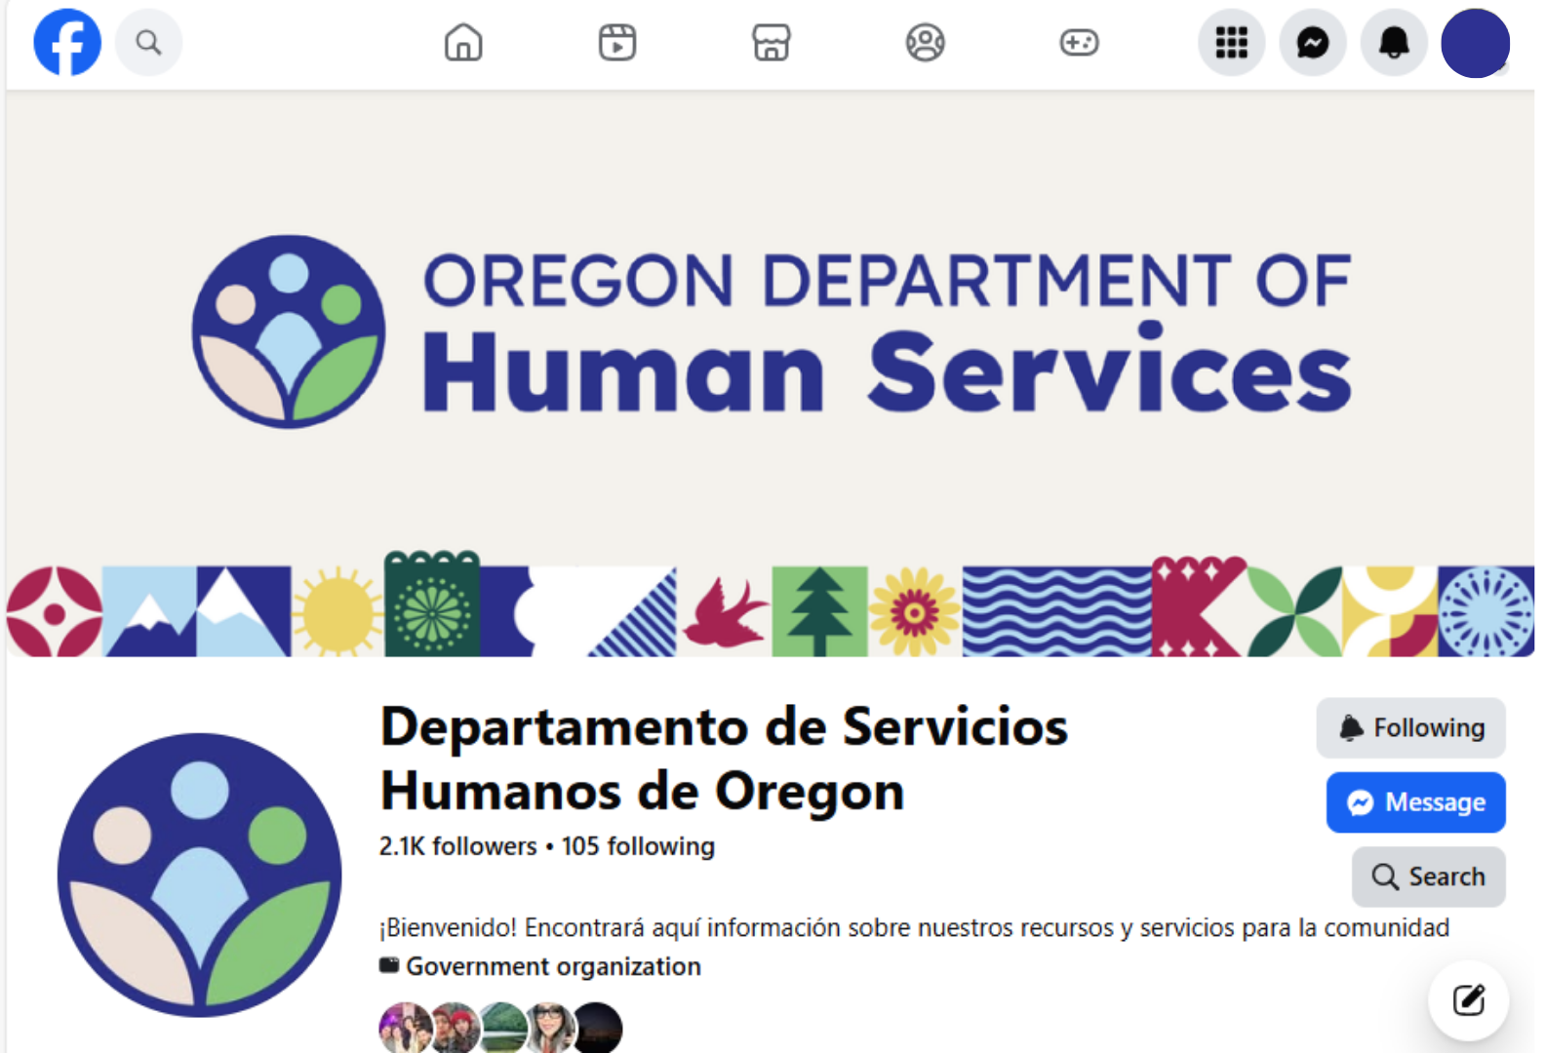
Spanish Facebook Live events
Monthly informative events for Spanish speakers in Oregon
Collaboration with community partners and other agencies
Opportunity for meaningful engagement and trust building
No registration needed
https://www.facebook.com/ODHSespanol
Notes:
Dedicated social media for Spanish speaking community in Oregon
Topics and collaborators for Live events vary by month based on current events impacting services/community or monthly specific celebrations/notable dates
Space for live questions from audience
On March 26, ODHS in collaboration with Oregon Employment Department will discuss support for SNAP work rules. No need to register. People interested should visit the FB page.
https://www.facebook.com/ODHSespanol

Slide 40
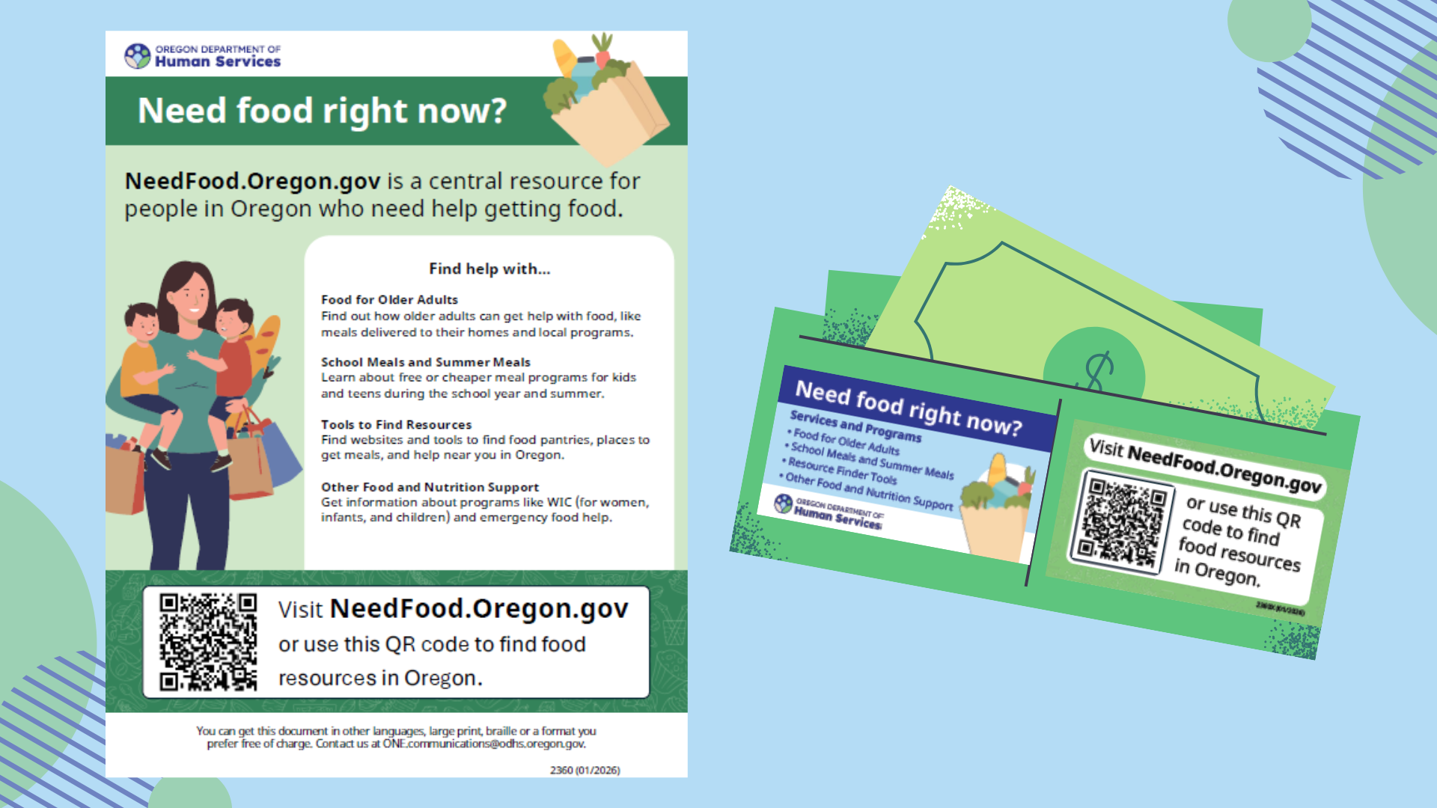
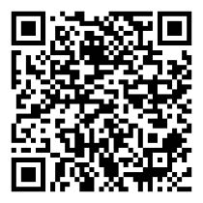
Central resource for finding food: NeedFood.Oregon.gov
QR code to NeedFood.Oregon.gov
Notes:
ODHS this month released new tools to make it easier for people to find food help quickly – even if they are not eligible for SNAP.
Flyers and wallet cards are now available in multiple languages and posted on NeedFood.Oregon.gov to support outreach and referrals. Scroll to the bottom of the page and select Materials to print and share.

Slide 41
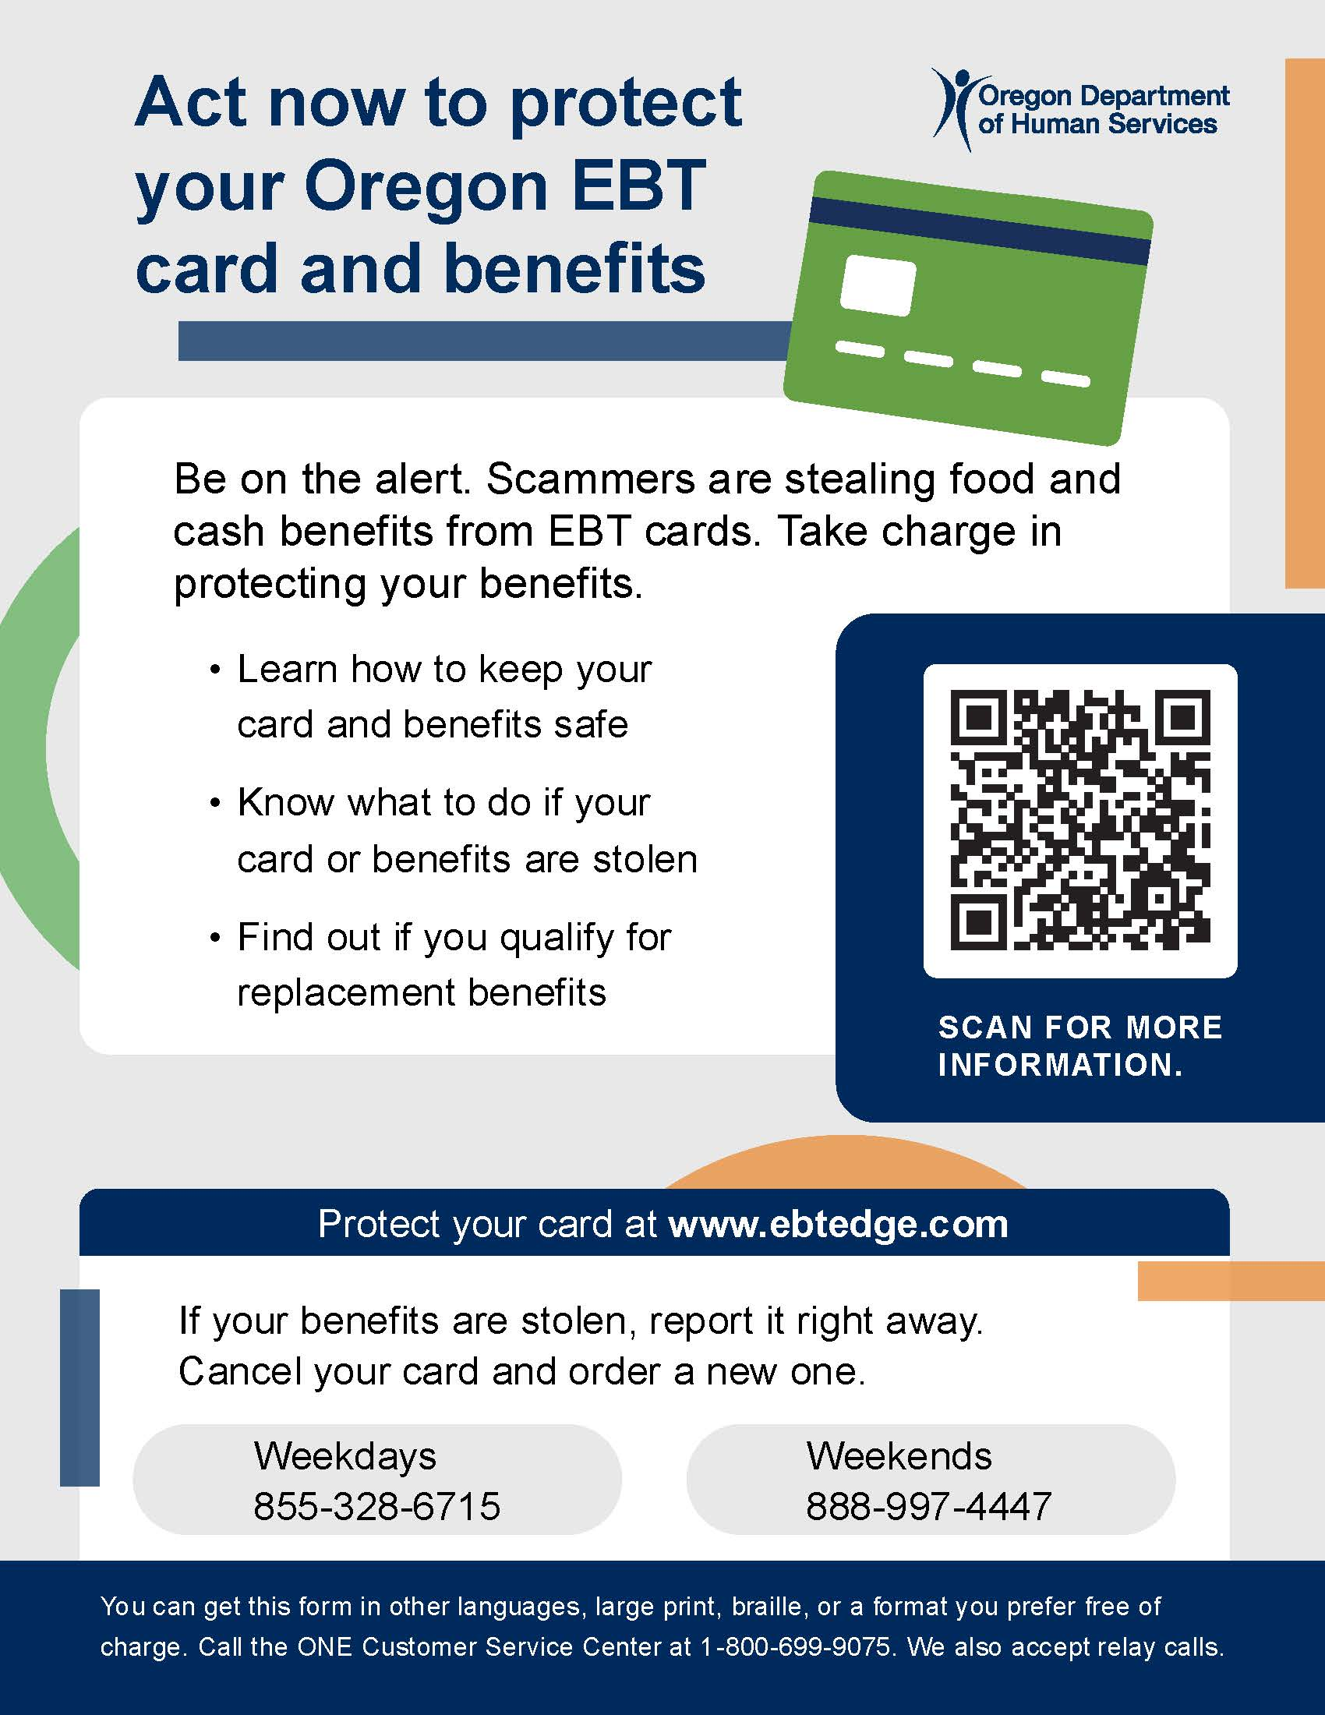
Protecting EBT Cards and Benefits
Electronic theft of benefits is on the rise nationwide.
Stolen SNAP benefits can't be replaced. TANF benefits can be replaced.
Safety tips for cardholders and downloadable resources for partners in many languages at www.oregon.gov/odhs/benefits/pages/protect.aspx
Notes:
Electronic benefit theft is on the rise. Criminals are using methods like skimming devices, internet scams and fake websites to steal card numbers and personal identification numbers (PIN). Once they have this information, they can drain food and cash benefits from a person’s card.
ODHS recommends that everyone with an EBT card take steps to keep their benefits secure. You can find simple tips on our website.
The federal funding to replace benefits ran out on Dec. 21, 2024, and ODHS is no longer authorized to replace stolen SNAP benefits. ODHS can replace Temporary Assistance for Needy Families (TANF) benefits that are lost due to fraud.
Again, information about how to protect EBT cards and benefits is on our website at https://www.oregon.gov/odhs/benefits/pages/protect.aspx. The webpage includes a downloadable wallet card, flyer and brochure in several languages for partners to share in your own communications.

Slide 42

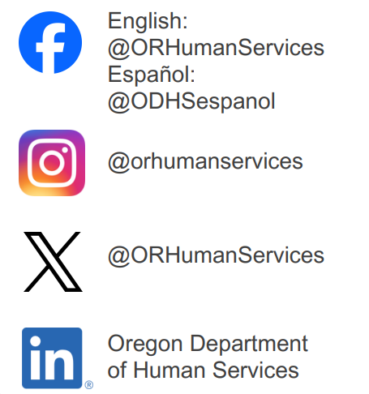



Stay in touch
Sign up for our partner newsletter.
Sign up for news alerts from ODHS.
Visit our federal updates webpage.
Visit our SNAP work rules webpage in English and Spanish.
Email the Community Engagement team.
Follow us on social media.
www.oregon.gov/odhs
Notes:
Partner newsletter: https://public.govdelivery.com/accounts/ORDHS/subscriber/new?topic_id=ORDHS_833
News alerts: https://www.oregon.gov/odhs/news/pages/default.aspx
Email community engagement team: communitypartners@odhsoha.oregon.gov
General Partner Information
Resource: https://www.oregon.gov/odhs/news/Pages/federal-updates.aspx
Help spread clear, accurate information—rules are changing, and people may be confused. Encourage people to follow ODHS communications channels to get the latest news: https://www.oregon.gov/odhs/news/Documents/stay-informed-flyer-en.pdf
Share how people can apply for and manage their benefits without going into an office, including by setting up a ONE Account or using Oregon ONE Mobile.
Create a ONE account instructions in English and Spanish
Encourage families to update contact information with ODHS so they get the right notices.
Connect people to food resources, including needfood.oregon.gov and local food banks.
Connect with local community based and culturally specific organizations in your area. I worry that people who do not understand how to navigate the resources because of language or Tech knowledge

Slide 43
Thank you
www.Oregon.gov/odhs

