Slide 1


Federal Actions Coordination Team (FACT)
April updates
April 2026
Notes:
Welcome, introductions

Slide 2

Table of Contents
SNAP Overview
HR1 SNAP Eligibility Changes
SNAP work and activity rules
Non-Citizen Limitations
SNAP Data Sharing
Sanctuary State
Public Charge
Resources

Slide 3
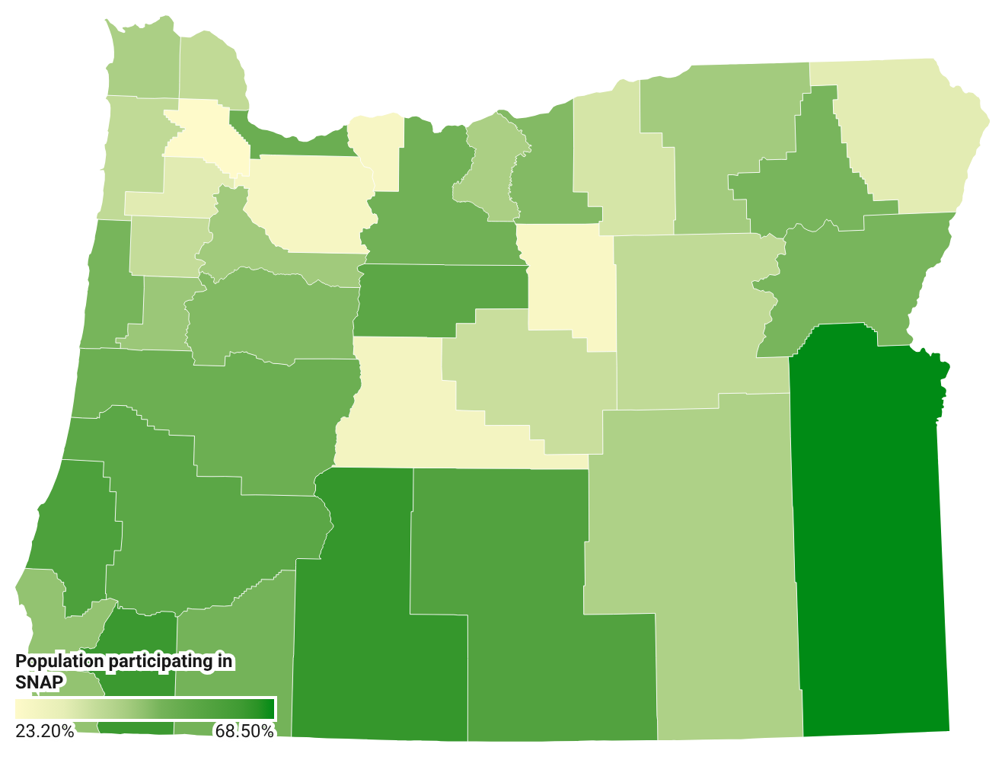
1 in 6 people in Oregon participate in SNAP
Percentage of households receiving SNAP by county
757,000 individuals*
76,343
Age 60+*
47,786
have a disability**
Map graphic based on ODHS caseload from the Office of Reporting, Research, Analytics and Implementation
*Based on ODHS caseload data October 2025
**As defined by Food and Nutrition Services
Notes:
In Oregon, SNAP helps 757,700 people put food on their tables – that’s about 18% of the population or 1 in every 6 people in our state. Many of these are older adults, children and people with disabilities.
SNAP continues to operate normally, and benefits are being issued on schedule.
People receiving SNAP are part of 450,000 households across the state. Many people receiving SNAP benefits are in rural areas of the state.
More than 54% of Oregon SNAP participants are in households with children.
More than 37% are in households with members who are older adults or have disabilities.
35% of participating Oregon households have income at or below 50% of the poverty line
The map shown used data from October 2025 courtesy the ODHS Office of Reporting, Research, Analytics and Implementation (ORRAI)

Slide 4
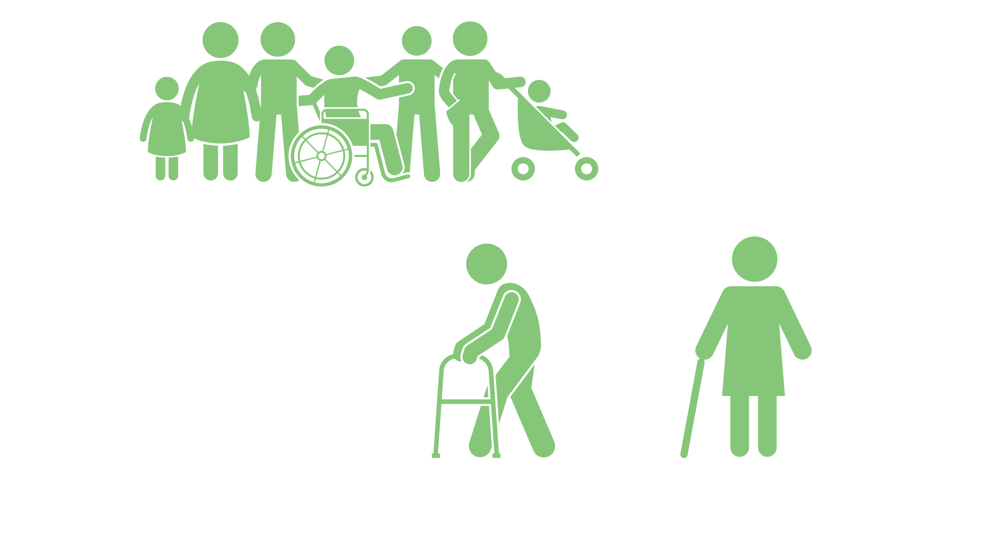
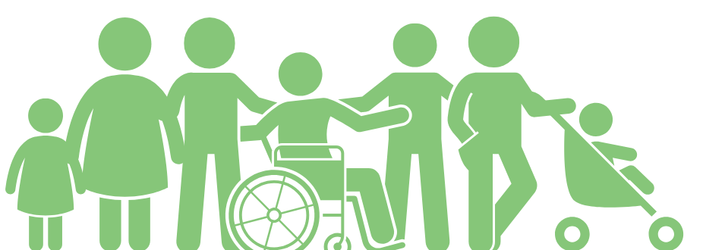
SNAP monthly snapshot
$313
$183
Average benefit per household
Average benefit per person
Source: Oregon Department of Human Services caseload data, March 2025.
Notes:
in Oregon, an average of $183 per month in SNAP is issued out to each individual participant

Slide 5


Sample title
Sample content
New changes coming to SNAP
Notes:
In July 2025, the federal government made major changes to SNAP under H.R.1
Many people have received notices describing changes mandated by the new federal law.

Slide 6


SNAP: Two changes take effect June 1
Provide verification of shelter and utility costs
Renewal interviews resume for households eligible for 24-month SNAP Certification
Notes:
Two SNAP changes that are part of our plan to reduce the Payment Error Rate begin June 1, 2026.
Verification of shelter and utility costs
Starting June 1, people who apply for SNAP or renew their benefits must provide proof of their shelter and utility expenses if that information is not already on file.
This includes costs such as:
Rent or mortgage
Electricity, gas, water or other utilities
Households must also provide updated proof if they move to a new address.
In previous years, many SNAP participants only needed to report these expenses without providing documents.
Benefits will not automatically close if proof is not provided. However, without verification, ODHS will calculate benefits without shelter and utility deductions. This may result in a lower monthly SNAP amount.
Renewal interviews resume for certain older adults and people with disabilities
A temporary federal waiver allowed some SNAP households to skip their renewal interview. That waiver ends May 31, 2026.
Beginning June 1, 2026, renewal interviews will resume for households where:
All adults are age 60 or older, or meet the SNAP definition of disabled, and
No one in the household has earned income
Beginning June 1, 2026, all SNAP households must complete an interview to renew benefits. Many people impacted by this change have not had an interview since their case first opened.
Renewal interviews are a standard part of SNAP and help ensure benefits are issued correctly.
Approximately 187,000 people in Oregon may be impacted.
As we get closer to implementation, we’ll have more information about how you can support SNAP participants. Right now, it’s most important to remind people to:
Make sure we have their current mailing address
Watch for mail, email or notices from ODHS about interviews or verification requests.

Slide 7
Sample title
Sample content
H.R.1 changes
to SNAP eligibility
Notes:
In July 2025, the federal government made major changes to SNAP under H.R.1
Many people have received notices describing changes mandated by the new federal law.

Slide 8
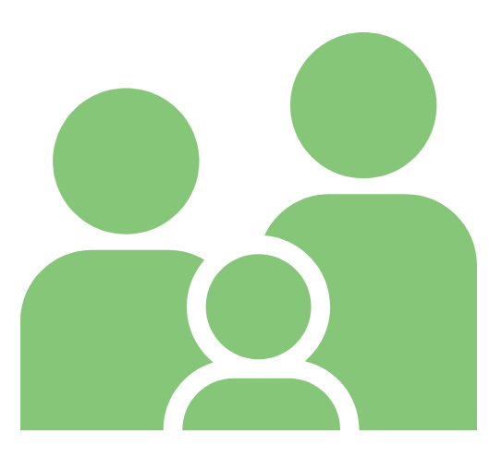
SNAP eligibility changes
Starting July 4, 2025
People may be required to participate in SNAP work or activity rules.
Many lawfully present non-citizens facing no longer eligible for benefits.
People may get less SNAP because of changes in how energy assistance is counted.
Notes:
These changes may reduce benefits for some households, expand their work requirements, or remove them from benefit eligibility.
People may be required to participate in Able-bodied Adults without Dependents (ABAWD) federal work an activity rules.
Lawfully present non-citizens facing reduction or the end of their benefits.
People may have a reduction in SNAP benefits from federal limits on energy assistance-based Standard Utility Allowance.
Some people who receive energy assistance may see a reduction in SNAP. They may have received a deduction for paying utilities that is now federally limited
Partners may see increased confusion, fear or requests for help from community members.

Slide 9

Changes to SNAP Able-bodied Adults without Dependents (ABAWD) Under 14
Work and activity rules will not impact individuals eligible for an exemption such as health issues, students, or caring for individual unable to care for themselves.
Will not apply to individuals receiving long-term services and supports, receiving income due to a disability or health issue.
People ages 55 through 64 who do not have a child under age 14 on their SNAP case must work 80 hours each month to get SNAP for more than three months.
Exemptions for veterans, people experiencing homelessness, and former foster youth have been removed.
There is a new exemption for American Indian/Alaska Native individuals who qualify under rules in the Indian Health Care Improvement Act.
Notes:
In June 2025, 310,626 Oregonians were aged 18-65 without a child under age 14 in their SNAP group. We do not know how many will meet an exemption or ABAWD work requirements. We estimate that AT LEAST 90,888 individuals will be at risk of losing their SNAP benefits if they do not meet ABAWD Work Requirements.
ODHS will screen each person to see if they are:
Already meeting work and activity rules
Are exempt from work and activity rules
Need to create a plan to meet work and activity rules. In these situations, ODHS will refer them to the Oregon Employment Department to create a plan and access supports.

Slide 10


SNAP time limit
If a SNAP participant with ABAWD status* does not meet the work or activity rules for three months in a three-year period, they reach their time limit.
After that, they cannot receive benefits for the rest of the three-year period. The current three-year period ends Dec. 31, 2027.
People can restart SNAP during the three-year period if they start meeting the work or activity rules or become exempt.
*Unless the person has an exemption
Notes:
If a SNAP participant with an ABAWD status (unless they have an exemption) does not meet their work requirements for three months, they will reach the three-year time limit for SNAP.
When that happens, they cannot get SNAP benefits for the rest of that three-year period.
The current three-year period is Jan. 1, 2025, through Dec. 31, 2027.
Each month a counting month is added to a case, the individual will receive a notice informing them:
Which counting month they have received
information on how to meet the work requirements
Ways to meet an exemption
How to contact ODHS
SNAP Time Limit: A SNAP participant with an ABAWD status can receive up to 3 months of SNAP during each 3‑year period unless they meet the ABAWD work rules or have an exemption. • Current 3‑Year Period: The current federal 3‑year period is Jan. 1, 2025 – Dec. 31, 2027. • Counting Months: Each month a SNAP participant with an ABAWD status does not meet the ABAWD work rules (and does not have an exemption), they receive a counting month. • Reaching the Time Limit: After three counting months in the 3‑year period, the SNAP participant with an ABAWD status reaches the SNAP time limit and becomes not eligible for SNAP for the remainder of that period unless they regain eligibility. • Regaining Eligibility: A SNAP participant with an ABAWD status can become eligible again if they reapply and complete 80 hours of work or qualifying work activities within 30 days. This is called regaining eligibility.

Slide 11

Oregon SNAP work or activity rules: 2026 Timeline
People who do not meet new work rules in the initial six counties could see their benefits end as early as January
Benton, Clackamas, Hood River, Multnomah, Washington and Yamhill Counties
January 2026
Discretionary exemptions for people living in seven counties begin because their county doesn’t have a WorkSource center:
Crook, Gilliam, Jefferson, Lake, Morrow, Sherman, Wheeler
Feb. 1, 2026
First month of benefit closures for people who do not meet work and activity rules in the remaining counties
April 2026
Notes:
In January we started to see an Impact to SNAP recipients
In the initial six counties, Benton, Clackamas, Hood River, Multnomah, Washington and Yamhill people who didn’t meet the new ABAWD work rules may have had their benefits end at the end of the month. Then each month after that a new group of individuals will lose benefits due to reaching their third countable month.
As of Feb. 1, 2026, discretionary exemption begins
For people who live in the following counties are exempt because their county doesn't have a WorkSource Center:
Crook, Gilliam, Jefferson, Lake, Morrow, Sherman, Wheeler
April 2026
Those impacted by the HR1 changes and the expanded counties, continue to lose benefits. Over 20,000 individuals lost benefits for the month of April.

Slide 12
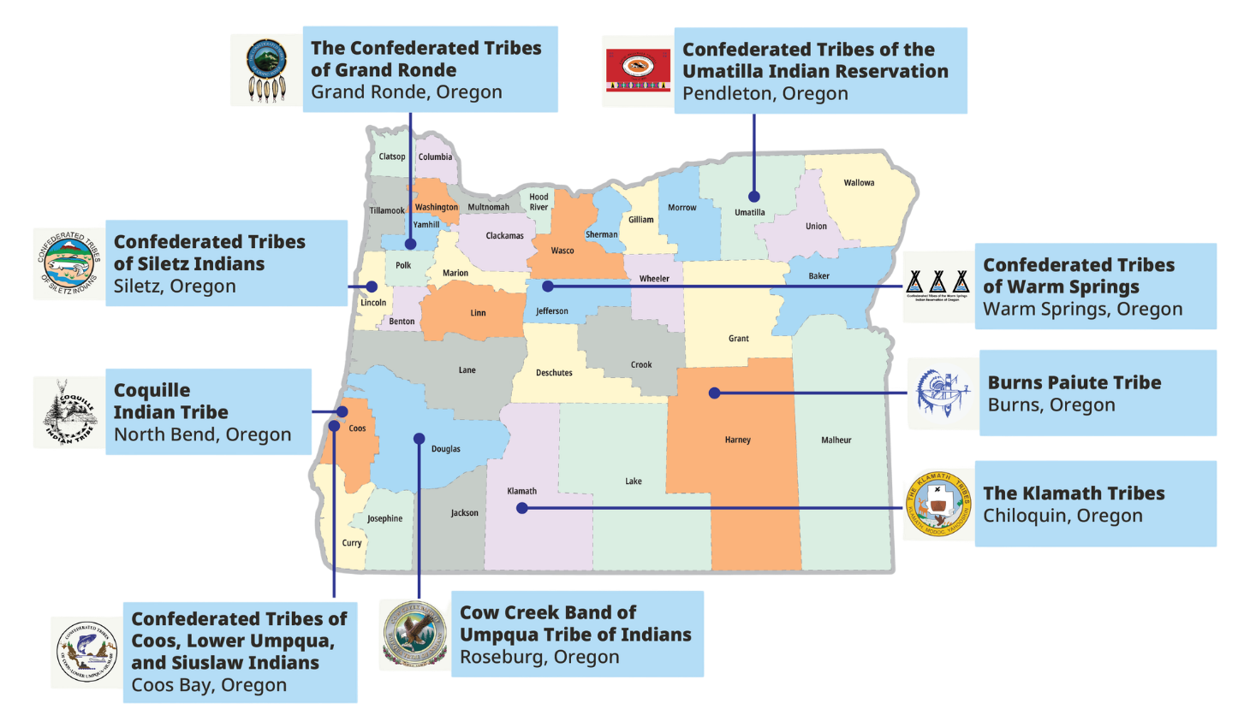

Five Tribal lands are waived from SNAP work or activity rules due to high unemployment rates
Notes:
Only five tribal lands are exempt due to high unemployment rates:
Burns Paiute Tribe Reservation and off-Reservation Trust Land
Coquille Indian Tribe Reservation and off-Reservation Trust Land
Cow Creek Band of Umpqua Tribe of Indians Reservation
Klamath Tribes Reservation
Confederated Tribes of Siletz Indians Reservation and off-Reservation Trust Land

Slide 13
Meeting work and activity rules
80 hours of
work activities required
per month.
Requirement can be met by one or a combination of activities:
Working
Volunteering
Bartering
Participating in an ABAWD case plan developed by Oregon Employment Department (OED)
Some may already be meeting the work or activity rules and only need to provide proof.
Notes:
80 hours of work activities per month averages to about 20 hours per week.
See the webpage for full details:
https://www.oregon.gov/odhs/food/Pages/snap-time-limits.aspx

Slide 14




People who may not need to follow SNAP work or activity rules if they:
Meet criteria for allowable exemptions like health issues, attend school half-time or caring for a person with a disability. Must inform ODHS when they apply, reapply or experience a change.
Live in a Tribal Land waiving ABAWD work rules due to high unemployment.
Live in a county using discretionary exceptions.
Notes:
There are people who do not have to follow ABAWD work and activity rules. Groups include:
People who have problems or hardships that make working hard
People who do other things that count the same as work
People who live in an area where ABAWD rules do not apply
People who are given an extra excuse from the ABAWD rules
Examples of barriers to work:
Health problems
Physical, behavioral, or mental health (temporary or permanent)
Pregnancy
Receiving money due to a disability
Attending an alcohol or drug treatment program
Inpatient or outpatient Note: May qualify as health issue.
Caring for a person with a disability
Note: Not required to reside together.
Attending school at least half-time
High school and/or GED programs
Higher Education (community college, university, graduate programs etc)
Trade/vocational programs
Training programs
Participating in a training plan with a federal refugee resettlement program
Immigrant and Refugee Community Organization (IRCO),
Corvallis for Refugees etc
Examples of equivalent work activities
Unemployment benefits (UC) – Verbal Attestation
Applied for unemployment and has not been denied
Receiving unemployment benefits.
Temporary Assistance for Needy Families – (ONE system verified)
Participates in the TANF Jobs program
Working for pay (Proof of hours is required)
At least 30 hours a week.
Earning at least $935.25 a month.
Earning at least $935.25 from self-employment and have no business costs
Earning at least $1,870.50 and has business costs.
Discretionary exemption
Current Discretionary Exemptions in Oregon:
Foster care parents who do not include foster children in SNAP case. Verbal attestation.
SNAP eligible non-citizens not authorized to work. Verbal attestation

Slide 15



Contact ODHS to see if SNAP work or activity rules apply to you.
Call the ABAWD team:
1-833-947-1694
Email:
SNAP.ABAWDTeam@odhsoha.oregon.gov
ODHS may connect people to:
Oregon Employment Department
Notes:
Take action: Contact ODHS
If someone gets a notice — or thinks — they may need to follow new work and activity rules to keep SNAP benefits, they should contact ODHS as soon as possible.
We know these notices can feel stressful or confusing.
ODHS will check to see if customers already meets the work and activity rules, including giving credit for any verified work activities they’ve completed.
ODHS will look for any exemptions that might mean the customer does not have to meet work and activity rules.
OED may also offer training, job search help, education programs, or other services to help the person get and keep a job.
If needed, ODHS will connect customers with the Oregon Employment Department so they can make a plan to meet the work requirements.

Slide 16

What happens when ODHS reviews an ABAWD case
ODHS reviews each person’s situation
Checks if they are already meeting work or activity rules
Checks for exemptions or good cause
If support is needed:
ODHS connects the person to WorkSource.

Slide 17

Support available through WorkSource Oregon
At WorkSource, people can get free help to meet SNAP work or activity rules:
Meet with an Employment Specialist
Create a plan based on skills and goals
Get help finding a job or training
Services may include:
Job search support
Training and education programs
Help with resumes and interviews
Support like transportation or work supplies
Notes:
These work rules also open the door to more support.
After ODHS reviews someone’s information, the specialized ODHS ABAWD team may refer individuals who needs an ABAWD case plan to the Oregon Employment Department (OED).
Those referred receive an appointment at their local OED office and meet with an assigned Employment Specialist, also called an ABAWD Coach or SNAP Coach.
These coaches offer individualized support to develop an ABAWD case plan. The Case Plan is based on the person’s skills, interests, and required monthly work activities. They are going to review employment history, job search strategies, resumes, professional development opportunities, and how comfortable that person is with technology.
We often see ABAWD case plans include resume workshops, mock interviews, learning to navigate online job boards, and support with job applications. There are also educational activities that can count towards the monthly hour requirement like attending a class at the local community college, taking online trainings to obtain certifications, or researching local career options that align with the person’s current skills.
Other activities could include support in finding and participating in a justice involved record expungement clinic, or even some work readiness skills such as working with the OED ABAWD coach to discuss workplace conflict resolution skills, workplace time management or organization techniques, and much more.

Slide 18
What to expect at WorkSource
At the first appointment
During ongoing support
To stay eligible for SNAP
Review SNAP work or activity rules and any exemptions
Talk about skills, interests and goals
Create a plan for work or training
Meet regularly with an Employment Specialist or coach
Get help finding a job or training program
Get help with resumes, applications and interviews
Complete monthly work or activity hours
Report progress and hours worked
Get help staying on track

Slide 19



What this means for people
Work or activity rules are not just rules, they come with support
Many people may already be meeting requirements
Others can get help to meet them
Notes:
• Contact ODHS as soon as possible • Acting early helps avoid losing benefits

Slide 20

If ABAWD work rules are not met
Some adults can only receive SNAP for 3 countable months in 3 years
A countable month means an adult got a full month of SNAP but did not meet SNAP work or activity rules during that month
ODHS sends notices midmonth every time a countable month is issued.
Act early to keep your SNAP benefits
Notes:
If a person's SNAP benefits closed because work requirements were not met, they may still be able to get them back.
Advise the person to reapply and, if they choose to participate, complete 80 hours of work or approved activities within 30 days.
We understand that life circumstances can make this difficult. If more time is needed, or the person thinks they may qualify for an exemption, please let ODHS know. Staff are there to talk through situations and help people understand their options.

Slide 21
SNAP work or activity rules: timeline
When someone is identified as having an ABAWD status
Countable (CT) Month 1
Countable (CT) Month 2
Countable (CT) Month 3
A notice is sent explaining SNP work or activity rules and rights and Responsibilities.
First countable month is used
15th of the month: CT1 notice sent
Second countable month is used
15th of the month: CT2 notice sent
Third countable month is used
15th of the month:
CT3 notice sent, and a separate closure or reduction notice is sent
The three countable months may not happen consecutively
Notes:
Notices include:
That a counting month was used (when sent?)
Ways they can meet the work requirement
Possible exemptions

Slide 22

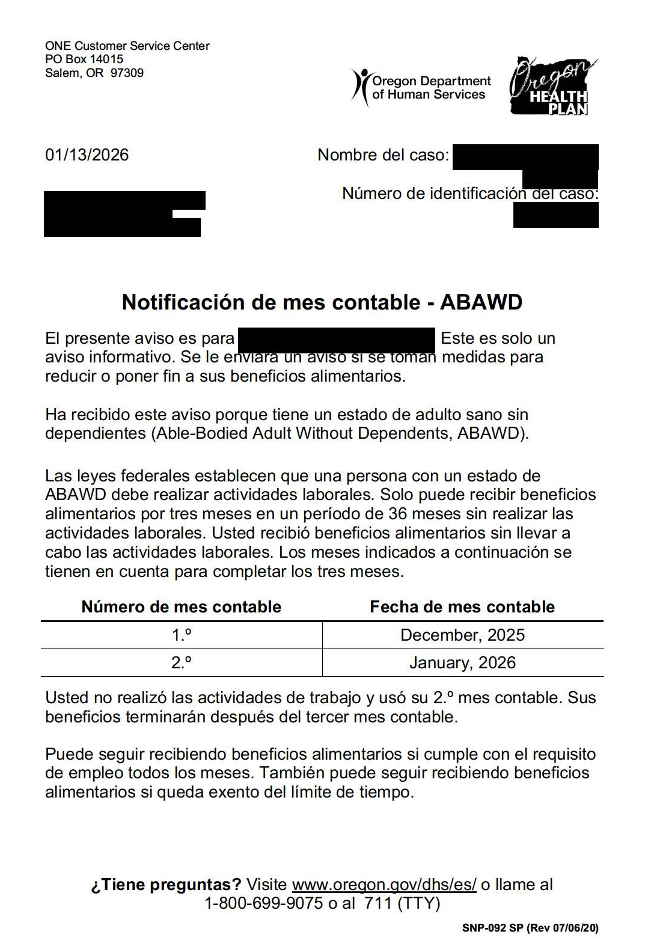
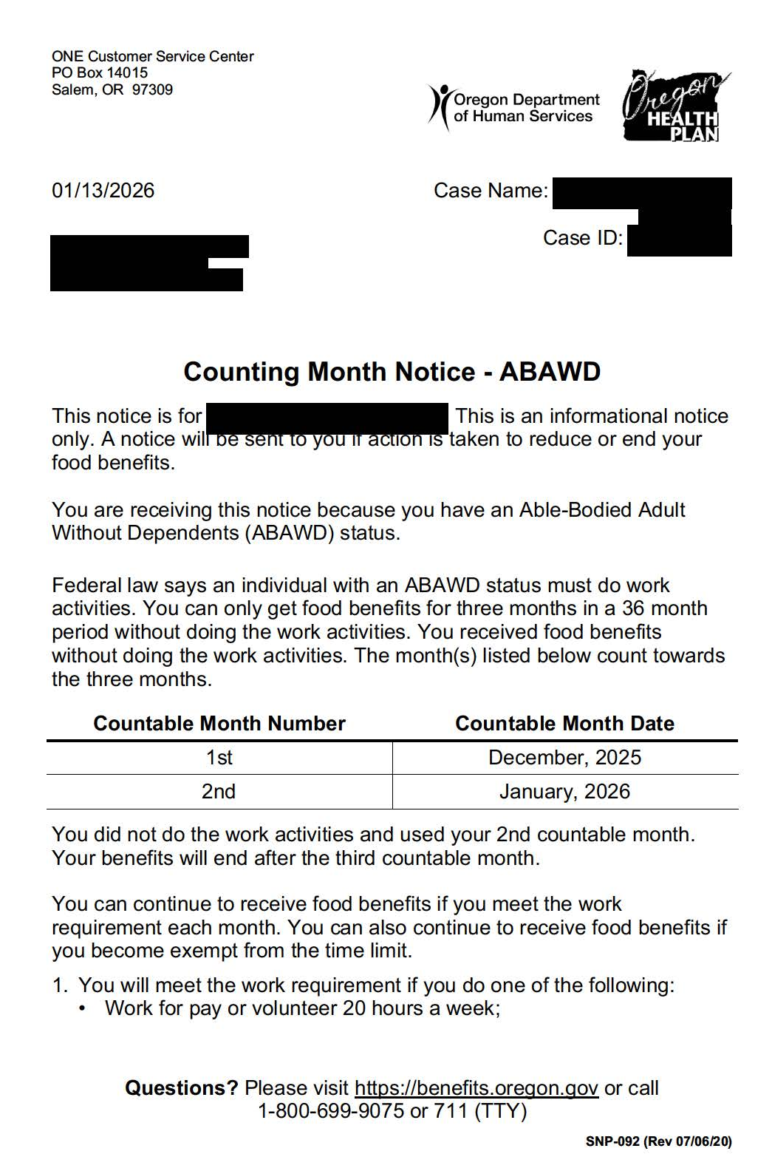
Example notices
Important: Notices are sent to the head of household on the SNAP case, even if another household member is the person required to meet work or activity rules.

Slide 23
Getting SNAP benefits back (Regain)
Even if someone’s benefits have stopped, it doesn’t mean they’re permanently ineligible. There are a few ways to regain SNAP benefits, and ODHS staff can help you understand those options
Ways to regain eligibility:
Meet work or activity rules (80 hours in 30 days)
Qualify for an exemption
Live in a Tribal Land or County currently not applying SNAP work or activity rules

Slide 24
How to resume benefits
If SNAP benefits were reduced ask to be added back to the case, if they were closed, you must reapply to resume benefits.
If benefits were reduced:
• Contact ODHS and request to be readded to the case. • You will need to regain before benefits begin
If benefits were stopped and case closed: • Reapply for SNAP • You will need to regain
• Benefits may restart from date you reapplied
Notes:
Remember
Benefits do not restart automatically
Acting quickly helps avoid gaps in benefits
ODHS can review your situation and explain your options
WorkSource Oregon can help with job search, training and support services

Slide 25

Non-citizen SNAP eligibility
HR1 limited SNAP eligibility to only a few lawfully present immigrant groups in addition to US Citizens
July 4, 2025
Oct. 1, 2025
October 2025
Dec. 10, 2025
December-January
Federal law changes SNAP eligibility for some lawfully present immigrants.
Original guidance said many lawfully present humanitarian immigrants were not eligible for SNAP.
USDA issued new guidance saying that some humanitarian entrants who now have Lawful Permanent Resident (LPR) status can qualify for SNAP.
Oregon applies original federal guidance.
ODHS identified who qualifies, how benefits are restored, and how to apply guidance to new applicants.
Notes:
When HR1 was signed in July 2025, federal guidance made changes to SNAP eligibility for some lawfully present immigrant groups.
Oregon implemented the original guidance in October 2025.
It is important to note that this original FNS guidance released, excluding many lawfully present humanitarian entrant immigrants from SNAP
On Dec. 10, 2025, the USDA issued new information that clarifies who can get SNAP under current federal law. Several groups who became ineligible when HR1 passed in July 2025 can qualify for SNAP if they have or obtain a Lawful Permanent Resident (LPR) status.
In December and January, Oregon identified who will qualify for their benefits to be restored, how they were restored and how to apply the recent guidance to applicants. ODHS estimates a small number of people will qualify for retroactive or new SNAP benefits under the revised guidance.

Slide 26

Non-citizens eligible for SNAP
Eligible immediately, without a five-year waiting period, if they meet all other SNAP financial and
non-financial eligibility requirements.
Non-citizen U.S. nationals
Cuban and Haitian Entrants (CHE)
Compact Of Free Association (COFA) Citizens
Lawful Permanent Residents (LPRs) who meet certain criteria
Source: USDA FNS at https://www.fns.usda.gov/snap/obbb-alien-eligibility
Notes:
Now, SNAP is limited to the following groups:
U.S. citizens
U.S. nationals
Lawful permanent residents (LPRs)
Cuban and Haitian entrants¹
Citizens of Compact of Free Association (COFA) nations

Slide 27

Criteria for Lawful Permanent Residents
Lawful Permanent Residents (LPR)
also known as Green Card holders.
Eligible for SNAP after a five-year waiting period if they meet all other SNAP financial and non-financial eligibility requirements.
They are not required to meet 5 year rule if…
Notes:
Prior to the change, certain lawfully present immigrants, as defined by the Personal Responsibility and Work Opportunity Act (PRWORA) were eligible to receive SNAP benefits, provided they met all other SNAP eligibility requirements and completed a 5-year waiting period, unless exempted by PRWORA.
Today, some immigrant groups previously eligible for SNAP are no longer eligible. They continue to be subject to a 5-year waiting period, unless exempted by PRWORA.

Slide 28

LPRs may be immediately eligible for SNAP if they previously held one of the statuses below:
Refugees
People granted asylum
People with deportation withheld
Iraqi & Afghan Special Immigrant Visa (SIV) holders
Certain Afghan parolees (July 31, 2021–Sept. 30, 2023)
Certain Ukrainian parolees (Feb. 24. 2022–Sept. 30, 2024)
Victims of severe trafficking
Important to remember: These statuses alone do not make someone SNAP-eligible — they remove the 5-year wait after the person becomes a lawful permanent resident.
Notes:
Exempt from the 5-Year Waiting Period (once they become Green Card holders)
Refugees
People granted asylum
People with deportation withheld
Iraqi & Afghan Special Immigrant Visa (SIV) holders
Certain Afghan parolees (7/31/2021–9/30/2023)
Certain Ukrainian parolees (2/24/2022–9/30/2024)
Victims of severe trafficking
Important: These statuses alone do not make someone SNAP-eligible — they remove the 5-year wait after the person becomes a lawful permanent resident.
Folks need to meet one of these conditions.
https://www.oregon.gov/odhs/food/Pages/snap.aspx#noncitizens
https://www.oregon.gov/odhs/transmittals/oeptransmittals/pt25043.pdf

Slide 29

LPRs may also be eligible if
They meet one or more of the following conditions:
Are under 18 years old
Have 40 qualifying work quarters
Are blind or disabled
Lawfully resided in the U.S. & 65 or older on Aug. 22, 1996
Have a U.S. military connection
Are admitted to the United States as an Amerasian immigrant
Are an American Indian born abroad
Certain Hmong or Highland Laotian tribal members
Notes:
Some lawful permanent residents are exempt from the 5-year waiting period.
They must still meet income and other SNAP rules.
Are under 18 years old
Have 40 qualifying work quarters
Are blind or disabled
Were lawfully residing in the U.S. and 65 or older on August 22, 1996
Have a U.S. military connection
Are admitted to the United States as an Amerasian immigrant
Are an American Indian born abroad
Certain Hmong or Highland Laotian tribal members
https://www.oregon.gov/odhs/food/Pages/snap.aspx#noncitizens
https://www.oregon.gov/odhs/transmittals/oeptransmittals/pt25043.pdf

Slide 30
Medicaid work or activity rules
Beginning
January 2027
People ages 19-64 in “adult expansion group” and some YSHCN
Renewal will generally happen every six months​
When some adults apply or renew, they will need to show:​
​
An exemption, or​
Qualifying activity (one or in combination)​
Work​
Volunteer activities​
Education or training​
For more, visit OHAs webpage https://www.oregon.gov/oha/HSD/OHP/Pages/Federal-Changes.aspx
Notes:
Beginning with January 2027 renewals, adults ages 19-64 who are eligible for Medicaid will need to comply with federal requirements through work or another qualifying activity, or some combination. ​
Some Young Adults with Special Health Care Needs will also be subject to work requirements.​
The rules will not apply to people who qualify for OHP programs that are based on disability, parent, or caretaker status or to people who have both Medicare and OHP. ​
For people who are subject to these requirements, there are exemptions. CMS will release more information about those exemptions in June this year.
​
​
Notes on timing: ​
This will first apply to new applications on Jan 1 2027, checking that the applicant met the requirement in December 2026.​
This will first apply to renewals sent in January 2027 that need a response by March 2027.​
Members in the expansion group (and MAGI Healthier Oregon, and YSHCN) will receive a notice in October 2026, informing them that at their next renewal they will need to show an exception or meet the requirements.​
​
Get more information from the Oregon Health Authority on its webpage at https://www.oregon.gov/oha/HSD/OHP/Pages/Federal-Changes.aspx

Slide 31

USDA SNAP data request
USDA asked states to share detailed personal information about people who have received SNAP food benefits
Notes:
In 2025, the U.S. Department of Agriculture (USDA) asked states to share more detailed personal information about people who received SNAP food benefits
Oregon is challenging this request to protect people’s privacy. A court order is currently in place that blocks the data from being shared while the case continues.

Slide 32

Timeline: USDA demands data
Oregon has not yet shared SNAP data with USDA from this order.
July 28, 2025
Oct. 15, 2025
Nov. 24, 2025
December 2025
January 2026
Oregon Department of Justice (DOJ) joined 22 other states in a lawsuit against USDA.
U.S. District Court issues temporary order stopping USDA from cutting SNAP funding while the lawsuit continues.
This order is not final.
USDA sent another letter to states repeating the data demand. Response deadline Dec. 8, 2025.
Oregon and other states objected to USDA’s latest data request and raised ongoing concerns.
States file new motion to enforce temporary order. Motion pending.
Notes:
In May 2025, the U.S. Department of Agriculture (USDA) told all states to give the federal government five years of personal information about every person who received SNAP since Jan. 1, 2020.
This included Social Security numbers and home addresses.
Oregon has not shared any SNAP data with USDA from this order.
On July 28, 2025, the Oregon Department of Justice (DOJ) joined 22 other states in a lawsuit against USDA.
The lawsuit says USDA’s request breaks privacy laws and asks for more information than it is allowed to have. SNAP already has strong checks in place, and states have never had to give this kind of personal data to USDA before.
USDA also said it might cut funding from states that did not follow the order. This put Oregon and other states in a difficult position: share people’s private information and break the law or protect people’s data and risk losing SNAP funding.
On Oct. 15, 2025, a U.S. District Court gave a temporary order that stopped USDA from cutting SNAP funding while the lawsuit continues. This order is not final.
On Nov. 24, 2025, USDA sent another letter repeating the demand for data. States had until December 8 to agree or to send a letter saying they did not agree.
On Dec. 8, 2025, Oregon and the other states in the lawsuit sent a letter saying they did not agree.
USDA responded Dec. 23, 2025, with new details about data elements and data sharing protocol and the expectation that states comply by early January.
January 2026: Oregon and other plaintiff states notified USDA of its remaining concerns with the data demand and filed a motion to enforce the U.S. District Court’s previously issued temporary order.
This motion is pending with the court.

Slide 33

ODHS does share SNAP data with the federal government required for program administration
Small samples from people getting SNAP.
Information that does not personally identify someone. Like age, gender, household size, income and the amount of benefits a household gets.
The federal government has not collected or stored all applicants’ personal information.
Notes:
Historically, the federal government checked SNAP data by looking at small samples from people who were getting SNAP.
Information that does not personally identify someone. Like age, gender, household size, income and the amount of benefits a household gets.
The federal government did not collect or store all applicants’ personal information. Federal law states that SNAP data can only be used for running the SNAP program, with limited exceptions.
(If needed, when data is provided for studies, it is required to be de-identified)

Slide 34
Sample title
Sample content
Oregon is a Sanctuary State
Notes:
We follow Oregon’s Sanctuary Laws
Our staff does not help with immigration activities
Immigration officers can’t request customer information or enter areas closed to the public unless they have a signed court order, subpoena or warrant.
When legal papers are presented, we make sure they are real and valid.
People can also connect with us by phone or online. Visit benefits.oregon.gov to learn all the ways you can connect with us about medical, food, cash and child care benefits.

Slide 35
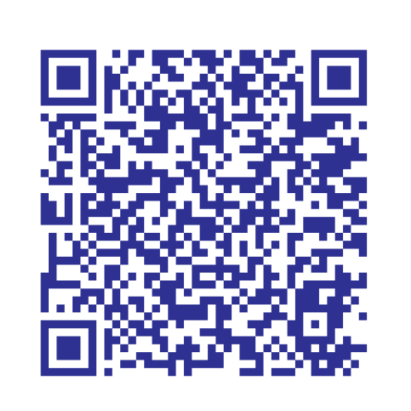
Oregon Department of Justice Community Toolkit
Scan the QR code for the DOJ toolkit
“Everyone in Oregon can live, work, play, go to school, report a crime to police, go to court and access government services without fear that a state or local government employee will report you to ICE.”
https://www.doj.state.or.us/oregon-department-of-justice/civil-rights/sanctuary-promise/community-toolkit/
Notes:
The Civil Rights Unit at the Oregon Department of Justice has a free, online community resource for anyone seeking to understand Oregon’s sanctuary laws and help make sure our communities are safe for everyone. This toolkit covers the essential information needed to understand, report and combat violations of Oregon’s Sanctuary Promise Laws.
Scan the QR code or visit their webpage for more information
https://www.doj.state.or.us/oregon-department-of-justice/civil-rights/sanctuary-promise/community-toolkit/

Slide 36
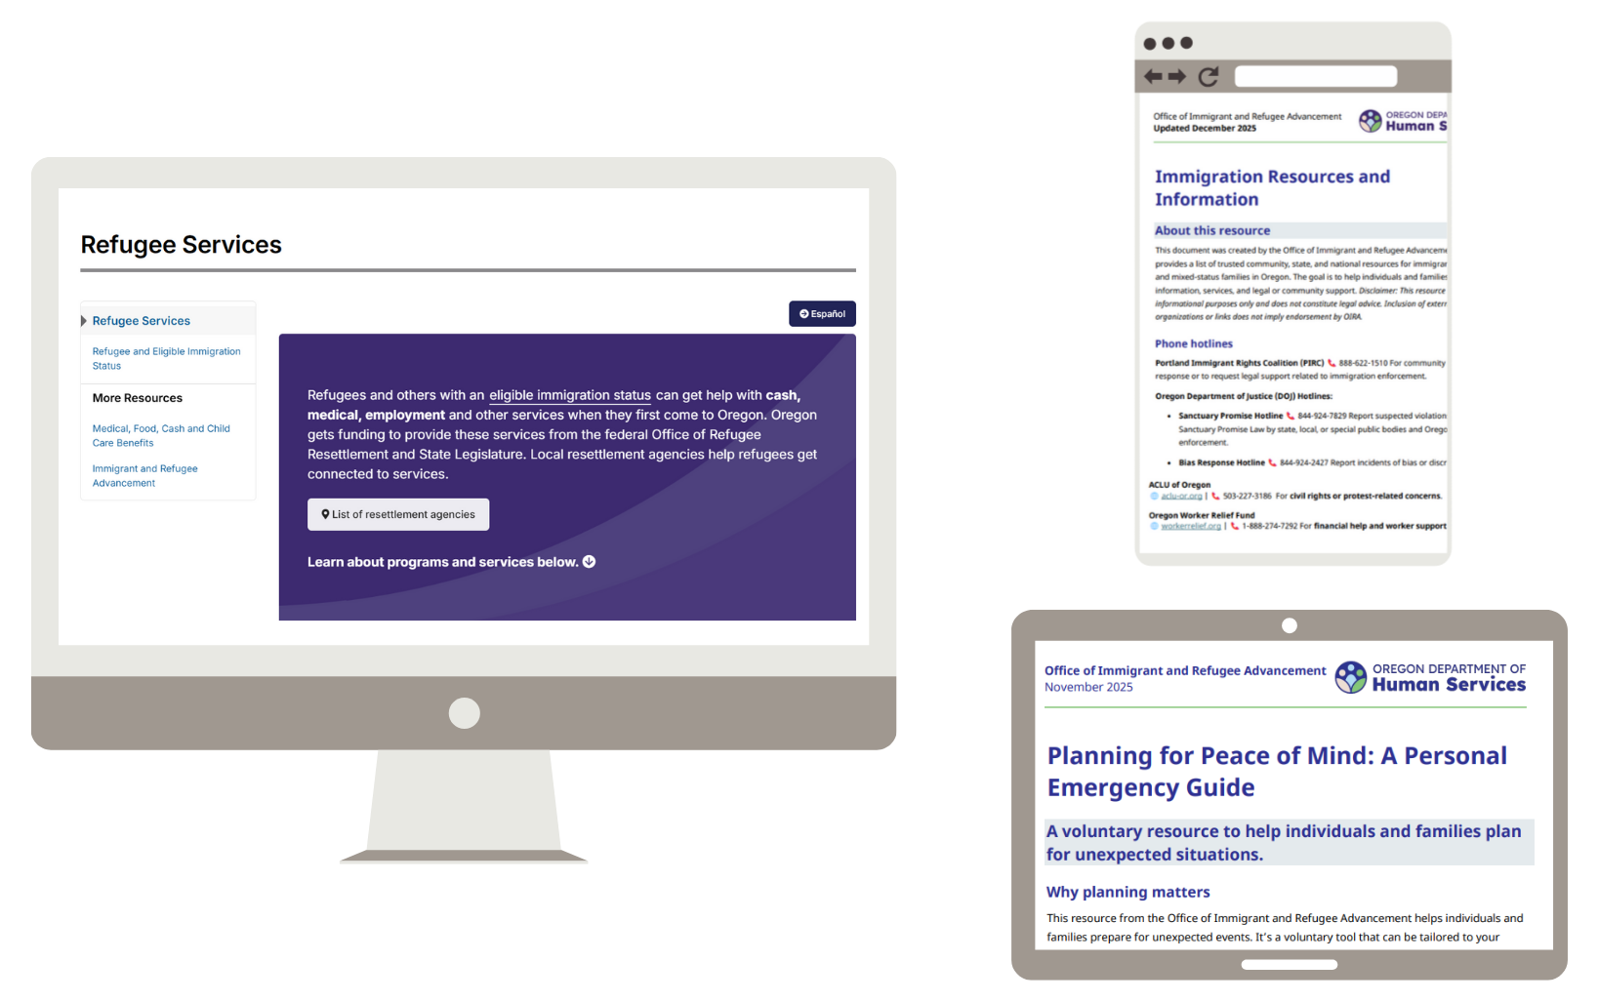
Office of Immigrant and Refugee Advancement online resources
Refugee Services
Immigration Resources & Info
Emergency Planning
Legal directory
https://www.oregon.gov/odhs/about/pages/oira.aspx
Notes:
The Office of Immigrant and Refugee Advancement (OIRA) serves as the bridge between ODHS, OHA, and other state agencies.
Coordinating policy, research, and communication to ensure immigrant and refugee communities are centered in Oregon’s systems.
OIRA has trusted community, state, and national resources listed on their webpage for immigrants, refugees, and mixed-status families in Oregon.
These tools are available online – visit https://www.oregon.gov/odhs/about/pages/oira.aspx

Slide 37
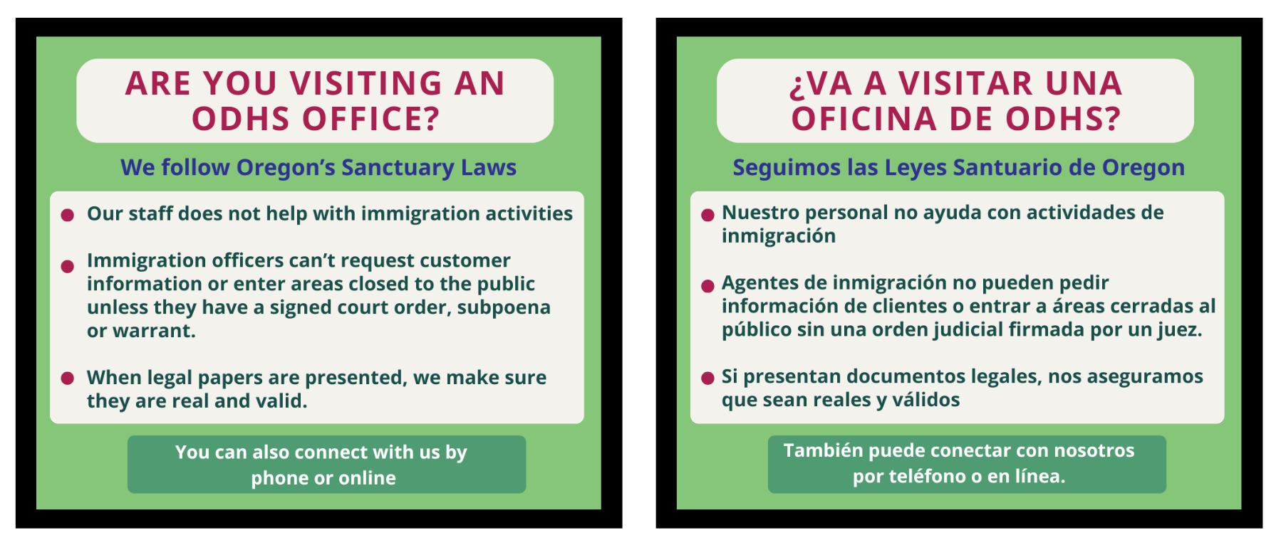
ODHS message to community about Oregon’s Sanctuary Law
Notes:
In February, ODHS shared a message with our Spanish Facebook followers about Oregon’s Sanctuary Law.
National events and local immigration enforcement activity are creating fear and uncertainty in our communities. During these challenging times ODHS remains committed to our Equity North Star and to follow Oregon’s Sanctuary Law at our offices for the people we serve and our staff.
Under Oregon’s Sanctuary Law, ODHS staff are not allowed to help with immigration enforcement, and immigration enforcement officers can’t request customer information and are not allowed to enter areas closed to the public unless they have a signed judicial order, subpoena, or warrant.
Any legal documents presented to staff will be reviewed to confirm they are valid.
It is also important to know that while our staff cannot assist with immigration enforcement without a judicial order, they also cannot intervene in interactions involving federal immigration officers.

Slide 38
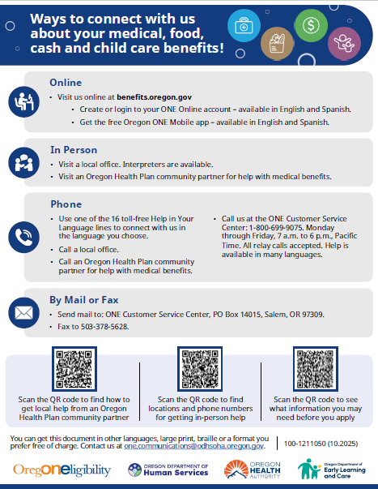
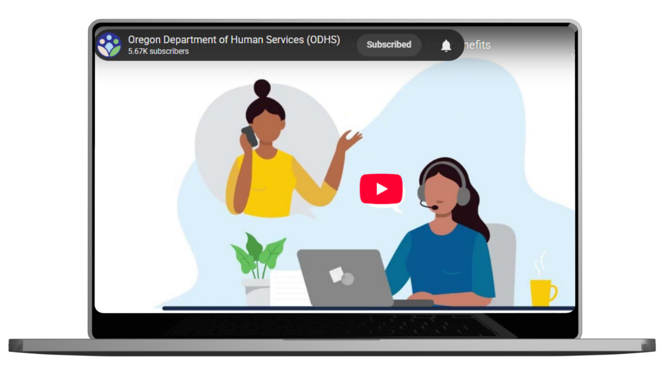
How to connect with ODHS
People can connect with ODHS in the way that feels best for them including:
Online
By phone 1-800-699-9075
By mail or fax
Help is available in multiple languages, and in video format.
Notes:
Please share how people can connect with ODHS. Especially if someone prefers to not visit an office in person.
Options include calling a local office by phone, apply for and manage benefits through a ONE Online account, or call the ONE Customer Service at 800-699-9075 for support and information about services and benefits.
Help is available in multiple languages. https://www.oregon.gov/odhs/benefits/Pages/languages.aspx
Visit benefits.oregon.gov to learn more.
We’re now introducing a new short video, also available in English and Spanish, to help people find and use the support that works best for them.

Slide 39

Public charge
When people adjust their status to Lawful Permanent Resident (LPR) or seeking to enter the U.S. from outside the country, immigration officials may look at whether they will mostly depend on the government for support in the future. This is called the “public charge rule."
This rule does not apply to everyone. Some people are exempt under federal law.
Notes:
When people are applying for Lawful Permanent Resident (LPR) status (also called a green card) or seeking to enter the U.S. from outside the country, immigration officials may look at whether they will mostly depend on the government for support in the future. This is called the “public charge rule."
This rule does not apply to everyone. Some people are exempt under federal law.

Slide 40

Public charge rule has not yet changed
Federal government proposed a new rule in November 2025. Nothing has changed yet.
Only two ODHS programs currently count towards public charge determination:
Medicaid-funded long-term care (LTC) in a nursing home
Monthly cash through TANF
Notes:
The public charge rule has not changed. A new rule has been proposed at the federal level, but the 2022 rule is still in effect. Families can keep using medical, food, cash, and child care benefits without new immigration consequences.
Most ODHS programs do not count toward public charge. Only two programs count today: Medicaid-funded long-term care in a nursing home and monthly cash through TANF. This has not changed.
The U.S. Department of Homeland Security (DHS) has proposed a new public charge rule that would replace the current rule from 2022.
Once DHS reviews all comments, they will decide on a final rule. Families can keep using medical, food, cash, and child care benefits without new immigration consequences.
Lost clarity is what creates fear and confusion for families. However, this is not in effect. Oregon and other states submitted comments before the federal deadline in December 2025.
Partners can help by sharing clear information and connecting families to trusted legal and community resources.

Slide 41

2026 Oregon Legislative Session
Session ended March 6
ODHS and OHA secured additional resources to comply with new federal SNAP and Medicaid rules
Prevents people from losing benefits wherever possible
EBT cards will be updated with chip technology
Notes:
Our top priority heading into the 2026 session was to secure the funding and positions we need to absorb these changes and minimize harm to the people we serve. Lawmakers understood the urgency and, as part of their statewide budget bill (House Bill 5204), approved $111 million General Fund and 392 positions to begin HR 1 implementation. The dollars will cover:
More eligibility staff along with technology upgrades to handle increased SNAP screening and verification requirements while improving accuracy.
Staffing and other resources to handle verifications and exemptions related to new Medicaid work requirements.
Higher SNAP administrative costs that HR1 requires states to take on.
Updating SNAP EBT cards using smart chip technology — a much-needed security improvement that will help protect Oregonians’ essential food benefits.1 Expect to launch in Sepetmeber

Slide 42
House Bill 5204: Key HR1 resources for ODHS
$111 million General Fund
392 positions
Added staffing to:
Handle additional eligibility workload
Meet new accuracy targets
Process sweeping policy changes
Funds for ONE system updates to ensure HR1 compliance
Funds to backfill eliminated federal dollars for SNAP administration
Funds to transition to chip-enabled SNAP EBT cards
Notes:
Nate
House Bill 5204, the statewide budget bill, includes $111 million General Fund and 392 positions that will allow the state to begin implementing required HR1 changes. The big highlights here are:
Additional eligibility staff will allow us to absorb the hundreds of thousands of additional work hours driven by HR1 changes – including increased case reviews, more frequent verifications, and identifying and processing exemptions. This staffing will be essential as we continue efforts to increase accuracy and avoid federal penalties. HB 5204 also adds staff to manage the new rules, regulations, federal reporting and oversight that HR1 adds. This will help Oregon make sure that the federal changes are translated into clear guidance and consistent statewide practice, reducing errors, audit findings, and rework.
The bill will also fund the substantial technology updates driven by HR1 changes. The updates – including enhancements to reduce SNAP payment errors – are essential to maintain federal compliance and ensure Oregonians can continue accessing critical benefits.
Many are aware that HR1 reduces the federal government’s share of SNAP administrative costs, shifting more of the costs to states. HB 5204 includes the General Fund dollars Oregon needs to backfill that lost federal funding and ensure we can keep running essential SNAP operations—including eligibility processing, call centers, outreach, employment and training services, and contracted vendor costs.
Finally, HB 5204 includes resources to fund Oregon’s transition to chip-enabled SNAP EBT cards, a proven fraud-prevention strategy that has significantly reduced skimming, benefit theft, and organized crime in states like California. The request covers card production, vendor and retailer upgrades, ongoing system operations, and limited policy staffing needed to implement and oversee the transition statewide. By preventing fraud before it happens, this investment protects federal and state SNAP dollars, reduces the need for benefit replacement, and ensures families can rely on benefits being there when they need them.
NOTE: While HR1 doesn’t require these security updates, it does increase the urgency of completing the upgrades now, before the state’s required administrative cost share jumps in October 2026.

Slide 43




What people can do right now
Open and read all mail from ODHS
Respond quickly if ODHS reaches out for information
Visit benefits.oregon.gov for ways to connect with ODHS in person, by phone or online through the ONE Eligibility system
Make sure ODHS has current phone number and mailing address
Notes:
What SNAP participants can do right now:
Make sure ODHS has their current phone number and mailing address.
Open and read all mail from ODHS.
Respond quickly if we reach out for information.
Visit benefits.oregon.gov to learn how to connect with ODHS in person, by phone or online.
ODHS encourages people to have a ONE Online account and consider using the Oregon ONE Mobile app for faster service from anywhere.

Slide 44
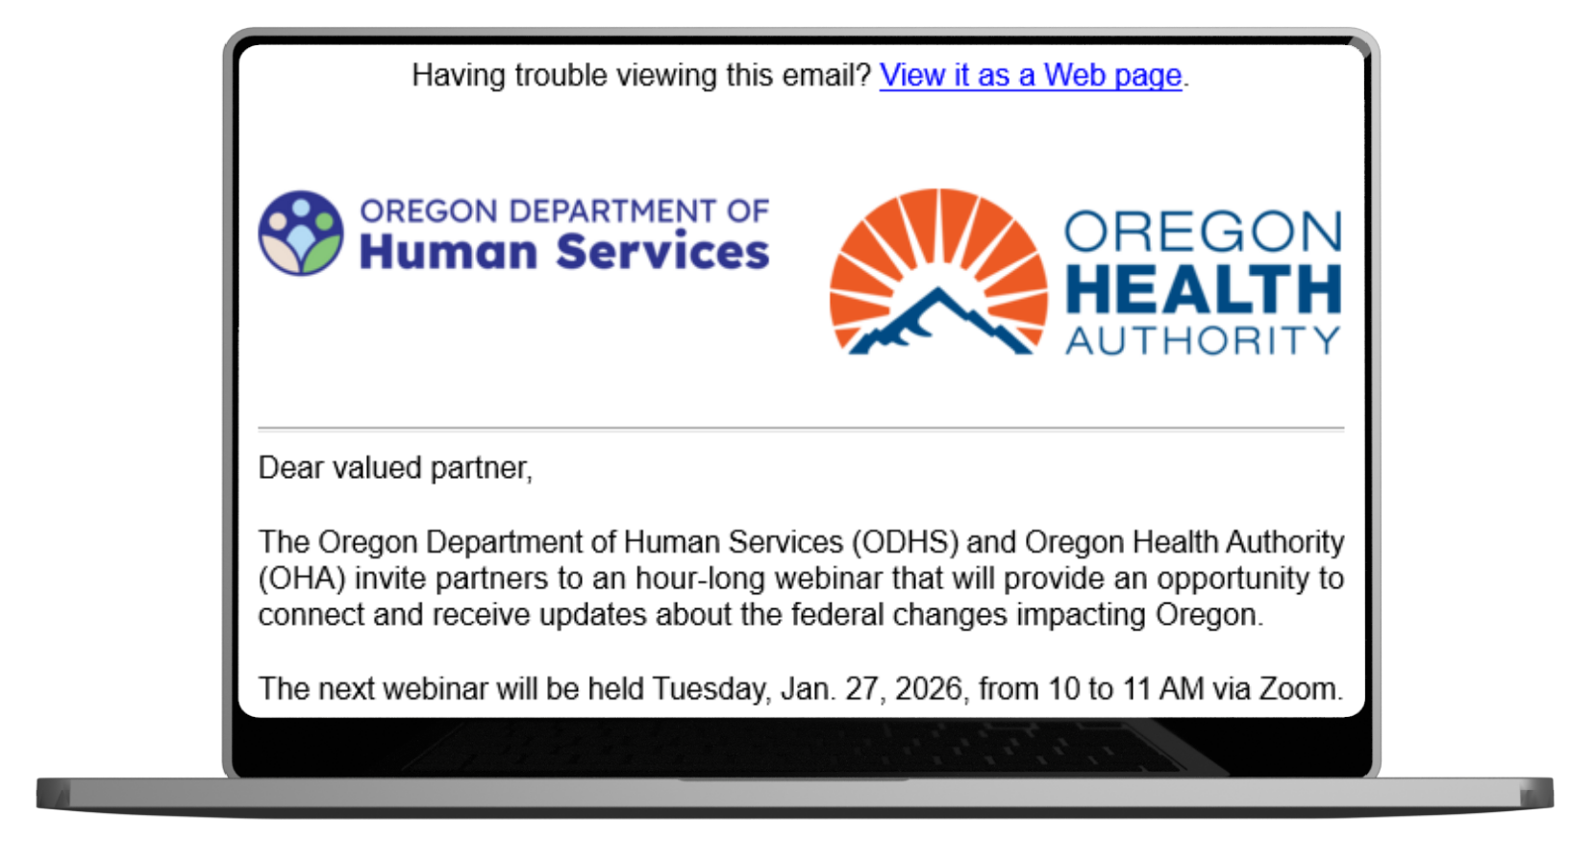
ODHS and OHA 2026 Forward Together Oregon webinar schedule
Tuesdays from 10 to 11 a.m., PT:
May 19, 2026
July 28, 2026
Sept. 22, 2026
Nov. 17, 2026
2026 Zoom Series Registration Link:
https://www.zoomgov.com/webinar/register/WN_-Q6HyPQoR76PxkMFSXcQ2Q#/registration
Notes:
ODHS and Oregon Health Authority will continue the Forward Together Oregon webinar series throughout 2026.
These sessions are offered in English and Spanish
The purpose is to provide partners an opportunity to connect with us and receive updates about federal changes impacting Oregon.
English messaging
Dear valued partner,
Oregon Department of Human Services (ODHS) and Oregon Health Authority (OHA) warmly invite you to a webinar series that will provide an opportunity to connect with us and receive updates about federal changes impacting Oregon.
Details:
Tuesday, 10 to 11 a.m. Pacific Time:
Mar 24, 2026
May 19, 2026
Jul 28, 2026
Sep 22, 2026
Nov 17, 2026
Virtual via Zoom
2026 Series Registration Link:
https://www.zoomgov.com/webinar/register/WN_-Q6HyPQoR76PxkMFSXcQ2Q#/registration
What to expect:
All participant microphones will be muted.
There will be an option to submit written questions.
This webinar series will not be recorded.
Materials and links shared during the webinars will be e-mailed to all registrants. You can also find information on the ODHS web page and the OHA web page. Questions? Email feedback@odhsoha.oregon.gov.
Spanish language and ASL Interpretation along with Real-time captioning (CART) will be available.
For people who speak or use a language other than English, people with disabilities or people who need additional support, we can provide free help. Some examples are:
Sign language and spoken language interpreters
Written materials in other languages
Braille
Real-time captioning (CART)
Large print
Virtual platform change
Audio and other formats
This meeting will be virtual-only. This meeting will screen share and use PowerPoint slides.
Please contact Fabiola Herrera at mayra.f.herrera-hernandez@oha.oregon.gov or 503-979-6984 (voice or text), at least 48 hours before the start of the webinar to request an accommodation. We will make every effort to provide services requested after the 48-hour deadline. We accept all relay calls. If you need an accommodation, please contact us right away, even if you are only considering attending. The earlier you make a request the more likely we can meet the need.

Slide 45
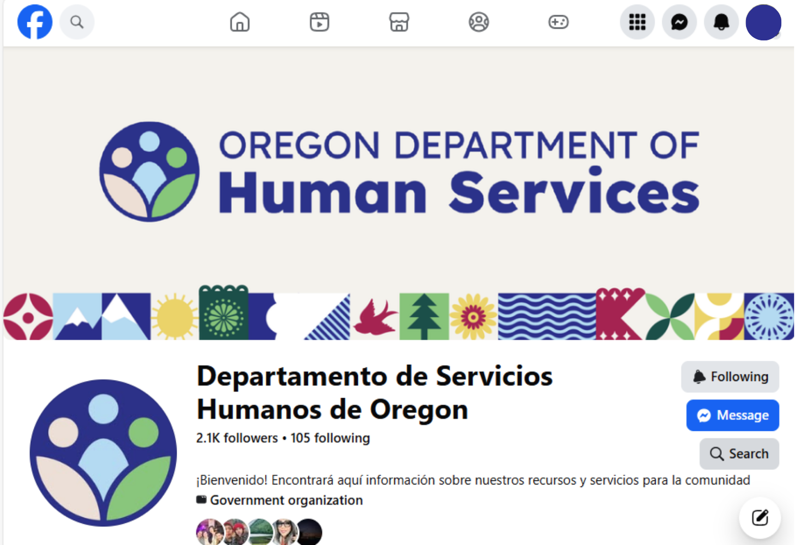
Spanish Facebook Live events
Monthly informative events for Spanish speakers in Oregon
Collaboration with community partners and other agencies
Opportunity for meaningful engagement and trust building
No registration needed
https://www.facebook.com/ODHSespanol
Notes:
Dedicated social media for Spanish speaking community in Oregon
Topics and collaborators for Live events vary by month based on current events impacting services/community or monthly specific celebrations/notable dates
Space for live questions from audience
On March 26, ODHS in collaboration with Oregon Employment Department will discuss support for SNAP work and activity rules. No need to register. People interested should visit the FB page.
https://www.facebook.com/ODHSespanol

Slide 46
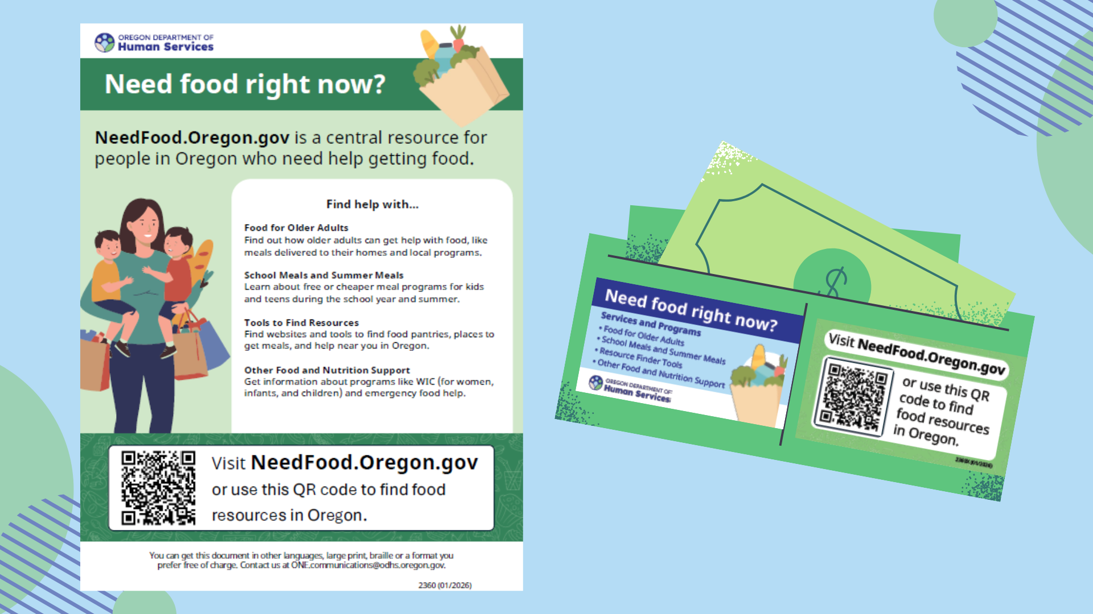
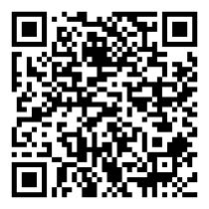
Central resource for finding food: NeedFood.Oregon.gov
QR code to NeedFood.Oregon.gov
Notes:
ODHS this month released new tools to make it easier for people to find food help quickly – even if they are not eligible for SNAP.
Flyers and wallet cards are now available in multiple languages and posted on NeedFood.Oregon.gov to support outreach and referrals. Scroll to the bottom of the page and select Materials to print and share.

Slide 47
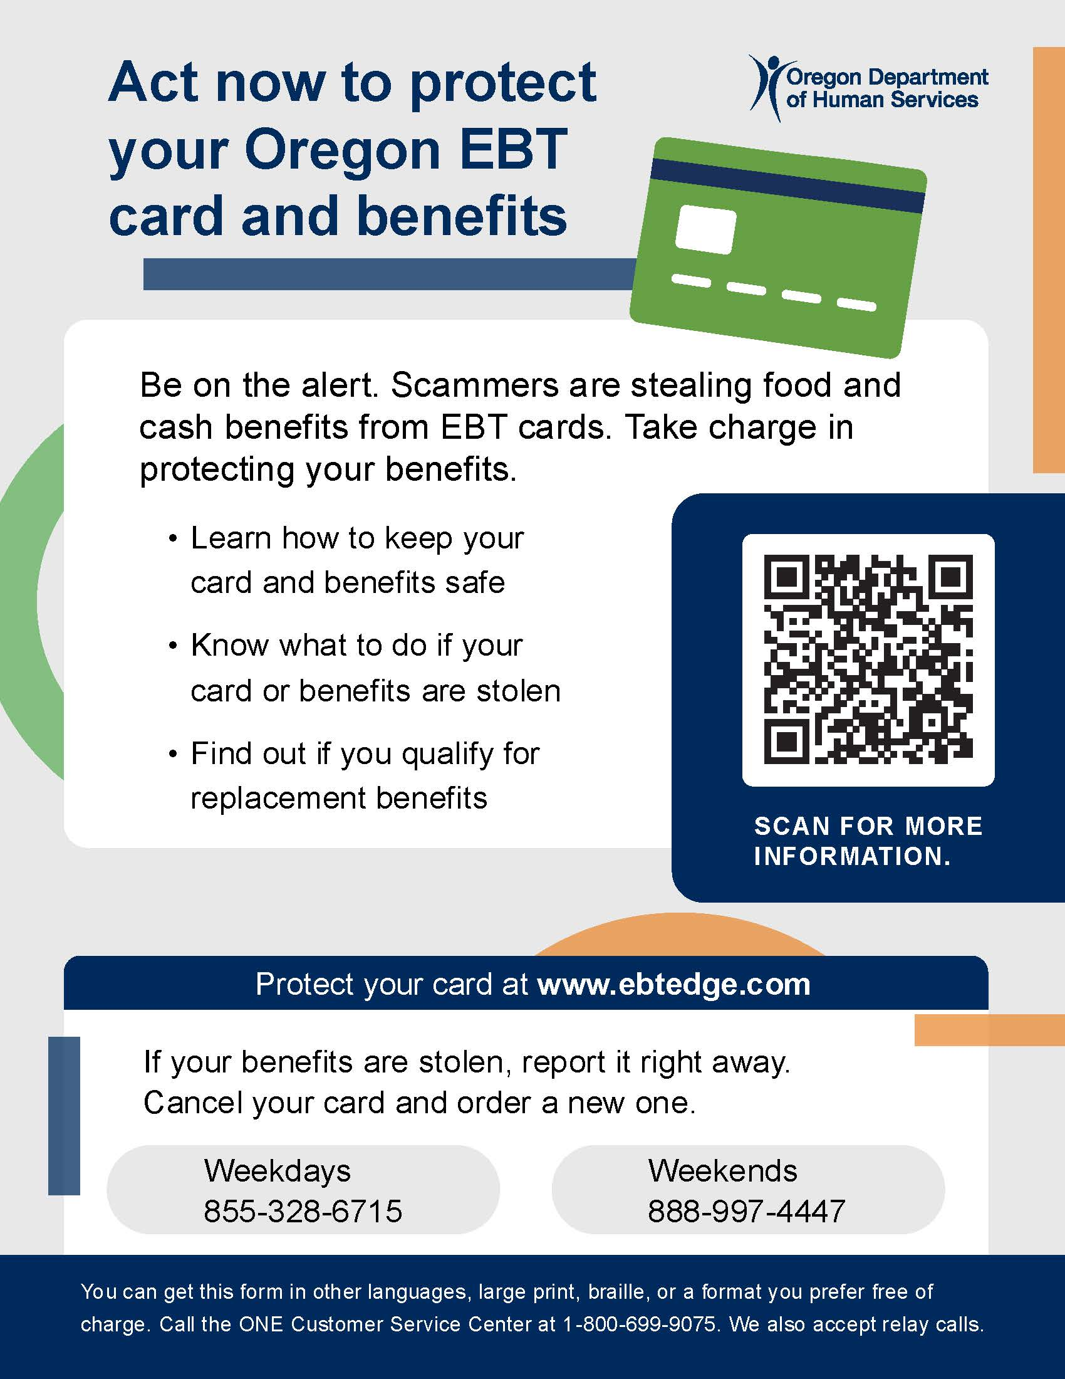
Protecting EBT Cards and Benefits
Electronic theft of benefits is on the rise nationwide.
Stolen SNAP benefits can't be replaced. TANF benefits can be replaced.
Safety tips for cardholders and downloadable resources for partners in many languages at www.oregon.gov/odhs/benefits/pages/protect.aspx
Notes:
Electronic benefit theft is on the rise. Criminals are using methods like skimming devices, internet scams and fake websites to steal card numbers and personal identification numbers (PIN). Once they have this information, they can drain food and cash benefits from a person’s card.
ODHS recommends that everyone with an EBT card take steps to keep their benefits secure. You can find simple tips on our website.
The federal funding to replace benefits ran out on Dec. 21, 2024, and ODHS is no longer authorized to replace stolen SNAP benefits. ODHS can replace Temporary Assistance for Needy Families (TANF) benefits that are lost due to fraud.
Again, information about how to protect EBT cards and benefits is on our website at https://www.oregon.gov/odhs/benefits/pages/protect.aspx. The webpage includes a downloadable wallet card, flyer and brochure in several languages for partners to share in your own communications.

Slide 48

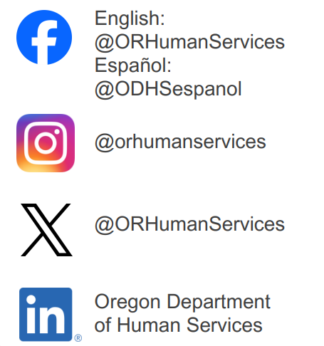



Stay in touch
Sign up for our partner newsletter.
Sign up for news alerts from ODHS.
Visit our federal updates webpage.
Visit our SNAP work or activity rules webpage in English and Spanish.
Email the Community Engagement team.
Follow us on social media.
www.oregon.gov/odhs
Notes:
Partner newsletter: https://public.govdelivery.com/accounts/ORDHS/subscriber/new?topic_id=ORDHS_833
News alerts: https://www.oregon.gov/odhs/news/pages/default.aspx
Email community engagement team: communitypartners@odhsoha.oregon.gov
General Partner Information
Resource: https://www.oregon.gov/odhs/news/Pages/federal-updates.aspx
Help spread clear, accurate information—rules are changing, and people may be confused. Encourage people to follow ODHS communications channels to get the latest news: https://www.oregon.gov/odhs/news/Documents/stay-informed-flyer-en.pdf
Share how people can apply for and manage their benefits without going into an office, including by setting up a ONE Account or using Oregon ONE Mobile.
Create a ONE account instructions in English and Spanish
Encourage families to update contact information with ODHS so they get the right notices.
Connect people to food resources, including needfood.oregon.gov and local food banks.
Connect with local community based and culturally specific organizations in your area. I worry that people who do not understand how to navigate the resources because of language or Tech knowledge

Slide 49
Thank you
www.Oregon.gov/odhs

