Slide 1
Suicide Death and Suicide-Related Data
Presented to
State Child Fatality Review Team
May 6, 2021
Miranda Sitney, Youth Suicide Prevention Coordinator
Meghan Crane, Zero Suicide in Health Systems Coordinator

Slide 2
Youth Suicide In Oregon (Ages 10-17)
Year | # Youth Suicides | Suicide death rate per 100,000 | Avg U.S. youth suicide death rate
2014 | 24 | 6.2 | 4.0
2015 | 20 | 5.2 | 4.2
2016 | 28 | 7.1 | 4.6
2017 | 31 | 7.9 | 5.3
2018 | 39 | 9.9 | 5.5
2019 | 18* | 4.5 | 4.9
2020 | 25** | NA | NA
*In addition, 2019 saw two suicides by youth younger than 10.
**2020 data is preliminary. This number is subject to change.
Notes:
Lets start by just orienting to how many youth suicides occur in Oregon. The trend in Oregon is that youth suicides had been increasing until 2019, when the rate of youth suicide in Oregon decreased substantially. 2020 data is preliminary, but while this 25 may change, we are relatively sure that a big spike in youth suicide has not yet occurred during the pandemic. The number will be up compared to 2019 levels, but not higher than 2018.
Vital statistics?

Slide 3
Rates Among Youth Aged 10 to 17 by year, U.S. vs. Oregon
n = 18
Source: CDC WISQARS
Notes:
While this is encouraging news, Oregon’s suicide rate continues to be well above the national average. We will need to see trend data in the out years to determine if this decrease will continue. I always like to tell people to focus on trends as opposed to single years, so we will need more years of data to determine if this decrease is the beginning of a trend.
The most recent CDC statistics have our youth suicide rate tied for 9th highest in the county.
Here is a graphical representation of the youth suicide trend in Oregon vs. the U.S. for those youth aged 10-17 years old.
As you can see, for 10–17-year-olds we hovered around the national rate until 2011 and then saw a spike. In 2019, the rate dropped below the national rate for the first time since 2010.

Slide 4
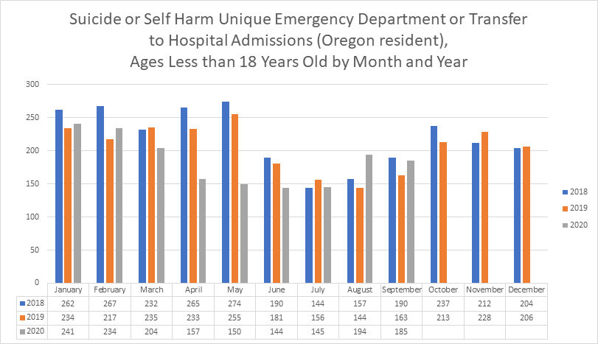
Youth Hospital Visits for Suicide-Related Causes by Month and Year
Notes:
Now this data on this slide is not death data like we have been looking at in the previous two slides, but rather is hospitalization data for youth who came to an Oregon hospital due to a concern of suicide.
You can see that we are tracking a trend where youth are least likely to be admitted in the summer months, and most likely mid winter. Again you can note that we have been tracking 2020 data and haven’t seen a spike in hospital admissions for concerns of youth suicide either, though this data is complicated by the facts that people we wary to enter hospitals at all for any medical concern in 2020 and further when schools are closed, there may have been fewer referrals to the hospitals simply because there are fewer adults around the kiddo to connect them with resources.

Slide 5
Suicide Rates Among Youth aged 10 to 17 by Race / Ethnicity and Sex, Oregon, 2000-2019
Notes:
Okay so we covered year and month data. Now here we are going to look at some demographics.
This slide is an Oregon-specific comparison for youth completed suicides aged 10-17, by race/ethnicity on the left and sex on the right.
The important takeaways here are that our Native youth and our male youth are at heightened risk for completed suicide as a young person.

Slide 6
Oregon Hospital Admissions for Suicide-Related Concerns, Youth Aged 10-17, 2019-2020
Notes:
However, when we look at suicidal ideation and attempts that go to the hospital, the picture is very different. Our hospitalization data shows that the youth who show up in this system are overwhelmingly White and Female. Again, the previous slide was completed suicides or death data, while the youth in this slide generally did not die by suicide.

Slide 7
Mechanism of Youth Suicide, Aged 10-17, Oregon, 2015-2019
10-17 years of age
18-24 years of age
Definition of “other”: drowning, fall, motor vehicle, sharp, blunt instrument, or other/unknown.
Source: CDC WISQARS, ORVDRS
Notes:
That difference may have a lot to do with the lethality of the chosen means.
For 10-17 year olds, we see a higher percentage of youth dying by suffocation/hanging as opposed to 18-24 year olds, where the leading mechanism of suicide is firearm.

Slide 8
Circumstances Surrounding Oregon Youth Suicide, Aged 10-17, 2013-2018
Mental Health Circumstance | Count | Percent
Mentioned Mental Health Problems* | 114 | 66%
Diagnosed Mental Disorder | 70 | 40%
Problem with Alcohol | 6 | 3%
Problem with Other Substance | 17 | 10%
Current Depressed Mood | 72 | 42%
Current Treatment for Mental Health Problem** | 49 | 28%
* Includes diagnosed mental disorder, a problem with alcohol, other substance, or depressed mood, or a combination of these.
** Includes treatment for problems with alcohol, other substance or both.
Notes:
The majority of youth in Oregon who die by suicide have mentioned a mental health concern in the past, and frequently have either been diagnosed with a mental health concern or were being actively treated for depressed mood.

Slide 9
Circumstances Surrounding Youth Suicide, Aged 10-17, 2013-2018
Interpersonal/Relationship Circumstance | Count | Percent
Broken up with Partner | 31 | 17%
Suicide of Family Member/Friend, last 5 years | 2 | 1%
Death of Family Member/Friend, last 5 years | 5 | 3%
Family Stressors | 48 | 30%
History of Abuse as a Child | 9 | 6%
Notes:
Many of these youth also have experienced family stressors.

Slide 10
Circumstances Surrounding Youth Suicide, Aged 10-17, 2013-2018
Life Stressors Circumstances | Count | Percent
A Crisis in the Past Two Weeks | 30 | 17%
Physical Health Problem | 3 | 2%
Job/Financial Problem | 1 | 1%
Recent Criminal/Legal Problem | 6 | 3%
School Problem | 32 | 19%
Notes:
Less frequently, but still notable are recent crises and school problems.

Slide 11
Circumstances Surrounding Youth Suicide, Aged 10-17, 2013-2018
Suicidal Behavior Circumstance | Count | Percent
History of Expressed Suicidal Thought/Plan | 55 | 27%
Recently Disclosed Intent to Die by Suicide | 41 | 23%
Left a Suicide Note | 59 | 33%
History of Suicide Attempt | 31 | 17%
Notes:
And then through postvention work we see that a strong minority of youth had previously expressed a suicidal thought or plan, disclosed intent to die by suicide, written a suicide note, or had a previous attempt.

Slide 12
Oregon Youth Suicide Data Resources
Youth Suicide Intervention Prevention and Postvention 2020 Report
https://www.oregon.gov/oha/HSD/BH-Child-Family/Pages/Youth-Suicide-Prevention.aspx
Link to join the Youth Suicide Prevention ListServ
https://omls.oregon.gov/mailman/listinfo/yspnetwork
Link to receive the monthly Oregon Suicide Surveillance Report
https://public.govdelivery.com/accounts/ORDHS/subscriber/new?topic_id=ORDHS_838

