Slide 2
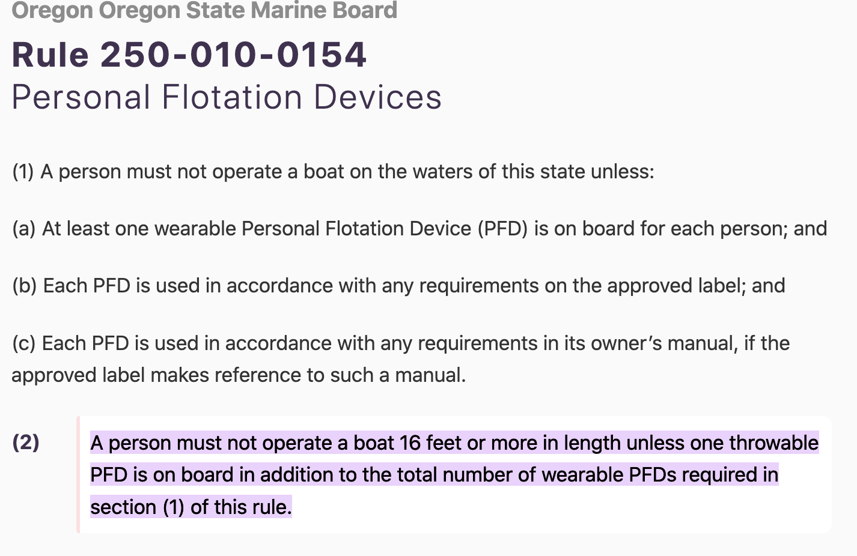
Current Oregon Law Regarding Personal Flotation Device Use

Slide 3
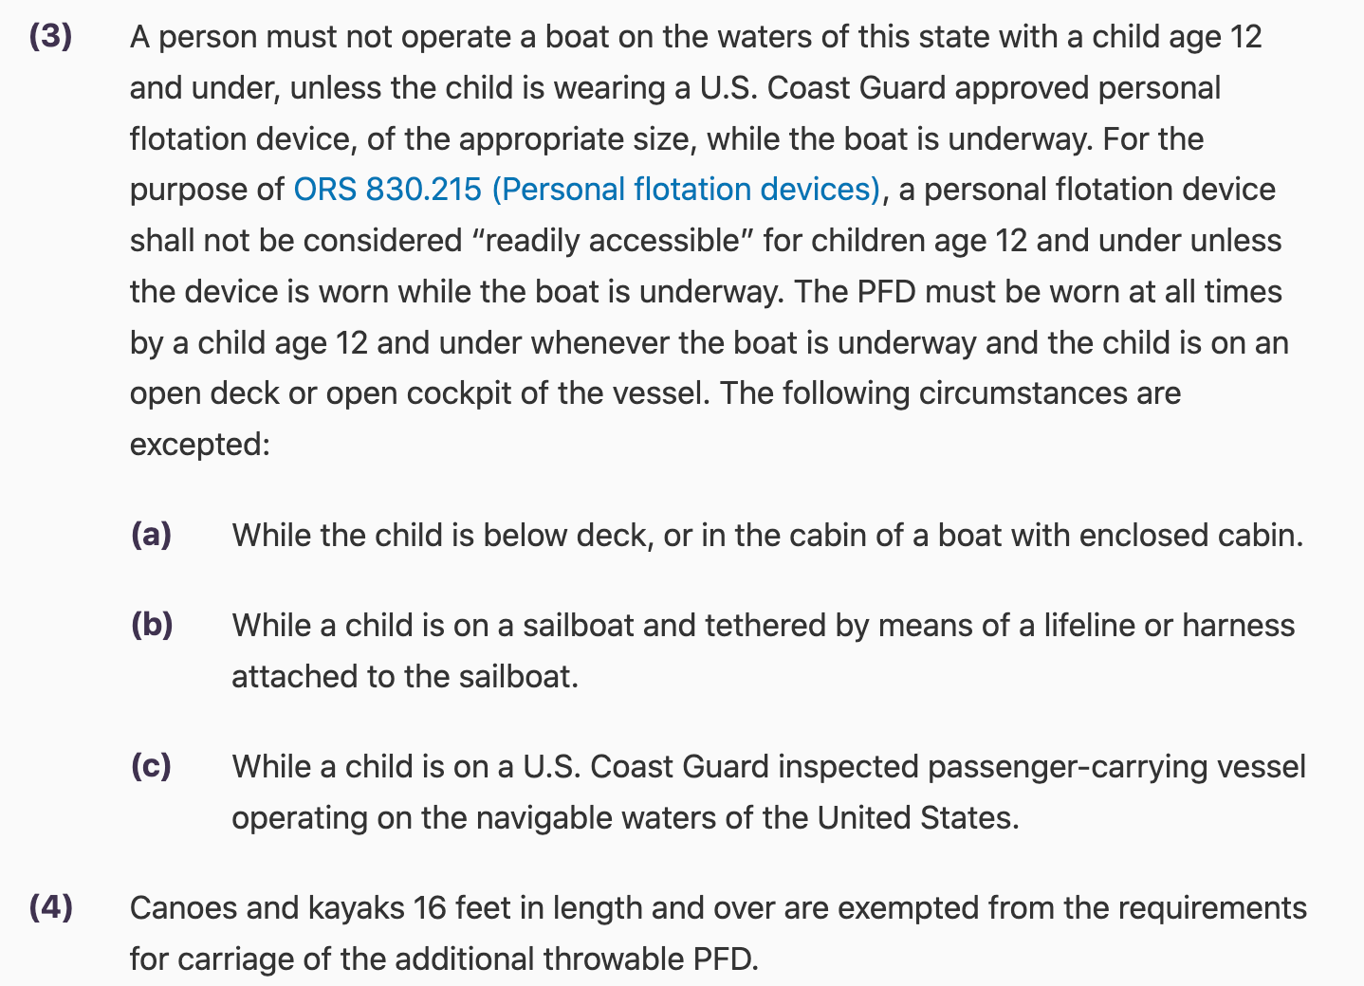

Slide 4
Drowning is the 4th Single Leading Cause of Death for Oregon Children
2006-2020, Ages 0-18 years
U.S. CDC

Slide 5
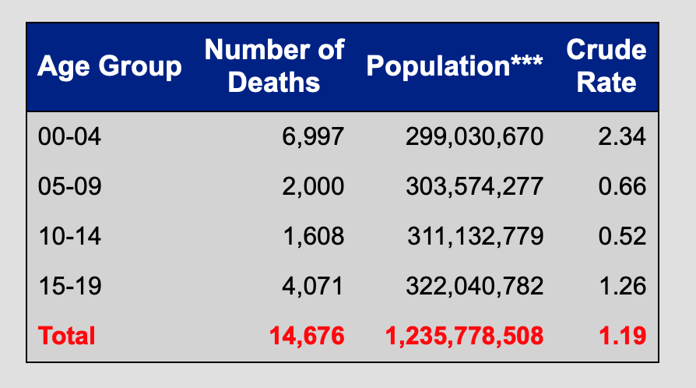
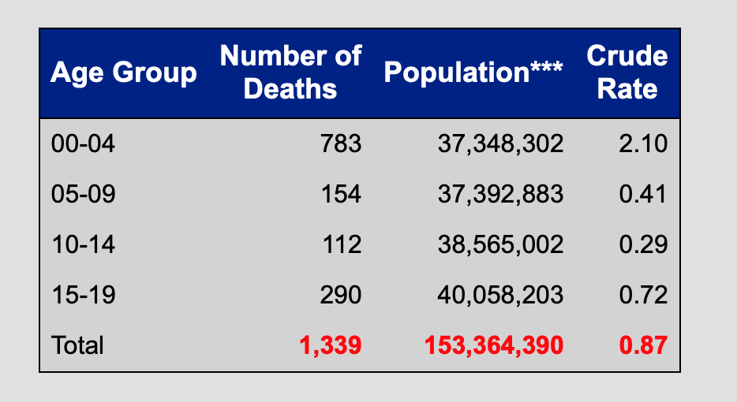
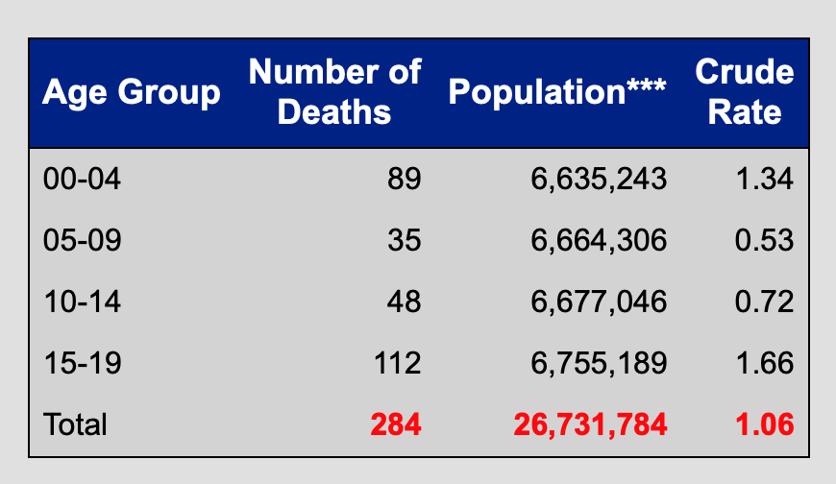
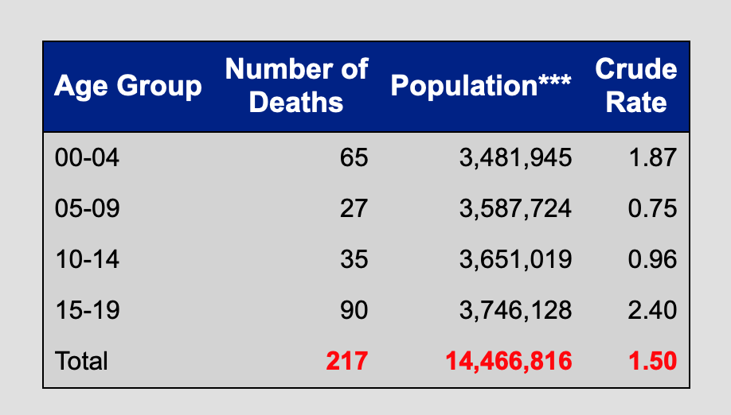
Oregon Children Drown at Higher Rates
All US Drowning 2006-2020
California Drowning 2006-2020
Washington Drowning 2006-2020
Oregon Drowning 2006-2020

Slide 6

Epidemiology of Drowning in Oregon 2006-2020
Data from Oregon Vital Statistics
Age Birth to <18 years of age
Reviewed all media reports
Print
Video
Obituary

Slide 7
Most Child Drowning Deaths in Oregon Occur in Natural Water
0-18 years of age
2006-2020

Slide 8
Boys Drown Much More Often Than Girls
0-18 years of age
2006-2020

Slide 9
Young Kids and Older Teens Have the Highest Drowning rates
0-18 years of age
2006-2020
Notes:
I changed the graph from 15-17 to 15-18 to account for ex: 17.5 years old

Slide 10
Children of Color Drown More Often
Population | Rate Per 100,00
Non-Hispanic White | 17.4
BIPOC | 25.8
Relative Risk | 1.483
Population of individuals 0-18 in Oregon = 870,461
US Census, 2022

Slide 11
Oregon Children Aged 0-4 Years Old Drown Most Often In Water on Private Property
N=61
2006-2020
Notes:
I changed the graph from 15-17 to 15-18 to account for ex: 17.5 years old

Slide 12
Oregon Children Aged 0-4 Years Old Drown Most Often In Water on Private Property
N=61
2006-2020
Notes:
I changed the graph from 15-17 to 15-18 to account for ex: 17.5 years old

Slide 13
Oregon Children Aged 5-9 Years Old Drown Most Often In Natural Water on Public Lands
N=24
2006-2020
Notes:
I changed the graph from 15-17 to 15-18 to account for ex: 17.5 years old

Slide 14
Oregon Children Aged 10-14 Years Old Drown Most Often In Natural Water on Public Lands
N=34
2006-2020
Notes:
I changed the graph from 15-17 to 15-18 to account for ex: 17.5 years old

Slide 15
Oregon Children Aged 15-18 Years Old Drown Most Often In Natural Water on Public Lands
N=52
2006-2020
Notes:
I changed the graph from 15-17 to 15-18 to account for ex: 17.5 years old

Slide 16
Natural Water Drowning Demographics N=104
Notes:
I changed the graph from 15-17 to 15-18 to account for ex: 17.5 years old

Slide 17
Natural Water Drowning is Almost Twice As Likely To Happen to Children of Color
Population | Rate Per 100,00
Non-Hispanic White | 9.6
BIPOC | 18.5
Relative Risk | 1.927
Population of individuals 0-18 in Oregon – 870,461
U.S. Census, 2022

Slide 18
Most Drownings Occur Along the I-5 Corridor
2006-2020

Slide 19
Natural Water Drowning: Ages 0-4 N=12
2006-2020
Notes:
I changed the graph from 15-17 to 15-18 to account for ex: 17.5 years old

Slide 20
Natural Water Drowning: Ages 5-9 N=19
2006-2020
Notes:
I changed the graph from 15-17 to 15-18 to account for ex: 17.5 years old

Slide 21
Natural Water Drowning: Ages 10-14 N=26
2006-2020
Notes:
I changed the graph from 15-17 to 15-18 to account for ex: 17.5 years old

Slide 22
Natural Water Drowning: Ages 15-<18 N=47
2006-2020
Notes:
I changed the graph from 15-17 to 15-18 to account for ex: 17.5 years old

Slide 23
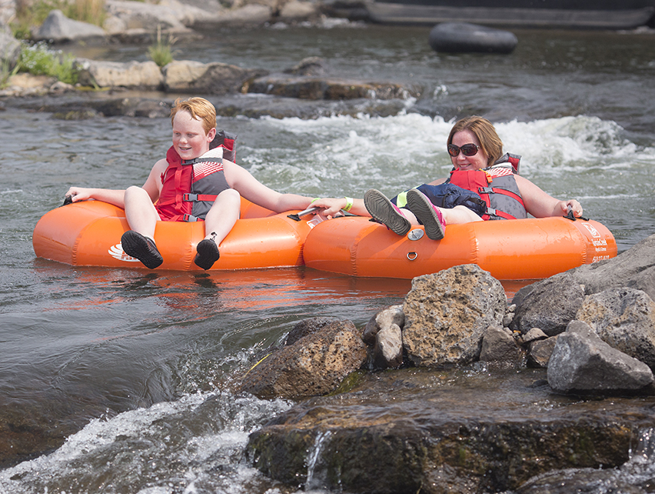
www.visitbend.com
Between 7 and 22 Oregon children would be alive if they had been wearing life jackets on watercraft or inflatables on open water
Another 56 likely Oregon children aged 5-17 would be alive if they had been wearing life jackets in or around open water

Slide 24
The Ask…
Amend Oregon Oregon State Rules re. Personal Flotation Devices:
A person must not operate a boat on the waters of this state with a child age 15 and under, unless the child is wearing a U.S. Coast Guard approved personal flotation device, of the appropriate size, while the boat is underway. For the purpose of ORS 830.215 (Personal flotation devices), a personal flotation device shall not be considered “readily accessible” for children age 15 and under unless the device is worn while the boat is underway. The PFD must be worn at all times by a child age 15 and under whenever the boat is underway and the child is on an open deck or open cockpit of the vessel.

Slide 25
The Ask…
Add Language that would require All Children and Youth age 15 years and under to wear a U.S. Coast Guard Approved Personal Flotation Device, of the appropriate size, when floating on natural water on public lands on an inflatable or otherwise buoyant product this is not classified as a boat (e.g. inflatable kayak or paddleboard) outside of a designated swimming area. This is intended to include inner-tubes, inflatable or buoyant foam pool-toys, rafts, or other conveyances.

