Slide 1
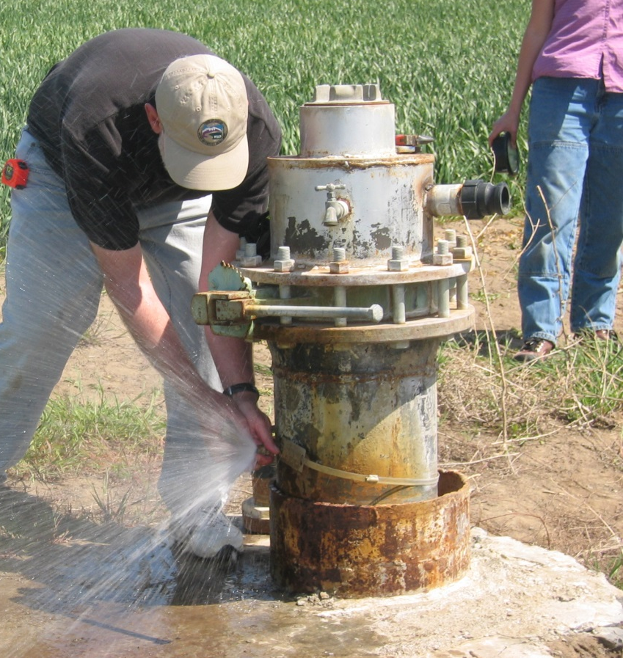
Oregon Water/Monitoring Wells Standard 1.1 amendment
Bob Harmon
Oregon Hydrography Framework

Slide 2
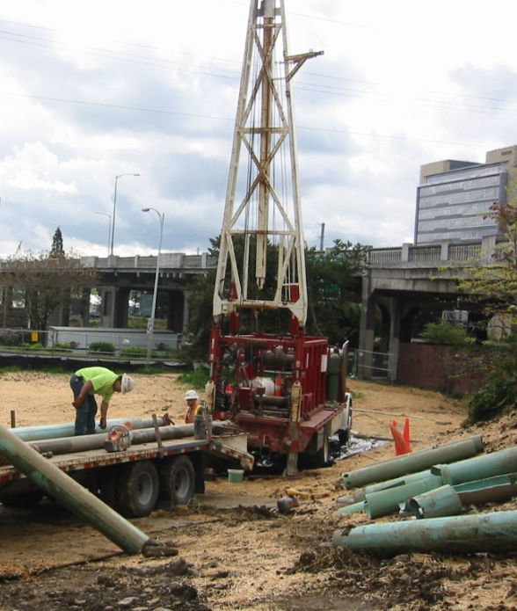
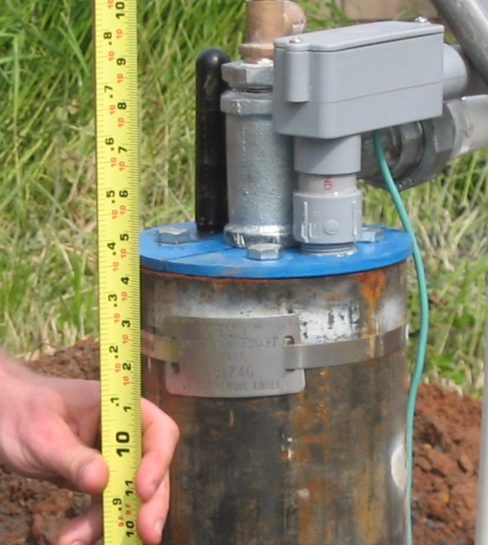
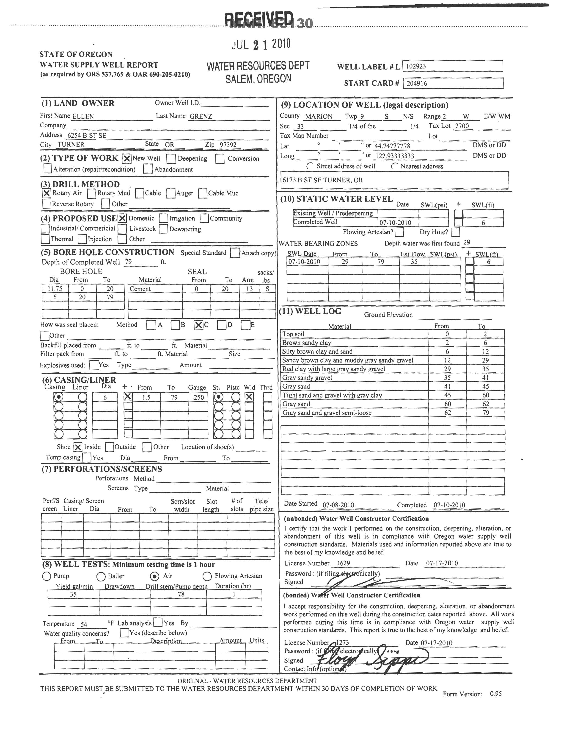
Background
Version 1.0 of the standard endorsed by OGIC in January 2012.
Basis for this amendment in discussions around the Preparedness FIT funding proposal that they were putting together in spring of 2013.
  Various mechanisms for deriving a well location were mentioned.
  Realized that the current standard didn’t capture that component of a location.
Discussed at February 2014 Framework Forum and suggestions incorporated.
Notes:
The basis for this amendment came out of discussions early last year when the Preparedness framework group was putting together its funding proposal. One of its objectives is to improve the resolution of the location on those wells that only have a Public Land Survey description—usually at best to the section, or square-mile. We had a conference call with DOGAMI whose staff has developed an automated process to capture coordinates for features based on tax lot and street addresses. Regardless of the method I realized that we didn’t record this in the water & monitoring well standard.

Slide 3
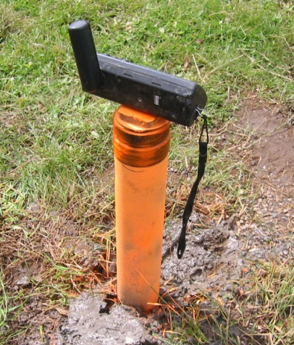
Elements - Required
Water well ID: generated when data submitted to repository (wwID)
Longitude (wwLongitude)
Latitude (wwLatitude)
Horizontal accuracy assessment (wwHorizontalAcc)
Location method (wwLocationMethod)
Date location method applied (wwLocationMethodDate)
Well label (tag; wwLabel)
Other agency id (wwOtherID)
Name of person that created data record (wwUser)
Agency that the person represents (wwAgency)
Date record created (wwRecordDate)

Slide 4
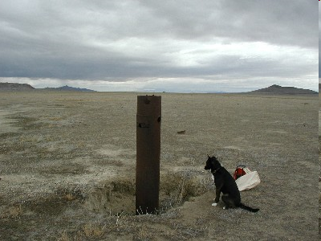
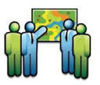
wwLocationMethod recommended domain
“GPS”
“land survey”
“imagery”
“scanned map”
“computed centroid of polygon”
“computed from street address”
“other”
“unknown”

