Slide 1
Hazard Mitigation Assistance Guidance
January 31, 2020
Amie E. Bashant
State Hazard Mitigation Officer (SHMO)
Notes:
Hazard Mitigation Assistance Guidance is also known as “404” or HMA. HMA includes: Hazard Mitigation Grant Program, Pre-Disaster Mitigation Program, and Flood Mitigation Assistance Program. The SHMO manages these grants. Other grants such as Public Assistance (PA) and Homeland Security are managed by other Office of Emergency Management (OEM) employees.
Ensure to refer to the notes areas for each slide as they will provide further information.

Slide 2
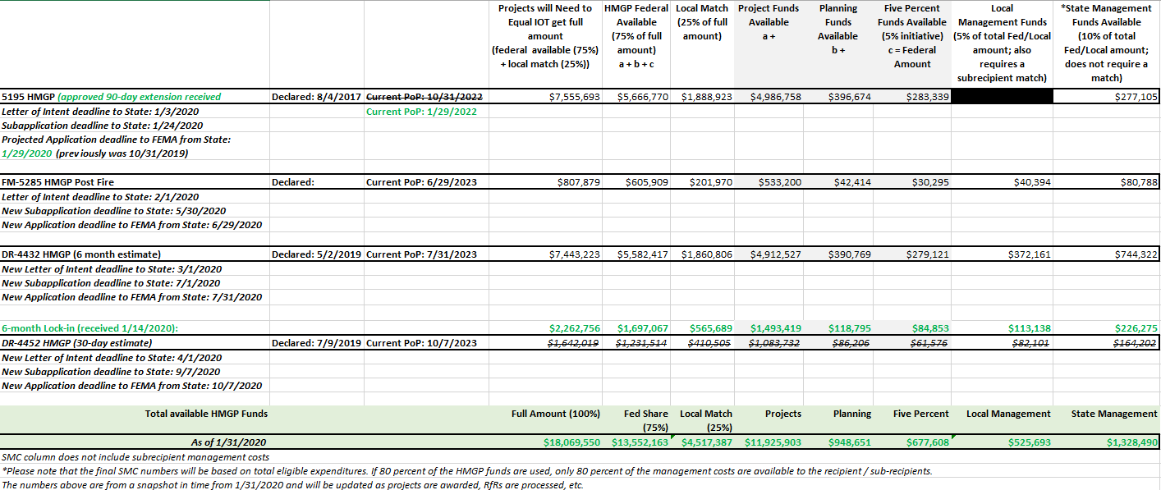
Current [Open] HMGP Grants
Reference documents only:
Notes:
Only update since 12/30/2019 is that the 6-month lock-in letter arrived. New numbers are reflected in green above.

Slide 3
Letter’s of Intent & Applications for 5285, 4432, & 4452
 | 5285 | 4432 | 4452
Priority Counties | Douglas County | Coos, Curry, Douglas, Lane, & Jefferson | Curry, Douglas, Grant, Linn, Umatilla, & Wheeler
Letter of Intent (required if applying for grant regardless of category; will be submitted PRIOR to application) | NLT 2/1/2020 to SHMO: | NLT 3/1/2020 to SHMO: | NLT 4/1/2020 to SHMO:
Project Application | NLT 5/30/2020 to SHMO: | NLT 7/1/2020 to SHMO: | NLT 9/7/2020 to SHMO:
Plan Application | NLT 5/30/2020 to SHMO: | NLT 7/1/2020 to SHMO: | NLT 9/7/2020 to SHMO:
Advance Assistance (AA) Application* | NLT 5/30/2020 to SHMO: | NLT 7/1/2020 to SHMO: | NLT 9/7/2020 to SHMO:
Application Extension Approval Letter (reference only)
Notes:
NLT=no later than
IOT=in order to
Letter of Intents will be reviewed IOT determine which entities will be move forward to apply for the grants. Priority will be given to the counties effected by the disasters (annotated above)
Dates above are all current.
*AA uses the same application as the state will (please annotate which grant you are applying to AA for when submitting)
If interested in the 5% initiative, inquire with the SHMO about the application (will basically use the project application and tailor it to what you’re applying for)

Slide 4
Steps for Applying to HMGP Grants
Fill out and submit a Letter of Intent for the grant you intend on applying to/for (on slide 3)
SHMO will consolidate all Letter’s of Intent shortly after the NLT date for each
SHMO will then review each letter in order to prioritize and select those entities who will apply for the grant
SHMO will notify those selected to apply for each grant
Selected entities will need to then fill out and submit a grant application with supporting documents for said grant by the NLT dates (on slide 3)
Notes:
Just because you submit a Letter of Intent, it does not mean that you will automatically be able to apply for the grant. In order to adhere to federal and state guidance, the SHMO must review the letters and prioritize subapplicants.
After the Letter of Intent has been received, reviewed, and you have been contacted by the SHMO and informed your project/plan/5 percent initiative/advance assistance has been selected.

Slide 5
Additional Information
HMGP grants have 4 different categories that can be applied for (only one of the four per application):
A project (a)
A plan (b)
5 percent initiative (c)
Advance Assistance (up to 25% of the HMGP ceiling & not reflected on the grant breakdown spreadsheet)
Each has a separate application. All four require a local match. If interested in applying for the 5 percent initiative, please contact the SHMO.
Notes:
For 5 percent initiative, the application to be used will be determined based upon assessment of what is trying to be done.
For the 5 percent initiative, if you are looking at purchasing generators as a primary focus for an area in your NHMP, please apply using one project application clearly stating everything throughout the application .

Slide 6
Subapplicant Mitigation Plan Requirement
There is no mitigation plan requirement for development of a new mitigation plan.
All subapplicants for HMGP must have a FEMA-approved local or Tribal Mitigation Plan at the time of obligation of grant funds for mitigation projects.
State agencies are eligible subapplicants under HMGP, PDM, or FMA, and a State Mitigation Plan under 44 CFR Part 201 is required as a condition of the State agencies receiving assistance as defined in 44 CFR Section 201.4. State agencies with assets identified in the State Mitigation Plan meet the mitigation planning requirement. PNP subapplicants are eligible for HMGP but do not have mitigation plan requirements as a condition of subapplicant eligibility.
(per HMA Guidance: https://www.fema.gov/media-library-data/1424983165449-38f5dfc69c0bd4ea8a161e8bb7b79553/HMA_Guidance_022715_508.pdf E.5.2)
Notes:
For updates to an expired NHMP or creation to a CWPP of which an entity does not have a current FEMA approved NHMP, a Extraordinary Circumstances request must be made. Contact the SHMO for more information.

Slide 7
Eligible Subapplicants
In addition to the eligible subapplicants described in Part III, A, PNP organizations may act as the subapplicant for HMGP. PNP organizations or institutions that provide an essential government service are defined in 44 CFR Section 206.221(e). Each subapplication from a PNP must include either:
An effective ruling letter from the IRS granting tax exemption under Section 501(c), (d), or (e) of the Internal Revenue Code of 1954, as amended
State certification, under State law, of nonprofit status A qualified conservation organization, as defined at 44 CFR Section 80.3(h), is the only PNP organization eligible to apply for property acquisition and demolition or relocation projects.

Slide 8
Plans
E.1.3.1 Eligible Hazard Mitigation Planning–Related Activities
Eligible activities that can be funded as mitigation planning–related activities under HMGP (these activities are not eligible under PDM and FMA) include but are not limited to:
Updating or enhancing sections of the current FEMA-approved mitigation plan, such as:
The risk and vulnerability assessment based on new information, including supporting studies, such as economic analyses
The mitigation strategy, specifically strengthening the linkage to mitigation action implementation, with emphasis on available HMA project grant funding
The risk assessment and/or mitigation strategy, incorporating climate adaptation, green building, smart growth principles, or historic properties and cultural resources information
Integrating information from mitigation plans, specifically risk assessment or mitigation strategies, with other planning efforts, such as:
Disaster recovery strategy (pre- or post-), preparedness, or response plans
Comprehensive (e.g., land use, master) plans
Capital improvement or economic development plans
Resource management/conservation plans (e.g., stormwater, open space)
Other long-term community planning initiatives (e.g., transportation or housing)
Building capability through delivery of technical assistance and training
Evaluating adoption and/or implementation of ordinances that reduce risk and/or increase resilience
Notes:
E.1.3.2 Ineligible Hazard Mitigation Planning–Related Activities
The following activities cannot be funded as mitigation planning–related activities: ♦ Hazard identification or mapping and related equipment for the implementation of mitigation activities (eligible under 5 Percent Initiative) ♦ Geographic Information System (GIS) software, hardware, and data acquisition whose primary aim is mitigation activity (eligible under 5 Percent Initiative) ♦ Public awareness or education campaigns about mitigation (eligible under 5 Percent Initiative) ♦ Project scoping or development (also referred to as “project planning”), such as BCA, engineering feasibility studies, application development, construction design, or EHP data collection ♦ Activities not resulting in a clearly defined product or products

Slide 9
5 Percent Initiative
To be eligible for the 5 Percent Initiative, activities must:
♦ Be difficult to evaluate against traditional program cost-effectiveness criteria
♦ Comply with all applicable HMGP eligibility criteria as well as with Federal, State, and local laws and ordinances
♦ Be consistent with the goals and objectives of the State or Tribal (Standard or Enhanced) Mitigation Plans and local mitigation plans
♦ Be submitted for review with a narrative that indicates that there is a reasonable expectation that future damage or loss of life or injury will be reduced or prevented by the activity
Activities that might be funded under the 5 Percent Initiative include:
♦ The use, evaluation, and application of new, unproven mitigation techniques, technologies, methods, procedures, or products
♦ Equipment and systems for the purpose of warning citizens of impending hazards
♦ Purchase of generators or related equipment, such as generator hook-ups
♦ Hazard identification or mapping and related equipment for the implementation of mitigation activities
♦ Acquisition of GIS software, hardware, and data whose primary aim is mitigation
♦ Public awareness or education campaigns about mitigation
♦ Evaluation of model building codes in support of future adoption and/or implementation
Notes:
Generators
5 Percent Initiative Projects: These projects, which are only available pursuant to an HMGP disaster, provide an opportunity to fund mitigation actions that are consistent with the goals and objectives of the State or Tribal (Standard or Enhanced) and local mitigation plans and meet all HMGP requirements, but for which it may be difficult to conduct a standard BCA to prove cost-effectiveness. For additional information, see Part VIII, A.14. have been the primary inquiry for the 5 percent initiative.

Slide 10
Advance Assistance…
Section 1104 of the SRIA authorizes the use of Advance Assistance to accelerate the implementation of HMGP. Applicants and subapplicants may use Advance Assistance to develop mitigation strategies and obtain data to prioritize, select, and develop complete HMGP applications in a timely manner. See Part VIII, A.12 for additional information on Advance Assistance.

Slide 11
Advance Assistance Continued
Subapplicants may use Advance Assistance for the following activities:
Obtain staff or resources to develop a cost-share strategy and identify potential match funding
Evaluate facilities or areas to determine appropriate mitigation actions
Incorporate EHP considerations early into program decisions
Collect data for BCAs, EHP compliance, and other program requirements
Scope and prioritize hazard mitigation projects (including State coordination of local projects) to incorporate sustainability, resilience, and renewable building concepts
Develop hazard mitigation projects, including engineering design and feasibility actions
Incorporate SFM principles into mitigation project work schedules and budgets that will facilitate compliance with the legislative requirement to expend obligated funds within 24 months
Conduct meetings, outreach, and coordination with potential subapplicants and community residents to identify potential participants for property acquisition and demolition or relocation projects
Conduct engineering design and feasibility studies for larger or complex community drainage projects or critical facility retrofits (such as for phased projects)
Conduct hydrologic and hydraulic studies for unmapped flood zones or Approximate Zone A areas where communities propose to submit hazard mitigation projects
Perform professional cost estimation services to aid consistency in project budgeting across subapplications
Rectify data consistency needs for other project application categories, such as EHP compliance, cost-sharing mechanisms, and work schedules
Complete necessary documents for deed restricting properties such as acknowledgement of voluntary participation or Model Acknowledgement of Conditions for Mitigation of Property in a Special Flood Hazard Area with FEMA Grant Funds for property acquisition projects
Notes:
Note that AA is completely different than Phased Projects. Though they are defined back-to-back in HMA guidance, they are two separate items. Upon completion of whatever is done using AA you may actually have a phased project for another grant round ready, however they are two separate courses of action.

Slide 12
Local Management Costs
New for disasters declared in 2019 per DRRA – Section 1215 (more information can be found at: https://www.fema.gov/drra-1215-faq)
If applying for local management costs (see Section 5 in project/plan applications), you will need to fill out a local management cost application to actually apply for the local management costs (application for local management costs is still being drafted as of 1/31/2020, thus not being included in the slide deck at this time; once finalized, the local management cost application will be included in future PowerPoints/guidance prior to application deadlines)

Slide 13
Benefit Cost Analysis (BCA)
The BCA will be the most challenging part for most applications
Please use version 5.3 vs version 6.0 as it is more user friendly
For technical support, please call FEMA’s BCA help line at: 1-855-540-6744 or bchelpline@dhs.gov
More information for BCA 5.3 can be found at: https://www.fema.gov/media-library/assets/documents/128334
Helpful 5.3 video from Washington SHMO: https://youtu.be/lwjypk_uBSM

Slide 14
Useful Links
BCA V 5.3 Video (from WA SHMO): https://youtu.be/lwjypk_uBSM
FEMA Advance Assistance: https://www.fema.gov/media-library/assets/documents/32755
FEMA Grant Forms: https://www.grants.gov/web/grants/forms/sf-424-family.html#sortby=1
FEMA Hazard Mitigation Grant Program Post Fire: https://www.fema.gov/hazard-mitigation-grant-program-post-fire
FEMA Hazard Mitigation Assistance Guidance: https://www.fema.gov/media-library/assets/documents/103279
FEMA Hazard Mitigation Assistance Publications: https://www.fema.gov/hazard-mitigation-assistance-publications
FEMA Hazard Mitigation Grant Program: https://www.fema.gov/hazard-mitigation-grant-program
FEMA HMA Application Development Guidance: https://www.fema.gov/application-development-1
FEMA Management Costs: https://www.fema.gov/drra-1215-faq

