Slide 1
SNAP PArtner MEeting
MArch 23, 2023
Entry Music: Ain't got no, I got life – Nina Simone

Slide 2
Announcement: Food program partners listserv
foodprogrampartners@omls.oregon.gov
What to expect:
Auto generated welcome email
Deleted meeting series
Reissued meeting series under the new listerv. Date/time/meeting links will not change.

Slide 3

Oregon’s SNAP Nutrition Education Program
Coordinators
Adam Rea Lucy Huffman
SNAP Policy

Slide 4


What does SNAP-Ed do?
To provide educational programs, messaging and PSE interventions through community/public health approaches;
To increase the likelihood that people eligible for SNAP will make healthy food choices within a limited budget and choose physically active lifestyles consistent with the Dietary Guidelines for Americans and Food Guidance System.
Program goals measured around 4 core indicators:
Healthy Eating
Food Resource Management
Physical Activity and Reduced Sedentary Behavior and;
Nutrition Supports

Slide 5
SNAP-Ed Units
In Every County in Oregon!
96 SNAP-Ed Hubs across the state
Implementing Agency relationship with OSU Extension Service
Work with schools, food banks, tribal councils, WIC, various public health departments, health insurance providers, Department of Education, and other government and private organizations
Notes:
Map of SNAP-Ed units throughout the state. Not every county is its OWN unit, some are made up of multiple counties.

Slide 7


Slide 8
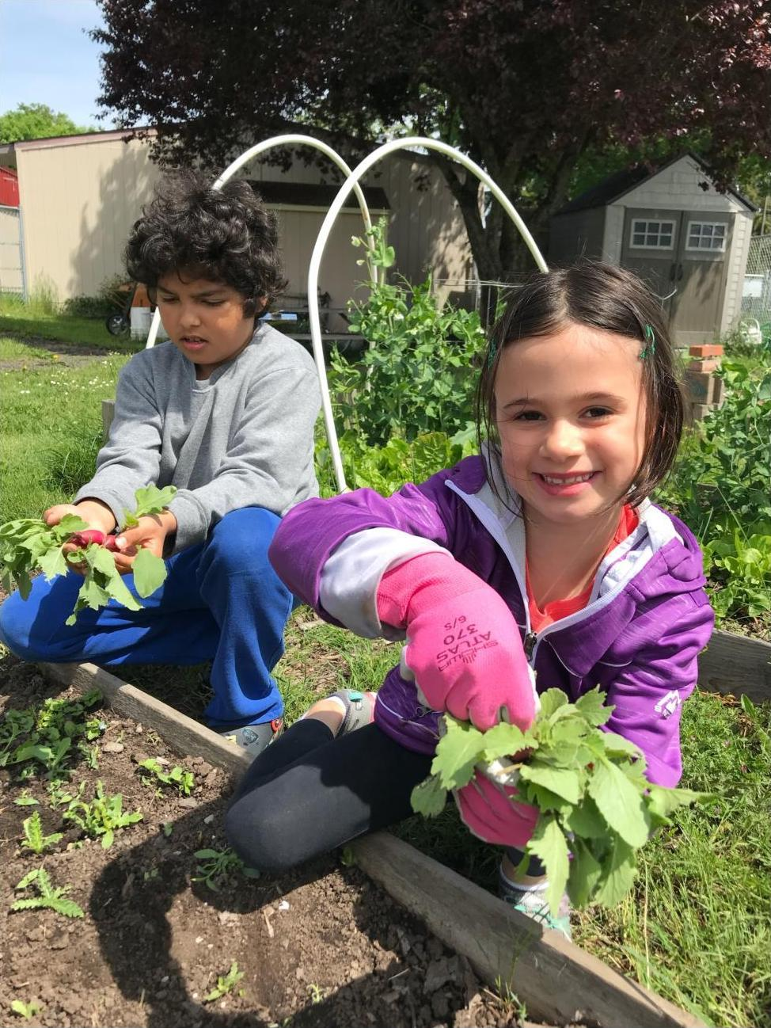

Slide 9
SNAP-Ed Cultural Work Groups
LatinX
Pasifika
Indigenous Peoples
African Heritage
Older Adults

Slide 10

Plan, Shop, Save & Cook
Ideas for weekly meal planning
Grocery Shopping tips
What’s really a “deal”?
Cost by weight
Where to shop
What to look for on nutrition labels
Maximize your buying power
Putting it all together and cooking up something delicious!
Notes:
Plan Shop Save Cook
Literally exactly what it is – planning meals for the week, shopping tips, getting the most from your dollar and cooking for yourself and your family.
Cost by weight –
Added sugars –
In Coos County, the Plan Shop Save & Cook class is currently offered through Waterfall Community Health Center and at the At Risk Kids Project (ARK). We’re hoping to also provide more classes later this year at the Coos Bay Farmer’s Market and the Bandon Community Youth Center

Slide 11


Walk With Ease
Physical Health for Older Adults
Developed by the Arthritis Foundation
In-Person, Virtual class, or Self-directed
Learn ways to be more physically active
Free Walk With Ease guidebook
18 sessions of 45-60 minutes each
Sessions can be offered 3 times a week for 6 weeks or 2 times a week for 9 weeks
Sessions include warm and cool downs, mini lectures and plenty of walking!
Facilitated by a trained, CPR-certified leader
Walking intensity can be modified to fit the needs of the group
Notes:
SNAP-Ed also focuses on the physical activity side of health. A popular program in Oregon is the Walk with Ease program.
his is a class that was developed by the Arthritis Foundation; while the crux of the program is walking, there’s also a lot of focus on other ways to be physically active, or to modify common exercises to be more comfortable You can sign up for the program and do it self-directed by yourself, or join a group.
I’ve been to a few Walk with Ease classes in different parts of the state, of all different sizes – small groups, big groups – but what was common to all of them was that they were having fun!
And hey, free book!

Slide 12
Connecting Oregonians with SNAP-Ed
Food Hero!
Facebook, Instagram, Pinterest
FoodHero.org
Food.Hero@oregonstate.edu
OSU County Extension
https://extension.oregonstate.edu/find-us
Notes:
Go to Food Hero website!

Slide 13
Adam REA: adam.j.rea@dhsoha.state.or.us Lucy Huffman: LUCY.HUFFMAN@DHSOHA.STATE.OR.US
SNAP-Ed Analyst contact

Slide 14
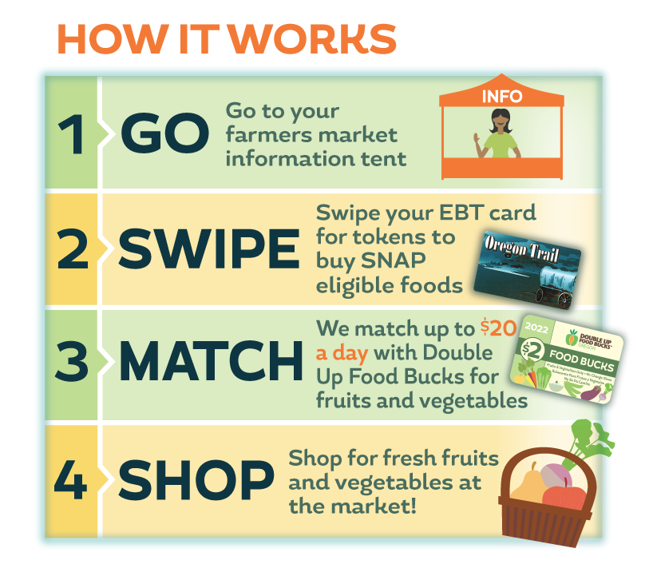


More Information at https://doubleuporegon.org/

Slide 15
Students of Higher Ed
Students aged 18-49 enrolled in higher education (community college, university) must meet additional criteria to be eligible for SNAP.
Students attending higher education more than part time need to meet one of the following to be eligible for SNAP:
Be working more than 20 hours per week
Participating in federally or state funded work study
Receiving TANF
Receiving Unemployment Compensation
Be in school because of employer-sponsored training
Participating in an Employment Dept. Training Program
Be enrolled in a program or course of study that would lead to employment.
Notes:
Students who are attending higher education, like community college or university, must meet additional criteria in order to be eligible for SNAP benefits.
This includes:
Be employed working more than 20 hours per week
Participating in federally or state funded work study
Receiving TANF
Receiving Unemployment Compensation
Be in school because of employer-sponsored training
Participating in an Employment Dept. Training Program
Be enrolled in a program or course of study that would lead to employment.

Slide 16
Students of Higher Ed
Students also may be able to get SNAP if they are taking care of a dependent household member:
Under the age of 6
Age 6 through 11 and do not have adequate child care to enable them to work a minimum of 20 hours per week or take part in a state or federally-financed work study program while attending school.
Notes:
In addition to the criteria just reviewed, a student can also be eligible if they are caring for a dependent household member who is either under the age of 6 or age 6 to 11 and the applicant does not have adequate child care which would allow them to work 20 hours a week.

Slide 17
Students of Higher Ed
During the Public Health Emergency, two additional temporary criteria's were added, these will expire in June 2023:
Eligible for work study—students do not need to have a work study position or award.
Have an Estimated Family Contribution (EFC) of $0 on FAFSA.
Renewals: the two temporary student exemptions are no longer available after June 30th
New Applicants: the two temporary student exemptions are not available after June 10th
Notes:
In addition to the criteria just reviewed, a student can also be eligible if they are caring for a dependent household member who is either under the age of 6 or age 6 to 11 and the applicant does not have adequate child care which would allow them to work 20 hours a week.

Slide 18
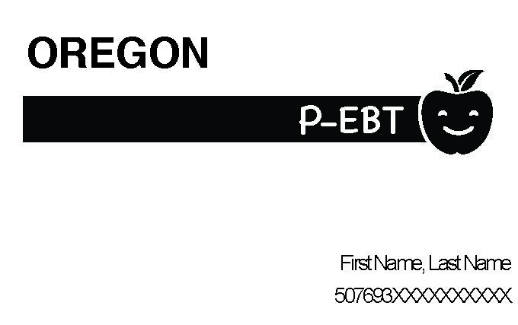
Summer P-EBT for Children
Retroactive issuance of 2022 Summer P-EBT begins in April and May
Households will receive a lump sum of $391 for each eligible child
Children age 6 years or younger who received SNAP at any time between June 1 and August 31, 2022
School-aged children eligible for free or reduced meals during the last month of the 2021-22 school year
Eligible households will receive a notice in the mail around March 27 (one for each child)
Summer P-EBT recipients will receive this P-EBT card in the mail between April and May to access the food benefits
Notes:
Stephanie Cooke
Summer PEBT and Pandemic EBT have been issued periodically during the PHE for children whose access to adequate and quality food may have been impacted by COVID-19. Although these temporary programs are ending when the PHE end, Oregon will still be able to issue retroactive Summer PEBT benefits for 2022 in April and May.
All eligible individuals will receive a new EBT card which will be mailed April and May.
Eligible individuals include both children age 6 years and younger who received SNAP at any time between June 1, 2022 and August 31, 2022 as well as school aged students who were eligible for free or reduced meals during the last month of the 2021-2022 school year.
This benefit is expected to reach 434,000 children.

Slide 19
Summer P-EBT for Children
A P-EBT call center opens March 27, 2023
Open Monday through Friday from 8 a.m. to 5 p.m.
Call 1-844-ORE-PEBT (1-844-673-7328)
Callers will have the option to choose English or Spanish. Callers can request translators for other languages.
Visit PEBT.Oregon.Gov for updated information and FAQs
Notes:
Stephanie Cooke
Summer PEBT and Pandemic EBT have been issued periodically during the PHE for children whose access to adequate and quality food may have been impacted by COVID-19. Although these temporary programs are ending when the PHE end, Oregon will still be able to issue retroactive Summer PEBT benefits for 2022 in April and May.
All eligible individuals will receive a new EBT card which will be mailed April and May.
Eligible individuals include both children age 6 years and younger who received SNAP at any time between June 1, 2022 and August 31, 2022 as well as school aged students who were eligible for free or reduced meals during the last month of the 2021-2022 school year.
This benefit is expected to reach 434,000 children.

Slide 20
Open Forum
Partners for a Hunger Free Oregon – SNAP Town Hall
James Barta – Speaker's Bureau

Slide 21
Contact Information
Stephanie Cooke, SNAP Policy
STEPHANIE.K.COOKE@dhsoha.state.or.us
Misha Mayers, Community Engagement
MICHELLE.MAYERS@odhs.oregon.gov

