Slide 1
Oregon Framework
Foundations
June 14, 2016

Slide 2
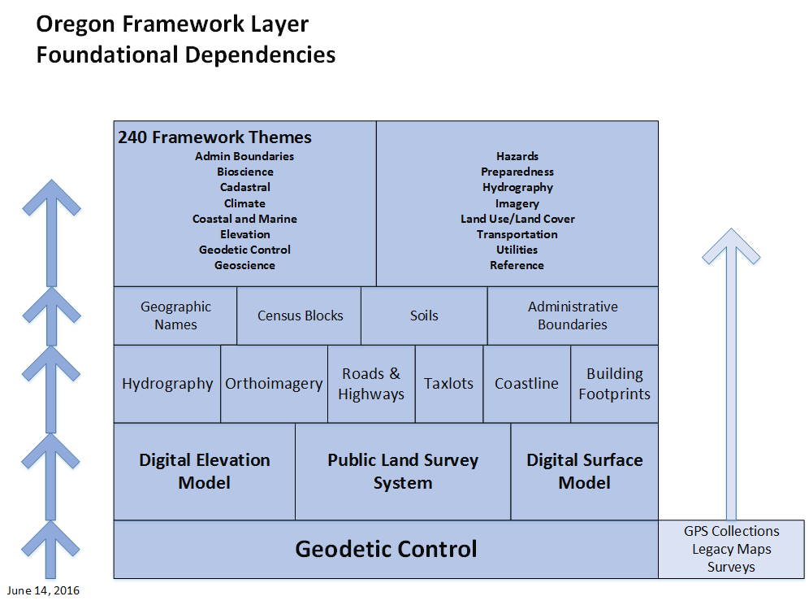

Slide 6
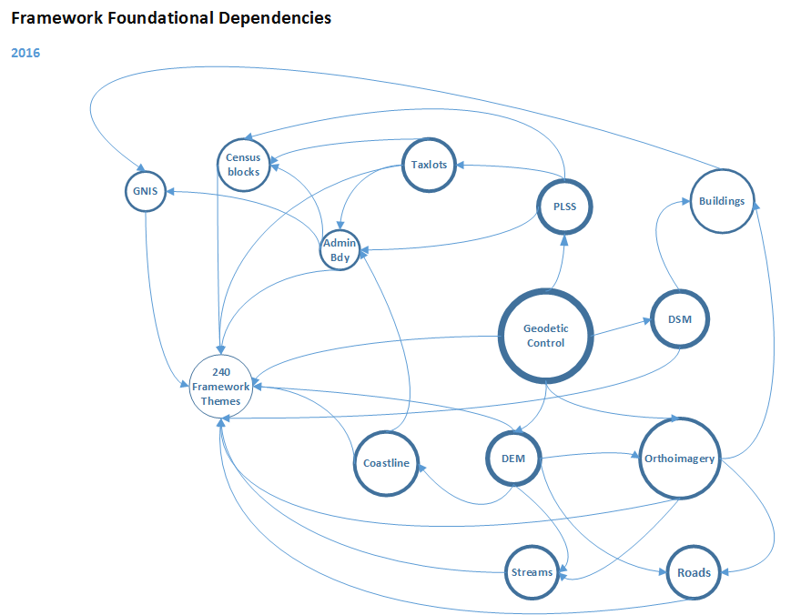

Slide 7
