Slide 1
G P L
February 14, 2017
1:30 - 3:30 PM
Oregon Department of Revenue
955 Center St NE
Salem, OR 97301
Room 467

Slide 2
Agenda
1:30 | Meeting Commence (Agenda)
1:35 | Announcements (Jobs, hires, conferences)
1:40 | Previous meeting minutes
1:45 | GEO update
1:55 | Framework update
2:05 | Shared Services update
2:15 | Updating GPL standing documents
2:20 | GNSS/GPS Toolsets Inventory Exchange
2:30 | Round Table
3:15 | Call for future topics
3:20 | Host locations for upcoming meetings
3:30 | Meeting Adjourn

Slide 3
Announcements
Close Date | Job Openings
Feb 21 5:00 pm | Lane County - Cartographer/GIS Specialist https://www.governmentjobs.com/careers/lanecountyor
Feb 26 11:59 pm | OWEB – GIS Specialist https://www.governmentjobs.com/careers/oregon
Feb 27 noon | City of Bend - Performance Analyst https://www.governmentjobs.com/careers/bend
Date | Events
April 17 & 18 | GIS In Action (and Data Fair)

Slide 4
Previous Minutes

Slide 5
Updates
GEO
Framework
Shared Services

Slide 6
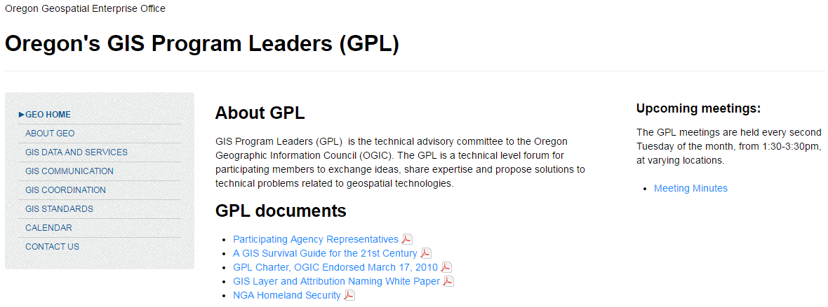
Updating GPL Standing Documents

Slide 7
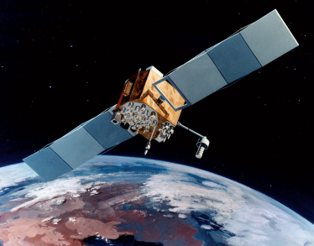
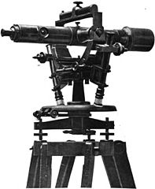
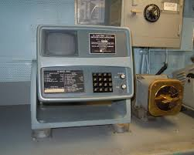
GNSS/GPS Toolsets Inventory Exchange
Field Tools in use by Agency
ArcPad?
Collector?
Survey 1-2-3?
Other?
Current status
New platform tests?
Real-time correction?
Cellular networks?
Data plans?
Transition plans?
Training plans?
Collaboration Opportunity
Agency peer exchange?
GPL work group?
Navstar 2F
Plate XXXIX of 1898 publication called Maryland Geological Survey Volume Two. Caption: Eight-inch Theodolite
private photo collection of Chris Hunkeler, Carlsbad, CA.

Slide 8
Agency Round Table
Dept. of Environmental Quality
Dept. Human Services/Health Authority
Dept. of Land Conservation and Development
Dept. of Geology & Mineral Industries
Dept. of Revenue
Dept. of State Lands
Dept. of Employment
Geospatial Enterprise Office
Lane County Public Works
Linn County
Office of Emergency Management
Oregon Dept. of Agriculture
Dept. of Forestry
Dept. of Fish and Wildlife
Dept. of Military
Dept. of Transportation
Parks & Recreation
Oregon State University
Watershed Enhancement Board
Water Resources Dept.
Port of Portland
Public Utility Commission
University of Oregon
United States Geological Survey

Slide 9
Upcoming meetings
Call for future topics ?
Meeting locations & Hosts
March 14th | ODOT – Phil Smith
April 11th | Agriculture – Diana Walker
May 9th | DLCD – Rachel Smith
June 13th | ODFW – Jon Bowers
July 11th | TBD ?
August 8th | TBD ?
September 11th | TBD ?

