Slide 1



CDO Legislative Update
Notes:
https://www.oregon.gov/das/OSCIO/Documents/68230_DAS_EIS_DataStrategy_2021_v2.pdf
https://data.oregon.gov/stories/s/xr2x-d2d7

Slide 2
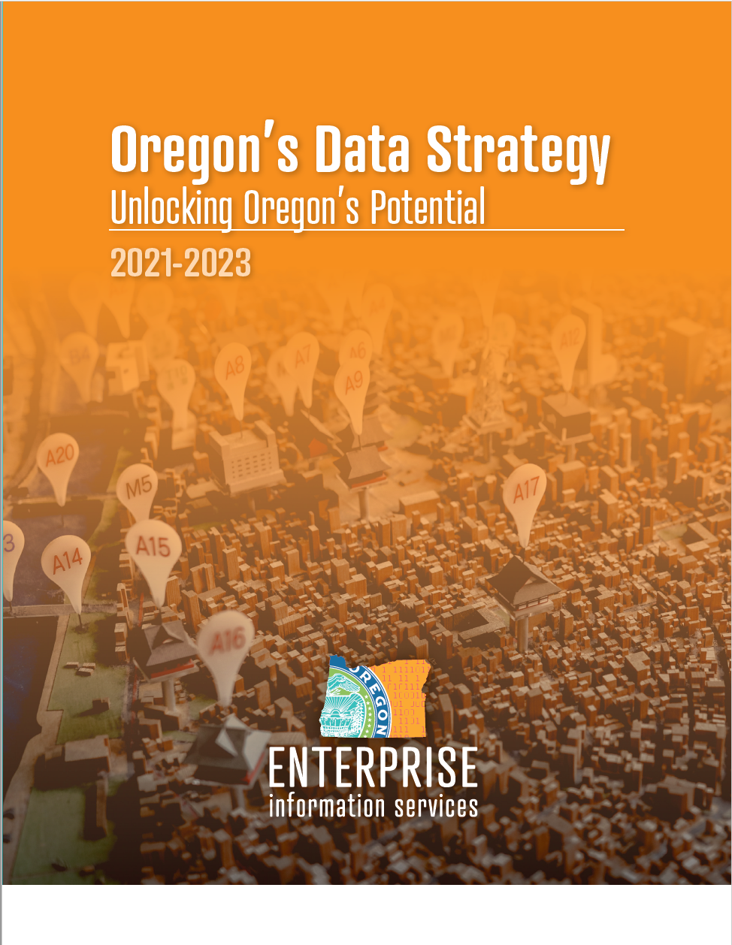
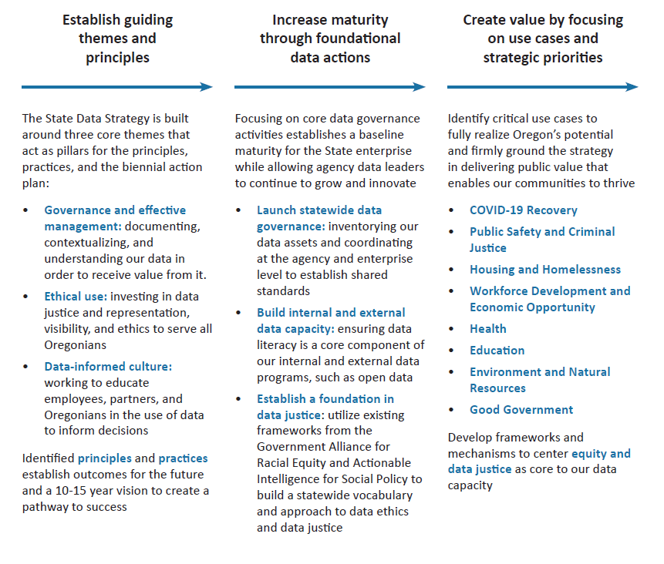

Oregon’s Data Strategy
Data Strategy Summary

Slide 3
Action Completed
Action Underway
Action not yet started
Informs future work in 2023-2025
2021-2023 Data Strategy Actions
Q1 2021 | Q2 2021 | Q3 2021 | Q4 2021 | Q1 2022 | Q2 2022 | Q3 2022 | Q4 2022 | Q1 2023 | Q2 2023 | Q3 2023 | Q4 2023
Launch Statewide Data Governance Policy
Convene Data Stewards Council
Statewide DG Maturity Assessment
Governance and Effective Management
Launch DG Resource Library
Enterprise Data Inventory
Publish EDI online (ODS deadline)
Launch GeoHub, the State’s secured Geographic Data Sharing Hub
Launch Open Data Program
OD Privacy Guidance
Conduct survey of ADS
Develop State Data Ethics Framework
Ethical Use
Evaluate demographic data collection standards
Partner with RJC to identify priority data needs
RJC produced State Research Agenda
Develop State Data Literacy Framework
Identify opportunities for partnership in data literacy training
Data-Informed Culture
Integrate data literacy training and tools into CDO portfolio
Build OD literacy/capacity

Slide 4
CDO POP 2021-2023
Focused on building infrastructure to establish proof of concept GeoHub and provide open data publishing capacity to agencies
~3 million for Geospatial Data Management and Sharing project, “GeoHub”
~1 million for ETL tool infrastructure
7 new FTEs
  1 GIS Analyst (ISS6)
  2 ETL Developers (ISS7)
  1 Content Strategist (ISS7)
  1 Program Manager (OPA4)
  1 ‘Equity in Analytics’ Researcher (ISS8)
  1 LD Project Manager (OPA3) – already hired through EIS PMO

Slide 5
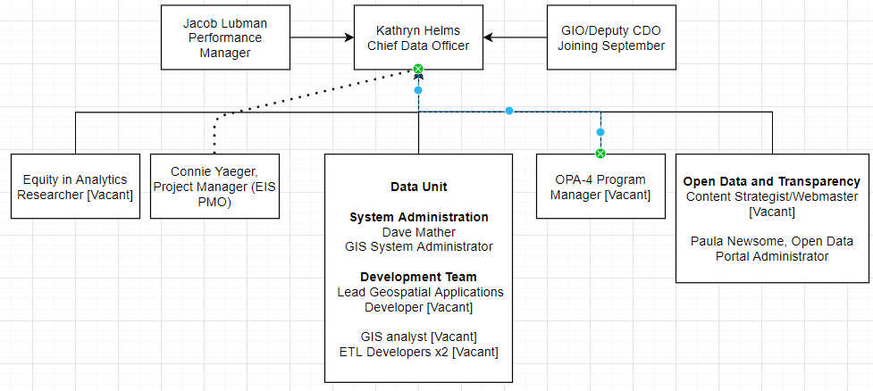
New Organizational Design

Slide 6
General Notes
Chief Data Office at <30% staff capacity
Working to onboard critical roles
  Hoping to be at full capacity by EOY
CDO Advisory Council working through Data Strategy Execution and planning for 2023-2025 biennial plan/budget requests

Slide 7


Thank you
Kathryn Darnall Helms
Kathryn.helms@Oregon.gov

