Slide 1
ArcGIS Enterprise Some lesson learned September 14, 2021
Department of State Lands
GIS Coordinator: R. Sounhein, GISP

Slide 2
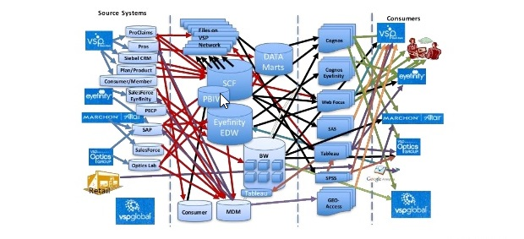

Problem Statement
Why Enterprise approach; what are benefits?
Provides better content management.
Promotes greater usability and security
Promotes greater discovery/collaboration
Provides efficient Web/Desktop/Mobile access.
Utilizes RDBMS managed Geodatabases. Organized

Slide 3
ArcGIS Enterprise Components
Typically, there five main parts
ArcGIS Portal Content management.
ArcGIS Server Backend Server
ArcGIS DataStore Used for Hosted Datasets
Web Adapters Masking the Admin access.
MS SQL Server Hosting the Enterprise Datasets

Slide 4
Current Enterprise Architecture
Enterprise 10.9
Server 1
ArcGIS Portal on Win 2012R2 VM
Server 2
ArcGIS Server Win 2012R2 VM
MS SQL 2014 Win 2012R2 VM DataStore – Relational
Enterprise Geodatabases
DMZ
GIS Proxy Server – redirect to Server 1, Server 2
ISS Web Sites (JavaScript and FLEX)
Field Maps
Having struggles with this.
Use Version data or not?
New FM Web Application should help to move staff forward.
AGOL
Collaborations and older content/sites

Slide 5
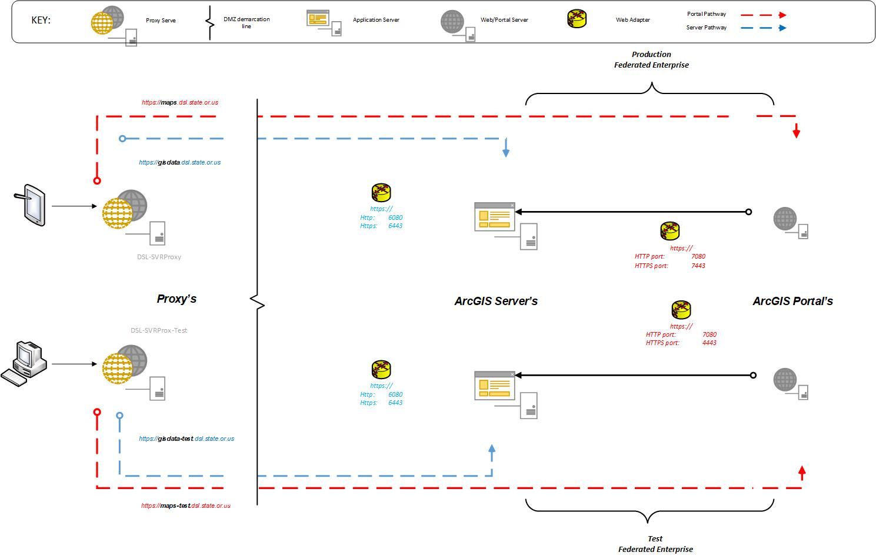
Enterprise Architecture: Production & Test
Enterprise Architecture: Production & Test

Slide 6
Portal structure
Portal as Spatial Content Management
Groups – Agency subject/content:
Hydro
Cadastral
Apps
Groups for Agency Divisions
Bend
South Slough
Looking to create Test Groups in Production.
Limited access to Test environment. Only for Admin etc
Groups for other agencys (secure work)
DAS - Collaboration
ODOT
ODOF

Slide 7

Windows Firewall Ports
Ports reserved to following:
ArcGIS Server
6443
6080
ArcGIS Portal
7443
7080
DataStore
2443
9876

Slide 8
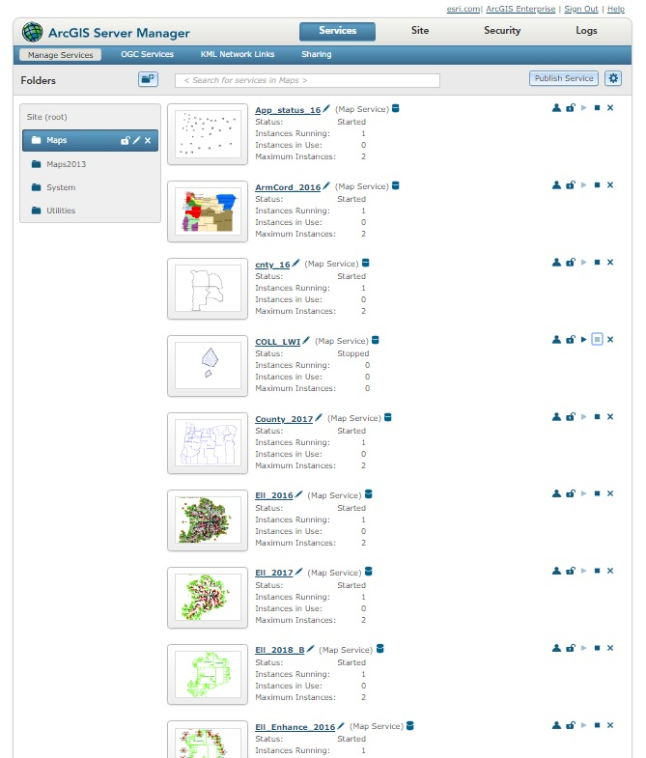
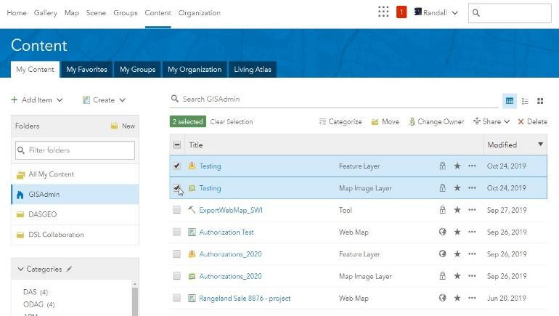
Content Management)
Old Way:
ArcGIS Server (Stand Alone)- content management is limited and crude.
Designed for Administrators.
New Way:
Enterprise/Portal – (federated) content management is simple and efficient.
Designed for Users..
Membership assigned to appropriate Group. Galleries promote discovery. Tags allow fast search/discovery
Notes:
Testing ….

Slide 9
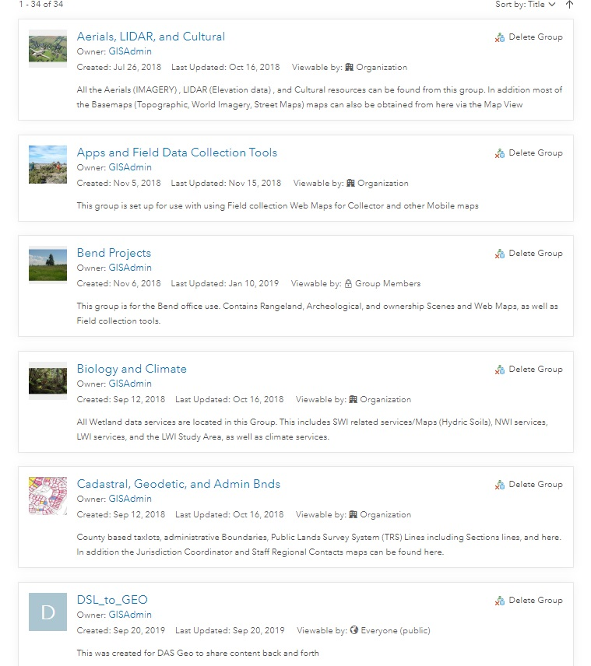
Portal Groups

Slide 10
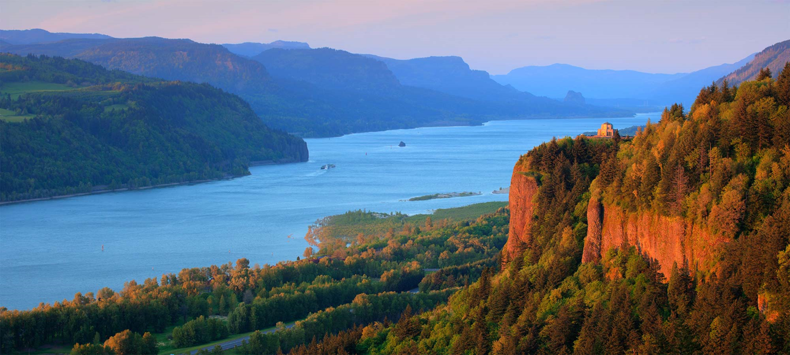
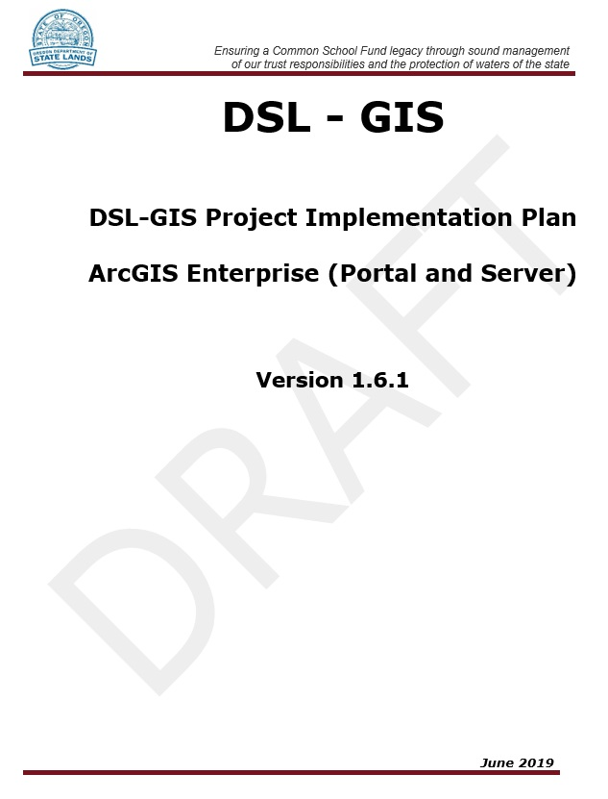
Enterprise - Plan it out …
Objectives - define strategies/implementation steps to attain the Goals.
Workflow - will decide your Process steps.
The Implementation plan should illuminate the Road down the path to GIS success. Is the process that transforms a strategic plans objectives into actions to reach you goals. Describes how the technology is put into place. Why Implementation Is Important? implementation is the necessary step that transforms your strategic plans into action to achieve your goals. Not a static document and continues to evolve.

Slide 11
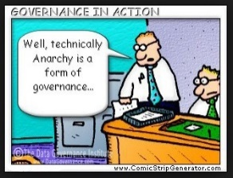
Governance
Guiding principals
Establishes Responsibility and sustainability. Authority and Accountability
Promote independence to Members/Stakeholder. Avoid conflicts of interest.
Adhere to procedures/structure. Promote Integrity of System and Security. (Both Enterprise Database and Portal)
Demo a Data Quality improvement in one component of project. Resource Availability (Authoritative date) is a must.
Focus on User Needs not Solutions. Create transparency of decisions and actions. Allow users opportunity for authority/accountability. Promotes the “Agile” approach.
Start with Needs not Solutions. Demo a data quality improvement in one component of project
Can Governance solve some business problems? If driven by IT wont work. Need users to own it. Demonstrate the value.
Support Early Adopters – identify staff in business who understand benefits. Allow transfers of ownership to them.

Slide 12
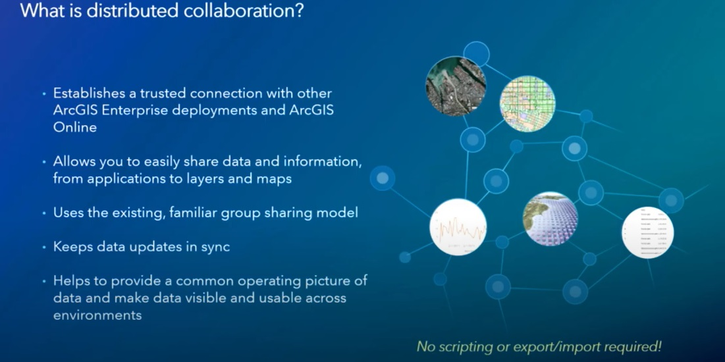
Portal – Collaborations Agencies to DAS Geo
ESRI 2019
https://www.youtube.com/watch?v=5uLzmuanVDw&ab_channel=EsriEvents

Slide 13

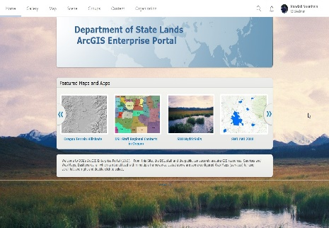
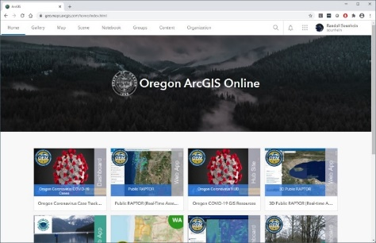
Collaboration Example (Department State Lands & DAS GEO)

Slide 14
The End
Questions?
Department of State Lands
GIS Coordinator (503) 986-5270
randy.sounhein@dsl.state.or.us

