Slide 1
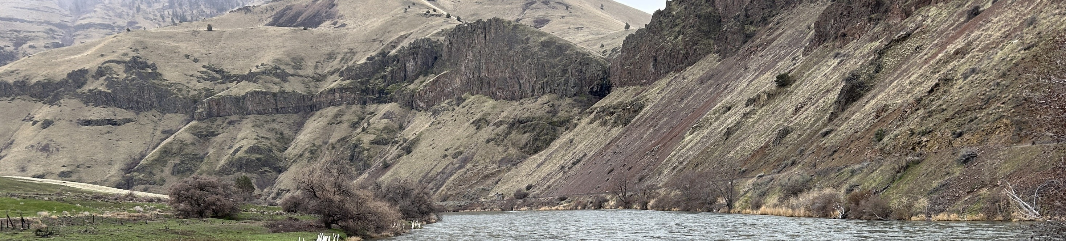
Updated Oil Spill Response Plans for the Deschutes River
OR DEQ Emergency Response Program
Sarah Behrman
12 May 2026
Presented remotely at the GIS Program Leaders monthly meeting

Slide 2
Geographic Oil Spill Response Plans (GRPs)
Geographic Oil Spill Response Plan
For a waterway or transportation route

Slide 3
Geographic Oil Spill Response Plans (GRPs)
Geographic Oil Spill Response Plan
For any type of oil or hazardous material that doesn’t mix with water

Slide 4
Geographic Oil Spill Response Plans (GRPs)
Geographic Oil Spill Response Plan
For the first 24-48 hours of the response to a major spill

Slide 5









Components of a GRP
Potential Spill Origin Points
Strategies
  Response
  Notification
Boat Ramps and Staging Areas
Priority Tables
Lots and lots of maps

Slide 6





Resources at Risk
  Tribal designated areas
  Cultural designated areas
  Water intakes
  Threatened and Endangered Species
  Waterfowl
  Fish
  Riparian habitat
  Recreational swimming/shoreline use
  Boat Launches

Slide 7
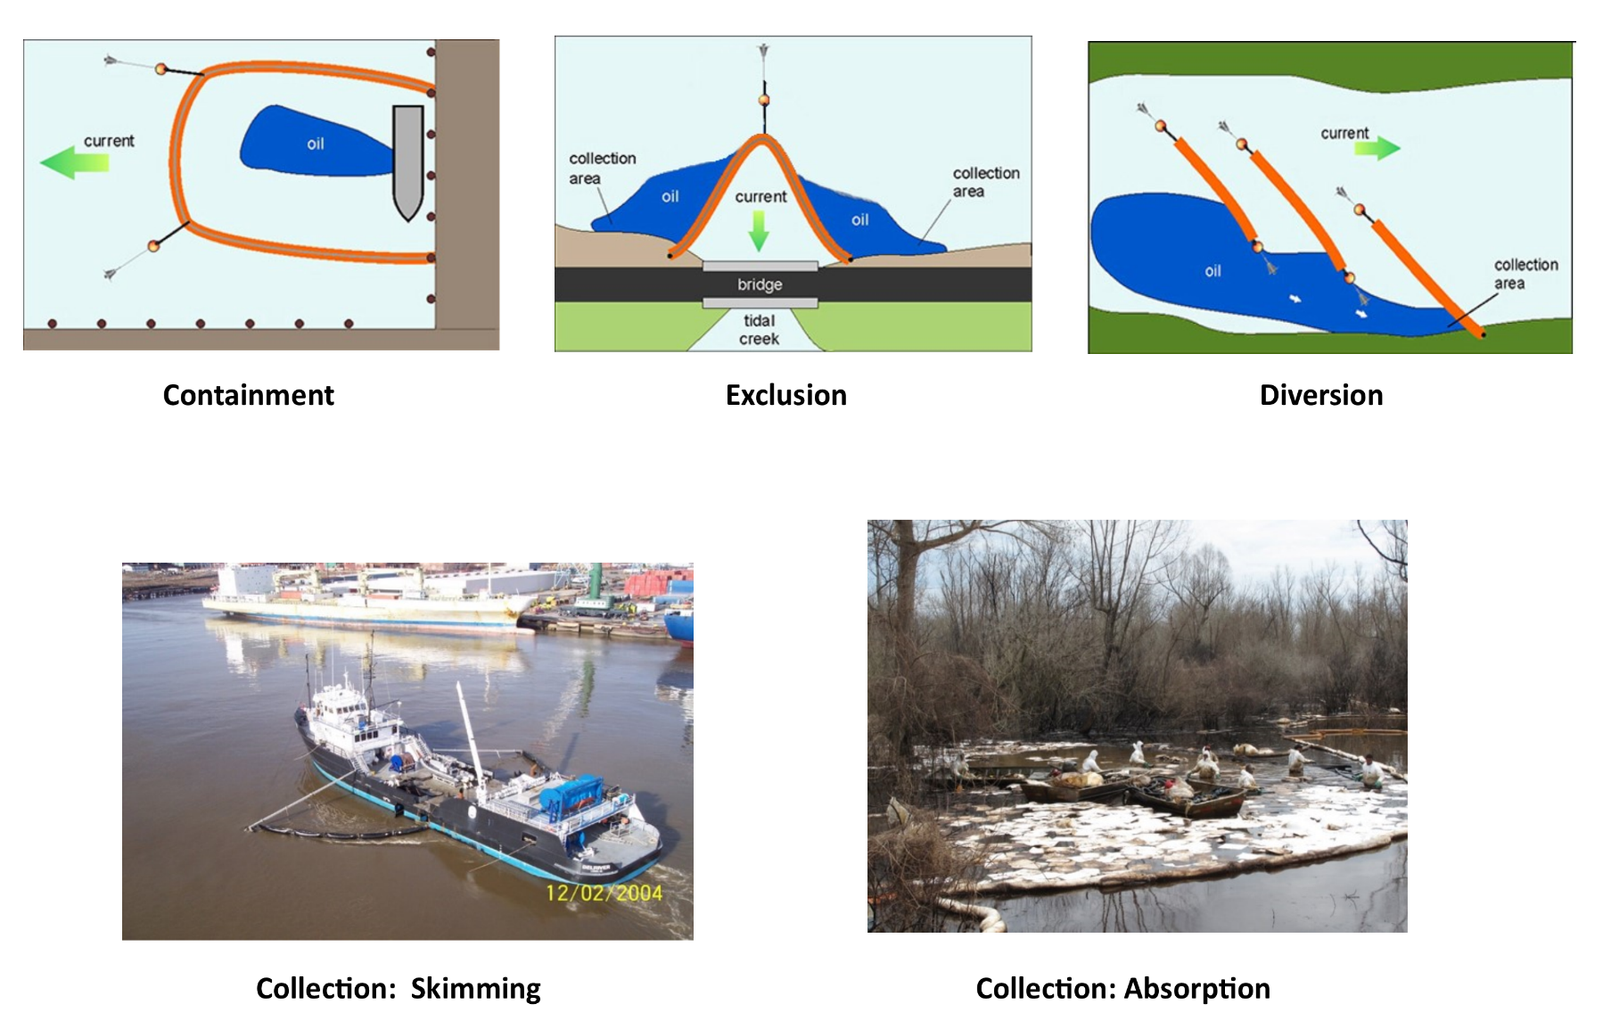
Types of Strategies
Not pictured: Notification Strategies
Image Credits:
Top row: Massachusetts DEP
Bottom row: NOAA ORR

Slide 8
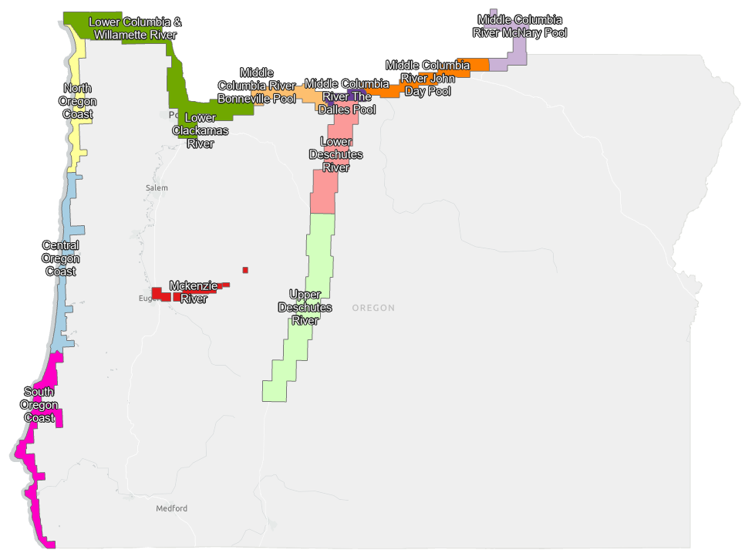
Current GRPs

Slide 9
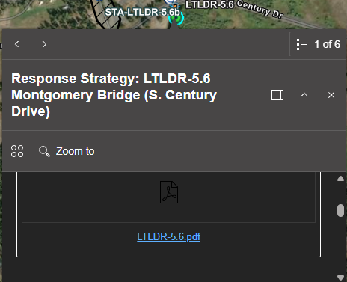
How to Access the Plans
Option 1: PDFs of full plans, linked from DEQ’s website
Download rather than view in a browser
Option 2: Interactive GIS Applications
Lower Deschutes River GRP
Upper Deschutes River GRP
Option 3: The best of both worlds
Navigate to strategies or features of interest in the GIS App
Download “2-pager” PDF reports and tables from feature pop-ups

Slide 10
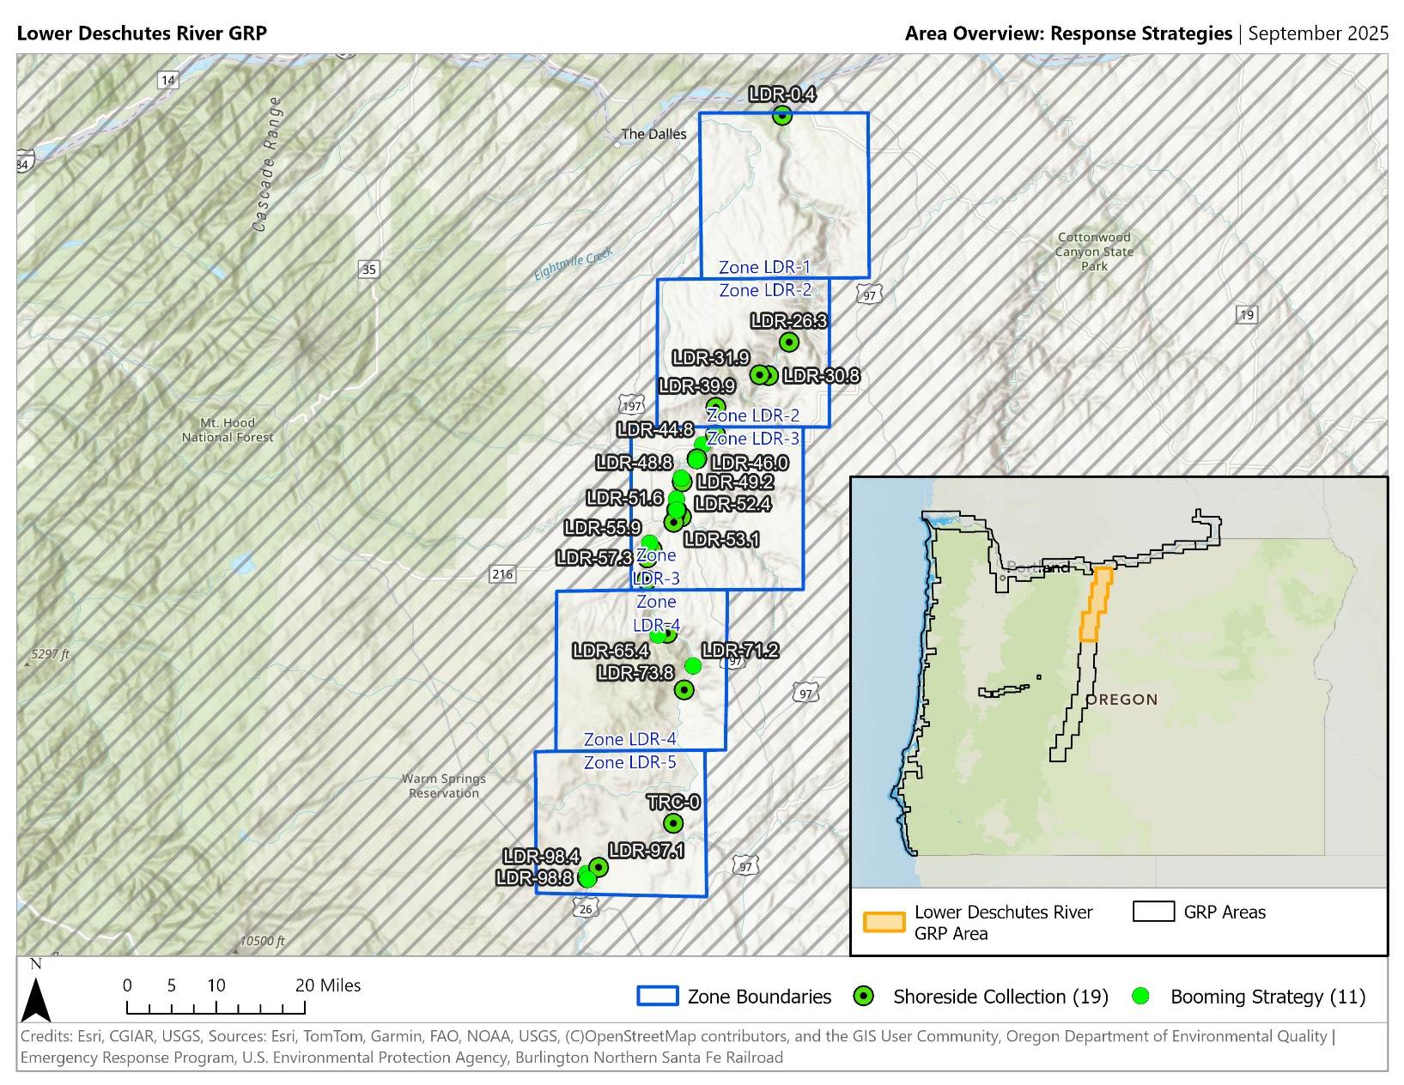
A Look at the Lower Deschutes GRP
River miles 0-100
30 response strategies
7 notification strategies

Slide 11
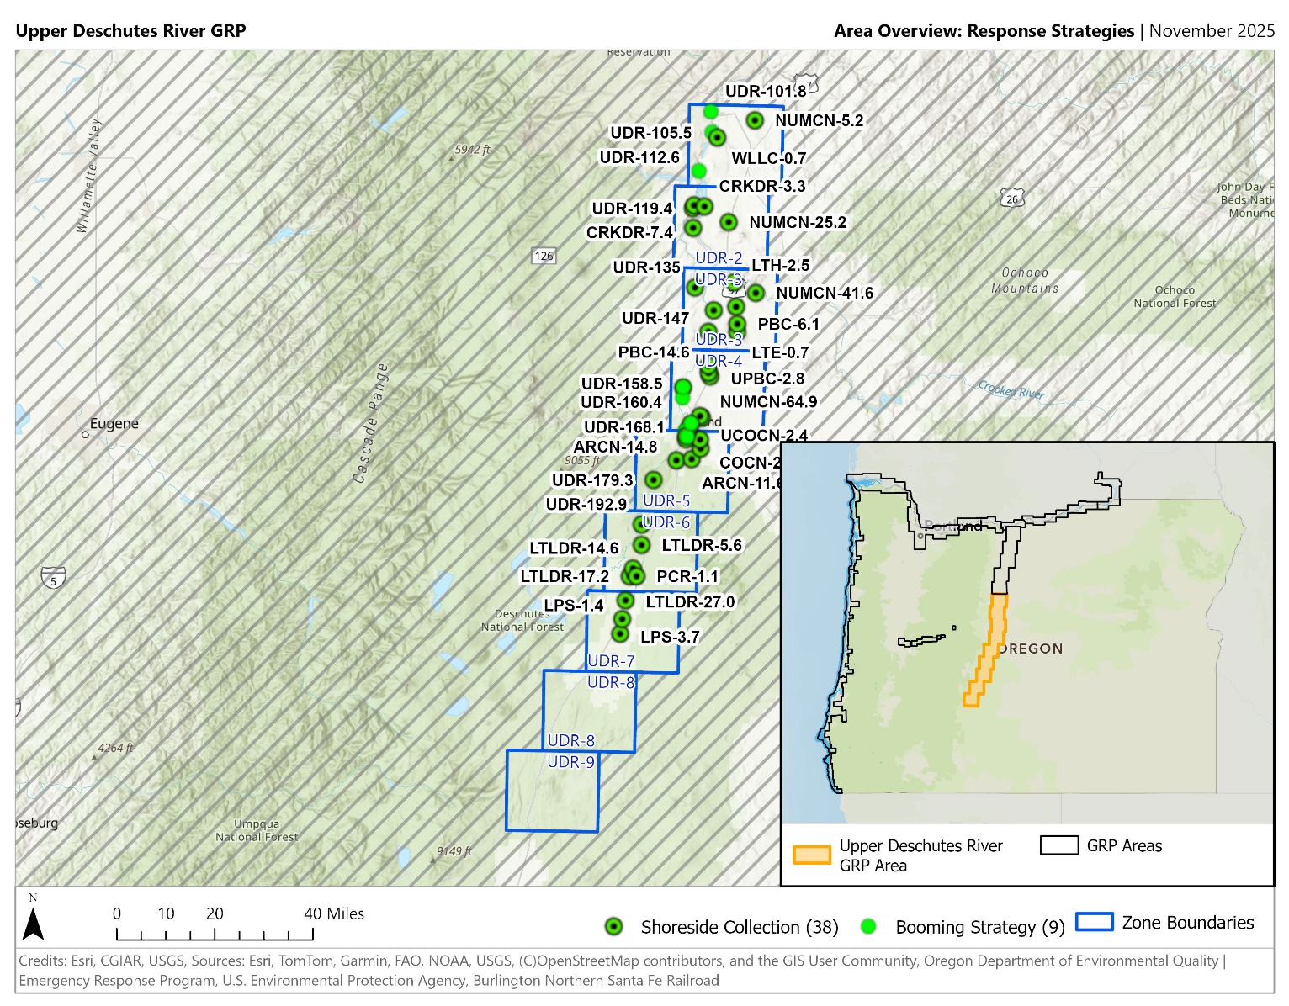
A Look at the Upper Deschutes GRP
River Mile 100 and up, plus Little Deschutes River and other tributaries and irrigation canals
47 response strategies
19 notification strategies

Slide 12
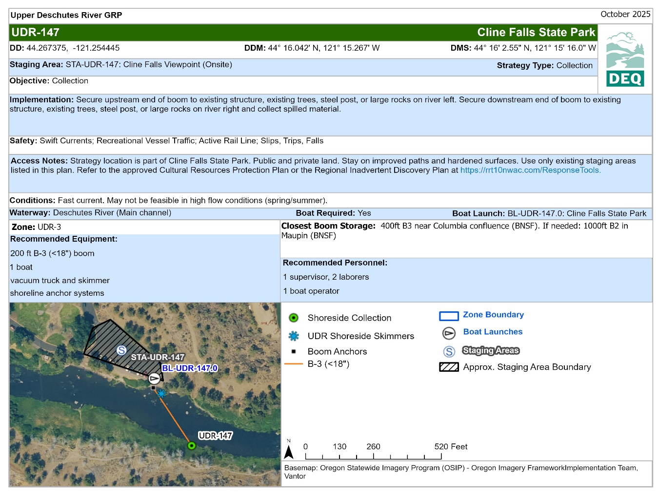
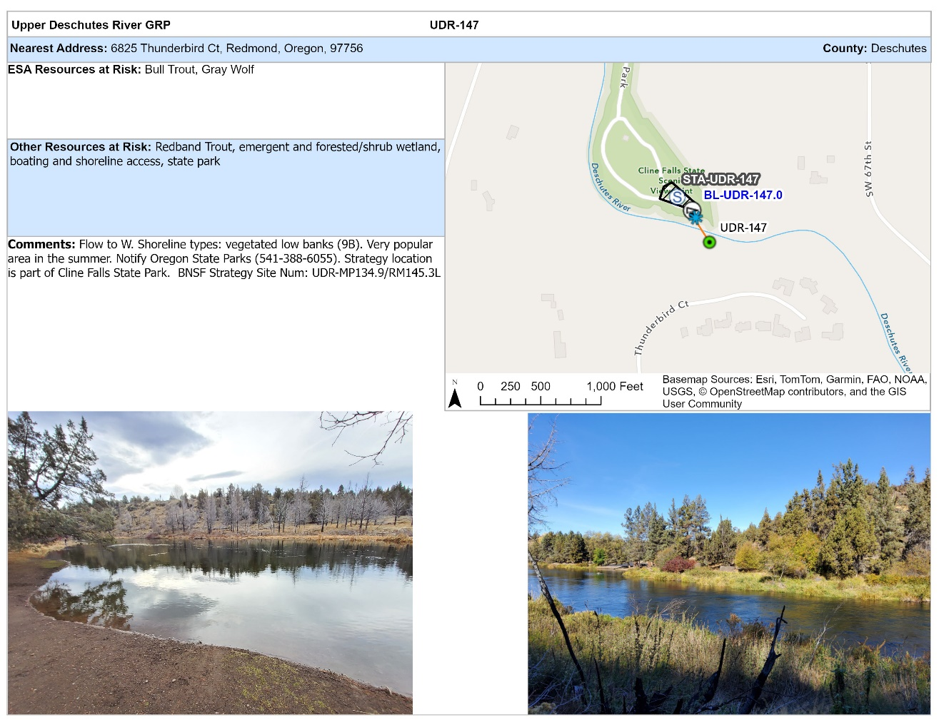
A Look at a “Two-Pager”

Slide 13





GIS Tools and Methods
Feature services hosted in ArcGIS Online
Daily backups using a Python script
Maps and 2-pagers: ArcGIS Pro layouts with spatial map series, exported as images
Document assembled in Word
OCR Text Detection on PDF
Experience Builder applications
Survey123 widget for feedback

Slide 14
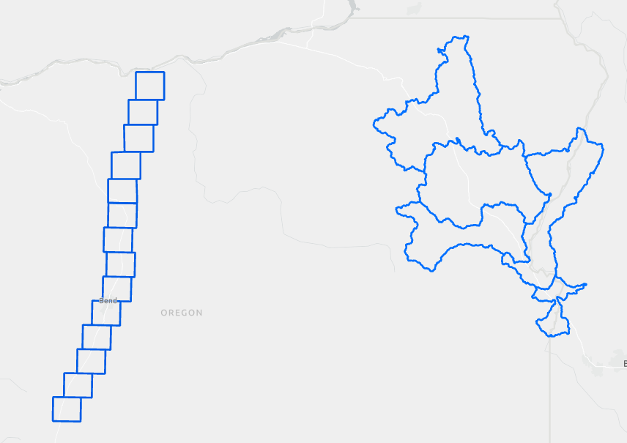

Planning for Future Plans
Accessibility: 2-pager layout is an issue
Zones: changing from rectangles to watershed boundaries

Slide 15
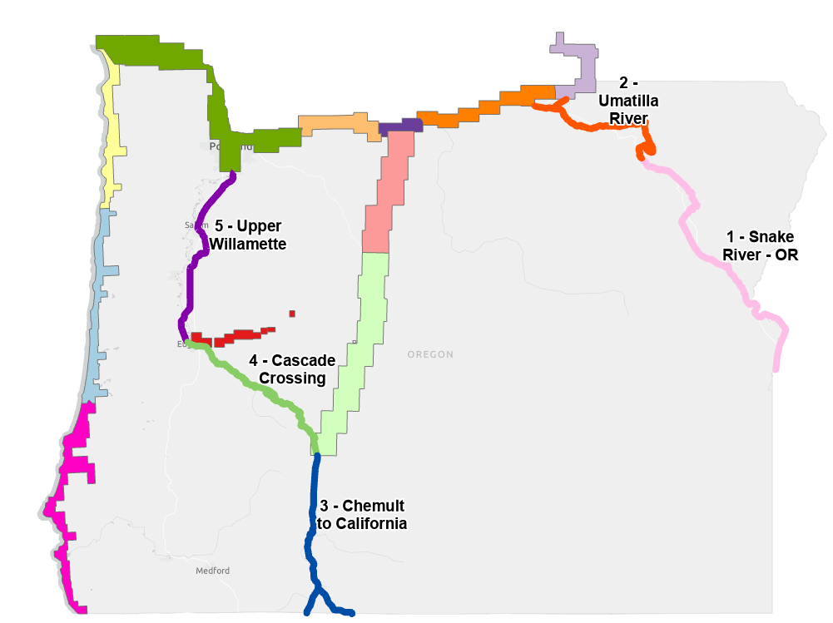
Future GRP Coverage

Slide 16
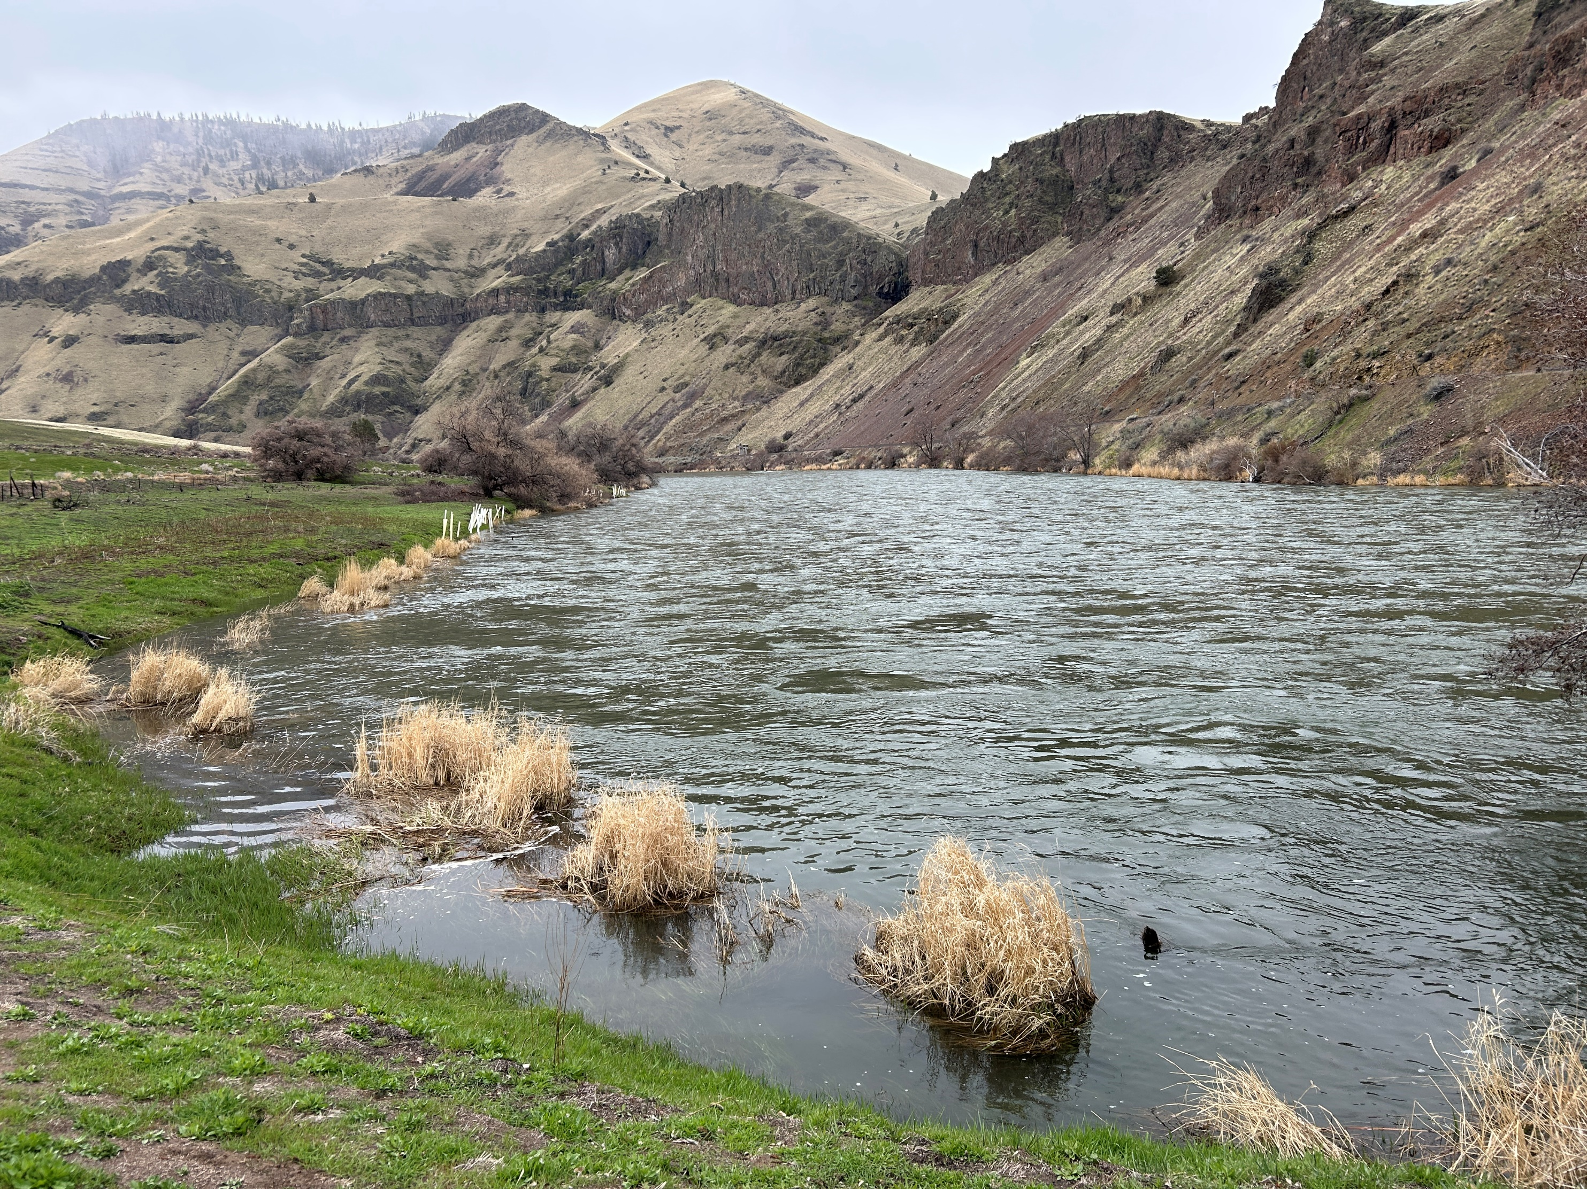
Questions?

Slide 17
Title VI and alternate formats
DEQ does not discriminate on the basis of race, color, national origin, disability, age, sex, religion, sexual orientation, gender identity, or marital status in the administration of its programs and activities.
Visit DEQ’s Civil Rights and Environmental Justice page.
Español | 한국어 | 繁體中文 | Pусский | Tiếng Việt | العربية
Contact: 800-452-4011 | TTY: 711 | deqinfo@deq.oregon.gov

