Slide 1
Grantee Webinar: Preparing for the Launch
June 28 and 30, 2011

Slide 2
Roadmapfor Today
Worksite Wellness: Program Overview
Website and Assessment
Statewide Launch
Media
Business

Slide 3
Health Insurance Premium Increases Outpace Inflation and Growth in Workers’ Earnings 1999-2010
Source: Kaiser/HRET Survey of Employer-Sponsored Health Benefits, 1999-2010. Bureau of Labor Statistics, Consumer Price Index, U.S. City Average of Annual Inflation (April to April), 1999-2010; Bureau of Labor Statistics, Seasonally Adjusted Data from the Current Employment Statistics Survey, 1999-2010 (April to April).

Slide 4
Medical Costs: Tip of the Iceberg
Direct Medical Costs
Medical
Pharmaceutical
Visible
Costs
Indirect Medical Costs
Missed Work
Presenteeism
Short-term Disability
Long-term Disability
Workers’ Compensation
Non-Visible
Costs
Indirect Medical Costs = 2-3 times Direct Medical Costs
Source: William B. Baun, EPD, CWP, FAWHP
University of Texas MD Anderson Cancer Center

Slide 5
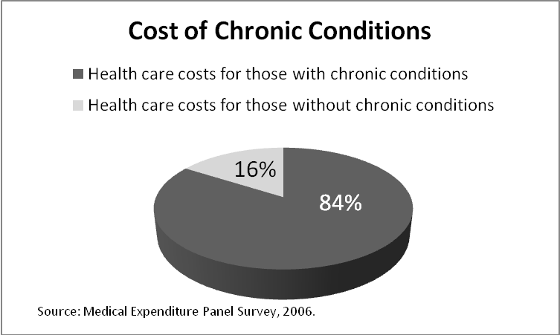
Annual Toll of Chronic Disease in Oregon
19,000 lives
$16 billion in health care costs
Countless hours of missed work

Slide 6
Oregon’s Young People: Our Future Workforce
Diagnosis of childhood chronic diseases almost quadrupled over past four decades
Childhood obesity more than tripled in past 30 years
1 in 3 children will develop diabetes over their lifetime, given current trends
If the trend continues, today’s young people could be first generation to live shorter lives than parents.
Source: Prevalence of obesity/overweight data source is 2007 Oregon Healthy Teens Survey
Daniels SR, Arnett DK, Eckel RH, et al. Overweight in children and adolescents: pathophysiology, consequences, prevention, and treatment. Circulation. April 19 2005; 111 (15): 1999-2012

Slide 7
Why Wellness at Work?
Employees spend nearly half their waking hours at work.
Environment shapes habits.
Habits at work influence habits at home.
Most Oregonians want to be healthy!
Did you know that…
80% of Oregon smokers want to quit.
90% of overweight and obese Oregon adults want to lose or maintain weight.

Slide 8
Wellness@Work: An Economic Imperative
A comprehensive, strategically designed investment in employees’ health pays off.
Source: Chapman LS. The Art of Health Promotion: Meta-evaluation of worksite health promotion economic return studies: 2005 update. Am J Health Promotion, 19 (6), July/Aug 2005
Lowers health care costs by 26%
Reduces sick leave by 27%
Reduce workers’ compensation costs by 32%
Return on Investment
For every $1 spent on wellness programs, an average of $5 (range of $2-19) is saved.

Slide 9
Oregon’s Commitment to
A statewide initiative to create healthier worksites guided by leaders from business, public health, health care, and education
Contributes toOregon’s Triple Aim to:
Improve lifelong health of all Oregonians
Lower or contain cost of care
Increase the quality, reliability and availability of care
Notes:
9
9

Slide 10
About Wellness@Work
Local Action Forums
Central Oregon
Southern Oregon
Metro Area
Website and online assessment tool www.healthoregon.org/wellnessatworkthat helps employers:
Assess their wellness needs
Modify sample policies
Create a doable, step-by-step wellness program

Slide 11
The Launch: Talk it Up
Health care costs continue to soar in Oregon, driven largely by ongoing, preventable health conditions: costs money and quality of life.
Employers can reverse this trend by creating a culture of wellness at work.
Worksite wellness can contain costs, decrease absenteeism, improve morale, cut workers’ compensation claims, and help attract and retain healthy employees.
Healthy habits at work carry over into home life, benefiting children and families.
Employers of all sizes and types are taking steps to support employee health—and improve the bottom line.
Joining the worksite wellness movement is easy, affordable and fun. Visit www.healthoregon.org/wellnessatwork to get started.
Notes:
11

Slide 12
The Launch: ID Local Success Stories
Boeingadopted tobacco-free policy and turned smoking shelter into bicycle parking
City of Albanyrented garden plot for $20; spent another $20 for vegetable starts for healthier eating and physical activity
DuckwallPooleycut workers’ compensation costs in half by incorporating stretching into workday
Use the storytelling tool and website

Slide 13
The Launch: Media Outreach
Place stories with your local media
News release, pitch points
Editorial board how-tos and pitch points
Op ed
Notes:
13

Slide 14
Media Talking Points
Oregon and XXX County have launched Wellness@Work to help employers cut costs and improve employees’ health.
Covering this can illuminate the increasing trend and growing need for worksite wellness.
I have several ideas for how you might cover this…
I’d be happy to help connect you with
local businesses
experts from the XXX County Health Department and Oregon Health Authority
the Oregon Health Care Purchasers Coalition
To learn more, visit www.healthoregon.org/wellnessatwork.

Slide 15
The Launch: Promote the Website
Add the Wellness@Work badge to your website
Ask area associations and businesses to do the same
Notes:
15

Slide 16
Wellness@Work
Questions?
Don’t forget to tour the website to become more familiar with its functions!
www.healthoregon.org/wellnessatwork

