Slide 1
Results from TPEP Grantee Survey: Progress on Cross Agency Health Improvement Project Activities

Slide 2
Refresher since August…

Slide 3
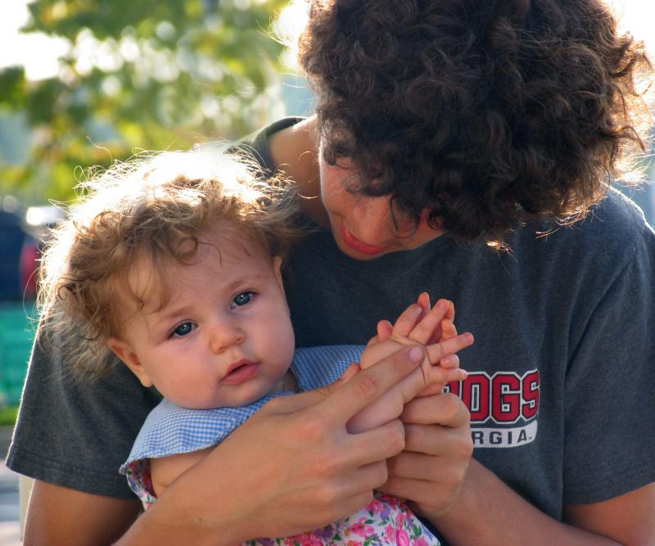
Cross Agency Health Improvement Project
CAHIP Work Plan Activities:
Ensure that Oregon Quit Line materials are available to SNAP ED clients and in Child Welfare offices.
On a quarterly basis, TPEP coordinators may reach out to SNAP Coordinators and Child Welfare offices to establish contact and promote Quit Line materials.
Jan ’14: TPEP coordinators were asked to contact SNAP ED coordinators and DHS Children and Families (CAF) District Offices.

Slide 4
Tobacco Education Project for People With Disabilities
Project Objectives:
Reduce tobacco use among Oregonians with disabilities and their providers;
Develop Quit Line referral systems in disability service provider agencies;
Increase the number of agencies that become tobacco free workplaces.
In July ‘14, TPEP grantees were asked to contact disability service provider agencies in their area to provide technical assistance.

Slide 5
Survey Results (Oct ‘14)

Slide 6
Survey completed by 38 grantees
Not completed by: Clatsop, Deschutes, Wallowa, Burns Paiute, CLUSI, Cow Creek, Siletz, Yellowhawk
Percentage of grantees who have reached out to local agencies
Percent

Slide 7
Successes
“I spoke at all staff meetings for DHS giving them Quitline promotion materials and helping them understand the benefits, as well as reviewing 2A & R. They put posters up promoting the Quitline and asked their staff to refer where appropriate.”
-Polk County
“The SNAP Ed program lead is a close community partner that we work with regularly and are supportive of our work. I've asked her if she could connect me with others in the SNAP department and offered to present to her staff.”
-Klamath County
“We have partnerships with the County Development Disability office, and are working through Community Health Improvement Plan activities to support both of these agencies in tobacco cessation resources for their clients.”
-Lincoln County

Slide 8
Challenges
“The barrier for me has been the need to connect with other TPEP coordinators and coordinate our efforts before we contact DHS.”
-Union County
“DHS staff don't feel that tobacco prevention is an important part of their job (i.e. they feel not pressure from their program to refer to the Quit Line).”
-Polk County
“I sent an email to our CAF district but have not received a response”
-Multiple grantees
“We are in between TPEP Coordinators.”
-Multiple grantees

Slide 9
How HPCDP Can Support Grantees
Provide training on the 5A's and/or 2A's protocol
Share talking points, data, presentation templates, model protocols
Work with DHS leadership to promote tobacco policies/protocols
Support tribal based campaigns, diverse promotional materials
Allow time at state sponsored meetings to discuss things regionally
Provide hard copies of Quit Line materials

Slide 10
Next Steps & Discussion
Develop talking points, PowerPoint template
New Quit Line materials for disability community
Follow up during RSN calls, next reporting interviews

