Slide 1
Health Promotion Chronic Disease Prevention - (HPCDP) Connection
New Coordinator Orientation Webinar
August 19, 2015
Jenica Palmer
Community Programs Liaison/Comprehensive Cancer Programs Coordinator
Public Health Division
Oregon Health Authority
PUBLIC HEALTH DIVISION
Center for Prevention and Health Promotion
Notes:
Webinars:
will be held quarterly with a total
of four (4) calls in the year. All coordinators who have been in TPEP for less
than a year are required to attend. Coordinators who have worked for TPEP for
more than a year are also invited, but not required to attend. These calls will
cover skills and topic areas necessary to perform TPEP work and are intended
to supplement orientation provided by the HPCDP liaison and the local health
department.
In addition to these calls which are set up and staffed by HPCDP personnel,
experienced coordinators are strongly encouraged to organize ongoing peer
mentoring of new coordinators in order to strengthen the statewide TPEP
program and facilitate advancement of common goals and strategies. HPCDP
staff will provide assistance and support to mentors with the goal of
strengthening the peer network and enhancing capacity in the field.

Slide 2
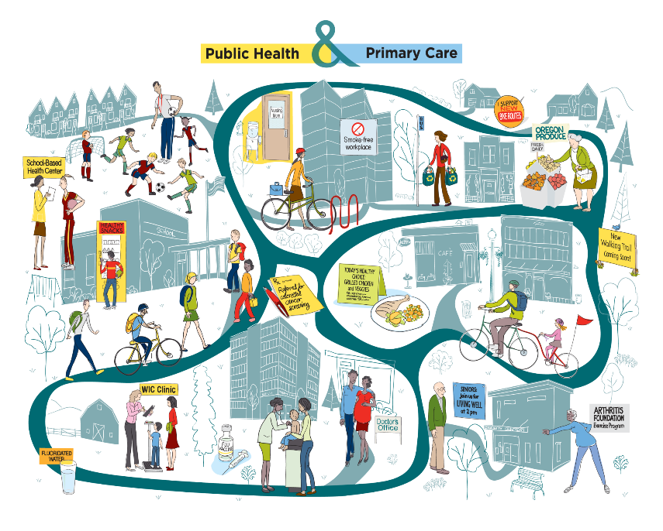

Tobacco Prevention and Education Program &
Healthy Communities Program
Evidence-based, data-driven work
Need for understanding your
local community (live, work,
learn and play)
Community Readiness
Engage Stakeholders

Slide 3
What is HPCDP Connection?
Oregon Public Health Division main web page: https://partners.health.oregon.gov/Pages/Home.aspx
HPCDP Connection
A web-based resource hub for HPCDP grantees and contractors, specifically Tobacco Prevention and Education Program (TPEP) and Healthy Communities coordinators.
HPCDP Connection www.healthoregon.org/hpcdpconnection
  Username: HPCDP
  Password: Communities12 (both are case sensitive)
Notes:
HPCDP Connection offers a myriad of tools and resources that can inform and guide your work – ways to assess where you are, where you want to go, and how to get there. But as you will see in this walk-thru of the site, the pathway to change is not necessarily straightforward. It can begin in the middle, jump ahead, and circle back around. You just need to have a plan, be patient, and not be afraid to ask for help along the way.

Slide 4

Take Away Points for HPCDP Connection
Developed over time to adapt to the needs of grantees
One of several methods for training and technical assistance to help you achieve your work (liaison, in person trainings, list serves, etc.)
Contact your liaison if you need help finding what you are looking for
Notes:
A lot of staff oversee HPCDP Connection- if you find a link that does not work, please let your liaison know.

Slide 5

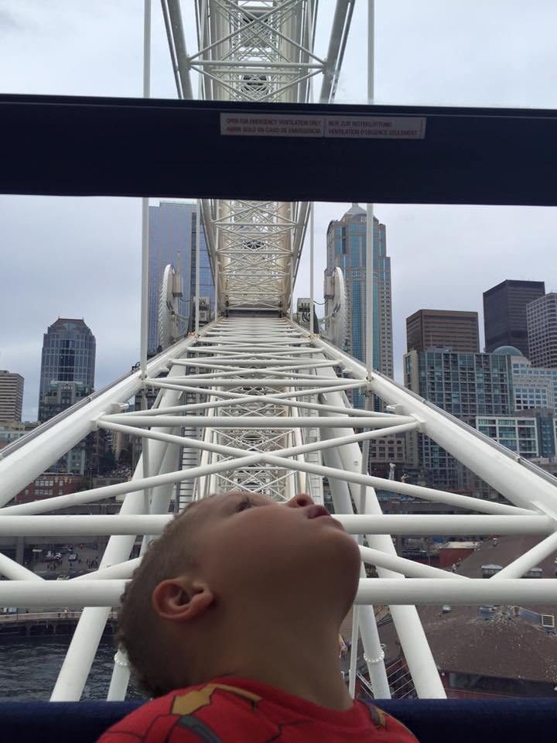
Questions?
Contact Information:
Jenica Palmer
Jenica.palmer@state.or.us
Ph: 971-673-1117
Jennifer Diallo
Jennifer.Diallo@state.or.us
Ph: 971-673-1080

