Slide 1
Protecting Youth Through Tobacco Retail Licensing
[INSERT YOUR COUNTY PUBLIC HEALTH LOGO IF DESIRED]
[YOUR NAME]
[YOUR TITLE, COUNTY PUBLIC HEALTH DIVISION]
[DATE]
Notes:
Hi, I’m [NAME], [TITLE] with [COUNTY HEALTH DEPARTMENT].
Thank you for taking the time to learn about what our county is doing to keep youth tobacco-free.

Slide 2
Overview
Youth & tobacco
Retail tobacco in our community
Tobacco Retail Licensing and the benefits to our community
Tobacco Prevention + YOU!
Notes:
I’ll share some information with you about tobacco use among youth, and then we’ll take a look at how tobacco is marketed and sold in our community. Next we’ll discuss Tobacco Retail Licensing—one of the most effective strategies to prevent youth tobacco initiation and use—and, finally, your role in tobacco prevention in [COUNTY]. Let’s get started …

Slide 3
Youth and Tobacco
Youth are vulnerable to nicotine
90% of smokers begin before age 18
Adverse consequences for brain development
Can lead to long-term addiction
Tobacco industry creates new products and flavors to appeal to youth
[INSERT STATISTICS AND DATA FROM YOUR COUNTY]
Notes:
Youth are vulnerable to nicotine: The brain’s peak period for developing addiction starts in adolescence, and early exposure to nicotine paves a pathway for future addiction of all kinds.
90% of smokers begin before age 18, and more than three quarters of smokers start before the age of 20.
Because young people’s brains are still developing, they are more sensitive to the effect of nicotine—specifically, the so-called “rewarding properties” that make people want more and that lead to addiction.
Nicotine exposure during adolescence may have lasting adverse consequences for brain development.
If you’ve ever tried to quit smoking, or know someone who has, you know it’s a very difficult addiction to break. So it’s vital that we keep young people from getting addicted in the first place.
The tobacco industry knows all of this, so they focus on hooking new smokers when they’re young to create a pipeline of future customers. Two of their current tactics are marketing fruit- and candy-flavored products, and marketing e-cigarette or vape devices that use flavors and are easy for youth to hide. As a result, vaping is now outpacing cigarette smoking among youth. I’ll tell you more about that in a minute.
First, here’s what youth tobacco use looks like in our county ... [INSERT STATS AND DATA FROM YOUR COUNTY]
SOURCES:
Where are Kids Getting JUUL? The Truth Initiative, May 29, 2018. http://www.truthinitiative.org/news/where-are-kids-getting-juul. Accessed 9/17/18.
Willett, JG, et al. Recognition, use and perceptions of Juul among youth and young adults. Tobacco Control. 2018. http://dx.doi.org/10.1136/tobaccocontrol-2018-054273. Accessed 9/17/18.
Preventing Tobacco Use Among Youth And Adults: A Report of the Surgeon General. Centers for Disease Control & Prevention, 2012, www.cdc.gov/tobacco/data_statistics/sgr/2012/consumer_booklet/pdfs/consumer.pdf. Accessed 9/23/18.
Robinson, LA, Klesges, RC, Zbikowski, SM, Glaser, R. Predictors of Risk for Different Stages of Adolescent Smoking in a Biracial Sample. Journal of Consulting and Clinical Psychology. 1997;65:653-662. doi:10.1037/0022-006X.65.4.653.
The Health Consequences of Smoking—50 Years of Progress: A Report of the Surgeon General. 2014. https://www.surgeongeneral.gov/library/reports/50-years-of-progress/full-report.pdf. Accessed 10/4/18
Kandel DB, Kandel ER. A Molecular Basis for Nicotine as a Gateway Drug. New England Journal of Medicine. 2014. http://www.nih.gov/news-events/nih-research-matters/why-nicotine-gateway-drug. Accessed 10/4/18

Slide 4
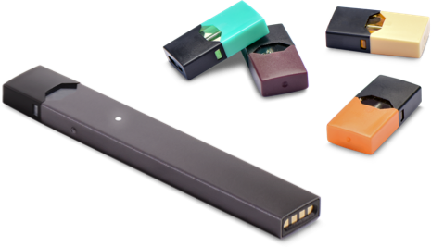
Marketing to Youth
Sweet flavors mask tobacco’s harsh taste
High tech products look cool and are easy to hide
Youth don’t realize it contains nicotine
It’s highly accessible
Pictured: JUUL device with pods
Notes:
There are currently over 15,500 tobacco flavors … and counting. Many of them are fruit and candy flavored—designed to mask the harsh taste of tobacco and appeal to youth. These flavors are found in e-cigarettes as well as mini cigars and other products.
Youth are using electronic cigarettes or “vape pens” more than other tobacco products. (The official name for these devices is inhalant delivery systems.)
Adolescents of showed an increased use of e-cigarettes since 2013.
In Oregon, e-cigarette use among 11th graders nearly tripled from 2013 to 2017 from 5% to 13%.
JUUL is a brand of e-cigarettes that has skyrocketed in popularity among teens across the United States, commanding over half the e-cigarette market.
High tech, it looks like a USB flash drive and charges in a computer.
It’s available in sweet flavors and small enough to fit into a closed hand, making it easy for youth to use inconspicuously in school.
Just one JUUL pod contains as much nicotine as a pack of cigarettes! Let me say that again—one JUUL pod contains as much nicotine as a pack of cigarettes. It’s highly addictive.
That’s not commonly known. In fact, a recent study found that 63% of JUUL users, ages 15–24, did not know the product always contains nicotine.
The most common way youth buy JUUL is through retail locations in the community. Nearly three quarters (74%) of youth said they obtained JUUL at a store or retail outlet.
These are not a safe alternative to cigarettes—they’re addictive and the nicotine they deliver can harm young people’s brains.
These products are easy to get—and perception of easy access is one of the strongest predictors of smoking initiation in youth. If they see it being used and think it’s easy to get, they’re more likely to start.
SOURCES:
Oregon Tobacco Facts Report. Oregon Health Authority, 2018: https://apps.state.or.us/Forms/Served/le9139.pdf. Accessed 9/10/18.
Where are Kids Getting JUUL? The Truth Initiative, May 29, 2018. http://www.truthinitiative.org/news/where-are-kids-getting-juul. Accessed 9/17/18.
Willett, JG, et al. Recognition, use and perceptions of Juul among youth and young adults. Tobacco Control. 2018. http://dx.doi.org/10.1136/tobaccocontrol-2018-054273. Accessed 9/17/18.
Preventing Tobacco Use Among Youth And Adults: A Report of the Surgeon General. Centers for Disease Control & Prevention, 2012, www.cdc.gov/tobacco/data_statistics/sgr/2012/consumer_booklet/pdfs/consumer.pdf. Accessed 9/23/18.
Robinson, LA, Klesges, RC, Zbikowski, SM, Glaser, R. Predictors of Risk for Different Stages of Adolescent Smoking in a Biracial Sample. Journal of Consulting and Clinical Psychology. 1997;65:653-662. doi:10.1037/0022-006X.65.4.653.

Slide 5
In [COUNTY]
This is what tobacco marketing looks like in [COUNTY]:
[INSERT PHOTOS & DATA FROM YOUR COUNTY]
Notes:
In [COUNTY], this is how Big Tobacco is marketing to our youth …

Slide 6
Tobacco Retail Licensing
Requires businesses to purchase a license to sell tobacco and nicotine products
Retailer education and support
Enforcement system
Annual license fee
Notes:
Tobacco Retail Licensing is an effective strategy being used in many other states and in several Oregon counties. It allows counties to do the following:
Require all businesses—including large retailers, convenience stores, gas stations, pharmacies and bars—to purchase a license to sell tobacco.
Provide tobacco education and support to retailers (education can take many forms, including online training and one-on-one technical assistance).
Implement an enforcement system, which includes regular inspections with the possibility of penalties such as fines and suspension of license to sell tobacco.
Charge an annual licensing fee, needed to cover the cost to administer licenses, educate retailers and conduct compliance checks.
Let me share more about why these things are so important in our work to prevent youth tobacco use ...

Slide 7
Tobacco Retail Licensing Benefits
Increase compliance checks for underage sales
Provide education
Enforce penalties
Notes:
This year (2018), Oregon increased the state’s tobacco product sales age to 21 (Tobacco 21), which now aligns with alcohol and marijuana sales. However, tobacco is one of the only products that is not licensed.
Here’s what Tobacco Retail Licensing would allow us to do to protect youth:
The OHA Public Health Division coordinates with the Oregon State Police to conduct unannounced compliance checks for underage sales, using minor decoys. But due to the State’s limited capacity and resources, only a random sample of retailers get selected for compliance checks. This means many tobacco retailers in Oregon can go one or more years without being inspected.
Tobacco retail licensing would allow [COUNTY] to augment the state’s system so that every tobacco retailer is inspected [FREQUENCY IN YOUR COUNTY].
Inspections would include education and penalties for violations. Penalties motivate clerks and owners to be more vigilant about checking IDs before selling tobacco.

Slide 8
Tobacco Retail Licensing Benefits
Increase compliance checks
Provide education
Enforce penalties
Reduce density of tobacco retailers
Set limitations on proximity to schools
Notes:
In places that have Tobacco Retail Licensure, it is also possible to take further action to keep tobacco away from young people. For example, some counties use Tobacco Retail Licensure to reduce the density of tobacco retailers in a given area and limit the number of retailers that can be near a school.
Studies show that both of these factors impact youth tobacco rates. Youth are more likely to experiment with smoking in areas with more tobacco retailers. Prevalence of smoking is higher at schools with five or more retailers within the area.
We also know that tobacco retailers cluster in neighborhoods with higher rates of poverty. High densities of tobacco retailers are linked to increased smoking rates among adults. So not surprisingly we see higher rates of tobacco use among people living with lower incomes—and therefore higher rates of tobacco-related chronic diseases, like heart disease and lung cancer.
SOURCES:
Henriksen, L, Feighery, EC, Schleicher, NC, Cowling, DW, Kline, RS., Fortmann, SP. Is adolescent smoking related to the density and proximity of tobacco outlets and retail cigarette advertising near schools? Preventative Medicine. 2008;47:210-214.57
McCarthy, WJ, Mistry, R, Lu, Y, Patel, M, Zheng, H, Dietsch, B. Density of Tobacco Retailers Near Schools: Effects on Tobacco Use Among Students. American Journal of Public Health. 2009;99: 2006-2013. doi: 10.2105/AJPH.2008.145128.

Slide 9
Tobacco Retail Licensing Benefits
[INSERT OTHER PROPOSED TRL POLICIES OR PLUG-INS IN YOUR COUNTY]
Notes:
Additional benefits in our county include
[INSERT NOTES ON OTHER PROPOSED TRL POLICIES OR PLUG-INS]

Slide 10
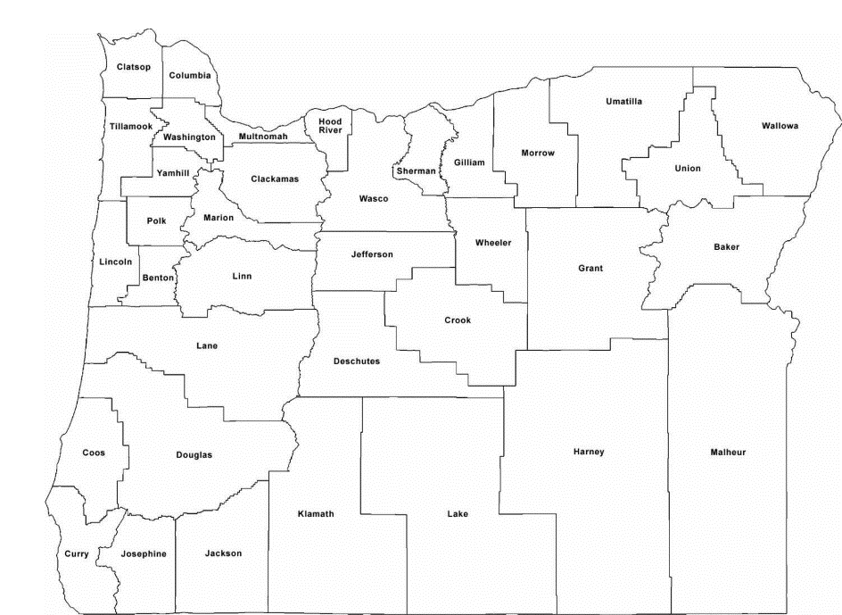
Tobacco Retail Licensing in Oregon
We are one of only 9 states that doesn’t have Tobacco Retail Licensing
Lessons leaned from Benton, Klamath, Lane & Multnomah Counties
Notes:
Oregon is one of only nine states in the country that has not passed a statewide Tobacco Retail License. As a result, counties are taking the initiative to pass licensing themselves to reduce youth access to tobacco and protect the health and safety of their communities.
Benton, Klamath, Lane and Multnomah Counties have all passed Tobacco Retail Licensing. Here are some things we’ve learned from them:
Tobacco Retail Licensing is most effective when implemented countywide.
Support from city leaders is critical to successfully pass and implement Tobacco Retail Licensing.
A licensing fee is needed to cover education and enforcement.
Public Health Authorities are best positioned to implement Tobacco Retail Licensure.

Slide 11
Impact of Licensing
Reduce youth initiation of tobacco use
Reduce youth addiction to tobacco
Reduce lifelong tobacco use
Reduce tobacco-related disease & death
Increase productivity & health care savings
Notes:
Tobacco Retail Licensing ensures that all retailers are equipped with the appropriate information and tools to keep tobacco and nicotine inhalant devices out of the hands of our young people, and help protect them from a lifetime of addiction and poor health.
The American Lung Association Center for Tobacco Policy and Organizing studied the effects of a strong Tobacco Retail Licensing ordinance in 33 California communities in 2013:
They found significant decreases in illegal sales to minors in nearly every community.
14 communities saw decreases of 30% or more in the time since a strong licensing ordinance was adopted.
Tobacco Retail Licensing protects youth today and also sets us up for less tobacco-related disease and death, and increased productivity and health care savings.
SOURCE:
Tobacco Retailer Licensing Is Effective. The American Lung Association in California Center for Tobacco Policy and Organizing, 2013. https://center4tobaccopolicy.org/wp-content/uploads/2016/10/Tobacco-Retailer-Licensing-is-Effective-September-2013.pdf. Accessed 9/27/18.

Slide 12
Tobacco Prevention + YOU!
[INSERT YOUR CALL TO ACTION - What do you want this audience to do?]
Notes:
Here’s how you can help protect youth in our county for tobacco industry marketing and tobacco use:
[INSERT SPECIFIC REQUESTS AND CALLS TO ACTION]

Slide 13
Questions and Discussion
Notes:
I’d love to hear your questions and ideas about how we can protect our youth from tobacco industry marketing and tobacco use.

Slide 14
Contact Information
[INSERT YOUR CONTACT INFORMATION HERE]
Notes:
If you’d like to discuss this further or have ideas of how we can work together, please don’t hesitate to reach out. Here’s my contact information.

Slide 15
THANK YOU!
[INSERT YOUR COUNTY PUBLIC HEALTH LOGO IF DESIRED]
Notes:
Thank you for having me here today.

