Slide 1

Interagency Sustainability Coordinators Network
July 2, 2019

Slide 4
https://www.oregon.gov/energy/Get-Involved/Documents/2019-Efficient-Equipment-Standards.pdf

Slide 5
Other updates
Sustainability Board September meeting
  12-13, Astoria
  Plan guidelines high on agenda
Sustainable procurement pilot program
Resource Conservation Policy
Water report
What's next after cap and invest
Tools for real estate and PCM projects
Training needs: DAS training initiative

Slide 6
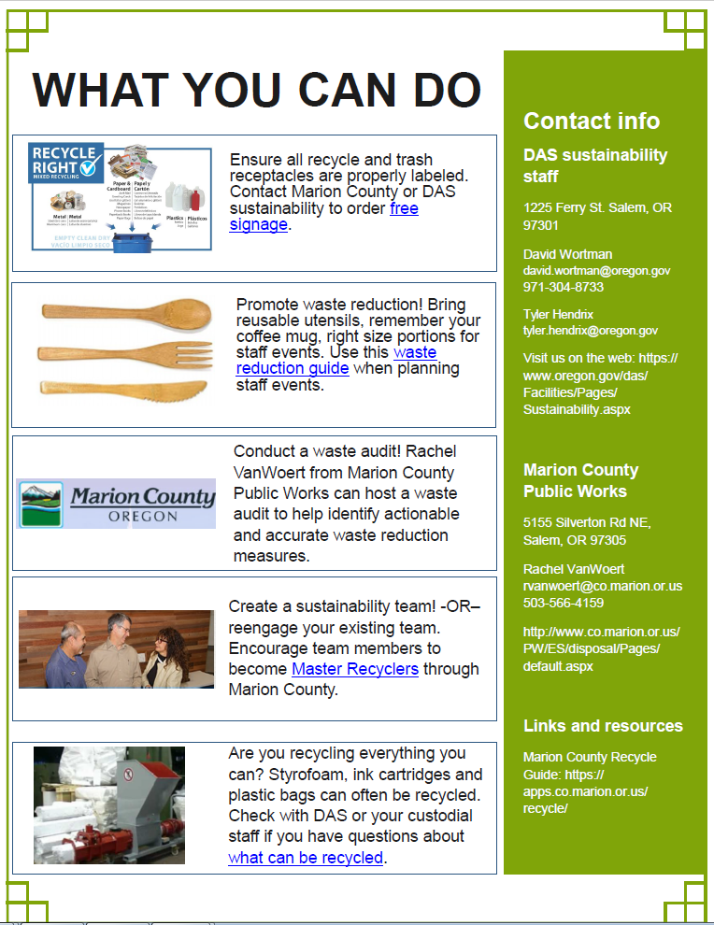

Slide 7
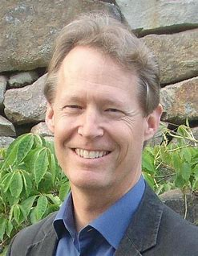
“Guest” speaker: Alan AtKisson
How to be a change agent for sustainability?

Slide 8



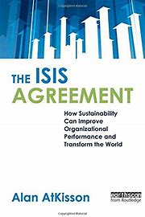

Alan’s books

Slide 9

How to be a change agent for sustainability?

Slide 10
How can we effectively promote change for sustainability?
What barriers have you confronted?
Where have you had success?
Where have you experienced epic failures?
Can you map your “amoeba”?

Slide 11
