Slide 1
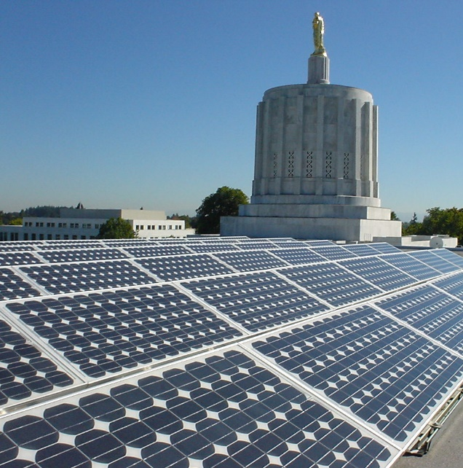
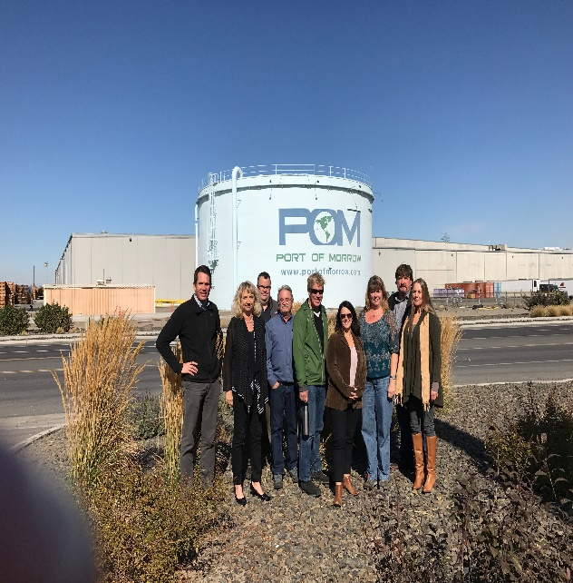
Oregon Department of Administrative Services
Interagency Sustainability Coordinators Network
February 2025
Notes:
About me first

Slide 2
ITEM | PRESENTER | TIME | ACTION/NOTES
Welcome
Welcome, introductions to new members. Quick announcements. Refresher on ISCN. Schedule for 2025. | Dave Wortman, DAS, All | 1:30-1:50 | Convene group, introductions, review agenda.
Oregon Sustainability Board | Josh Proudfoot, Board Member (tentative) | 1:50-2:15 | Purpose of the Sustainability Board, work planning, support for agencies. Questions from agencies.
Office of Sustainability 2025 work plan and statewide policy recap 2025 legislative session and sustainability-related bills | Dave Wortman, DAS | 2:15-2:30
Breakout discussion and report out: what are your challenges? Where do you need support? | Dave Wortman, DAS | 2:30-3:00
Adjourn |  | 3:00
Notes:
Main objective- re stablish why we’re here, and connections among us as agencies

Slide 3
Why are we here? EO 06-02 and the ISCN

Slide 4
Month | Topics | Guest Presenters (Tentative)
February 19 | Refresh on ISCN purpose, agency expectations and DAS support DAS Office of Sustainability role and annual work plan Role of Sustainability Board Refresher on statewide policies Agency roundtable: how can we best support you? | Oregon Sustainability Board member. Brief from one agency on their sustainability program – successes and challenges.
April 2 | Climate and agency operations Climate action planning Roundtable: how your agency integrates climate into agency considerations | Guest presenter from Maryland on state’s “agencies lead by example” initiative. Brief from one agency on their climate action planning efforts.
June 4 | Recycling changes – Recycling Modernization Act DAS experience and what it means for agencies – recycling and composting Roundtable: Input from agencies on recycling and composting challenges | DEQ Materials Management Program. Garten Services, Republic, Waste Management. Brief from one agency on their recycling and composting efforts.
August 6 | Legislative changes and state agency sustainability Presentation of updated Enterprise Sustainability dashboard – transparency and accountability Agency communications and training for sustainability Roundtable: Communications | DAS legislative director or coordinator. Brief from one agency on their communications efforts.
October 1 | Revised agency sustainability planning guidance How to be a change agent in your agency Roundtable: dealing with change in your agency | Guest presenter on behavior change in organizations.
December 3 | Field trip, TBD. | Potential visit: Garten Services Material Recovery Facility, Salem

Slide 5
About the DAS Office of Sustainability
Develop and implement statewide policy: e.g., energy and resource conservation, fleet, procurement
Implement executive orders related to agency operational energy, climate, water, equity and other topics
Serve as a resource for agencies: technical support, guidance, facilitation
Leverage sustainability opportunities across the enterprise
Support the Oregon Sustainability Board
Sustainability Plan Guidelines
Agency climate action planning tool
Engagement with Oregon communities
ORS 184:421: “Sustainability” means using, developing and protecting resources in a manner that enables people to meet current needs and provides that future generations can also meet future needs, from the joint perspective of environmental, economic and community objectives.

Slide 6
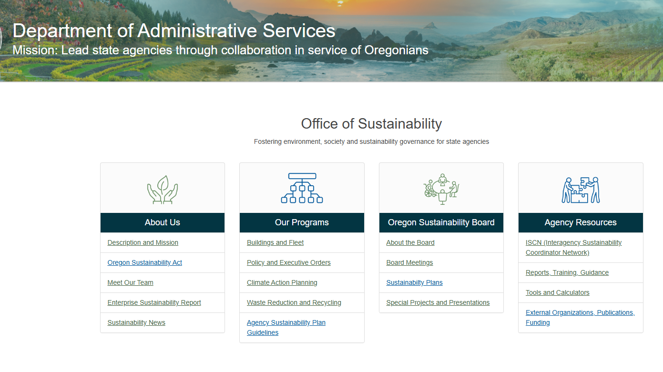

Slide 7
OREGON SUSTAINABILITY BOARD

Slide 8
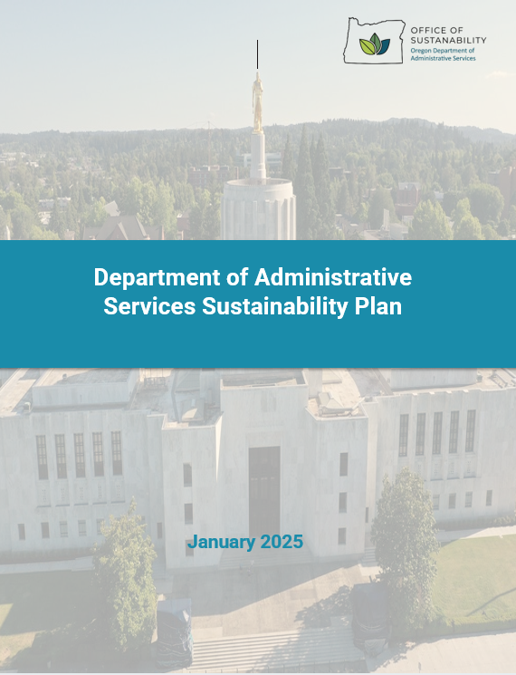

Slide 9
Other Updates
2025 legislative session – sustainability impacts on agency operations
Green Chemistry Policy being updated
Other policy reminders:
Sustainable Procurement Policy
Energy and Resource Conservation Policy
Sustainable Design Policy and guidelines (coming in 2025)
Landscape Practices Policy and guidelines (coming in 2025)
All DAS policies can be found here: Department of Administrative Services : Statewide Policies and Guidelines : State of Oregon

Slide 10
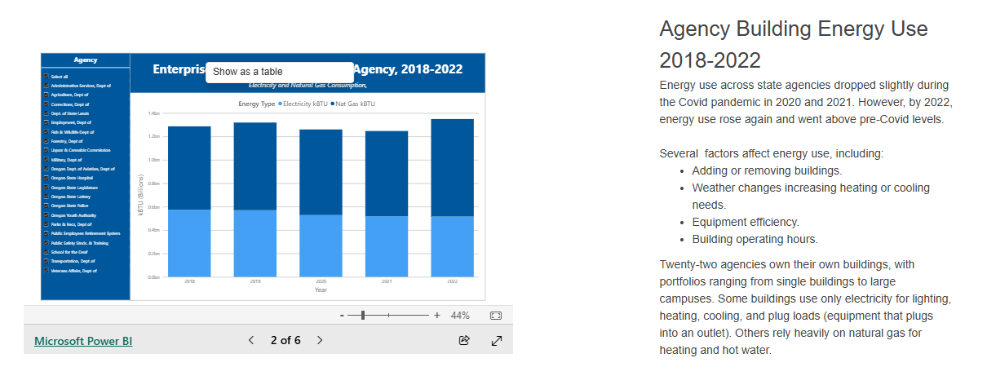
Enterprise Sustainability Dashboard
Department of Administrative Services : Enterprise Sustainability Report : State Facilities and Land : State of Oregon

Slide 11
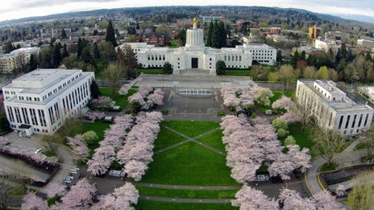
Where We’re Going: Building Portfolio
Statewide sustainable design guidelines
How to design carbon neutral ready buildings
Forward-leaning standards for energy, water, materials, location and landscape
Addressing equity in design and construction
Designing with climate adaptation and resiliency in mind
Replicable, cost-effective design process
Long-term goal of carbon neutrality across whole portfolio
Companion landscape guidelines/policy

Slide 12
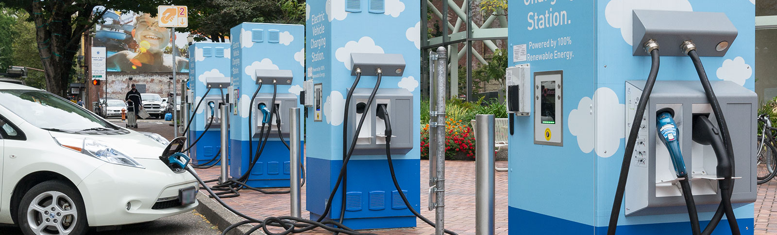
Where We’re Going: Fleet
Added 250-300 additional EV chargers to sites in Salem
Establishing statewide price agreement for EV charging infrastructure and services
Goal to add 100-150 EVs to fleet in next year
Looking to establish EV Infrastructure Project Fund, additional staffing
Funding challenges: $250 million needed for complete electrification of light duty fleet

Slide 13
Leading by Example: Executive Building Remodel
Just re-opened in January
Included aggressive energy efficiency targets, path to carbon neutrality (electrification ready)
Recreated local prairie conditions- native grasses and habitat in landscape
Calculated and reduced embodied carbon in the building materials
Used LEED Social Impact checklist to inform equity in design and construction

Slide 14
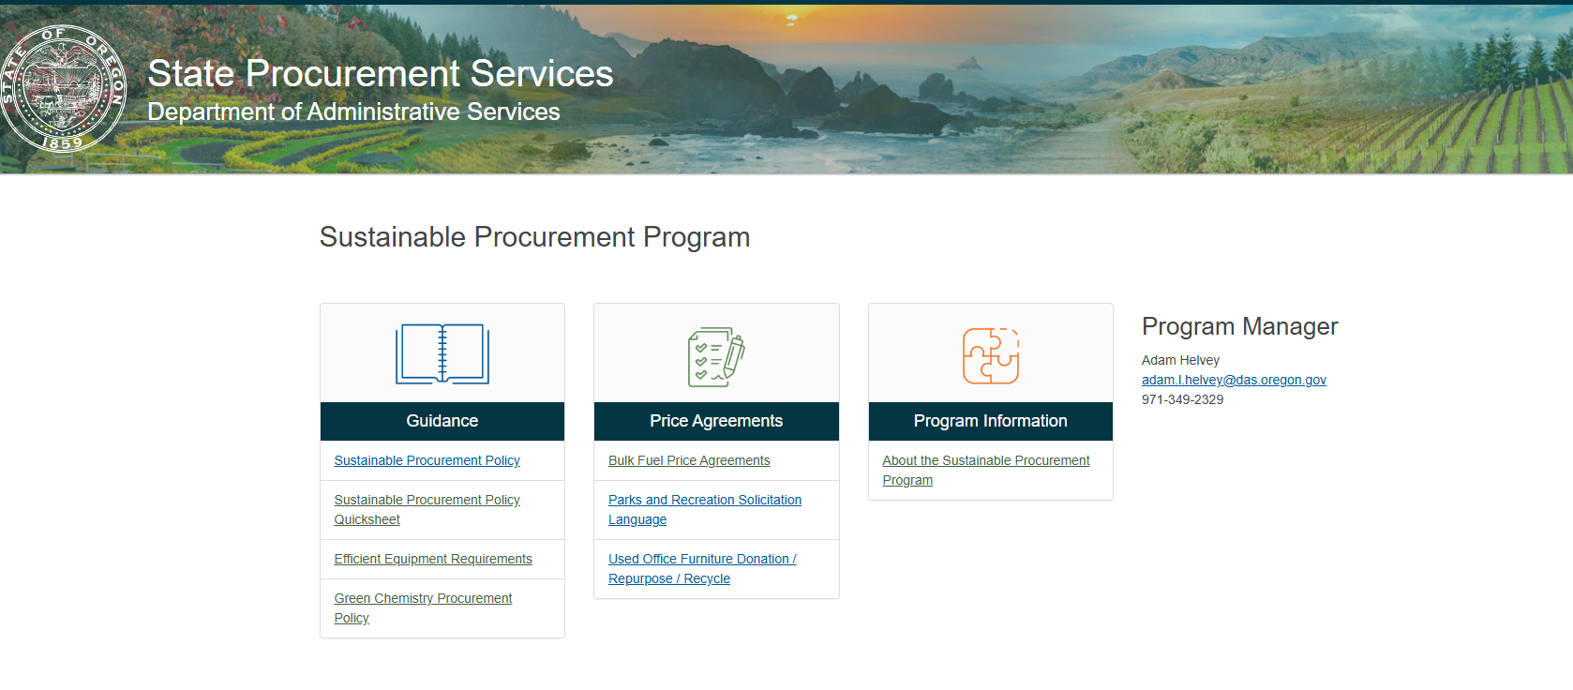
Sustainable Procurement Department of Administrative Services : Sustainable Procurement Program : State Procurement Services : State of Oregon Sustainable Procurement Training Classes in March! https://wd5.myworkday.com/oregon/learning/course/12787c4efba80139aca86cc8ea0101d3?type=9882927d138b100019b6a2df1a46018b

Slide 15
Challenges
Agencies are being directed to keep budgets down and focus on Governor’s priorities
Disconnect between legislative directives and agency budgets
No funding for increased staffing
Lack of capital investments in new, more efficient equipment
Agency sustainability and energy managers are sometimes not high up the leadership chain
Limited for sustainability is a challenge!

Slide 16
Breakout Group Discussion
What are the biggest challenges you face as sustainability representatives for your agencies?
What are some things that are going well – where you are making good progress?
What do you need (especially from the Office of Sustainability) to help further your sustainability efforts?
Take 20 minutes to discuss and we’ll report back. Pick someone to report out.

Slide 17
Thank you!
Dave Wortman
Office of Sustainability
David.Wortman@das.Oregon.gov

