Slide 1
Implementing Performance Measurement System
Clackamas County Public Health Division
July 17, 2013
Cindan Gizzi
Manager, Office of Assessment, Planning & Improvement
Tacoma-Pierce County HD
Marni mason
MarMason Consulting, LLC

Slide 2
Introducing Cindan Gizzi
Cindan Gizzi, MPH, manages the assessment, planning and improvement programs and serves as deputy director pro tem at the Tacoma-Pierce County Health Department in Washington State.
She is a member of NACCHO’s Quality Improvement Leaders; serves on Robert Wood Johnson Foundation’s PHQIX Expert Panel; is part of NACCHO’s Accreditation Speakers’ Bureau of Champions; and leads the Public Health Performance Management Center for Excellence at Tacoma-Pierce.

Slide 3


Tacoma-Pierce County Health Department
Notes:
A little about my agency . . . . We are an independent local public health jurisdiction, funded through interlocal agreements with our county and main city. Pierce County has a population of about 850,000, and the largest city, Tacoma, has about 200,000. We are governed by a local board of health.
In terms of our accreditation and QI journey, we started our QI Council in 2006 and developed our first QI plan that year. We first began developing and reporting performance measures in a systematic way across our agency in 2007. We will be applying for accreditation at the end of this year after our CHIP is completed.
Marni asked me to speak about how we have implemented the monitoring and reporting of performance measures at Tacoma-Pierce. I’ll also give a couple of examples of how we’ve used PMs to move into a QI process.

Slide 4
Using Performance Measures
Identify and agree what matters
Collect the right information
Learn and improve performance
Key performance questions Outcome, output, and performance measure definitions Internal and external stakeholder assessment | Performance measure design template Performance management spreadsheet or database | Building blocks of performance/quality/ learning culture Performance improvement meetings
Notes:
We have stressed these three steps in developing, monitoring and reporting PMs. The ultimate goal is to learn about key processes and programs and improve performance. We talk a lot about making sure that managers/supervisors have chosen PMs that are meaningful to their work. This is the first step in successfully monitoring and reporting PMs. Staff will not be able to truly learn and improve if they have not selected meaningful PMs in the first place.

Slide 5


Performance measurement is not punishment!
Lesson Learned
Reward improvement and learning
Notes:
We have also stressed that PM is not punishment. Again, this is key in being able to report and use PM data.
Understandably, some people get a little nervous when an organization begins to develop performance measures. They might think this is a measurement of their personal worth or performance, they might see performance measures as extra work, or they might feel like performance measurement is some type of punishment for not producing good work. Performance measurement is none of that, but public health managers and leaders need to be careful about unintentionally reinforcing this message.
Need to make sure that the organization’s culture doesn’t turn competitive; very important to foster an organizational culture that rewards improvement and learning, or else the structure you’ve built for performance measurement will be undermined.
Also important to tell staff that asking “why” is not an accusation but rather a desire to get at the root of the problem; sometimes staff need to let go of their fear of questioning—it’s not always bad. Asking questions about another person’s program can create learning for your program.
Need your leaders, managers/supervisors/front line staff all saying this and doing things to support learning and improvement.

Slide 6
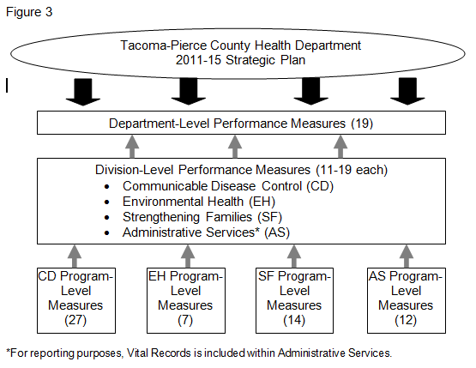
Tacoma-Pierce County’s Performance Measures
Notes:
Here’s a model of our performance measures at Tacoma-Pierce. This has not been updated for 2013; the model changed at the Dept-level PMs. Following Friedman’s Results-Based Accountability model, we have split those into two categories: Dept-level PMs (long-term outcomes which are within our control) and population-based indicators (long-term outcomes which take work from multiple community partners to achieve). For example, we have Dept-level PMs related to our quality culture score and employee morale. Population-based indicators include the smoking rate, youth obesity rate, and communicable disease rates for county residents.

Slide 7
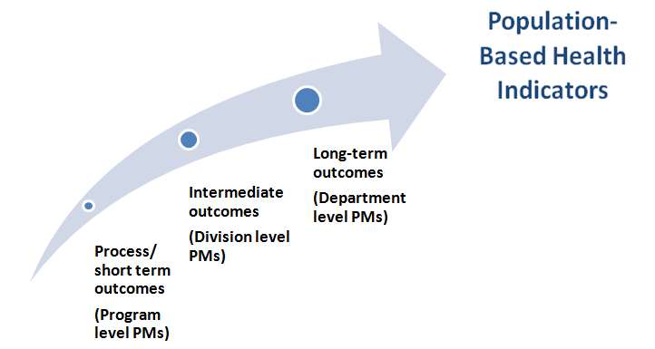
2013 Performance Measurement Model
Notes:
Marni will be showing you a similar visual later in the presentation. This is how we think of our PM model.

Slide 8
Performance Measure Description Form
Performance measure: | The rate of Chlamydia (CT) positivity at Infertility Prevention Project (IPP) sites.
Target population: | People being tested for Chlamydia
Numerator: | Positive CT tests at IPP sites
Denominator: | All CT tests at IPP sites
Which are you using—a target or benchmark? | Target
What is the target/benchmark? | 8.0%
SMART objective: | Decrease the rate of CT positivity at IPP sites from 8.1% to 8.0% by the end of 2011.
Source of data: | DOH records
Who will collect the information? | Jim Marshal
How often will the data be analyzed and reported? | quarterly
Baseline measurement data and date(s): | 2005: 10.1% 2008: 8.6% 2006: 9.3% 2009: 8.2% 2007: 10.5% 2010: 8.1%
Definitions and other comments: | IPP sites include TPCHD, Planned Parenthood, Remann Hall.
Notes:
Here’s an example of the performance measure description form that we use to make sure that people have defined exactly what they are collecting and monitoring. This is a PM development tool that also helps ensure consistency in reporting, ie, the same thing is being measured each time period. This one looks at Chlamydia positivity rates.

Slide 9
Tacoma-Pierce’s Reporting Schedule
Performance Measure Level | QIC Review | What
Department | Annually Feb | Report all measures
Division | Semi-annually Feb/Aug | Report % of PMs meeting target Highlight 1 success Highlight 1 falling short of target - Key insights -Actions
Program | Quarterly Feb/May/Aug/Nov | Report % of PMs meeting target (Discussion of PMs should happen within program)
Notes:
This is our reporting schedule. Program staff are responsible for collecting and reporting data for the PMs that they develop. Because we have 100+ PMs, we don’t have time to review each one at our QI Council.

Slide 10
Who Do We Report Measures to?
QI Council (quarterly)
Board of Health (annually)
Staff (semi-annually)

Slide 11
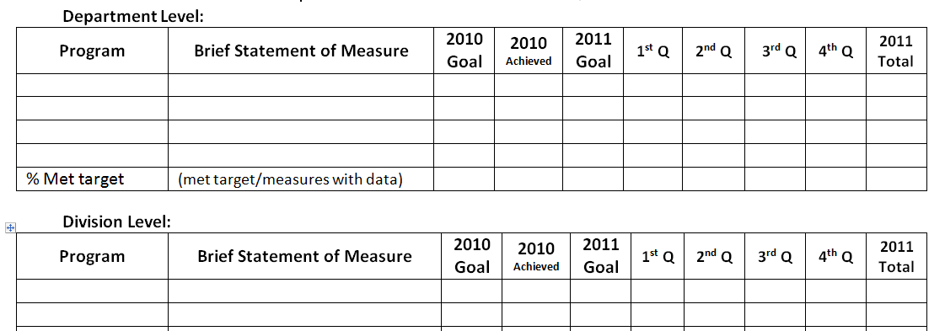
Performance Measures “Snapshot”
Notes:
This is a tool we have been using to report our performance measures to QIC in a quick at-a-glance look.

Slide 12
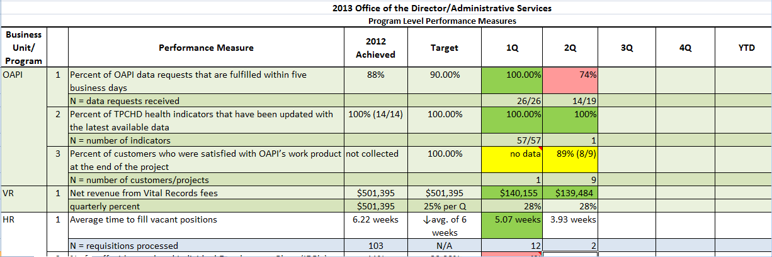
Notes:
Here’s an example for some of our Admin Services program-level measures.

Slide 13
Performance Measure Title
Measure Description:
Target:
Actual:
Status:
Outcome Owner:
Data Source:
Link to Strategic Plan:
Key Insights
Why are we getting the results we are getting?
Are we progressing toward our target?
Have we achieved our target?
Are there any unintended consequences of our actions?
Next Actions
What is likely to happen in the future?
What are possible areas for improvement?
Notes:
This is a template we use to report key performance measures.
Think about if there other questions that you would want to ask as staff talk about their performance measure to your QI Council?

Slide 14
Small Drinking Water Systems
Measure Description: | Percent of population served by smaller water systems that do not meet drinking water standards
Target: | 20%
Actual: | 22% (12,179/55,034)
Status :
Outcome Owner: | Brad Harp
Data Source: | Wash. St. Dept. of Health and Envision Database
Link to Strategic Plan: | SD 1, 3 and 4: Pierce County has access to safe & reliable water resources
Key Insights
Small water system managers face numerous challenges due to lack of water system management experience
Through education and technical assistance water systems are better able to meet system standards
Line of Sight: division level PM not met, program level PM met
Next Actions
Ongoing education and technical assistance is critical due to the high level of turnover in small water system managers and operators
QI needed to evaluate effectiveness of current assistance strategies.
Notes:
Here is an example of one division-level PM that used the template to report to QI Council.

Slide 15
Performance Management Conversations
Four questions that drive performance management conversations at Sedgwick County Health Department:
What was a key opportunity that you pursued?
Which roadblocks/hurdles did you experience? What potential QI project(s) might help with overcoming the barrier(s)?
State one way that you believe you improved the community’s health status.
What is ONE research study (or program evaluation study) that you would find useful in the planning/implementation of your program?
Notes:
Here’s another example of how another health department has chosen to have conversations about their key performance measures when reporting them to their QI Council.

Slide 16
QI Opportunity: Grants Billing Customer Satisfaction Scores
Performance Measure: Percent of Department staff who are satisfied with the grants billing process.
April 2011 | October 2011 | April 2012 | December 2012
66% | 74% | 54% | 60%
Notes:
Here’s an example of how one PM was used to move into QI. Data come from our Admin Services Customer Satisfaction Survey of staff (used to be twice a year, now an annual survey). The target was 80% satisfaction. Identified an opportunity to apply some QI methods and tools, formed a cross-divisional team and are using a lean approach to make improvements (conducting value stream mapping, identifying customer needs, eliminating steps that are not valuable, etc.)

Slide 17
What Questions Do You Have?

Slide 18
Establish an Agency Measurement System
The most important monitoring action you can take is the development of program-level reports that are made available to every staff person in the organization on a regular basis
Supervisor and program manager reports that work with the same data elements
These reports should be used on a regular basis to understand whether the program activities are performing as expected (cost, utilization, outcomes, etc.)

Slide 19

Performance Measures
Agency level measures (between 12-18)
  Modeled after Healthy People 2020 Leading Health Indicators or County Health Rankings. . . plus any key additional
Approx. 10-20 performance measures per division and/or program
  Percent of solid waste complaints responded to within 20 days
  Reduce the rate of positivity at Infertility Prevention Project (IPP) sites
  Percentage of Positive Steps clients who engage in services for 30. days or more who have a 10% reduction on three youth violence risk factors

Slide 20

Agency Level Performance Measures
Measure | Indicator | Responsibility
Improve immunization rates | Increase the percentage of kindergarten enrollees that are up to date on their immunizations upon school entry from 86% to 92% by 2014.
Reduce tobacco use | Decrease the percentage of adult smokers to 16% by 2014.
Reduce overweight & obese populations | Reduce the rate of increase for adult obesity to 0% by 2014.
Increase healthy physical activity | Increase the percent of youth who are physically active for at least 60 minutes per day from 16.8% to 18.5% by 2014.
Reduce substance abuse | Increase the number of adults receiving opiate treatment service by 23% by 2014, to 800 patients.
Increase responsible sexual behavior | Increase the percentage of sexual partners treated for sexually transmitted diseases by 10% by 2014.
Notes:
Six agency level key indicators– emphasize the specificity of the indicator statements, including targets and timeframes for achieving the targets.

Slide 21
Success can be Measured in Stages
Health Issue/ Goal | 1. Short term “Process Outcome” | 2. Mid-range “Results Outcome” | 3. Long term ”Health Status or Risk Indicator”
Improve Childhood immunization rates of 2 year olds | Percent of planned materials distributed to increase provider awareness (Goal 100%) Percent of children with records kept in Child Profile (Goal to increase from year to year) | Percent of children 0 to 24 mo. completing the recommended series on time (Goal -increase ) | Disease rates related to the series are very low or approaching none (such as Pertussis, measles)

Slide 22
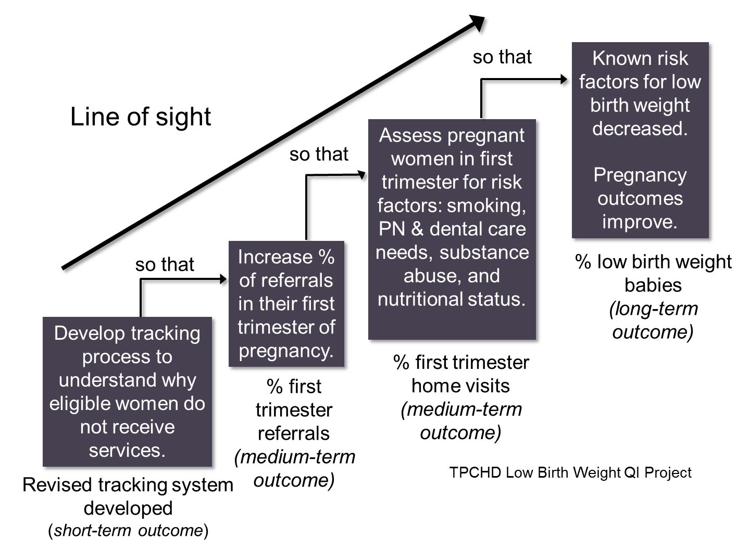
Line of Sight Concept
Notes:
This is another example from TPCHD of the concept of Line of Sight, meaning that everyone in the health department understands how their work and the outcomes they impact relate to a key indicator tracked at the division or agency level.
This example from the Maternal Support Services program describes the activities, outputs and outcomes at each level of the agency related to the goal of reducing low birth weight babies.
[Read the performance measures starting from the left side– the program staff outcome---- a revised tracking system.]

Slide 23

Reporting & Monitoring
Reporting structure
  Quarterly (Division/Program) and annually (Agency) to QI Council
  Dashboard annually to Board of Health
Performance measurement roles/responsibility matrix
Measures linked to financial dashboards
Performance management policy
MarMason Consulting
23

Slide 24
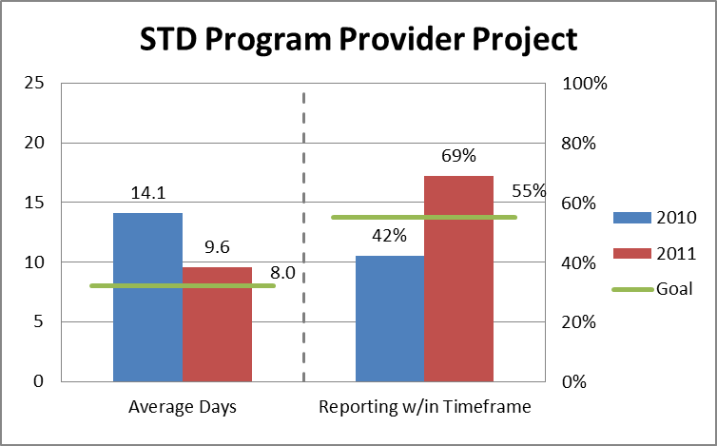
Program Reporting Example
STD Program Performance Measure: | 2009 Baseline | Current Status | Target | Variance
Increase percentage of contacts of STD exposures where treatment was obtained | 70% | 72% | 80% | -8%
Quality Improvement Project
Performance Measures:
Decrease average # days to report STD cases to PH
Increase % clinics reporting STDs within county average
MarMason Consulting
24
Notes:
In my division, we have a performance measure to increase the percentage of contacts of STD exposures where treatment was obtained. This is an example of a dashboard. Our target is 80%, but we haven’t reached it yet.
One of my staff is conducting a QI project around timely reporting. Here are two performance measures displayed using bar charts with a goal line. One met their goal and one did not.
We are hoping that this work will lay the structural foundation for making the needed improvements to our performance measures.

Slide 25

Let’s Discuss
What specific measures of performance are you monitoring and reporting for your program area?
How do you currently use your results to identify opportunities for improvement?
MarMason Consulting

Slide 26
What Questions Do You Have?

