Slide 1


VMSG
Vision Mission Services Goals
Dashboard
Public Health
Performance Management System
Overview
Notes:
Welcome to the VMSG Dashboard Public Health Performance Management System Overview. In this presentation, we’ll discuss a bit of the history of the Dashboard system and an overview of the functionality and structure.

Slide 2

What is the
?
Developed WITH and specifically FOR Public Health
A comprehensive, operational planning and execution system based on the Deming/PDCA Cycle.
Designated as “Fully Demonstrated” by PHAB for the implementation of Standard 9.1 and Measure 9.1.1 A
Engages all staff and selected external partners in planning, monitoring, updating, performance management and organizational success.
Notes:
The VMSG Dashboard Public Health Performance Management System is a comprehensive, Deming/PDCA Cycle-based, operational planning and execution system.
The system was initially developed in coordination with the Maricopa County, Arizona, Department of Public Health. It’s the 3rd largest Public Health jurisdiction in the US serving a population of about 4.2 to 5.5 million people (depending on the season) and covers more than 9,200 square miles in central Arizona. Maricopa County along with other Dashboard clients, provide continuous feedback and suggestions for the improvement of the system. These upgrades are implemented for all Dashboard clients on an ongoing basis. We’ll discuss some of these recent improvements during this presentation.
The planning methodology for the Dashboard was developed in conjunction with Dr. Thomas Keller. For over 25 years, Dr. Keller was a highly-regarded Management Professor at Arizona State University teaching at both the undergraduate and graduate levels. Over this time, he was able to distill the best practices of the most effective strategic and operational planning methodologies from the academic world. In addition to the academic view, we worked with several public health departments to fine tune the methodology to the specific needs of Public Health.
Designated as “Fully Demonstrated” at many health departments by the Public Health Accreditation Board for the implementation of PHAB Standard 9.1 “Use a performance management system to monitor achievement of organizational objectives.”
The Dashboard is the only system we are aware of that fully meets Measure 9.1.1 A “Staff at all organizational levels engaged in establishing and/or updating a performance management system”
The Dashboard engages all staff and selected external partners in planning, monitoring, performance management and organizational success.

Slide 3

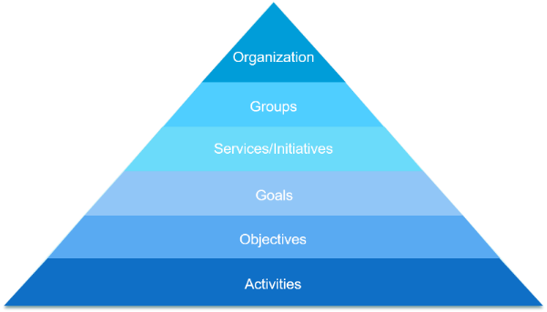
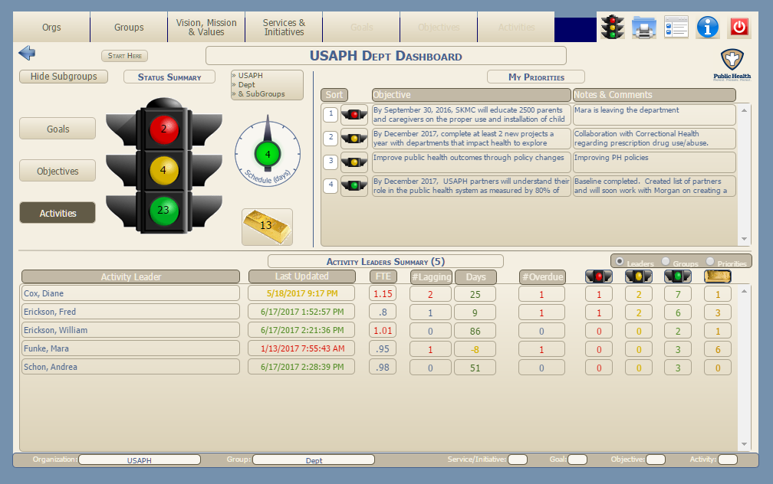
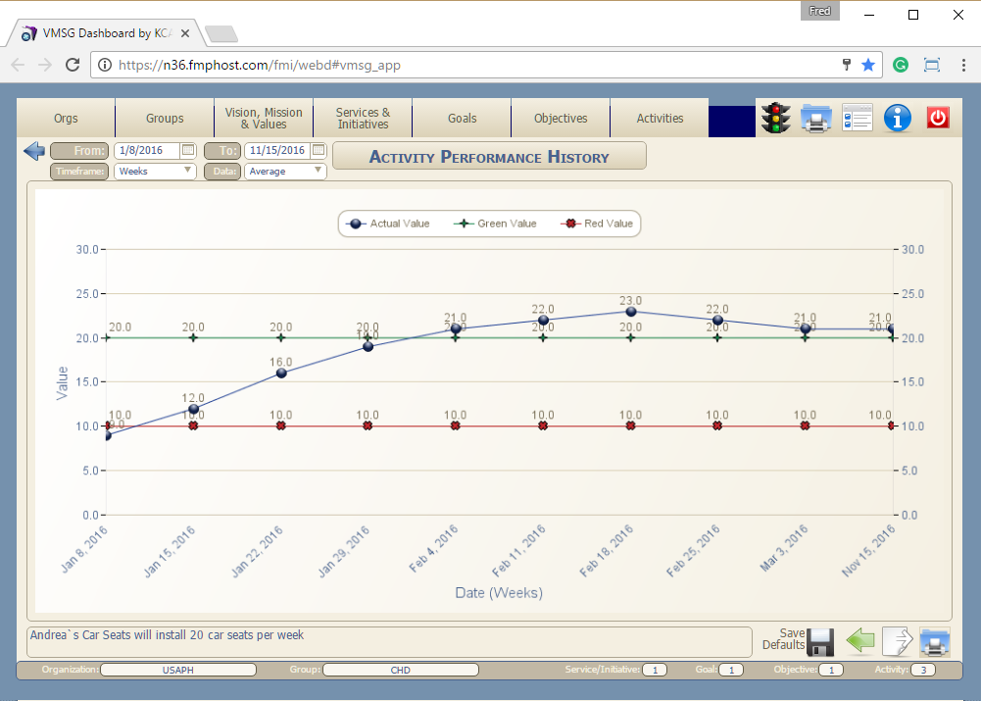
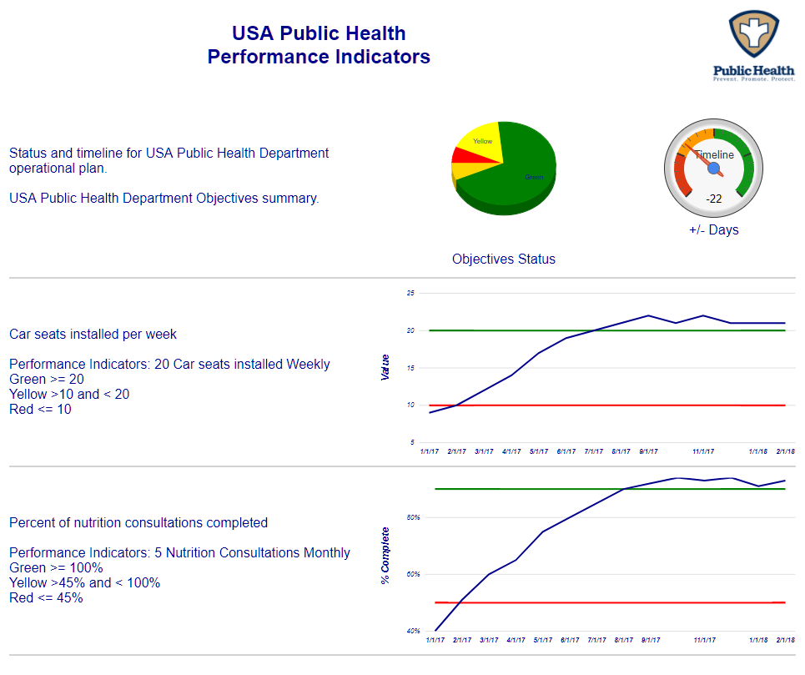
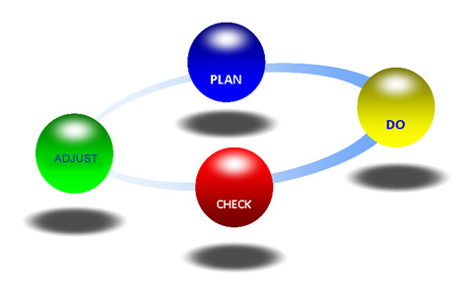
What is Performance Management?
Strategic Plan
Operational Plans
Operational Planning
QI
WFD
CHIP
Performance
Monitoring
Performance Improvement
Notes:
What is Performance Management?
There are 3 primary steps
Create a complete Operational Plan down to the Activity level. Activities will be done in a specific timeframe by a specific team with specific measurements
Monitor the performance of the Operational Plan at all levels
Using the Plan-Do-Check-Adjust (PDCA) cycle, manage the plan for continuous improvement

Slide 4

Operational Planning
WFD
Strategic Plan
Organization
[USAPH]
USA Public Health
Admin
Finance
HR
Community Health
WIC
IT
Environmental Health
Office of Performance Improvement
Public Health Emergency Preparedness
Vision, Mission
& Values
What we are about…
Groups
CHIP
[Community Health Division]
What we do…
Services/Initiatives
Operational Plans
[Safe Kids USA]
QI
Goals
How we do it…
[Provide Car Seats to those who cannot afford them]
Objectives
[By June 30, 2018, SKUSA will distribute 20 car seats per week to families….]
Activities
[Find Funding…. Hire Installation Partner…. Create Awareness…. Install 20 car seats per week]
Notes:
The KCA VMSG Operational Planning methodlolgy
Organization – typically the health department
Groups – the department’s organizational structure
Services/Initiatives – what you do in each division, office and program. Initiatives are future Services
Goals
Objectives
Activities
The “Project Plan” to execute each Service or Initiative

Slide 5
Performance Improvement (PDCA)
Strategic Plan
Operational Plans
CHIP
WFD
QI
Notes:
PDCA cycle
Plan - Create a robust Operational Plan
Do – put the plan into motion, execute the Operational Plan
Check – compare the plan to the results at any plan level (Services/Initiatives, Goals, Objectives, Activities)
Adjust – Make necessary adjustments to the Plan or the Resources (people, dollars, time, etc.)
Repeat – continue to repeat this cycle on some defined, regular basis

Slide 6
Types of Activities
Project-based - Activities to be completed over a specific period of time
Start date
End date
Percent complete
Examples
  Provide vaccinations to all school children between January 1, 2017 and December 31, 2017
  Complete the operational plan by June 30, 2017
Quantitative Measurement – Quantity measurement over a given period of time
Start date
End date
Target number
Metric Type
Examples
  Deliver 50 nutrition consultations between July 1, 2016 and June 30, 2017
  Hold 50 partner meetings between July 1, 2016 and June 30, 2017
Quality Assurance – Ongoing, periodic measurement Activities
Frequency
  Weekly
  Bi-Monthly
  Monthly
  Quarterly
  Bi-Annually
  Annually
High & Low values
Metric type
Examples
  Install 20 car-seats each week
  Process all timesheets bi-monthly
Notes:
Activities are the most detailed level of definition of the “how we do it” elements. The Dashboard contains 3 types of Activities.
Project-based were, originally, the only type of activities in the system. These are Activities to be progressively completed over a specific period of time. They are measured by:
Start date
End date
And Percent complete
An Example of a project-based Activity might be
To provide vaccinations to all school children between January 1, 2015 and December 31, 2015
The Start Date is January 1, 2015
The End Date is December 31, 2015
If the current date is June 30, 2015 and half of the school children have been vaccinated, the Percent Complete would be 50%
As the Dashboard was being implemented, we realized that there were other types of Activities which we had to enter into the system. The next type of Activity implemented was a Quality Assurance or QA Activity.
The next type of activity implemented is the Quantitative Measurement Activity. These Activities are very similar to Project-based Activities with the addition of a “Target Number” field. The Target Number field allows the system to automatically calculate the percent complete. They have a:
Start date
An End date
A Target number
And a Metric Type
An examples of a Quantitative Measurement Activities could be:
To Deliver 50 nutrition consultations between July 1, 2014 and June 30, 2015
In this case, the Target Number would be 50 and the Metric Type would be “Nutrition Consultations”.
Quality Assurance Activities are Activities performed on an ongoing basis and measured regularly. The Activities have a:
Frequency which may be:
Weekly
Bi-Monthly
Monthly
Quarterly
Bi-Annually
Annually
High & Low values
Metric type
An example of a QA Activity might be:
Install 20 car-seats each week.
In this case, the Frequency is Weekly.
The High Value might be set to 20 and the Low value set to 10.
The metric type would be “Car Seats Installed”.
QA Activities are unique in that the traffic light is automatically set based on the established High and Low values.
If 20 or more car seats are installed in a given week, the traffic light would be automatically set to Green.
If Less than 10 seats were installed, the light would automatically be set to Red
Between 10 and 20, the light would be yellow.

Slide 7

Performance Monitoring
“The Dashboard”
Notes:
This Dashboard screen is the namesake of the system. This is one of the main elements of the Performance Management system. The Dashboard shows a real-time snapshot of the performance of the organization or any subset of the organization.
In the system, all Planning Elements (Goals, Objectives and Activities) are flagged for status with a red, yellow, green or gold traffic light.
In the top-left corner of the screen, the traffic light will display the summary of Goals, Objectives or Activities which are selected by the buttons to its left.
Green indicates that the planning element is on track for successful completion. Typically, no additional changes are needed.
Yellow indicates that there’s a potential issue looming. It may be that a key resource is leaving the organization or that grant funding may be lost or one of the key partners is not able to fulfill their responsibilities.
Red indicates that the successful completion of the planning element is in serious jeopardy. Perhaps a key resource has left the organization or funding has dried up or a key partner is no longer available.
The Gold bar indicates a successfully completed Goal, Objective or Activity. These planning elements may become models for best practices in the future.
To get more detail on the specific planning elements, you can click on any “bulb” or the gold bar to see the list of those items.
In the default view, the traffic light represents only the status of the planning elements in the selected group. The selected Organization and Group are indicated in the box to the top-right of the traffic light The “Show Sub-Groups” button allows you to see the summary of all of the Groups below the selected Group. If the selected group is the top level group in the organization, selecting “show subgroups” will show the status of the entire organization..
The bottom half of the screen represents the Objective or Activity Lead Summary, Group Summary or Strategic Priority Summary. This section breaks down the information in the traffic light by each Objective or Activity team leader, Group or Strategic Priority.
The “Last Updated” column shows the last time the team leader updated their information in the Dashboard
The “FTE” column shows the summary of the Full Time Equivalent Activities for the Team Leader. Each Activity in the system can be assigned a Team Leader and a FTE value can be assigned to the portion of the Team Leader’s time that will be spent on the selected Activity.
The “#Lagging” column indicates how many Activities are behind schedule. The system calculates this value using the Start Date, End Date and Percent Complete for the Activities assigned to the Team Leader.
The “Lagging Days” column shows the average days ahead of or behind schedule for this Leader, Group or Priority
The “Overdue” column shows how many Activities assigned to the Team Leader are currently overdue. Overdue means that the End Date has passed and the Activity is not yet 100% complete.
The Red, Yellow, Green and Gold traffic light columns are the same as those in the Status Summary traffic light in the top left corner but for the specific team leader.
You can click on any item in the row to drill-down to the details.
The top-right corner is the My Priorities quadrant of the screen. This feature allows the logged-in user to track any selected Objectives in real-time. Each individual logged-in user can select their own Objectives to fill the My Priorities section.
Rolling your mouse over the Objective will display the Group, Service, Goal and Objective.
Rolling your mouse over the stoplight will display the meaning of each color.
Rolling your mouse over the Notes/Comments field will display the full note field if the note is longer than the display.
Clicking on a Key Issue will take you to the Objectives screen for more detail about the selected Objective.
These Objectives can easily be selected and de-selected from the Objectives screen.

Slide 8
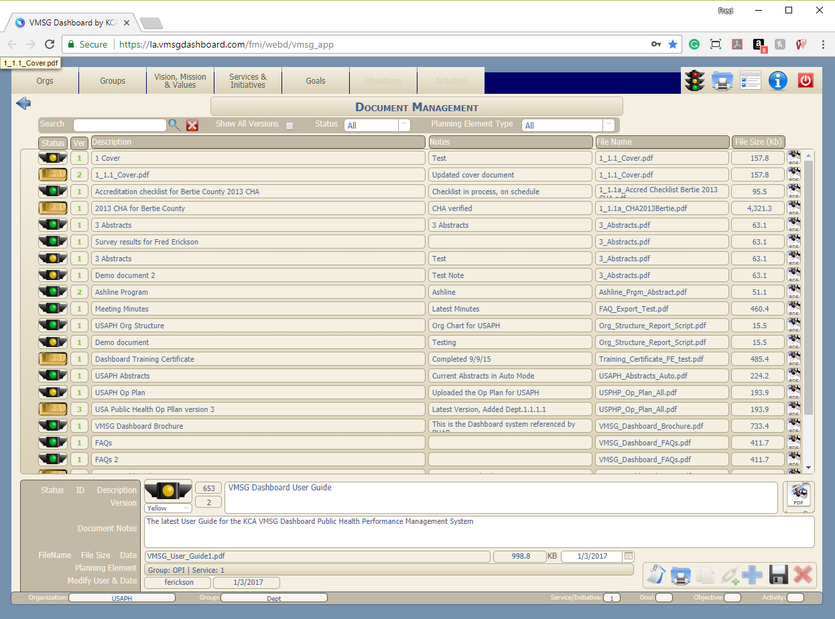
Document Management
Notes:
To add or edit documents for a specific planning element, first navigate to that planning element then click the Document Management button at the bottom of the screen to open the Document Management system. From this screen you can search for and select any document attached to the current planning element. In the default view, only the most current version is displayed in the table. The most current version number for each document is highlighted in Green. You can show all versions of the documents by selecting the “Show All Versions” checkbox. In addition to the normal editing functions, you can copy the document meta-data to save typing when a new document version is added. You can also show, save or print the selected document.
Documents can now be flagged for status:
Red = Initial document draft
Yellow = In process document draft
Green = Final Document for submission
Gold = Document submitted (i.e. ePHAB)

Slide 9





3-Dimensional Planning
Strategic Plan
Strategic Priority:
Partnering
PHAB
Standard 4.2
Public Health
Essential #1
Operational Plans
Document Management
WFD
CHIP
PHAB
Standard 6.1
QI
Notes:
Any planning element or document can be categorized by one or more categories and sub-categories. Categorization adds a third dimension across all of your plans. This allows you to look for commonalities, gaps and overlaps. It also allows you to share documents across many categories like the PHAB Domains and Standards without the need to replicate documents.

Slide 10
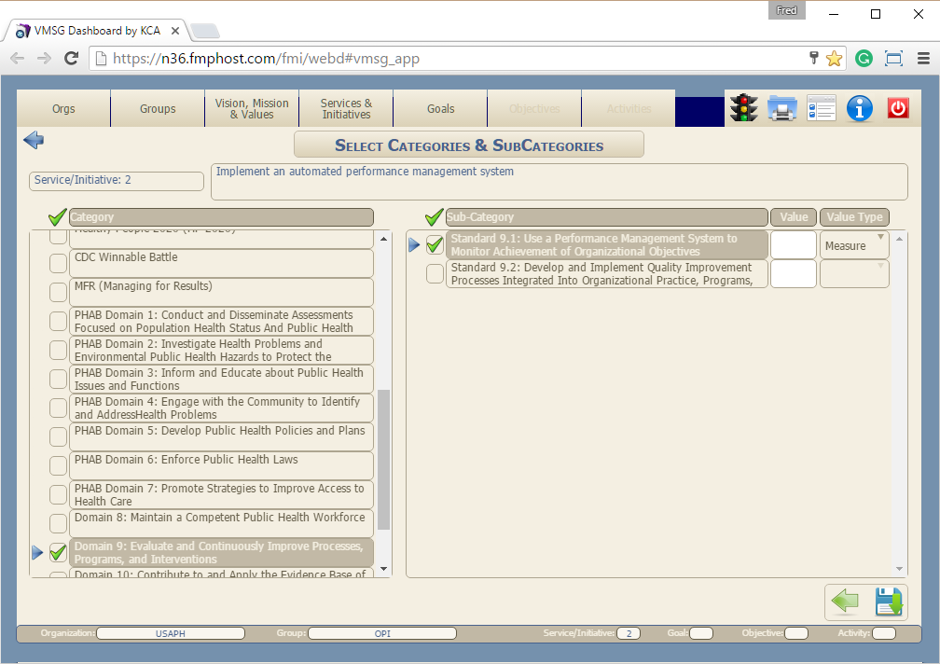
Categorization
Notes:
To Categorize a planning element, just select the planning element then select the Categorization button at the bottom of the screen
Let’s tag this Service/Initiative with the Category of PHAB Domain 9 and the Sub-Category of PHAB Standard 9.1.
Now we’ll Click the Save/Exit button to finish.

Slide 11
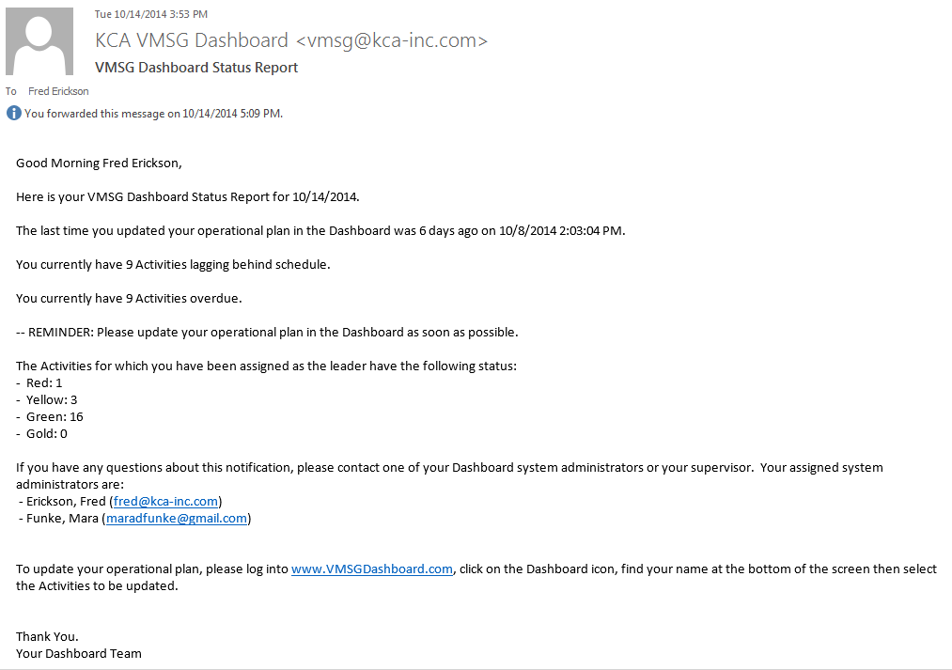


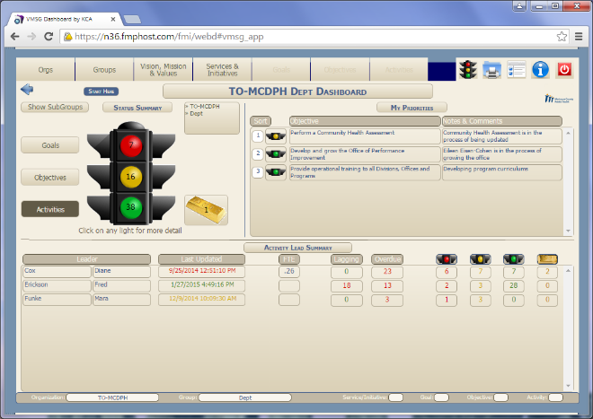
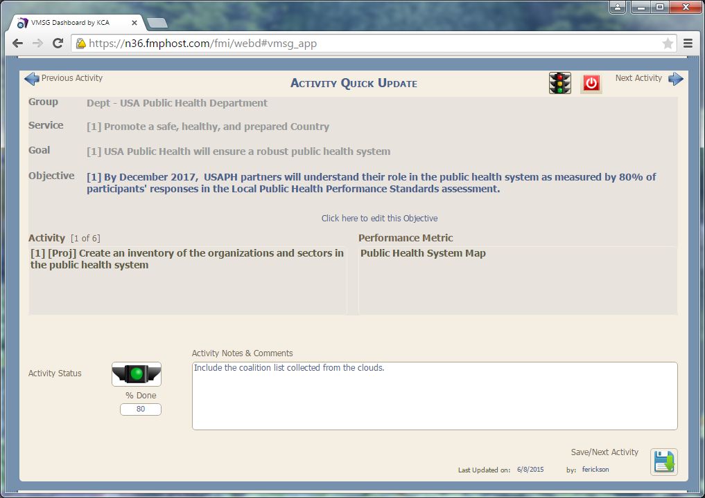
Real-Time Planning
Strategic Plan
Operational Plans
QI
CHIP
WFD
Notes:
Real-time planning refers to the email notification system built into the Dashboard. It only takes a few minutes to setup the email notification parameters (when and why the emails are sent). Once setup, the emails are automatically sent out to Activity and Objective Leaders (both internal and external partners) on the regular timeline selected. Users respond by clicking on a link in the email to get to the “Quick-Update System” which allow them to update all of their assigned Activities and Objectives within 3 to 5 minutes.

Slide 12
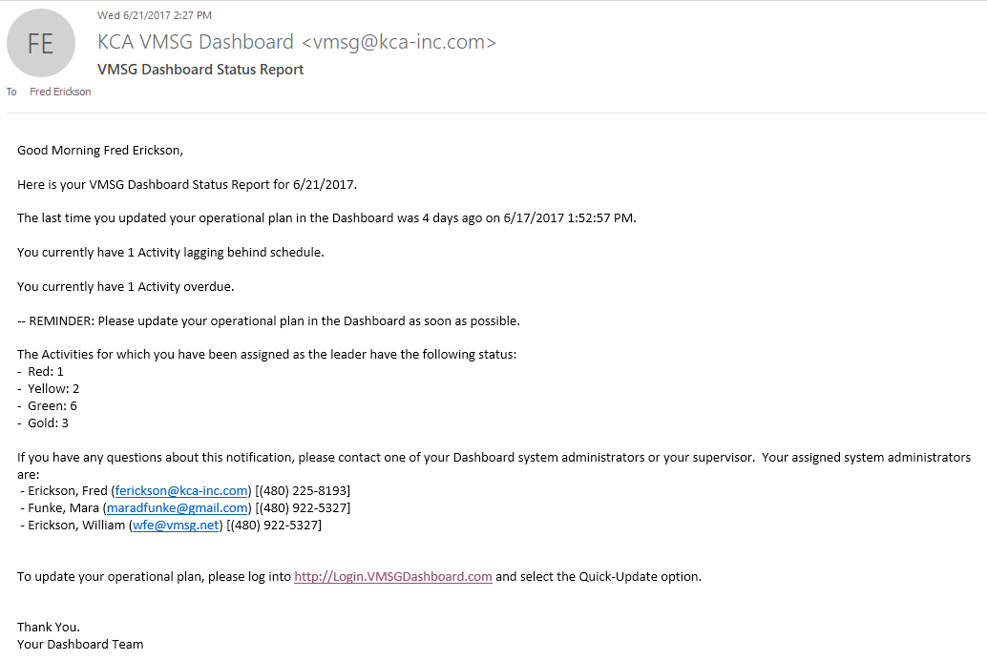
Automated Reminder eMail
Notes:
This is an example of an email notification from the Real-time Planning system. The system can provide automated email notifications to each person in the system who has been assigned as the team leader for any Activities. The messages can be configured to be sent anywhere from daily to monthly. Messages can be triggered for lagging and/or overdue Activities as well as if the person has not updated their information in the past 30 days. This email reminds team leaders to update their information in the system on a regular basis, keeping the information current.

Slide 13
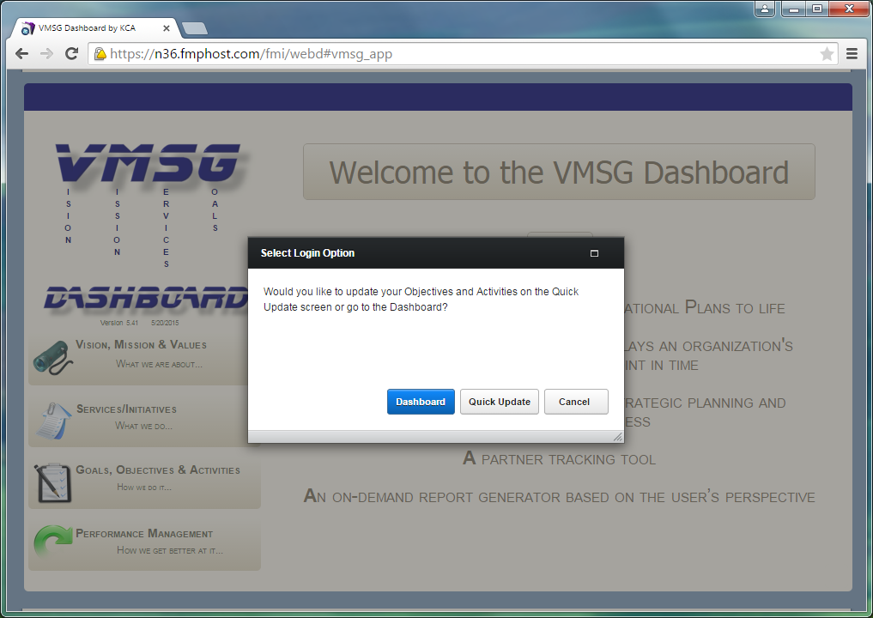
Quick Update
Notes:
Once you login to the Dashboard (if you have been assigned as an Objective or Activity Leader), you will be presented with a dialog box asking you to select the Main Dashboard or the Quick Update screens. If you have been assigned as a team leader for any Activities or Objectives in the system, you will be taken to the Activities Quick Update screen. The Quick-Update screens allow you to update all of your Activities and Objectives within 3 – 5 minutes.

Slide 14
Activities Quick Update
Notes:
The top half of the Quick Update screen provides the context for the selected Activity. Group, Service, Goal and Objective as well as the number of Activities, type, Activity Statement and Performance Metric.
The bottom half of the screen provides three editable fields for the user. Status, percent done or current value, depending on the Activity type, and the Notes and Comments field. Once these are updated, the user can click the Save/Next button to go to the next Activity.
The user also has the options to navigate to the previous and next activities with the arrows at the top corners of the screen. In addition, if the user is the assigned leader for the current Objective, they can click on the Objective field to edit the Objective.
Once all of the Activities have been updated, the user will automatically be directed to the Objectives Quick Update screen.

Slide 15
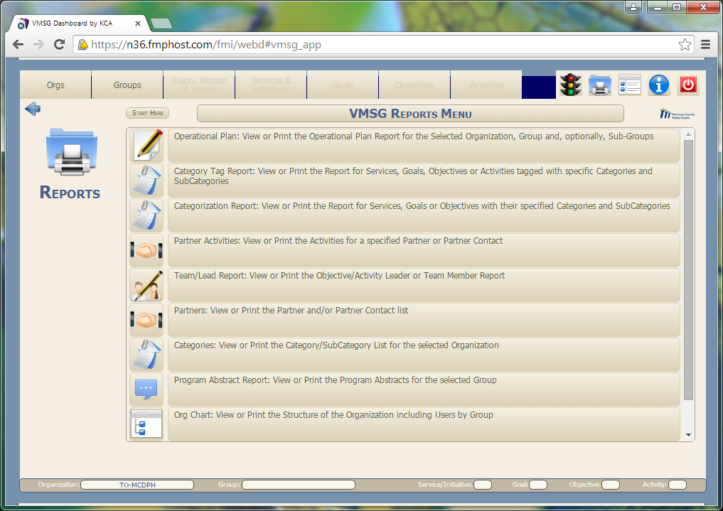
Reports
Notes:
The Dashboard Reports Menu is available from the main menu or by using the Quick Access menu from any screen in the system.
From the Reports Menu, you can select any one of the many reports in the system.

Slide 16
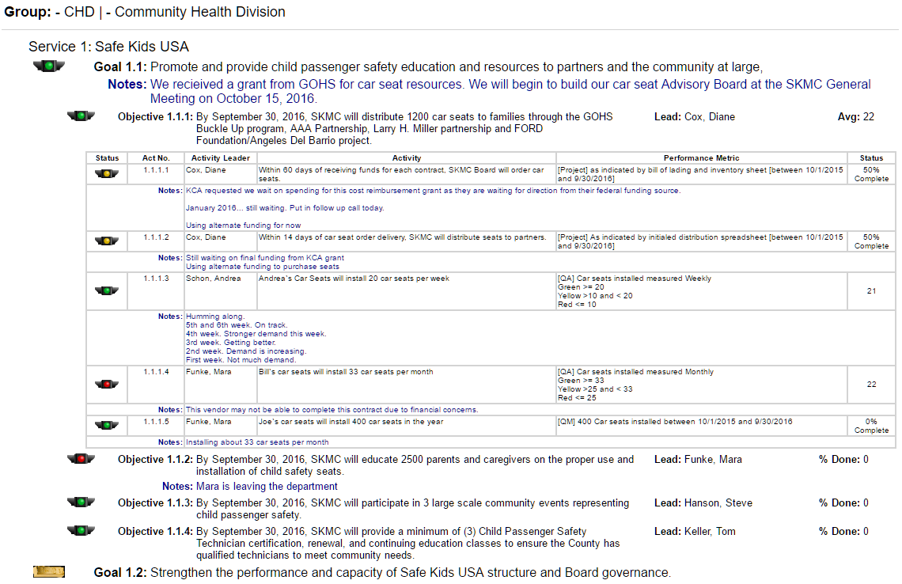
Operational Plan Report
Notes:
Most reports in the system are this Operational Plan format.
This Operational Plan Report can be generated for a specific Group and, optionally, it’s sub-groups
If you have also selected a specific Service, you can show the Operational Plan for just that service.
Operational Plans can be generated at any planning element level.
Once you’ve selected the report you want, you can display it in a separate browser window by clicking the Print button. From here, you can print the report, eMail it or save it in PDF or Word format.

Slide 17
VMSG Public
Notes:
VMSG Public is the interface to allow you to highlight any or all of your performance indicators to your constituents and community. Performance Indicator web pages can be created, literally, in a few minutes. You can create as many indicators and as many web pages as desired.

Slide 18
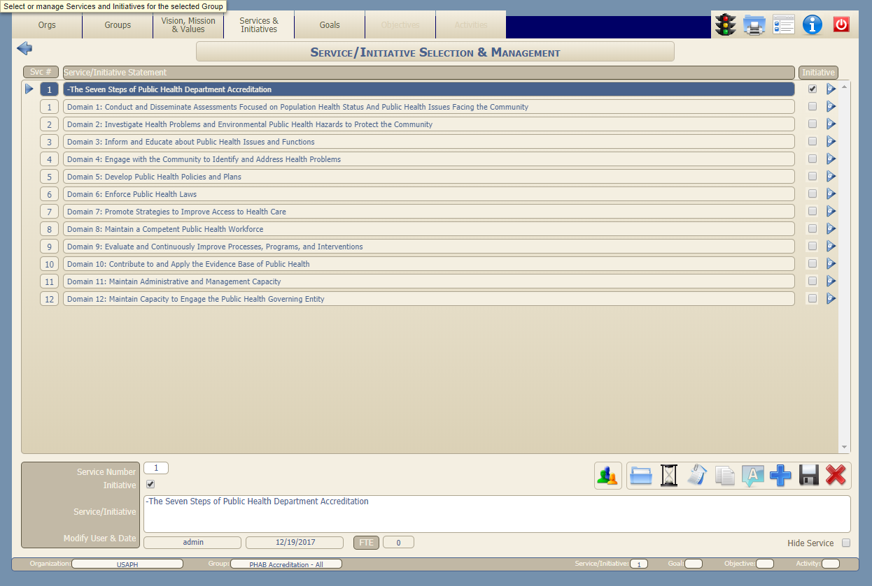
Accreditation Project Plan

Slide 19
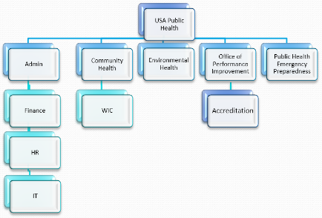
Quick-Start Program
We create your personalized Dashboard using your org chart, user list and graphics
We work with you to enter your strategic plan (or any plan you choose)
We help you to set up and assign the 3D Planning categories
We help you to assign Objective and Activity leaders and teams
We work with you to setup the Real-Time Update notifications to leaders and teams
We provide live training to your team using YOUR plan(s)
Notes:
The Quick-Start program is the easiest way to get you up and running on the Dashboard. We create a personalized Dashboard for your department. Then we work with you to enter your first plan and setup all of the parameters for 3-D Planning and Real-Time Planning. We typically suggest using your department-wide Strategic Plan to start. This can be used to involve everyone in the department as well as selected external partners. We, generally, get the system ready to go under Quick Start within a few days. Once the system is ready to go, we will take you through some live training around your specific plan. This seems to be the quickest way to get you going.

Slide 20
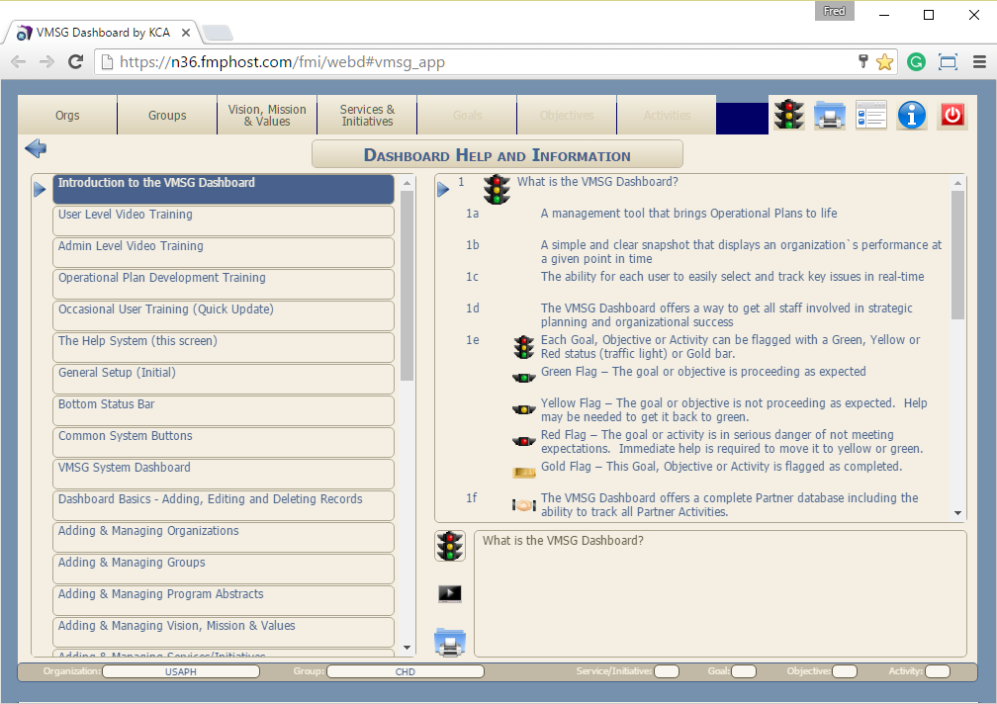
Dashboard Help & Information
Notes:
The Dashboard context-sensitive Help and Information is a available from any screen in the system. When you click on this Help Icon on the top of the screen, you will be directed to the proper Help topic based on your current function.
To use the Help & Information screen:
Select the desired topic on the left side of the screen
The steps to perform the selected function appear on the right side of the screen.
Each Help topic has a short (about 4 minutes on average) help video. Just click on the video icon to launch the help video
All user and administrator video training modules can be accessed from these buttons on the help screen.
If you’d like to see the User Guide for the Dashboard, click the the “Printer” button in the bottom-middle of the screen will open the User Guide in a new browser window. This document is hyperlinked to take you to the desired topic. You can print this guide if needed.

Slide 21
Benefit Summary
Cost effective for any size department
Precisely manage each bureau, division, office and program in your department in real time
Identify gaps, overlaps and commonalities across all of your plans and operations
Manage your Federal, State or Local accreditation process
  “Fully Demonstrated” for PHAB Standard 9.1
Cloud-based – zero installation required; accessible any time, any place
Notes:
VMSG Dashboard Benefits
Our “sliding scale” cost model makes the VMSG Dashboard affordable for departments with only a few users to departments with hundreds of users.
With individual Operational Plans for each Division, Office and Program, you can manage each entity within the health department in real time
3-Dimensional Planning allows you to identify the gaps, overlaps and commonalities across all of your plans and divisions
Many of the Dashboard features were designed to help departments navigate the PHAB and local accreditation processes. The Dashboard has, built in, a complete PHAB Accreditation project plan based on PHAB version 1.5
From an IT perspective, the entire system is cloud based. No installation is required.

Slide 22
VMSG
Vision Mission Services Goals
Dashboard
Public Health Performance Management System
Knowledge Capital Alliance
VMSG@KCA-Inc.com
(480) 225-8193
Notes:
Thanks for reviewing the VMSG Dashboard help and information system.
If you have any questions or would like more information on the VMSG Dashboard performance Management System, please contact us with the contact information here.

Slide 23
Performance History
Notes:
This chart represents the performance for Quality Assurance Activities. This chart represents the history of the planning element over time.
The controls in the upper left corner allow you to select the display criteria for the chart.
The green line indicates the green value for the QA Activity. The Red line represents the Red value. Everything between the red and green lines is the yellow zone. The blue line represents the actual data points for this Activity.

Slide 24
What is the
?
The VMSG Dashboard Public Health Performance Management System is a comprehensive, operational planning and execution system based on the Deming/PDCA Cycle.
Performance Management System vs. a Performance Monitoring System
Developed with the 3rd largest Public Health jurisdiction in the US, Maricopa County, AZ.
Designated as “Fully Demonstrated” at many health departments by the PHAB for the implementation of Standard 9.1 and Measure 9.1.1 A
  Engages all staff and selected external partners in planning, monitoring, updating, performance management and organizational success.
3 Dimensional Planning - Categorization to link elements of all plans together
Examples:
  Link planning elements and documents to PHAB Domains, Standards and Measures
  Link department strategic plan to CHIP and WFD plan
Cloud-based, version-controlled, categorized, document storage and management for all plan elements. (97 PHAB Measures, 1 - 6 documents per measure = 97 - 582 documents)
Notes:
The VMSG Dashboard Public Health Performance Management System is a comprehensive, Deming/PDCA Cycle-based, operational planning and execution system.
The system was developed in coordination with the Maricopa County, Arizona, Department of Public Health. It’s the 3rd largest Public Health jurisdiction in the US serving a population of about 4.2 million people and covers more than 9,200 square miles in central Arizona. Maricopa County along with other Dashboard clients, provide continuous feedback and suggestions for the improvement of the system. These upgrades are implemented for all Dashboard clients on an ongoing basis. We’ll discuss some of these recent improvements during this presentation.
The planning methodology for the Dashboard was developed in conjunction with Dr. Thomas Keller. For over 25 years, Dr. Keller was a highly-regarded Management Professor at Arizona State University teaching at both the undergraduate and graduate levels. Over this time, he was able to distill the best practices of the most effective strategic and operational planning methodologies from the academic world. In addition to the academic view, we worked with several public health departments to fine tune the methodology to the specific needs of Public Health.
Designated as “Fully Demonstrated” at many health departments by the Public Health Accreditation Board for the implementation of PHAB Standard 9.1 “Use a performance management system to monitor achievement of organizational objectives.”
The Dashboard is the only system we are aware of that fully meets Measure 9.1.1 A “Staff at all organizational levels engaged in establishing and/or updating a performance management system”
The Dashboard engages all staff and selected external partners in planning, monitoring, performance management and organizational success.
3-Dimensional Planning - Categorization to link elements of all plans together
Examples:
Link planning elements and documents to PHAB Domains, Standards and Measures
Link department strategic plan to CHIP and WFD plan
As health departments become more immersed in the PHAB accreditation process, they soon realize that a large number of documents need to be managed. Based on direct feedback from clients, the Dashboard now provides complete, cloud-based, version-controlled, categorized, document storage and management for all plan elements.

Slide 25
Performance Improvement (PDCA)
Strategic Plan
Operational Plans
CHIP
WFD
QI

Slide 26
What is Performance Management?
Strategic Plan
Operational Plans
Operational Planning
QI
WFD
CHIP
Performance
Monitoring
Performance Improvement

Slide 27
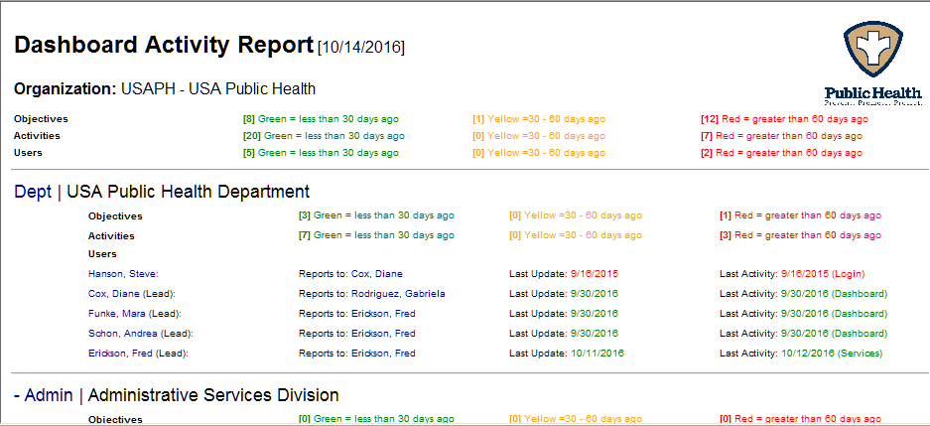
Dashboard Activity/Audit Report
Notes:
This performance management feature is the Dashboard Activity Report. This report, in effect, is an audit report. It shows every user in the system, the last time they updated their assigned planning elements, what they last did in the system and their supervisor. This report allows you to monitor user activity (or lack of).

Slide 28
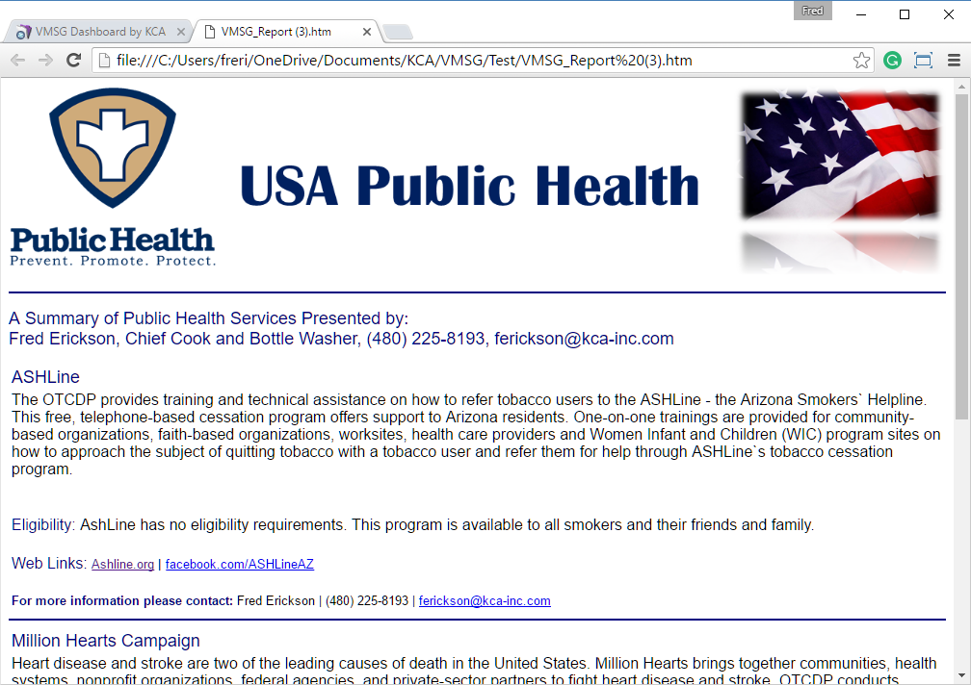
Program Abstracts
Notes:
The Program Abstract Report can be generated for the current selected Group (and Sub-Groups) or from the Category Tag Report option to print the Abstracts meeting a specific set of categorization criteria.
The Program Abstract report has a graphic header and the Abstract information for one or more Abstracts including:
“A Summary of Services Presented by: [Name], [Title], [Phone], [eMail]
Abstract Title
Abstract Text
Program Eligibility Requirements (if the entry field is not blank)
Web and Social Media links (websites, Facebook, Twitter, etc.) (if all of the entry fields are not blank)
Program Contact Name, phone number and email address

Slide 29
Flow
How we’re organized…
Organization
Groups
Notes:
The VMSG Dashboard structures and manages the planning and execution processes. The system is hierarchical in design like this pyramid. The system manages the following Planning Elements:
Organizations and Groups define “How we are structured and organized” Most health departments have a single Organization in the system. Each organization can have multiple groups and sub-groups. Groups and Sub-Groups define the “Org Chart” of the department.

Slide 30
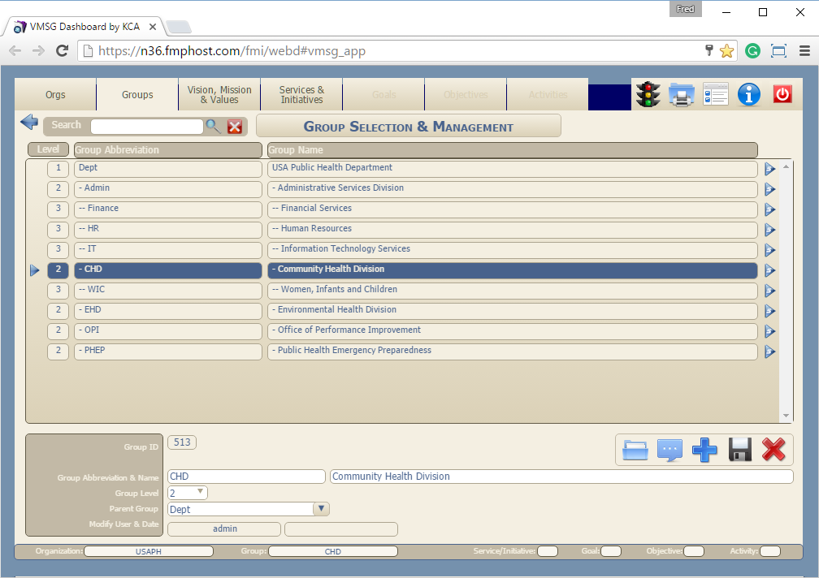
Groups
USA Public Health
Admin
Finance
HR
Community Health
WIC
IT
Environmental Health
Office of Performance Improvement
Public Health Emergency Preparedness
Notes:
This is how the Org Chart for the department is entered into the Groups screen in the Dashboard. Operational plans can be developed for each Group.

Slide 31
Flow
How we’re organized…
Organization
Vision, Mission & Values
What we are about…
Groups
What we do…
Services/Initiatives
How we do it…
Goals
Objectives
Activities
Notes:
Each Group can have its own Vision, Mission and Values. Most organizations have common Vison and Values across all groups. We’ve seen some divisions that have a different Mission statement. For instance, WIC and Emergency Preparedness may have a different Mission Statement defining their way of achieving the Vision of the Department.
The next layers of the pyramid define the actual operational plan for the department, division, office or program. Each group defines the current Services or desired Initiatives to be accomplished. Services are typically those things we are doing now as a health department. Initiatives are those things we want to do in the future. Both are entered in the Services module. The difference will be in the timelines for the Goals, Objectives and Activities. Planning elements for Initiatives will generally have future dates associated with them.
Goals, Objectives and Activities form a hierarchy to define how we will accomplish the Services and Initiatives. Goals may have multiple Objectives and Objectives may have multiple Activities.
Most of you have hard of the Deming Cycle or PDCA Cycle. PDCA stands for Plan – Do – Check and Act or Adjust. We prefer Adjust because it seems to describe this step better. After we Plan, Do and Check, we make Adjustments to the plan for the next cycle. The PDCA cycle in an integral part of the Dashboard planning process.
To Plan, the operational plan is developed using the Services and/or Initiatives, Goals, Objectives and Activities.
In the Do phase, the operational plan is implemented using the steps developed and tracked by the leaders responsible for the specific Objectives and Activities.
You then Check the performance of the operational plan using the Dashboard and Performance Management tools.
To Act/Adjust, use the feedback from the Dashboard and Performance Management tools, to adjust the operational plan to maximize performance of the Organization, Group and/or Services.

Slide 32
3-Dimensional Planning
Strategic Plan
Strategic Priority:
Partnering
PHAB
Standard 4.2
Public Health
Essential #1
Operational Plans
Document Management
WFD
CHIP
PHAB
Standard 6.1
Notes:
Do you know:
Which parts of your CHIP contribute to Public Health Essential #1?
Which plan elements contribute to PHAB Standard 6.1?
Which parts of your WFD plan contribute to your strategic priority for partnering?
Which documents you need to submit for Standard 4.2?
3-Dimensional Planning allows you to categorize any planning element or document to an unlimited set of standard or custom categories. This provides you with the ability to cross reference all of your plans against a common set of standards. The document management system allows you to store, edit and categorize all of your documents and files. This is especially useful in the PHAB Accreditation process where you may be required to manage up to about 600 documents.

Slide 33
Real-time Planning
Strategic Plan
Operational Plans
CHIP
WFD
Notes:
PHAB Measure 9.1.1 A states “Staff at all organizational levels engaged in establishing and/or updating a performance management system”
The Dashboard engages all staff and selected external partners directly in planning, monitoring, updating, performance management and organizational success. Distributing the process of updating your various plans across your organization assures that your information will always be current.
The system provides automated notifications and a “quick-update” system to assist and encourage everyone to participate in updating the plan information.
As activities reach designated milestones, the team leader and’/or external partner is notified through the automated notification system.
They can then go into the system through the Quick Update system to easily update the required plan status.

Slide 34
Pricing Model
Annual License fee Includes:
SaaS (Software as a Service)
  Hosting
  All software updates
  Daily backups
  Worldwide access via the Internet
Account setup (Org Chart, Users, Graphics, etc.)
Unlimited Video and/or Webinar-based User Training
Unlimited Technical Support
Operational Plan Development Assistance
NO startup fees
NO additional costs
Annual License fee Examples:
10 – 50 users = $100 per user per year
100 users = $60 per user per year
210 users = $35 per user per year
521 users = $20 per user per year

Slide 35
USA Public Health
Admin
Finance
HR
Community Health
WIC
IT
Environmental Health
Office of Performance Improvement
Public Health Emergency Preparedness
Accreditation

