Slide 1
2020-2024
SHIP & CHIPs and Dips
Christy Hudson, Policy Analyst
Policy and Partnerships Team
Christy.j.hudson@state.or.us

Slide 2
Overview
Purpose of the SHIP
Process for developing the 2020 SHIP
2020-2024 SHIP priorities
CCO 2.0 policy impacts
Resources
Questions and Discussion

Slide 3
What is a State Health Improvement Plan?
Identifies our state’s health priorities
Addresses unjust and unacceptable disparities
Tool for collective impact with cross-sector partners
Key strategic document for Oregon Health Authority’s, Public Health Division
Required for Public Health Accreditation
Notes:
The SHIP is a 5 year plan that identifies health priorities in our state – with evidence based strategies to address them and outcomes to measure our progress. The SHIP aims to advance health equity by addressing disparities that impact priority populations in our state, such as people of color, people with low-income, people with disabilities, and people who identify as LGBTQ+. We also aim to address disparities based on geography – rural and frontier areas in particular. We the see the SHIP as being a tool for collective impact – acknowledging that health is not only the concern of OHA or the PHD – but for many partner and cross-sector agencies. As an accredited health department, the public health accreditation board requires that we develop a new ship at least once every 5 years.

Slide 4
Who implements the SHIP?
Oregon Health Authority
Health care system
State legislators and other elected officials
State and local public health departments
Education (including early childhood, K-12, colleges and universities, and vocational programs)
Employers
Criminal justice and law enforcement
Transportation
Housing and human service providers
Community based organizations
Faith based organizations
Foundations and philanthropic partners
Anyone wanting to improve health in their community
Notes:
Although improving health is the work of the PHD and OHA – it is not our work alone. Thus, we see the SHIP as being a key tool for aligning agencies who are also working to improve health….with specific strategies and roles identified for a number of sectors and partner such as….

Slide 5
2015-2019 State Health Improvement Plan
  Prevent and reduce tobacco use
  Slow increase of obesity
  Improve oral health
  Reduce harms associated with alcohol and substance use
  Prevent deaths from suicide
  Improve immunization rates
  Protect the population from communicable disease
Notes:
Our current SHIP has 7 priorities - to prevent and reduce….and finally, protect the population from communicable disease. We are currently in our final year of implementation – and are seeing some success, especially in priorities related to tobacco, immunization and communicable disease. This plan will complete end of the year.

Slide 6
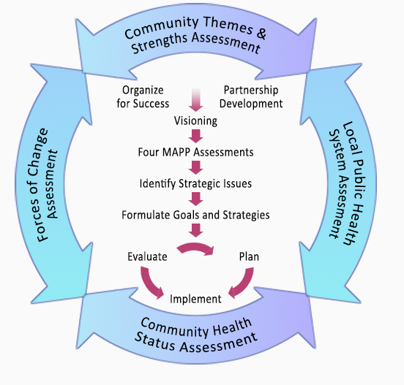
Overview of the MAPP process
MAPP Process

Slide 7
Vision for 2020-2024 SHIP
Oregon will be a place where health and wellbeing are achievable across the lifespan for people of all races, ethnicities, disabilities, genders, sexual orientations, socioeconomic status, nationalities and geographic locations.
Notes:
In terms of why we have a SHIP – this is the vision that was first drafted by the SHA steering committee and amended by the Partnership – or steering committee for the next SHIP. It reads…”Oregon….geographic locations”.
Our next ship has a very strong commitment to health equity and addressing the needs of our most marginalized neighbors.

Slide 8

State Health
Assessment and Indictors

Slide 9
Community Engagement
Online survey in English and Spanish
Mini-grants to community based organizations
Eastern Oregon Center for Independent Living
Self Enhancement, Inc.
Next Door
Unite Oregon
Q Center
Micronesian Islander Community (of APANO)
Northwest Portland Area Indian Health Board
Other community forums

Slide 10
2020-2024 Priorities
Institutional bias
Adversity, trauma and toxic stress
Economic drivers of health (including issues related to housing, living wage, food security and transportation)
Access to equitable, preventive health care
Behavioral health (including mental health and substance use)

Slide 11
CCO 2.0 and the SHIP
Shared CHAs & CHIP priorities
CHIPs must address at least 2 SHIP priorities
Increase strategic spending in SDOH and HRS, and align spending with community priorities (e.g. Community Health Improvement Plans)
Encourage adoption of SDOH, health equity and population health incentive measures

Slide 12
Resources
CHA/CHIP map – Links to all CHAs and CHIPs in state
CCO 2.0 Policy Recommendations
OPHAT – Web based data analysis tool
MAPP Framework
Healthoregon.org/2020ship
Healthoregon.org/sha
Notes:
So I’d love to answer any questions and/or hear your thoughts and responses. I know there’s a lot of really incredible community engagement work happening in Lane county - so would also love any feedback or learnings you might want to share related to this work in your community.
CHIP Goals:
Increase economic and social opportunities that promote healthy behaviors.
Increase healthy behaviors to improve health and well-being

Slide 13
Questions and Discussion
How can we ensure identified strategies and measures are relevant, implementable and meaningful to your CHIP?
What lessons can you share with us as we develop our next SHIP?
Notes:
So I’d love to answer any questions and/or hear your thoughts and responses. I know there’s a lot of really incredible community engagement work happening in Lane county - so would also love any feedback or learnings you might want to share related to this work in your community.
CHIP Goals:
Increase economic and social opportunities that promote healthy behaviors.
Increase healthy behaviors to improve health and well-being

