Slide 1
2022 LSTA Application Training
Rachel Cook, Grants Coordinator
Utah State Library Division
801-715-6722, rcook@utah.gov

Slide 2
Announcements
Applications are only available to those with an approved pre-application.
Approved pre-applications do not guarantee your project will be funded.
Applications will be completed at https://utahdcc.secure.force.com/usl/. Any applications submitted in any other way except this portal will not be accepted.
For feedback on your application prior to submission, leave your application in draft mode and send me an email to pre-review by September 27 at the latest.
Full applications are due October 7.

Slide 3

Today’s Agenda
Review grant timeline, allowable costs, and funds available
Receive instructions on application
Style, diction, and format of the grant
Review process
SAM.gov
Next steps
Tips for success

Slide 4
Grant Timeline
Date | Action
9/7/2021 | Full app opens
9/9/2021 | Full app webinar
10/7/2021 | Full app closes
10/7-10/2021 | Eligibility review
10/11-11/4/2021 | Panel Review
11/4/2021 | Funded projects announced
11/5/2021 | Contracts sent out
11/16/2021 | LSTA Admin webinar
11/19/2021 | Contracts due
11/19/2021 | LSTA spending can begin
2/15/2022 | Interim Report 1 Due
5/1/2022 | Interim Report 2 Due
6/30/2022 | LSTA Spending Ends
7/10/2022 | Reimbursements due
8/31/2022 | Contract end date
10/1/2022 | Final Report Due

Slide 5
Allowable costs
Allowable Cost Sheet
Unallowable:
Food and Beverages
Entertainment
Debt
Fines and penalties
Items/services not related to this grant
Promotional items
Gifts/prizes/awards
Lobbying costs
Capital expenditures
Subscriptions can only be paid for the months in the grant period.
These items listed are not the only unallowable costs. Please review the document on our website to ensure your budgeted items are within allowed spending.
If there is a question on an allowed cost, please call Rachel Cook.

Slide 6

Funds available
$250,000 total available.
These funds are given to the State Library by the Institute of Museum and Library Services (IMLS) through the Library Services and Technology Act (LSTA).
This is a matching grant (34% local, 66% grant funds).

Slide 7
Questions?

Slide 8
The Application

Slide 9
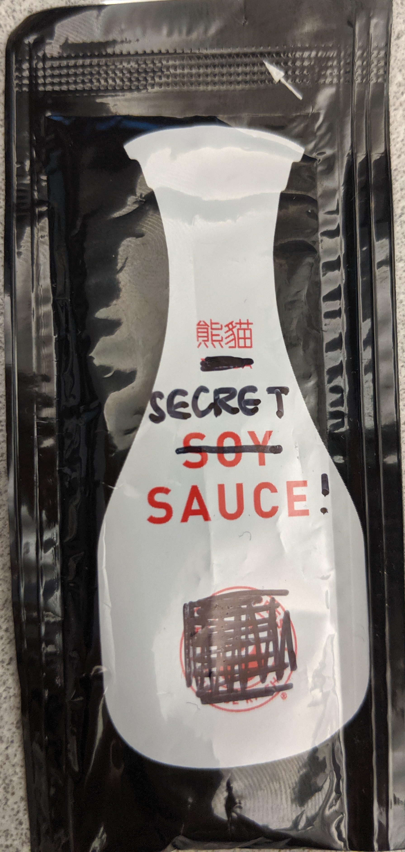
Guidelines document
https://drive.google.com/file/d/1D_fpEYYft-tjKZiQtjSIR8RTCODL94Wi/view

Slide 10
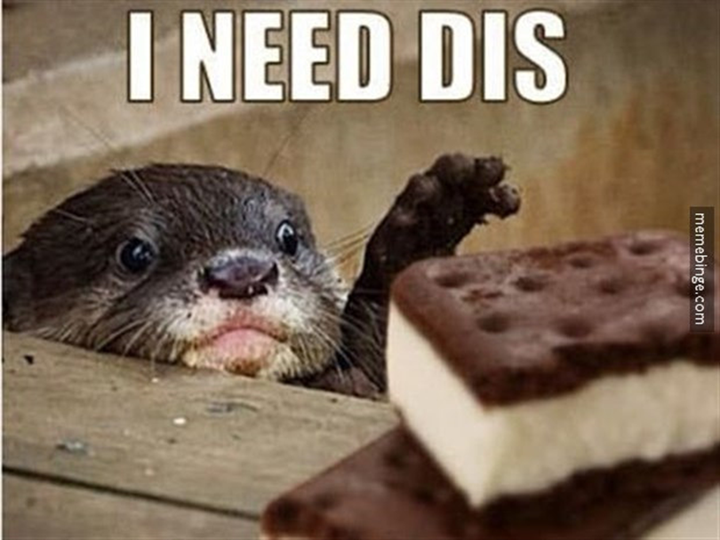

Need
Most important part of your application.
It is all about your community.
Patrons, students, staff. NOT the library.
Include how you determined need.
Should be a specific population.
No deck chairs on the Titanic.
Photo by: Meme Binge licensed under (CC BY 2.0) (“Funding” added)

Slide 11

Goals and evaluation
IMLS Intents
Choose one.
USL State Goal
Choose one.
Description of outcomes
Change in behavior, attitude, skills, knowledge, conditions, or status of your community you listed in need.
Evaluation methods
Can be surveys, observation, or qualitative feedback.
Plan how you will track this from the beginning.
Certain types of projects have required IMLS surveys to be collected.
Attribution: (CC BY 2.0) craftivist collective Image has been cropped.

Slide 12
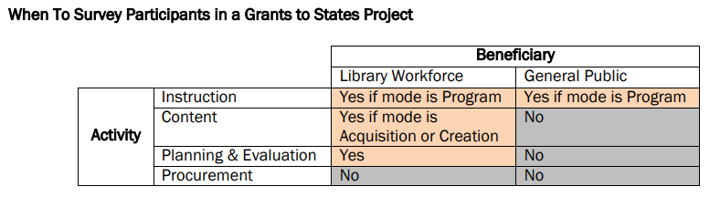
IMLS Surveys
Key takeaway here: if your project includes public programming or nearly anything focused on your staff, you MUST survey participants with a previously-written IMLS survey.

Slide 13
Description of activities
Activities
Partnerships
“How” of your project.
Major component of your project.
Activities of the same type (purchasing/creating content, instructing, planning/evaluation) and target audience can be bundled together.
Put detail of project happenings in these sections.
Format matches the final report.
List partners for each activity.
Must be a mutually beneficial partnership.
Partnerships are worth 5% of your final score.
Include a signed partnership statement for each partner.

Slide 14
Indirect costs
Administrative costs that cannot be calculated (things like utilities)
4 Options
Use no indirect costs
Use a current indirect cost rate that has already been negotiated with a federal agency
Use an indirect cost rate that has been submitted to a federal agency but not yet negotiated
Use the de Minimis rate not to exceed 10% of project costs
Can use a rate less than your federal negotiated rate if it is approved by your organization.

Slide 15
Budget
Budget
Budget Narrative
Review allowable costs in the step by step guide.
List the amounts in each category.
Use high level detail, eg $100 – Books.
Equipment is only for single items costing more than $5000 and has the useful life of more than 1 year.
Deeper explanation of what is listed in each budget category.
For example, in the $100 – Books category, you will now explain what those books are, and why they fit into your project (100 junior nonfiction STEM books for afterschool program).

Slide 16

Spelling, grammar, and math
Important, but often overlooked.
Worth 5% of your final score.
Your chance to review and edit.
This includes adding your budget up and making sure the numbers all tie out.
Have someone else read it who is not involved in the project.
Image by jamieanne (CC BY-ND 2.0)

Slide 17

innovation
Describe how this project is innovative/above-and-beyond.
Worth 5% of your final score.
This means innovative for YOUR library or YOUR community, not the library world as a whole.
Attribution: pexels.com, Meet Dagar

Slide 18
Style, Diction, Format
Follow the salt principle: enough information that it’s enjoyable, not so much it becomes indigestible.
Be concise and clear.
Write so a 6th grader can understand.
Avoid jargon and vague statements.
Instill confidence in the grantor.
Be excited about your project! Your grantor will be able to sense that and hopefully be excited, too.

Slide 19
Questions?

Slide 20
Review Process, Next Steps, and tips

Slide 21
The Review Process
Outside panel of reviewers.
Reviewers split into groups and review all applications in assigned categories.
Scores act as a guide for the conversation of funding decisions.
They do not have the prior knowledge of your application I have.

Slide 22
SAM.gov registration
To receive federal funds, you need to be registered in SAM.gov and receive a Unique Entity ID (UEI)
The UEI will be replacing the DUNS number.
If you are already registered in SAM.gov, you have a UEI already, you just need to ensure this gets renewed each year.
To see if you are registered, you will need to login or request a login. You can also work with your city/county/district financial office to see if they are aware of your status in SAM.gov.

Slide 23
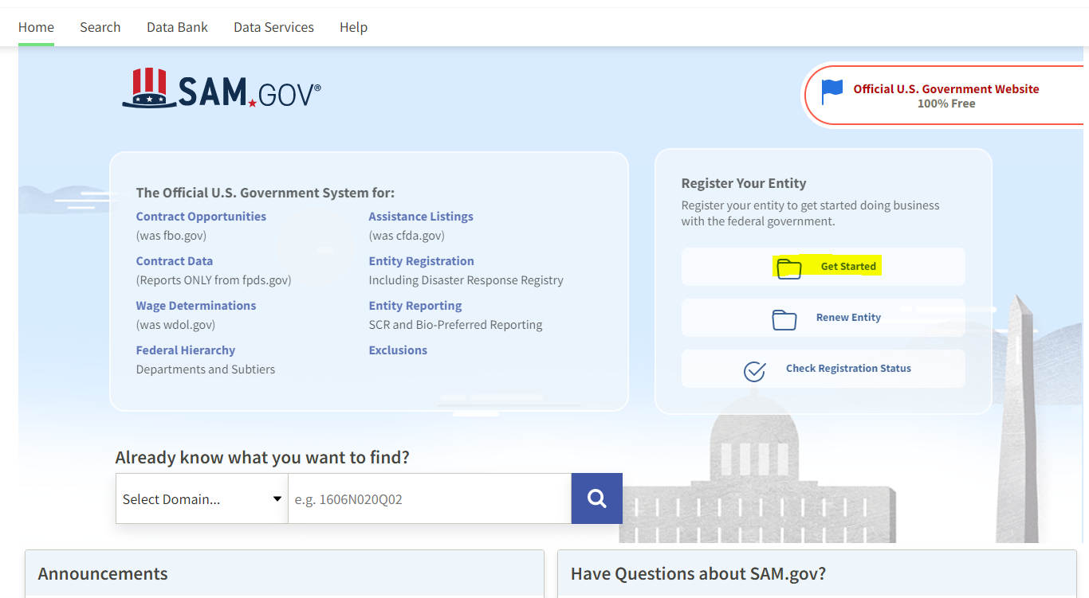

Slide 24
Next Steps
Go to our online portal and login to your account. Start your application.
Meet with all partners to prepare this information.
Refer to the pre-application documents to know what answers to prepare.
Submit your application a week before the deadline to avoid disaster.
If you want a pre-review, please email me by September 27.
Register on SAM.gov

Slide 25
Success tips
Read the guidelines and online resources. Then read them again. And again.
Do a training.
Encourage anyone working on the project to do a training.
Refer to the webinars.
Be concise and avoid jargon. Write so a 6th grader can understand.
Get excited!
Feel free to ask questions. rcook@utah.gov.

Slide 26
Questions?
Rachel Cook
801-715-6722
rcook@utah.gov

