Slide 1
ORPIN Upgrade
Version 3.00

Slide 2
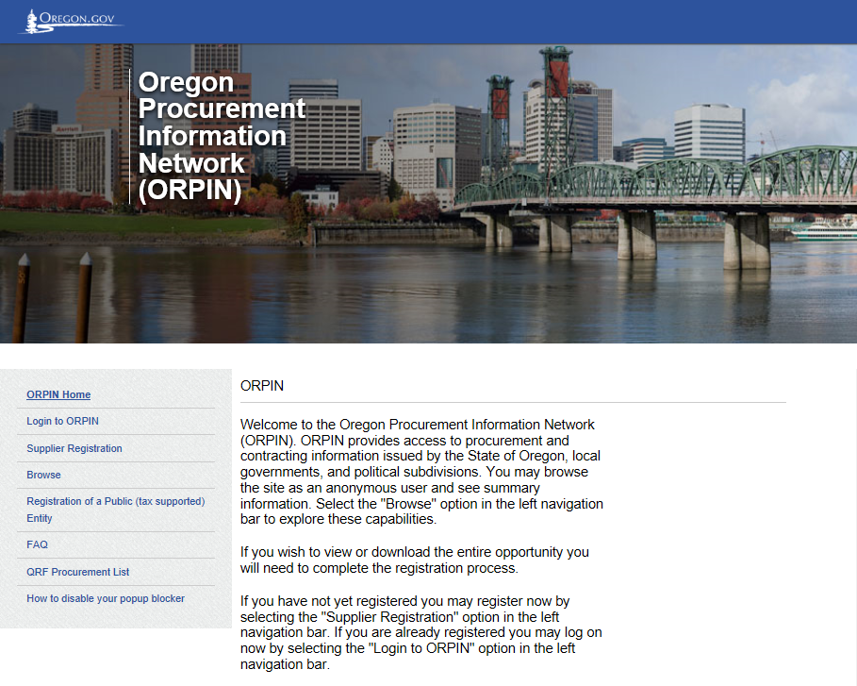
New Look and Feel

Slide 3
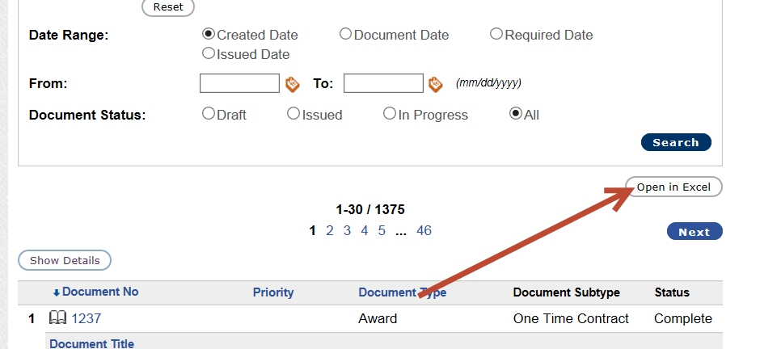
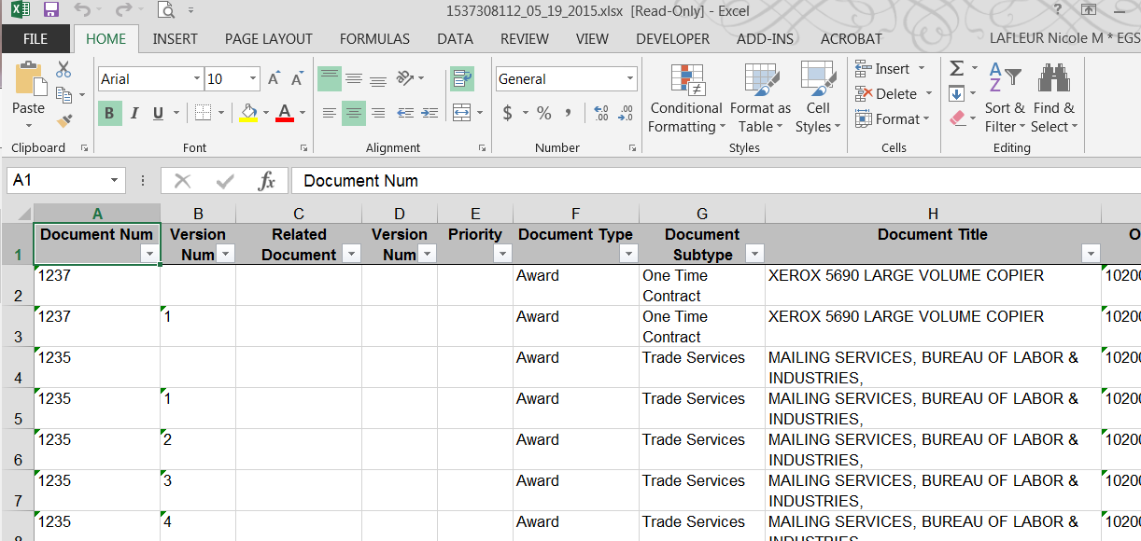
“Open in Excel” Option

Slide 4
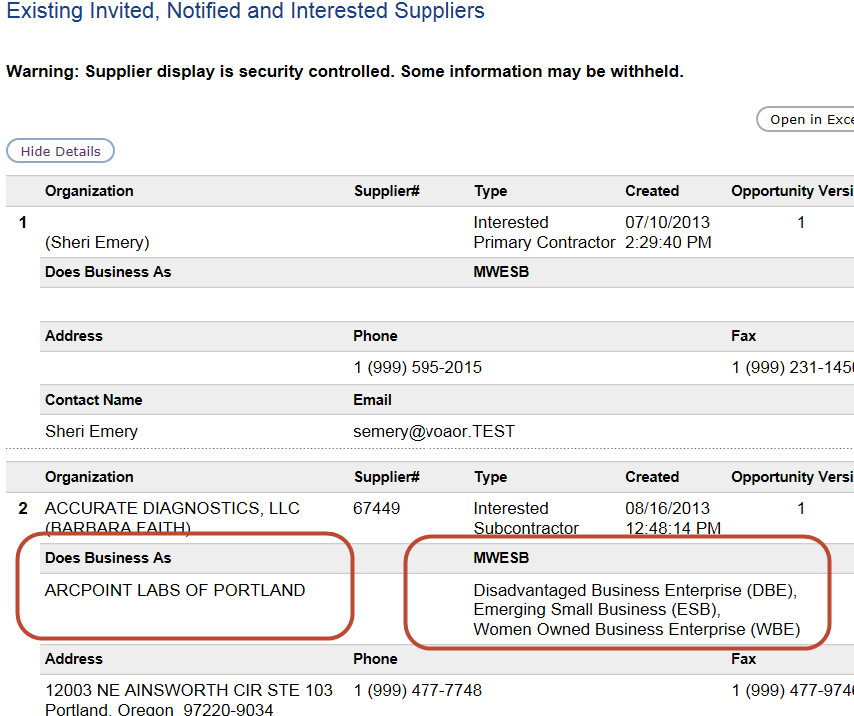
Changes to Express/View Interest Screen
If you click the Show Details button at the top of the Interested list, you can see Doing Business As names and MWESB information for interested suppliers!

Slide 5
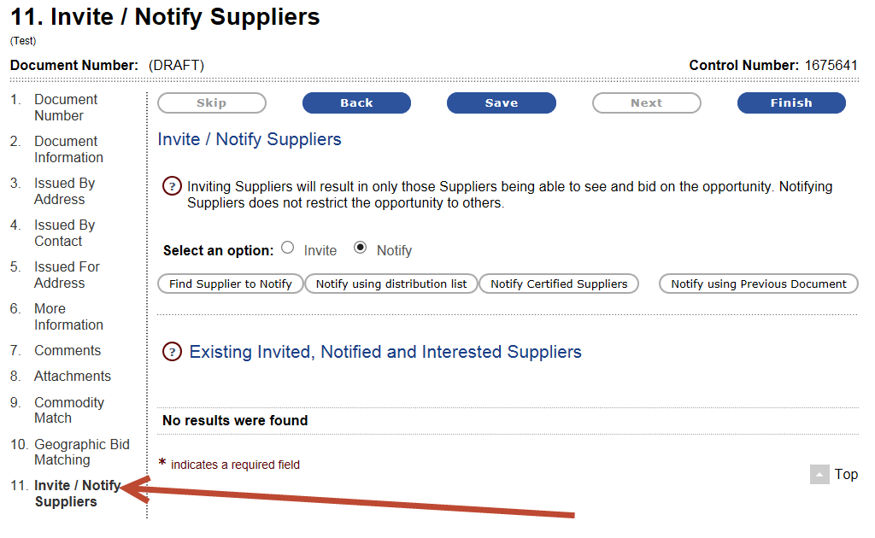
Invite/Notify Moved to Document Wizard
The Invite/Notify option will be the last step in the Maintain area (Document Wizard) on Opportunities and Notices. It is not a required page, so if a user doesn’t need to use the Invite/Notify feature, they can simply hit the Finish button after populating the Geographic Bid Matching section.

Slide 6
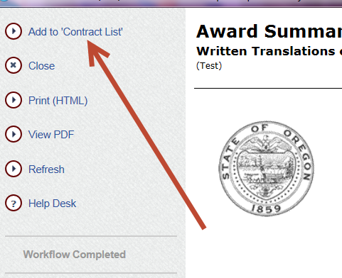
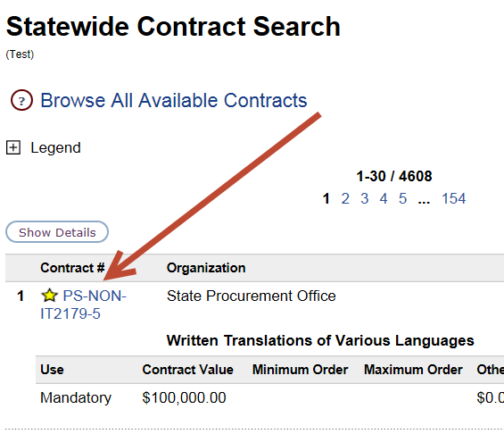
Flag Contracts as “Favorites”
Click on “Add to ‘Contract List’” on a contract to flag it as a favorite. Then when you do contract searches it will come up at the top of the list with a star next to it.

Slide 7
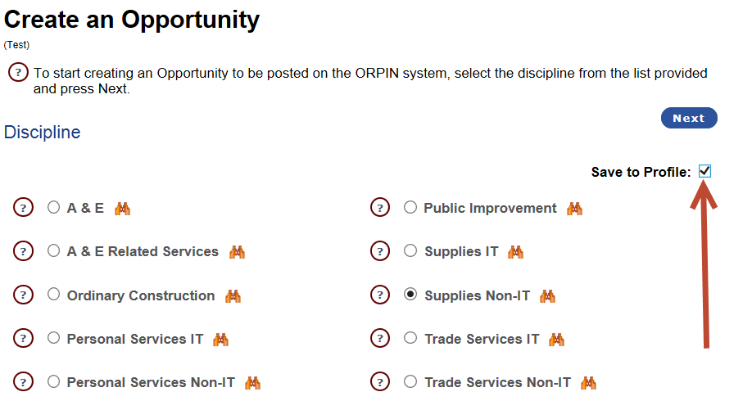
Save to Profile
If you routinely do the same type of entry into ORPIN, you can save choices to your profile. This essentially makes them the default selection and you can skip that step when creating documents.
This option is available for Discipline Type, Procurement Method, and Issued By/Issued For Agency Selection.

Slide 8
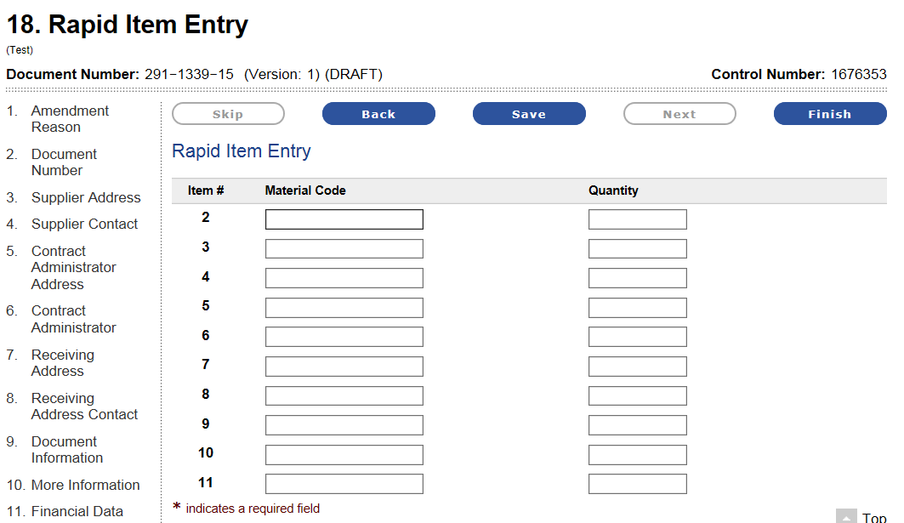
Rapid Item Entry
Enter NIGP Codes and Quantities to quickly add items to Opportunities, Notices, and Awards. (UOM will also be added to this screen before go-live.)

Slide 9
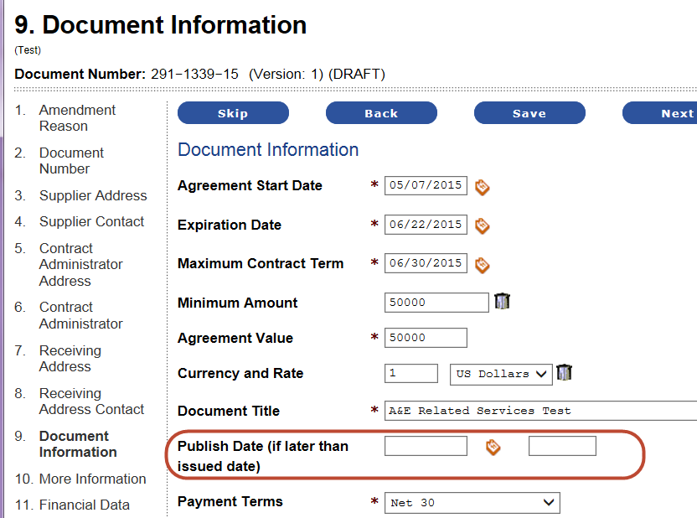
Publish Date on Awards
This tool allows you to postpone the “publish” of an award or an amendment/revision on an award.
A postponed award will not show up in searches or on reports.

Slide 10
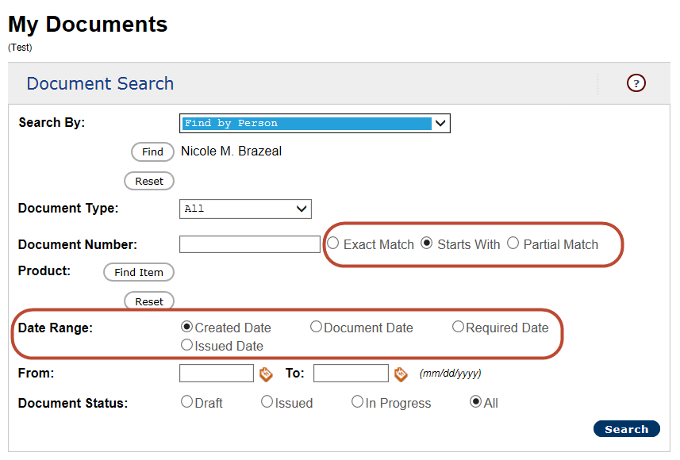
New Options on My Documents > Document Search
Created Date – the date the document was created. The user cannot change this date. It shows on the “Process History” screen as “Document Created”
Document Date – the date entered on the Document Information wizard screen as “Created Date”. The system pre-populates it with the date the document was created however the user can change it
Required Date – if we decide to turn this on, we will only use it for PR’s. Will allow customers to let the buyers know when they need the goods/services by.
Issued Date – the date the issue step was completed. The user cannot change this date. It shows on the “Process History” screen.

Slide 11
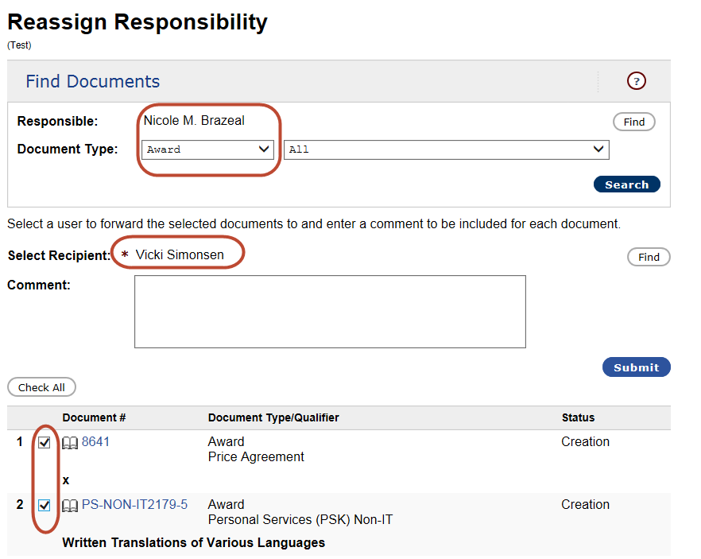
Reassign Responsibility Tool
This tool lets you look up draft documents (either All or specific types) assigned to a buyer and then assign the drafts to a different buyer in your organization.

Slide 12
Other New Functionality
Import/Export Items option on Opportunities
Group Items
Create Revisions on Purchase Requests
Ability to enter Items on ORS190 documents (optional)
Email reminder to suppliers with draft eBids
2nd sheet on Excel reports to show report parameters
New data on Statewide Printable Index (Use, Contact, Phone #)
Suppliers can view attachments on closed opportunities
And many more!!!

