Slide 1
Pandemic Small Business Assistance
What’s Changed? What’s New? What’s Next?
Prepared for our Partners at Oregon Main Street
April 15, 2021

Slide 2
Kat’s Disclaimer
Funding programs for pandemic relief change daily, sometimes hourly. Today’s information reflects “what we knew to be true at the end of yesterday.”
Expect changes!
Just keep swimming!

Slide 3
What’s Changed?
Paycheck Protection Program (1 and 2)
Eligible for PPP2 if Gross Revenue is down by 25% (Qtr to Qtr Comparison)
Extended to May 31st
Schedule C Filers get to use Gross instead of Net Income!
Businesses with NAICS 72XXX (Restaurants get 3.5 x Ave. Mo. Payroll)
No EIDL Advance Deducted from PPP
Simplified Forgiveness for Loans $150K or Less
Can now use ERTCs along with PPP (Talk to Accountants!)

Slide 4
What’s Changed?
Economic Injury Disaster Loans (EIDL)
Available until 12.31.21
Increased Maximum Loan Amount to $500 K
24 Months of Operating Capital instead of 6 Months
Targeted EIDL Advances
Invitation ONLY from SBA (sba.gov email addresses)
Low Income Communities (Census Tracts)
Difference of $10K minus amount they were originally granted
SBA Debt Relief
6 Months of Payments (P&I) on 7a and 504 Loans

Slide 5
What’s New?
Oregon Landlord Compensation Fund (Residential)
Second Round will Open April, Final in June
Landlord and Tenant Must Participate
Rent, Utilities, Late Rent Fees
80% Compensation
Oregon Commercial Rent Relief Fund
$42MM in Round 2
Landlord and Tenant Must Participate
Base Rent Only
80% Compensation – Can’t Evict for 6 Months
Taxable to Both Parties!
Lottery, not FCFS

Slide 6
What’s New?
Shuttered Venue Operator Grants (SVOG)
Eligible Applicants: Live Venue Operator or Promoter, Theatrical Producer, or Live Performing Arts Organization Operator; Motion Picture Theatre Operator; Museum Operator; and/or Talent Representative
Must have at least 25% Revenue Loss
SVOG Reduced by any PPP Amount Received
DUNS and SAM Required (14-21 Days if New)
Grant amounts up to $10MM Max
No Notice of Shortcomings! – One Shot Deal – Get Help (SBDC, SCORE, WBC, VBC)
This is a Federal Grant – Budget, Detailed Tracking & Reporting
Priority Phased Roll-Out by Revenue Loss
Portal to Re-open Soon . . .
SVOG Webinar SAM Webinar DUNS Request Guide SVOG Grant Portal

Slide 7
What’s Next?
Restaurant Revitalization Fund (RRF)
Eligible Applicants: Restaurants, food stand, food truck, caterer, saloon, Inn, tavern, bar, lounge, brewpub, tasting room, taproom, licensed facility. Premise of a beverage alcohol producer where the pubic may taste, sample or purchase products. Other similar place of business in which the public or patrons assemble for the primary purpose of being served food or drink. Independently owned franchises okay!
No chains with more than 20 locations, publicly-traded, non-profits, government operators, SVOG applicants. Cannot be permanently closed.
$28.6B
No SAM or DUNS or Cage Codes
Grant Amount Calculations
Open prior to 2019? 2019 Gross Revenue – 2020 Gross Revenue – PPP Loan (Max $10M)
Not in business all of 2019? Use Average Mo. Gross Revenue x 12 – 2020 Gross Revenue - PPP
Opened in 2019 or 2020? Use total of eligible expenses from 2.15.20 to 3.11.21 - 2020/21 Gross Revenue – PPP
Spent money by or on 3.11.21? Use total of eligible expenses from 2.15.20 to 3.11.21 - 2020 Gross Revenue – PPP
Covered Spend Out Period is 2.15.20 – 12.31.23
Eligible Expenses: Payroll, Rent, Mortgage, Utilities, Maintenance, PPE, COGS, Operating Expenses, Supplies
21 Day Priority Application Period (Women, Veterans, Socially & Economically Disadvantaged – Self-Cert)
However, everyone should apply on Day 1
Prep: Tax Returns (2019 & 2020); P&Ls and BS; POS Reports; IRS 1099-Ks; Bank Statements; IRS 4506-T
Hotline Coming & Application Linked to Toast, Square, Clover, Aloha Etc.

Slide 8
What’s Next?
RRF Continued . . .
Socially and Economically Disadvantaged Defined
The federal government defines “socially and economically disadvantaged” individuals under the Small Business Act (15 USC 637) as follows:
Socially disadvantaged individuals are those who have been subjected to racial or ethnic prejudice or cultural bias because of their identity as a member of a group without regard to their individual qualities.
Economically disadvantaged individuals are those socially disadvantaged individuals whose ability to compete in the free enterprise system has been impaired due to diminished capital and credit opportunities as compared to others in the same business area who are not socially disadvantaged. In determining the degree of diminished credit and capital opportunities the Administration shall consider, but not be limited to, the assets and net worth of such socially disadvantaged individual.
Other helpful links . . .
SBA RR Townhall Independent Restaurant Coalition

Slide 9
What’s Next?
Other American Rescue Plan Act Information
Localized Funding: Oregon $2.6B and $2B Localities
Pandemic Unemployment Assistance Extended to 79 Weeks Through 8.29.21
EIDL Advances & Restaurant Revitalization Act
Not included as gross income, no deduction denied

Slide 10
Oregon SBDC Capital Access Team (CAT)
Tweeting what we learn @OR_CAT
Disaster Funding CAT List

Slide 11
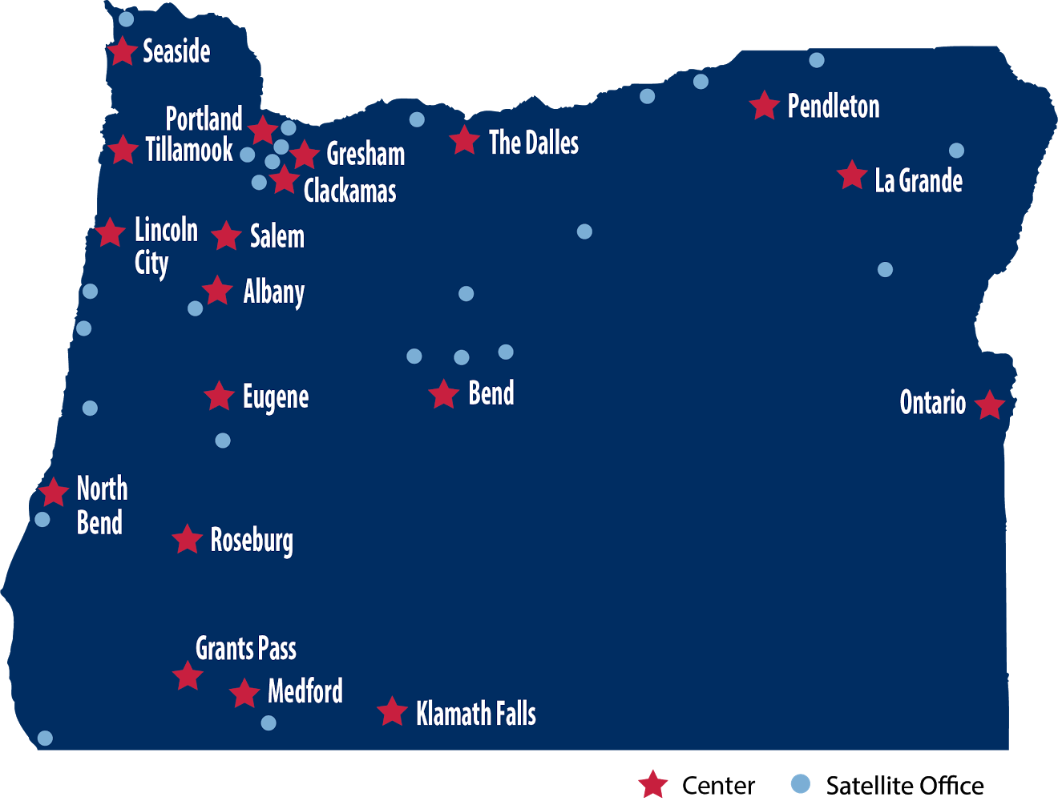
19 Centers, More than 40 Locations

Slide 12
Thank You
Kat Rutledge
Director
KCC Small Business Development Center
541.205.5404
Rutledge@klamathcc.edu

Slide 13
Questions?
Visit us online at OregonSBDC.org

