Slide 1
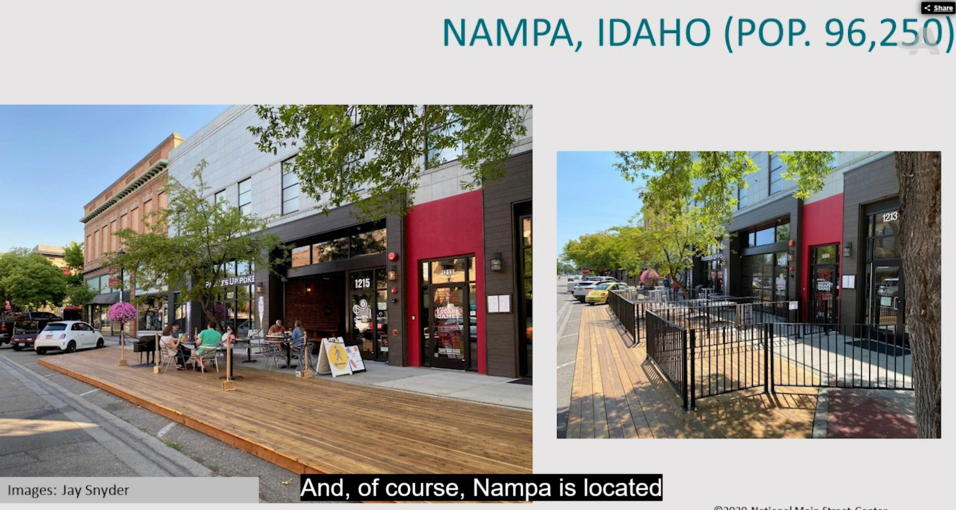
NMS Case Study…Nampa repurposed 9 parking spaces and extended the sidewalks. Restaurants then placed furniture, etc. on them.

