Slide 1
Infrastructure funding and Main Street
Kelly Humrichouser
February 23, 2022
Notes:
Hello, I’m Kelly Humrichouser, Director of Government Relations at Main Street America.

Slide 2
Connect with Main Street America
Welcome Marta Olmos to MSA’s Communications Team
Follow us, tag us!
Twitter: https://twitter.com/NatlMainStreet
LinkedIn: https://www.linkedin.com/company/main-street-america/
Facebook: https://www.facebook.com/NationalMainStreetCenter
Write for our Blog: https://airtable.com/shroj2R5BWERHexKe
Email Us: communications@savingplaces.org

Slide 3
Agenda for today
What’s in the Infrastructure bill?
What happened to Build Back Better?
American Rescue Plan Act – Final Rule
Updates from Main Street America
Notes:
You have a grassroots structure!

Slide 4
Infrastructure Legislation recap
Infrastructure legislation was a big part of President Biden’s agenda for his first year in office.
With a slim majority, the infrastructure ideas were broken into two separate pieces of legislation:
Bi-Partisan “hard” or “traditional” infrastructure – roads, bridges, transit, and broadband.
“Soft” infrastructure – child/elder care, housing, climate resiliency, community development.

Slide 5
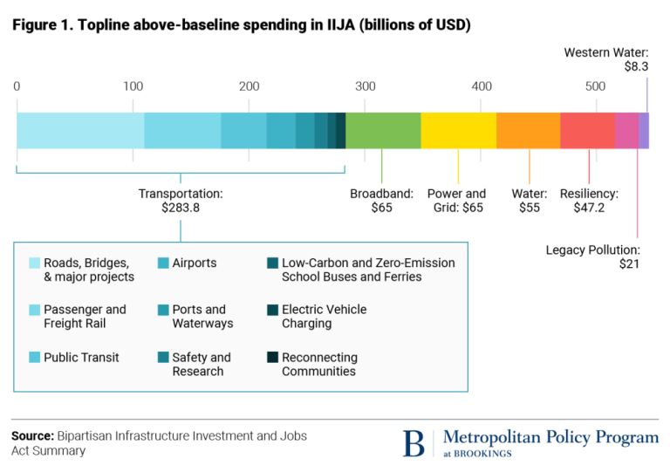
Infrastructure investment and jobs act
Infrastructure Investment and Jobs Act (IIJA) was pass in November, and includes big, broad buckets of funding totaling $1.2T.
Notes:
This is very helpful: https://www.bradley.com/-/media/files/insights/publications/2021/11/iija-broadband-summary.pdf

Slide 6
Infrastructure investment and jobs act
Things to know:
The Administration has appointed Mitch Landrieu as “Infrastructure Czar”. Each governor has also been asked to appoint an infrastructure coordinator and will ask mayors to do the same.
Individual agencies are also initiating comment periods on proposed programs and outreaching to stakeholder groups.
Roll-out of infrastructure programs is beginning to start, but various timelines are unclear.
Notes:
This is very helpful: https://www.bradley.com/-/media/files/insights/publications/2021/11/iija-broadband-summary.pdf
https://www.federalregister.gov/documents/2021/11/29/2021-25868/development-of-guidance-for-electric-vehicle-charging-infrastructure-deployment

Slide 7
Infrastructure investment and jobs act
Oregon State Specific Information (Formula Funding)
Type of Infrastructure | Funding to Oregon from IIJA
Roads and bridges | $3.4 billion highways; $268 million for bridges
Public Transportation | $747 million
Electric Vehicle Charing Infrastructure | $52 million
Broadband | $100 million
Wildfire Prevention Infrastructure | $39 million
Cybersecurity Infrastructure | $15 million
Water Infrastructure | $529 million
Airports | $211 million
Source: Peter DeFazio’s website

Slide 8
Infrastructure investment and jobs act
Selected Competitive Grant Programs (National Funding)
Infrastructure Grants | Available Funding
ReConnect Program (USDA)* - For rural broadband | $1.29 billion
Rural Broadband Program (USDA) | $74 million
Digital Equity Competitive Grant Program (Commerce) | $1.25B
RAISE Grants (formerly BUILD Grants)* | $7.5 billion
Charging and fueling infrastructure grants (DOT) | $2.5 billion
Reconnecting Communities Pilot Program (DOT) | $1 billion
Safe Streets for All (for Vision Zero) | $5 billion
*Accepting applications
Notes:
This is very helpful: https://www.bradley.com/-/media/files/insights/publications/2021/11/iija-broadband-summary.pdf
https://www.federalregister.gov/documents/2021/11/29/2021-25868/development-of-guidance-for-electric-vehicle-charging-infrastructure-deployment

Slide 9
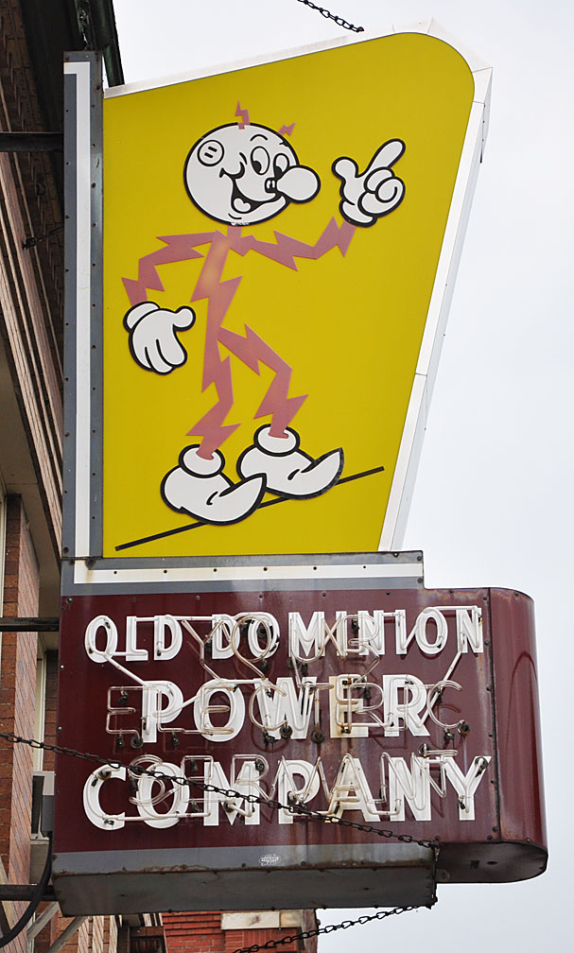
IIJA - Broadband
Overall, $65B in IIJA for broadband adoption and affordability.
Largest share is formula funding to states. Can be sub-granted to providers.
Digital Equity Competitive Grant Program – this is the pot for digital inclusion, workforce development, training – through states/providers
Also, a continuation of COVID subsidy program to local income households – Affordable Connectivity Program
NOTE: ARPA also included $10B for broadband and use of state/local relief funds.
Notes:
This is very helpful: https://www.bradley.com/-/media/files/insights/publications/2021/11/iija-broadband-summary.pdf
https://www.federalregister.gov/documents/2021/11/29/2021-25868/development-of-guidance-for-electric-vehicle-charging-infrastructure-deployment

Slide 10
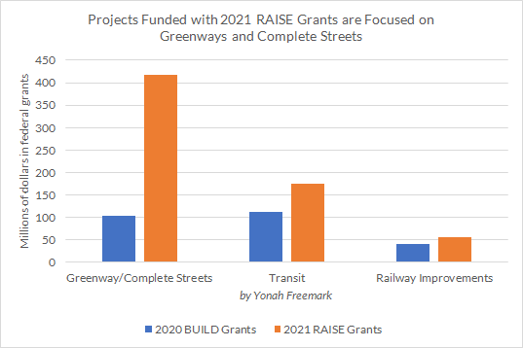
IIJA – raise grants
IIJA included $7.5B in funding for RAISE Grants
RAISE = Rebuilding American Infrastructure with Sustainability and Equity
TIGER (Obama) → BUILD (Trump) → RAISE (Biden)
Posted 1/14/22 – closes 4/14/22
Local units of government are eligible for competitive funds with $1M floor.
Notes:
Digital Equity Competitive Grant Program

Slide 11
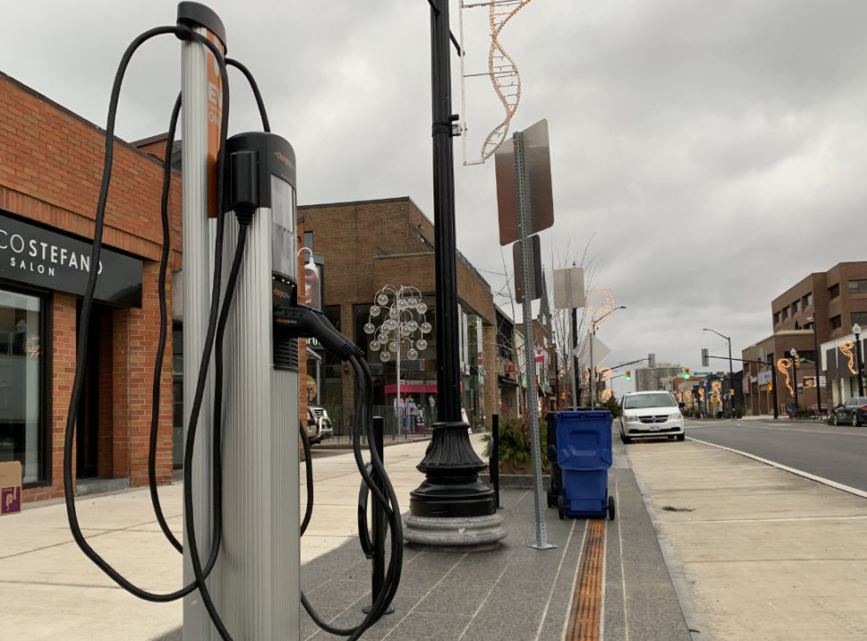
IIJA – Electric vehicle charging
Nationally, $5B formula funding to states for charging infrastructure
Designated “alternative fuel corridors”
$2.5B in competitive grants for both alternative fuel corridors and community grants.
50% each year reserved for “community grants”
Projects may be located in any publicly accessible place
Prioritized for rural, low-income areas
Public comments are currently being accepted on program development.

Slide 12

Build Back better and civic infrastructure
Over the past six months, Main Street America worked with the Percent for Place Coalition, a coalition of CDFIs, HUD, and the White House on the Community Restoration and Revitalization Fund (CRRF).
CRRF would be a $2B program for housing and civic infrastructure, with a capacity building component.
CRRF was included in the final version of Build Back Better, before it stalled.
BBB is anticipated to be broken up; unclear if CRRF may emerge as standalone legislation.

Slide 13
Other BBB Programs of interest
Other things left on the table, for reference:
$3B for Community Development Block Grants (CDBG) with a focus on housing.
$1B for the new Rural Partnership Program to make grants to nonprofits for development activities
$1B for SBA Uplift Incubator program for a network of incubator spaces in underserved communities.
$1.2B for an EDA pilot program – RECOMPETE – to build capacity for economic development job growth
And about another $100B for housing . . .

Slide 14
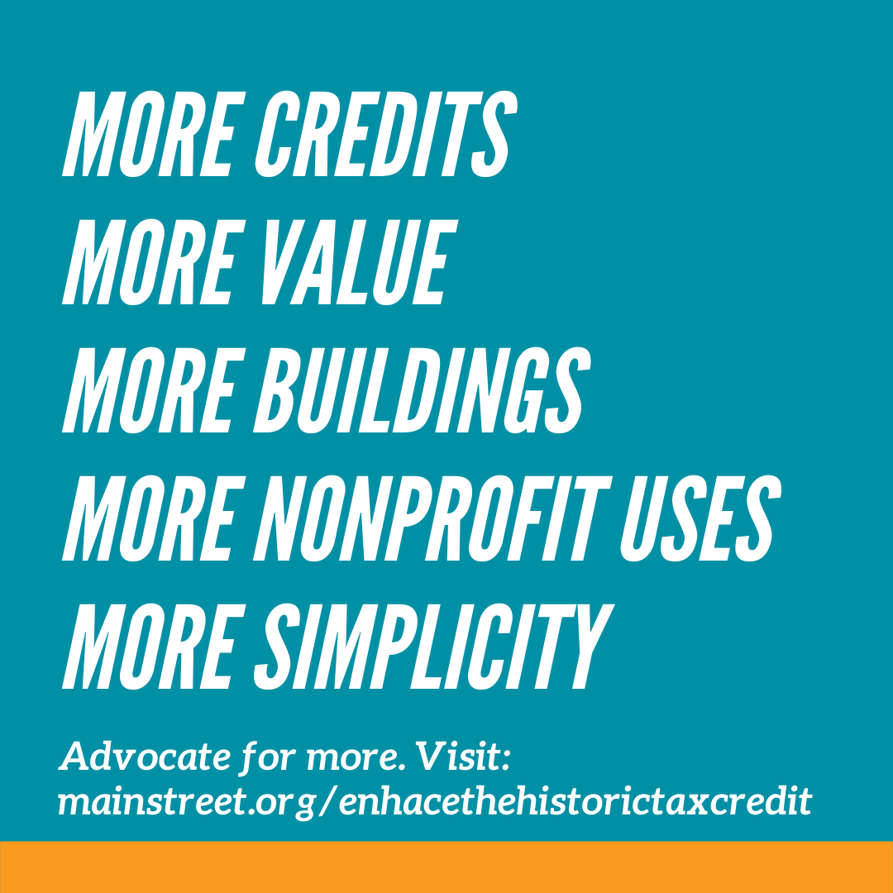
Federal historic tax Credit
Improvements to the federal Historic Tax Credit (HTC) were not included in final version of BBB.
Six provisions included temporary increase to 30% and a permanent increase to 30% for small projects (under $2.5M).
Currently, the advocacy action step is to ask Members to co-sponsor the Historic Tax Credit Growth and Opportunity Act (HTC-Go).

Slide 15
Historic Preservation Fund
H.R.6589 - Historic Preservation Enhancement Act introduced earlier this month.
HPF Reauthorization would:
permanently authorize HPF
increase funding to $300M/yr (from $150M/yr)
permanently fund the HPF.
Would increase funding to SHPOs
Would fund competitive grant programs administered by the National Park Service.

Slide 16
American Rescue Plan Act SLRF
American Rescue Plan Act (ARPA) Interim Rule was released in May; MSA submitted comments on its use for small businesses/business districts in July.
Final Rule was released on January 6. This is generally positive for Main Street.
Gives floor of $10M in Revenue Replacement
In QCTs, eligibility for expenditures includes rehabilitation of commercial properties, storefront improvements, and façade improvements, technical assistance, business incubators, and grants for start-ups or expansion costs w/o specific measurement of impact.
Clarifies measurement on proportionately impacted industry as 8% loss of employment. Tourism is always an impacted industry!
Allows capital expenditures for negative economic impacts. Under $1M = no justification.
Emphasizes and expands uses for broadband, non-profits, and housing.
Notes:
https://home.treasury.gov/system/files/136/SLFRF-Final-Rule-Overview.pdf
https://home.treasury.gov/system/files/136/SLFRF-Final-Rule.pdf

Slide 17
Revitalizing Small and Local Businesses Act
Revitalizing Small and Local Businesses Act – S. 3340 – was introduced in December. Anticipating a House introduction soon.
Creates $50M competitive grant program for national non-profit entities to subgrant to business district organizations.
EDA reauthorization expected in next 3-6 months.
We will need to start a more robust push to specific offices (first) then a broader push.

Slide 18
Questions!? Let’s discuss.

Slide 19
Kelly Humrichouser
Director of Government Relations
Main Street America
khumrichouser@savingplaces.org
Mainstreet.org

