Slide 1
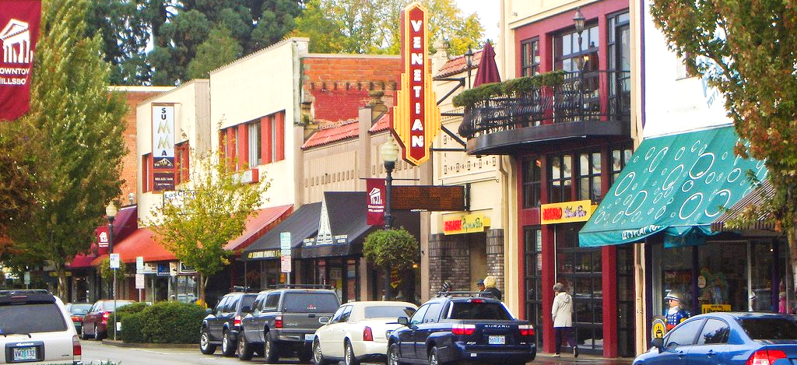






Insert Name of Program
OUR MAIN STREET IMPACT
Add a program tagline or brief sentence about your Main Street’s Impact.
Impact Number
Metric Description
Insert a brief description of a sentence or two about how this is creating great impacts in your community.
Impact Number
Metric Description
Insert a brief description of a sentence or two about how this is creating great impacts in your community.
Impact Number
Metric Description
Insert a brief description of a sentence or two about how this is creating great impacts in your community.
ABOUT OUR MAIN STREET
Add content about your Main Street. This can be a great place for your Main Street Mission Statement and/or vision statement. This looks best with a few lines of text, but feel free to keep things rather concise and easy to read.
GET IN TOUCH!
Website
Phone Number | email address
Street Address | City, Oregon 00000
THE OREGON MAIN STREET NETWORK
Oregon Main Street helps communities across the state preserve, sustain, and enhance their downtowns through strategic changes rooted in community vision and time-tested approaches for bringing people, businesses, and resources to the downtowns.
Learn more about Oregon Main Street by visiting www.oregonmainstreet.org.
MAIN STREET MEANS IMPACT!
Between 2011 and 2021, the Oregon Main Street network helped generate $266 million in sales revenue across the state, supporting over 2,400 jobs in our Main Streets communities. As a result, $3.5 million of additional state tax revenues were generated because of Oregon’s Main Streets.

Slide 2
Here’s a sample:
Hillsboro Downtown Partnership
OUR MAIN STREET IMPACT
Neighborly folks, building this place together.
3,985 Hours
Contributed to Placemaking
Insert a brief description of a sentence or two about how this is creating great impacts in your community.
38 Ideas
Shared and Implemented
Insert a brief description of a sentence or two about how this is creating great impacts in your community.
100+ Ways
To Meet Your Neighbors
Insert a brief description of a sentence or two about how this is creating great impacts in your community.
ABOUT OUR MAIN STREET
Our mission is to cultivate and amplify a vibrant Downtown Hillsboro community. We envision a thriving district of collaborative partners who embody community as an essential component of a vibrant and resilient Downtown Hillsboro, with HDP serving as the conduit for connections, engagement, and idea realization.
GET IN TOUCH!
www.downtownhillsboro.org
(503) 640-6145 | email@emailaddress.com
233 SE Washington Street | Hillsboro, Oregon 97123
THE OREGON MAIN STREET NETWORK
Oregon Main Street helps communities across the state preserve, sustain, and enhance their downtowns through strategic changes rooted in community vision and time-tested approaches for bringing people, businesses, and resources to the downtowns.
Learn more about Oregon Main Street by visiting www.oregonmainstreet.org.
MAIN STREET MEANS IMPACT!
Between 2011 and 2021, the Oregon Main Street network helped generate $266 million in sales revenue across the state, supporting over 2,400 jobs in our Main Streets communities. As a result, $3.5 million of additional state tax revenues were generated because of Oregon’s Main Streets.

