Slide 1
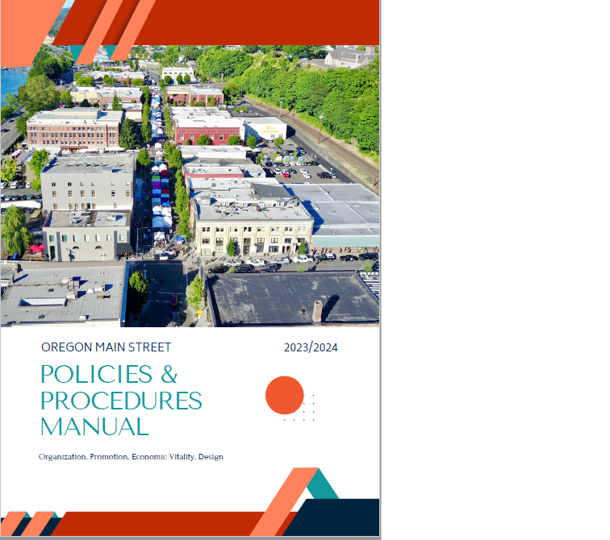
Introduction to Oregon Main Street Policies and Procedures Manual
Donna Ann Harris
Heritage Consulting Inc
2023
Notes:
Thank you for having me present this introduction to this NEW Main Street Policy and Procedures manual

Slide 2
Agenda
Best practices in Main Street Policies and Procedures
Fill in the blank, interactive PDF, how to use it
Ethics and Accountability
Organizational Finances
Communications/Administration/Board of Directors/Committees
Personnel Policies
Appendix: Whistleblower, Conflict of Interest, Board contract, Parliamentary Procedures
Notes:
These are the sections that are included in the manual, but half of the document is related to personnel.

Slide 3
How to use: Interactive PDF Manual
Open Adobe Acrobat Reader DC or Adobe Acrobat Pro/Standard/DC
Complete the required fields with relevant information
Save the document with the additional text, and
Rename it your own Policies and Procedures Manual electronically.
This setup eliminates the need for printing, handwriting, and scanning documents.
Notes:
This is how you use the document because it has many locations where you fill in the blank about who is responsible for carrying out the policy or procedure—Hint most often it is the Executive Director, but sometimes the treasurer or other officer.

Slide 4
Best Practices in Main Street
Gathers together most traditional policies for local Main Street organizations
Uses Oregon State Laws for Personnel policies
Compare these Policies and Procedures to what you have now
Update your policies or use this version
Have an attorney or HR professional review this P&P
Thank you to Nicole Feightner, PHR/SHRM-CP, of Bridgetown People Consulting for her careful review of personnel policies section
Notes:
Sheri developed an earlier version of this document when she was in Washington State. She wanted to review it, and bring it up to date with the current best practices for Main Street organizations. I reviewed my files and looked at the Main Street America files to see what is new or helpful to all of you.
Ideally you should compare this to your current policies if you have them. If you do not have polices at all, consider using these. If there is an attorney you use or a good HR person locally have them review these for you use and make changes they suggest. There are some of these policies that you do not use, and that is ok. Eliminate them.
We were lucky to have Nichole Freightner a local Main street board member, who was willing to review my collection of OR law and other personnel related matters. She made them easy to read and there are links to the law if you need to look at what the regulation actually says

Slide 5
Why have written Policies and Procedures?
Reference tool for Board and Staff
Guidelines for the Executive Director’s interaction with other staff if any
Make employees aware of their rights, benefits and responsibilities
Makes everyone aware of accounting and financial management, procurement, records retention, and a drug-free work environment.
Notes:
Sheri
Many main street organizations establish policies based on issues that arise:
Having a board member or volunteer express a personal opinion as if it represents the organization’s view – oops, we need to establish who can speak for our organization.
Having another organization approach your organization to support a levy – allows you to know when, or if, you should be taking a stand
Not knowing how much money is in the bank
Having policies and procedures can help your organization to be proactive rather than reactive. It alleviates stress for your board. And it improves the credibility of your organization and builds more faith if they understand you have policies and procedures in place that guide your processes.

Slide 6
Ethics, Accountability
Ethics and Accountability
Use Roberts Rules of Order when needed
Enact and use a Conflict of Interest Policy, annual Board statements
Confidentiality policy: Business information, personnel info
Whistleblower policy prevents retaliation if violations reported
Records management & destruction schedule, ED is responsible for regular document destruction
Keeping electronic records as if paper records
BACK UP Your Documents Weekly!
Notes:
There slides have plenty of bullet points showing you the content of the document. I am only going to review one or two points on each slide either because I think there are new, or important, or I have a horror story to tell about what happens when you don’t do what your policies say
Can anyone share a story about why you need a policy about backing up your electronic files
Can anyone share an example where the conflict of interest policy was not followed? And the result?

Slide 7
More ways to be accountable to stakeholders
Annual report issued yearly to all stakeholders
Program evaluation by state coordinating program yearly
IRS 990 available for public inspection within hours of request.
On website is best
Notes:
How many of you publish an annual report? Why do you do it? How long does it take?

Slide 8
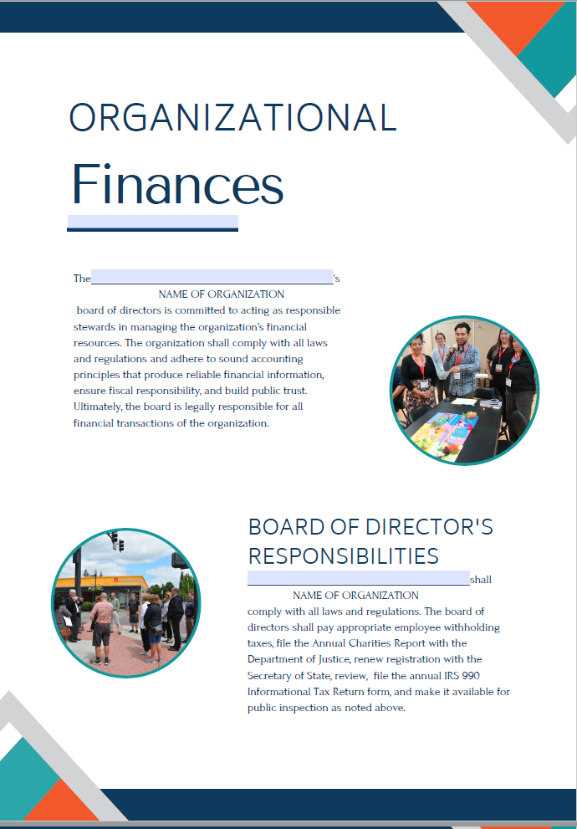
Organizational Finances
Organizational Finances
The Board is responsible for filing: IRS 990, withholding taxes, Annual Charities Report, Secretary of State registration
Board decides on accountant, bookkeeper, auditor, bank, financial, legal and insurance professionals to use
Fiscal year date
Financial controls: ED responsible for day to day management, Board ultimately responsible for organizational finances
Notes:
In the end, the Board is responsible for a well funded organization
If there are not good written financial policies, bad things happen.
Each year when I worked as State Coordinator for Illinois Main Street in the 1990s, there were at least one or two cases of embezzlement in the 56 Main Street organizations I worked with. In most cases, it was the AA, the Treasurer or the Main Street director who opened up a credit card in the organization’s name and charged things and had the bill sent to their home address. This is clearly fraud.
Other times the treasurer who never took a vacation finally did, and the ED opened the checking statement and looked at it, to find has that the treasurer had written large and small checks to themselves. This person was arrested and the organization was repaid eventually.
Needless to say, its important to have written policies to prevent the worst
FYI: We have had cases of fraud in Oregon too!

Slide 9
How to handle cash, paying invoices
ED and one Ex Ctty member count cash and deposit
Funds deposited within 24 hours
Checks copied and endorsed with name of organization (stamp)
ED gathers all invoices to be paid, checks them before paying
Treasurer/other board member reviews invoices before signing checks
Use electronic banking
Where are checks kept? Excess cash in interest bearing account, 2 board members or ED signs checks
Notes:
In this case the ED is the one who is creating the backup material such as invoices which are attached to checks for others to sign.

Slide 10
Purchasing
ED makes all purchases
Use a debit card for purchases
Buy Local Policy
Need 3 telephone bids for any purchase over $2500
Keep a $50 petty cash account, who is responsible for reconciliation?
Travel reimbursement for Board and staff, procedures
Notes:
We have a buy local policy in this document if you do not have one. It has a procedure for the organization to pay more for goods and services produced locally rather than take the lowest price from a big box store or Amazon for example.
It also has a process for taking bids from local and regional bidders on higher priced offerings.
The manual also offers advice about petty cash. One of the managers in Illinois was eventually fired for having too many IOUs in the Petty cash drawer, she was using it as her personal ATM.
Note: Maybe cover why an organization should use a debit card vs a credit card – that was news to me!

Slide 11
Annual Budget Process
Committees prepare work plans and budget
Board reviews committee work plans and budget, makes recommendations for changes
Board deals with any conflict between committees re donors/grants
Board approves committee work plan/budget, included in budget for year
Month when Board approves budget at meeting, before fiscal year
Notes:
We include how Main Streets budget because it is not typical to other nonprofit organizations.
We know that the budget is developed from the bottom up, meaning the committees decide what projects they will complete in the coming year, and then write a work plan and budget. These are submitted to the board, and they review and make comments and changes. If there are no changes and the board approves, the committee can start work and spend money approved in budget.
I hope all of you have a process to resolve conflicts when two or more committees want to approach to car dealer say to sponsor their event. The board decides who gets that opportunity, or which committee can approach a potential donors. Or work with the ED on a grant application.

Slide 12
How committees spend money
Once work plan is approved by board, committee can spend money budgeted in work plan
Anything beyond work plan budget must be approved by Board
Purchases over $250 need to follow Buy Local Policy
ED makes all purchases
Timing for purchases
2 signatures on all checks over $250.00
Notes:
Does anyone do something different than this, allowing committees to spend money after approval of the workplans by the Board?

Slide 13
Financial Records and the Treasurer
Treasurer responsible for presenting financial info monthly to board
At end of fiscal year, Treasurer prepares year end financial statement
Treasurer presents year end statement to board
Notes:
Treasurers are important people in downtown organizations. We rely on them heavily to make sure that we are following the procedures we set out. And it is a larger organization they are likely to work with the auditor.

Slide 14
Donors and Grants
Grant or donor restricted accounts are kept in restricted accounts
All donors over $250 receive acknowledgement per IRS rules
All donors receive a written thank you note
Board decides which committee shall approach sponsor, donor, grant funder
ED writes and manages all Grants, reporting and closeout
Notes:
I am curious about who actually sends out the thank you notes to investors if you have them for your organization?
Does anyone have committees or volunteers write or manage grants? Tell us about your experience with that. I still would prefer that the ED managed all grant writing, reporting and financial close outs.
FYI – some of our start-up organizations are all-volunteer so initially it might be volunteers who write/manage grants (or another organization serving as a fiscal agent)

Slide 15
Communications
Communications
Spokesperson for organization
Press releases, publicity
Presentations
Events
Email usage, organization’s equipment
Cellphone use of organization’s equipment
Letters of support
Social Media Policy
Notes:
Has anyone had trouble with board members speaking to the press?
I worked with one town, and there was a controversy and the board split 5 to 4 on a matter. One board member who Lost, was mad about the decision, the board member make sure to talk to their friend a writer on the local paper, who was more than happy to write a front page piece about “the stupid decision that the local Main Street Board Made.”
Of course, there were lots of recriminations, and the board president was called on to talk to the offending board member directly, Their bylaws allowed the board president to give a warning. If this happened again, the offending board member would be asked to resign as stated in the bylaws.
None if this is fun. But telling board members they are NOT allowed to speak to the press when they are being recruited is a very good idea and then to reinstate this provision in this document. We encourage you to include this document as part of the board packet that all new board members get each year

Slide 16
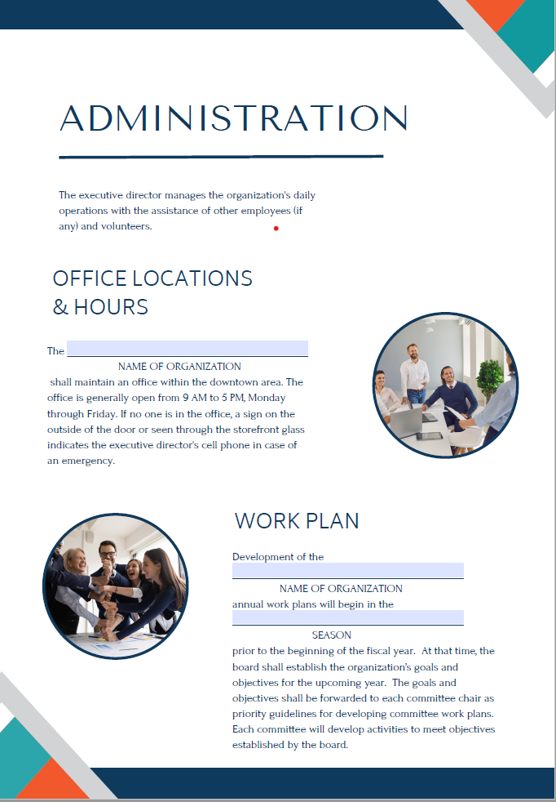
Administration
Office hours and location
Work plans
Master calendar
Notes:
I would like to know how you handle the office when you are not there? Do you post your cell phone number for people to call You? Other ideas?

Slide 17
Board of Directors & Committees
Purpose of the Board
Board Requirements
Board Responsibilities
Individual board member responsibilities
Officers
Confidentiality is a fiduciary responsibility
Four Committees
Executive Committee
Committee members
Collecting volunteer hours
Notes:
This is the most basic of roles and responsibilities.
If you don’t do Board training regularly and I mean at least every other year, this is a short course about what board members do.
If you have not had Sheri come to your board member to do board training, please make an appointment soon.
FYI – during the pandemic, we started virtual board roles and responsibility training. We are now offering them once per month until all board members who haven’t gone through the training and all new board members have a chance to go through the 2 –hour workshop.

Slide 18
Personnel Policies: the basics
Equal Opportunity (federal law)
At will employment OR law
Privacy of personnel files
Probationary period (optional)
Pay policy, breaks, wages
OR Equal Pay Act
Employment classifications
OR Minimum Wage Act
Notes:
Half of this manual is related to personnel matters, Much of it is about state of Oregon laws and regulations that local Main Street organizations need to know about
Oregon is an at will state. Meaning employees have no contract, they can be hired and fired at will
Do any of you use a probationary period? I have had several clients who use it for the first 3 months. It allows them to think about staff and how they are fitting in before giving them benefits. The benefits like health insurance, vacation time, comp time, all come after the first three months.
Oregon has many laws for employees than other places I have worked the Equal Pay Act is terrific, so is the Minimum Wage Act The manual has hot links to those State of Oregon websites that explain the law in detail.

Slide 19
Personnel Policies:
OR Overtime law
Compensatory Time Off
Bonus
Breaks and Meals
Pay Period (pick the one that is closest to yours)
Timekeeping
OR Final Paycheck Law
Notes:
There is an overtime law in Oregon, and a final paycheck law.
We also have language if you want to permit Comp time.
If you are going to offer a bonus, please do, but make sure it is tied to something that the employee actually does. Many ED’s are responsible for grant writing, perhaps there is a bonus for a successful grant win? Do not tie the bonus to something like member retention if the ED does not send out the renewal letters for example.

Slide 20
Personnel Policies: vacation and leave policies
Time off
Vacation time
Holidays
OR Sick Leave Act
Leave of absence
Paid Leave Oregon
Oregon Family Leave
Pregnancy Disability leave
Jury Duty Leave
Notes:
These leave policies are very important to employees
OR unlike many states actually has a Sick Leave Act. The hot link tells you more about it. Paid Family leave Oregon is also exemplary and Oregon Family Leave.
This last law makes it clear how many days you get for a death in the family, and for a sick child or relative. Read it all

Slide 21
Personnel Policies: Health & Wellbeing
Medical insurance
Disability insurance
Retirement benefits
Life Insurance benefits
Dental or vision benefits
Notes:
Sheri
This Manual allows you to include these benefits. Please do. They are important to employees and may help with staff retention.
I know that Sheri collects this information yearly, so if you are about to do budget for the year, please ask her for the information for comparable towns. For some ED benefits are more important than salary. Please keep current and up to date on salary and benefits

Slide 22
Personnel Policies: Discrimination and Harassment
Discrimination
Harassment
Prohibited conduct
Sexual harassment
Penalties
Retaliation protections
Reporting procedures
Notes:
There is a fairly long section about what discrimination is and sexual harassment. Please read this, and look at the hot links too. In this era of “Me, too” it is important to outline what is prohibited conduct and how an employee should report such.

Slide 23
More Personnel Policies
Workplace safety
Worker’s Compensation
Smoke Free Environment
Drug and Alcohol Policy
Notes:
Every worker in the state is covered by worker’s compensation. You all pay into this fund through your withholding
Work place safety in Oregon is governed by state laws. Please read the link in this paragraph to learn more

Slide 24
Personnel Policies: Employment Practices
Supervisor
Dress code
Evaluations
Unacceptable Performance
Absenteeism, Tardiness
Notes:
The ED is the supervisor for everyone else on staff,
The ED’s supervisor is the Board president
We hope no one ever gets to the point where there is unacceptable performance issues for an employee. Here the manual sets up a realistic process for coaching the employee, monitoring and recording improvements or not.
Firing employees is a board decision, with the full involvement of the Executive Director. The Executive Committee should not be firing staff. A long-term client recently did this and board members were surprised and unsettled by this. This could have been avoided with a zoom call before the board meeting to bring them up to speed on concerns.

Slide 25
Personnel Policies: Employment practices
Termination/resignation
Grievance
Personnel files
Outside employment/honoraria
Employment of Relatives
Conflict of Interest
Manual disclosure
Notes:
Does anyone permit the employment of relatives?
The termination and resignation paragraph ask for 2 weeks notice for voluntary resignation. If the ED wants to give more, terrific
Can you tell me what you do about passwords, keys and credit cards when someone is leaving the job?

Slide 26
Appendix
Acknowledgement form
Whistleblower Protections
Board contract
Conflict of Interest and Annual statement for Board members
Simple Parliamentary Procedures
Notes:
We have these things in the appendix because they are common documents that most Main Street organizations should have.

Slide 27
Questions?
Notes:
Thanks for participating in this discussion. Any one have a specific question.
Thank you

Slide 28
Thank you
Donna Ann Harris
Heritage Consulting Inc
422 South Camac Street
Philadelphia, PA 19147
267 251 5444
heritageconsultinginc@gmail.com

