Slide 1
Changes to OSPA for Workday
Fields removed from OSPA databases
  Double fill code
  City/County code
  Gender code
  Ethnicity code
  Handicap code
  Personnel Number
  Personnel Action (PA) Code
Any reports with these fields will be blank after WD goes live

Slide 2
Changes to OSPA for Workday
File will come nightly from Workday to OSPA instead of ‘real time’
Ad-hoc runs for immediate needs
  Processed centrally by WD support team
P030 screen changes
  Add Salary Eligibly Date field (benefit service date in Workday)
  Add Workday Authorization Number
  Add employee’s Date of Birth
  Remove the PERSONNEL TRANS CD field

Slide 3
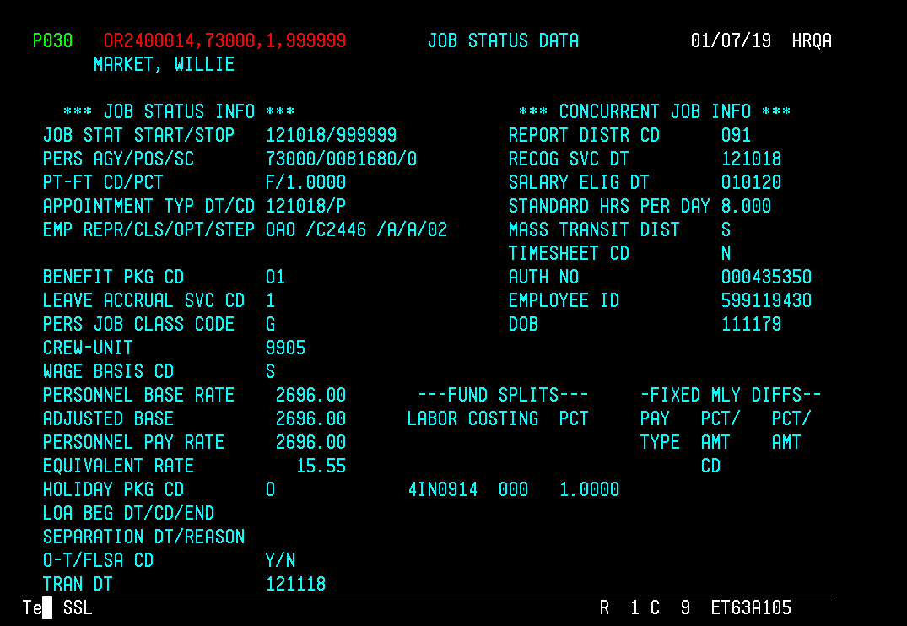
Updated P030 screen

Slide 4
Changes to OSPA for Workday
Monthly leave accrual code changes
  Starting in March the effective date will be the 1st of the month for all employees
  Does not impact eligibly for new hires
Differentials (Allowances)
  All will show as WOC on P030 screen
  3 WOC sections will be populated as follows
    1- Percentage
    2- Flat Dollar
    3- SED for PERS related differential

Slide 5
Changes to OSPA for Workday
Differentials (Allowances) Calculation
  Total salary – Base salary = allowance amount
  Allowance amount / Base salary = % for WOC-1
  WOC-2 contains flat dollar to get allowance to equal amount
Base salary is $10,422.00
Base salary plus differential is $12,922.00
$12,922-$10,422 = $2500
$2500/$10,422 = .239
$10,422X .239 =$2490.86
2500-2490.86= $9.14
$2490.86+$9.14+$10,422 = $12,922.00
$12,922/173.33 = $74.55 which is the hourly rate on the P030 screen

Slide 6
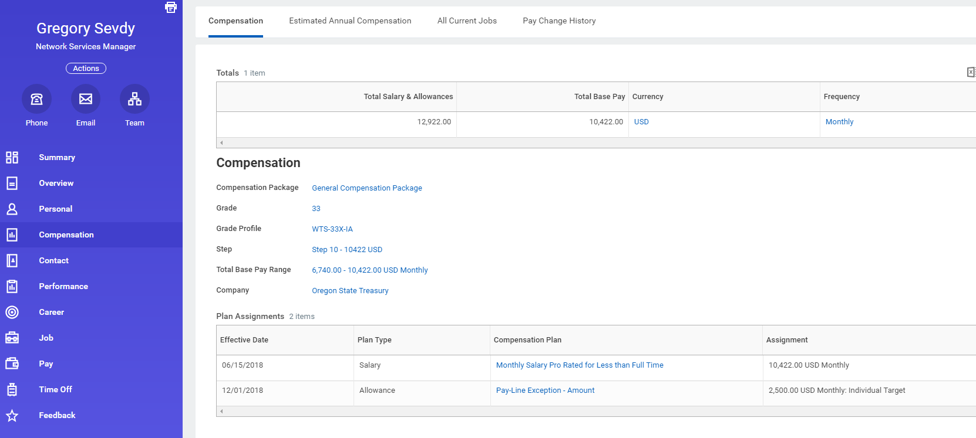
Changes to OSPA for Workday

Slide 7
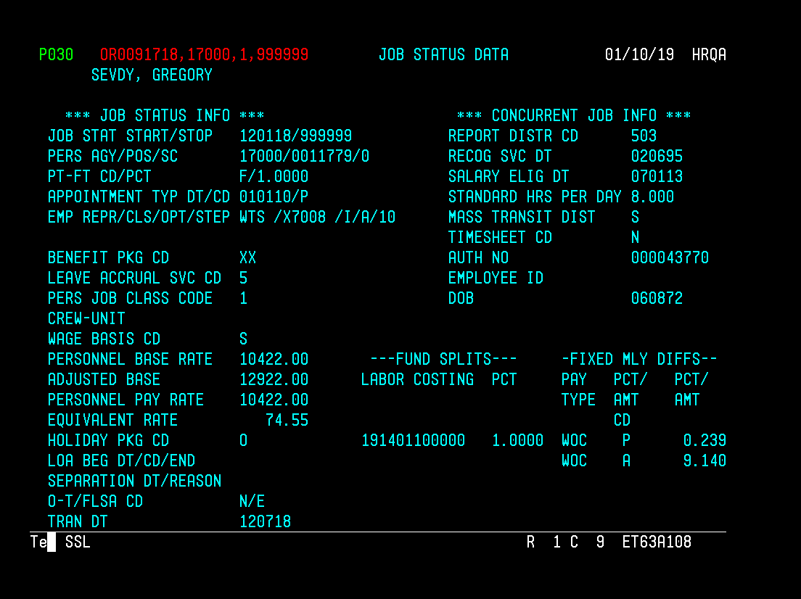
Changes to OSPA for Workday

