Slide 1
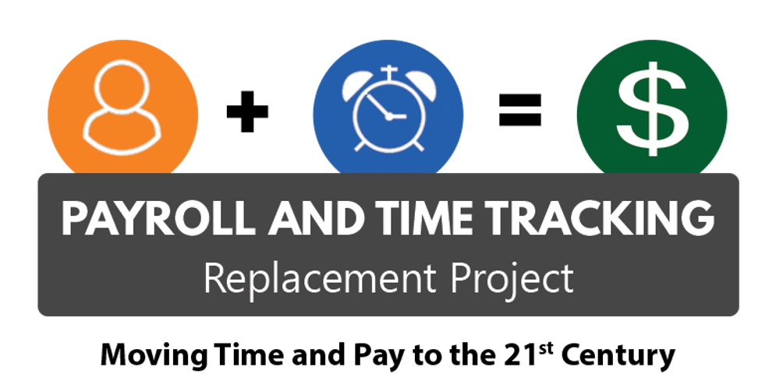
Pay Input
Payroll Partner
Micro training
Notes:
Today’s micro training is on pay input. This is a new format for micro training and may evolve over the weeks. We will be recording as we go through the slide show, however we cannot record the demo as we will be looking at real employees in Workday. We will stop the recording before we switch to the demonstration.

Slide 2
What is pay input?
What is pay input?
Rates, units, amounts, or other values that you enter on- or off-cycle
Can be either an earning or a deduction
Crosswalk: OSPA screens P050, P060 and P070
All earnings report
All deductions report
Notes:
Pay input is what we used to call the P050, P060 and P070 screens in OSPA. It is where a payroll partner can enter earnings and deductions on a one time or ongoing basis. You can use this to add to an employee’s gross or net pay, or take deductions from their pay. It is also where we can do PERS corrections or any other entries that will not be picked up in retro.
To find what earnings and deductions are available in Workday, you can run one of these two reports. The earning report will give you all the earnings and the deduction, all deductions. We will look at these reports in the demo and future trainings will take a more in depth look at how to read them.

Slide 3
Pay input: What and When
What to Enter in Pay Input
Payment vs. deduction
One-time or ongoing?
Adjustment or override?
What earning or deduction?
When to enter an amount, hours, or rate?
What notes to add to the comment fields?
Notes:
When it comes to making pay input, you need to think about some questions before making the entry. Is this a one time payment or deduction or is it on-going? Do I want to override a value or calculation that already exists or am I adding something new? What do I use (see previous slides on locating entries)
Do I enter am amount or hours or rate or nothing? This is why learning to read the earning and deduction reports is helpful in answering these questions.
Notes in the comment field are huge and do not have the character limit like we did in OSPA. Be professional but detailed so that if someone else had to look at this, either within your agency or outside of it, can they tell what this entry is for?

Slide 4
Pay input: questions
Payroll Partner Submitted Questions
Which deductions process with retro? Which do not?
What dates should be entered in pay input?
When can agencies make PEBB input entries?
What processing defaults should be used?
When do we enter hours?
Notes:
We had a few questions submitted for this training however many were larger topics that need more time to present. These topics will be covered in future training sessions being prepared and include deceased employees, transferring employees, and PERS retro corrections. There was one question about time off but that is usually not included in pay input and is around absence, and employees who are leaving your agency. These too will be covered in future trainings being developed.
We did combine several questions submitted into the ones you see on the screen so let’s talk about them. First up is what deductions process with retro? You can find this by looking at any deduction to see if it is set to process in retro. The default is no so when our deductions were set up they were mostly all set to no. We do realize that the Return of Overpayment deduction used for BTs need to be set to calculate in retro but are not able to update until we can start making configuration changes. If a deduction is not set to calculate in retro, it will not calculate on run 2.
What dates do we use? The effective date for one time entries is based on the end date used. If the employee leaves your agency before that date, then the pay input will not process. If they were hired before the date used, it will not process. Also if the earning you are entering is FLSA wages or hours subject, the date you select will impact the overtime calculation for that sub period so the answer is it depends. The best guidance we can give is use the last day of the pay period for the start/end dates unless they are leaving your agency and then use the last day of employment.
PEBB entries will also be covered more in depth next week but generally you make entries to either refund money (make negative entries) force optional to pay when an employee is on a leave of absence or to override the deduction to zero
Processing defaults should be one-time, adjustment for regular run or on-going adjustment for regular run. The override option can have impacts on current period entries as you are overriding what is paying or deducting from benefits or compensation
When to enter hours, again it depends. If you want the system to pay hours X rate, you can enter the hours. But if you want a specific amount, then enter an amount. The exception is when entering overtime you need to enter the amount and the number of hours
We did have one question I didn’t put on the slide around getting notifications when pay input is entered by someone centrally or when comments are entered by someone and unfortunately that is not possible with current workday functionality.

Slide 5
Pay input: how
How to Enter in Pay Input
Pay input demos
Taxable non-cash meals
Charitable fund deductions
Regular Salary
Hours
Amount
Zero/nothing entered
Which codes does your agency use regularly?
Notes:
Now let’s look at a demo of entering (follow along in Oregon 1, make entries on your own staff).
I want to enter a taxable non-cash meal. 1. Search earnings for it
2. Do I enter an amount or is one set for me?
3. Is this ongoing or one time entry?
4. Practice making the entry
I want to enter a charitable fund deduction
1. Search deductions for it
2. Do I enter an amount or is one set for me?
3. Is this ongoing or one time entry?
4. Practice making the entry
Entering Regular – Salary with different options
Hours
Amount
Zero amount

Slide 6
THANK YOU!
Notes:
We appreciate your partnership, see you next week!

