Slide 1
  Form 1098-T and
  Notice 972CG for
  Colleges and Universities

Slide 2
FORM 1098-T and NOTICE 972CG
Presented By:
Tax Exempt and Government Entities
Federal, State and Local Governments
(FSLG)
Pacific Area Group
June 17, 2014
Kathleen Rodegeb, Manager kathleen.rodegeb@irs.gov

Slide 3
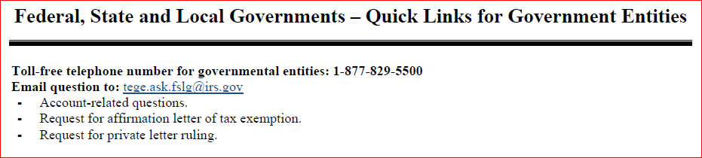
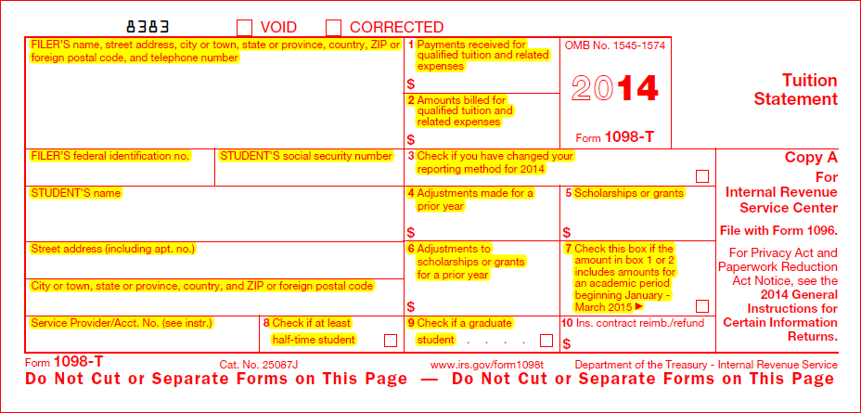
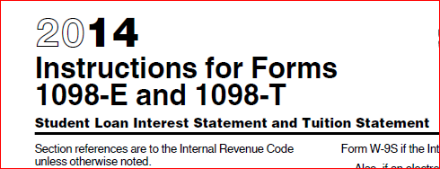
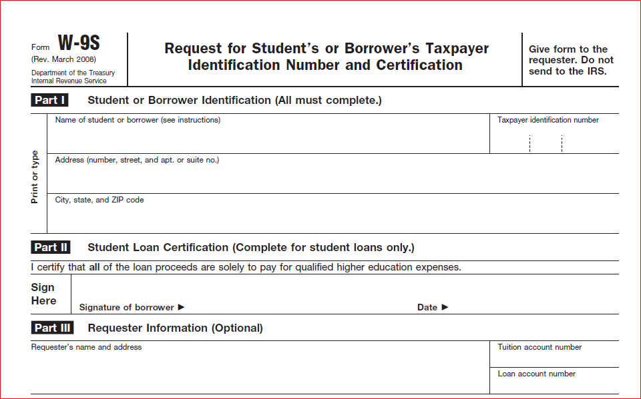
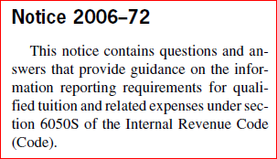

HANDOUTS

Slide 4
TOPICS
What is a Form 1098-T?
Who is required to file Form 1098-T?
Who is required to receive Form 1098-T?
What is Notice 972CG?
What should I do if I receive a Notice 972CG?

Slide 5
FORM 1098-T

Slide 6
FORM 1098-T
INSTRUCTIONS
Instructions for Forms 1098-E and 1098-T
Secure and use student’s social security number
Use student’s permanent address, not college address
Filer’s information, bottom left of form, used by third-party service provider
Note whether student is enrolled at least half-time in box 8

Slide 7
FORM 1098-T
INSTRUCTIONS
Box 1 – Payments received during the year
Box 2 – Amounts billed during the year
Box 3 – Change in reporting method for the year (from payments received to amounts billed or vice versa)
Box 4 – Reimbursements, refunds, reductions during the year for prior years
Box 5 – Scholarships and Grants administered (third party payments received)

Slide 8
FORM 1098-T
INSTRUCTIONS
Box 6 – reductions to scholarships or grants reported in prior years
Box 7 – payments received for January through March of subsequent year
Box 8 – Social Security Number of student
Box 9 – Graduate student check box
Box 10 – for use by insurers

Slide 9
FORM W-9S

Slide 10
FORM 1098-T
WHO SHOULD FILE
Eligible educational institution
College, University, Vocational School, other post-secondary educational institution
Described in §481 Higher Education Act of 1965 (as in effect 8/5/1996)
Eligible to participate in Department of Education student aid programs

Slide 11
FORM 1098-T
WHAT TO REPORT
Amounts paid for Qualified:
  Tuition
  Fees
  Course materials
  Related expenses
Required for student to be enrolled at or attend eligible educational institution

Slide 12
FORM 1098-T
WHAT NOT TO REPORT
Amounts paid for:
Courses in sports, games, hobbies (unless part of student’s degree program)
Charges for room, board, insurance, medical expenses, transportation

Slide 13
FORM 1098-T
EXCEPTIONS TO REPORTING
Courses for which no academic credit is offered, even if the student is otherwise enrolled in a degree program
Nonresident alien students, unless requested by the student
Students whose qualified tuition and related expenses are entirely waived or paid entirely with scholarships

Slide 14
FORM 1098-T
EXCEPTIONS TO REPORTING
Students for whom you do not maintain a separate financial account and whose qualified tuition and related expenses are covered by a formal billing arrangement between an institution and the student's employer or a governmental entity, such as the Department of Veterans Affairs or the Department of Defense.

Slide 15
FORM 1098-T
WHO GETS FORM 1098-T
Students enrolled for any academic period
For whom a reportable transaction is made
  Amounts received
  Amounts billed
  Reimbursements or reductions in charges for amounts previously reported
Exception – non-resident aliens unless they request the form (then must meet § 6050-S provisions & provide SSN/ITIN)

Slide 16
FORM 1098-T
HOW TO ISSUE FORM 1098-T
By paper
Electronically – Treasury Regulations 1.6050S-2(a)(2) through (6)
  Secure consent of student
  Meet consent, disclosure, format, notice and access period requirements

Slide 17
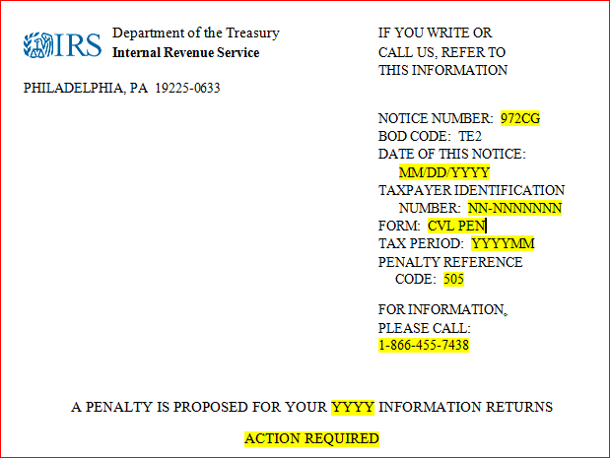
NOTICE 972CG

Slide 18
NOTICE 972CG
CONTENTS
  Explanation of proposed penalty
  Explanation of how to respond to the notice
  A record of each submission considered in the penalty
    Form type,
    Date received (if late filed)
    Whether returns were original or amended
    Transmitter control code (for electronic filers)
    Type(s) of penalty(s) that apply

Slide 19
NOTICE 972CG
CONTENTS
  Listing of all incorrect or missing payee names/TINs, if the penalty is for mismatched Names/TINs
  Summary of proposed penalty, including all penalties proposed and maximum penalty that can be assessed under IRC 6721
  Response page

Slide 20
NOTICE 972CG
RESPONSE DUE DATE
In writing within 45 days of notice date (or by extension date)
If unable to respond within the 45 days - request extension in writing to Philadelphia Campus using mail stub included with Notice 972CG before expiration of 45-day period
Follow up request for extension with telephone call to Philadelphia Campus (telephone number on notice) to inform them that the request has been sent

Slide 21
NOTICE 972CG
RESPONSE REQUIREMENTS
Include with response:
Response page
Payment slip
No other part of the Notice 972CG
Proof of solicitation of TINs (do not submit copies of the solicitations unless requested by an IRS employee)

Slide 22
NOTICE 972CG
RESPONSE EXPLANATION
Provide detailed explanation of:
Written explanation substantiating reasonable cause for waiver of the penalty (see Treasury Regulation 301.6724-1(m))
Demonstrate that institution acted in a responsible manner both before and after the failure
Steps taken to comply with Code and Regulations provisions

Slide 23
NOTICE 972CG
ACTING IN A RESPONSIBLE MANNER
Treasury Regulations §1.6050S-1
Initial solicitation of SSNs from students
Subsequent solicitations (by mail, by telephone or electronically) when individuals did not comply with initial solicitation
If no TIN provided, file and furnish F1098-T without TIN, but include all other required information

Slide 24
NOTICE 972CG
MANNER OF SOLICITING TIN
In writing
Clearly notify individual that the law requires the individual to provide the TIN for purposes of filing an information return
Use of Form W-9S satisfies requirement of Treasury Regulations §1.6050S-1(e)(3)(iii)
May establish electronic system to secure TINs
May develop separate form and instructions (e.g., as part of enrollment package)

Slide 25
NOTICE 972CG
ESTABLISHING REASONABLE CAUSE
Significant mitigating factors (e.g., history of filing Information Returns with correct TINs)
Failure due to events beyond filer’s control (e.g., even though requested to do so, the students did not provide the SSN)
Planned actions that have been or will be implemented in order to be in compliance in the future

Slide 26
NOTICE 972CG
EXPLANATION ACCEPTED
If reply established reasonable cause, filer will receive Letter 1948C stating the explanation was accepted

Slide 27
NOTICE 972CG
EXPLANATION REJECTED
If reply does not establish, or only partially establishes reasonable cause, penalty will be assessed and balance due Notice CP15/215 sent with letter explaining appeal rights
If filer agrees with proposed penalty, send payment with the response page
If filer does not send a response to Notice 972CG within 45 days (or extension date) balance due Notice CP15/215 for full amount of penalty will be issued

Slide 28
FORM 1098-T and NOTICE 972-CG
REFERENCE MATERIALS
Internal Revenue Code §6050S
Treasury Regulations §1.6050S-1 & 2
Internal Revenue Code §§6721 & 6722
Publication 970
Publication 1586
Instructions for Forms 1098-E and 1098-T
General Instructions for Certain Information Returns
Notice 2006-72

Slide 29
PACIFIC AREA GROUP
AK, CA, HI, NV, OR, WA, Territories
Name | Email | Location Telephone Number | Coverage Area
Kathleen Rodegeb Group Manager | Kathleen.Rodegeb@irs.gov | Walnut Creek, CA (925) 974-3827 | Pacific Area
Clark Fletcher FSLG Specialist | Clark.M.Fletcher@irs.gov | Bellevue, WA (425) 489-4042 | Hawaii Oregon Washington
Ronald Coleman FSLG Specialist | Ronald.Coleman@irs.gov | San Diego, CA (619) 744-7169 | California Nevada
Thomas Mansell FSLG Specialist | Thomas.Mansell@irs.gov | Santa Rosa, CA (707) 535-3830 | Alaska California
Alice Huang FSLG Specialist | Alice.Huang2@irs.gov | El Monte, CA (626) 927-1238 | California
A. “Jay” Gonzales FSLG Specialist | Amelito.Gonzales@irs.gov | San Diego, CA (619) 744-7160 | California
Nimfa Destreza FSLG Specialist | Nimfa.G.Destreza@irs.gov | San Carlos, CA (760) 736-7347 | California

Slide 30
FORM 1098-T and NOTICE 972-CG
QUESTIONS?

Slide 31
FORM 1098-T and NOTICE 972-CG
Thank You
for joining us today

