Slide 1
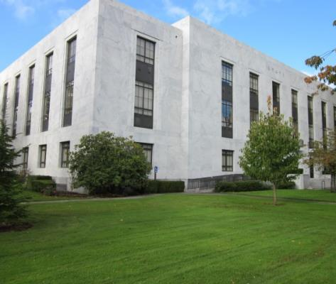
State Library of Oregon
Equitable access to library and information services for the people of Oregon
Notes:
At the State Library of Oregon, we really have 2 libraries (our Talking Book service for the print disabled, and a Government Services library for state employees) and a consulting firm.

Slide 2
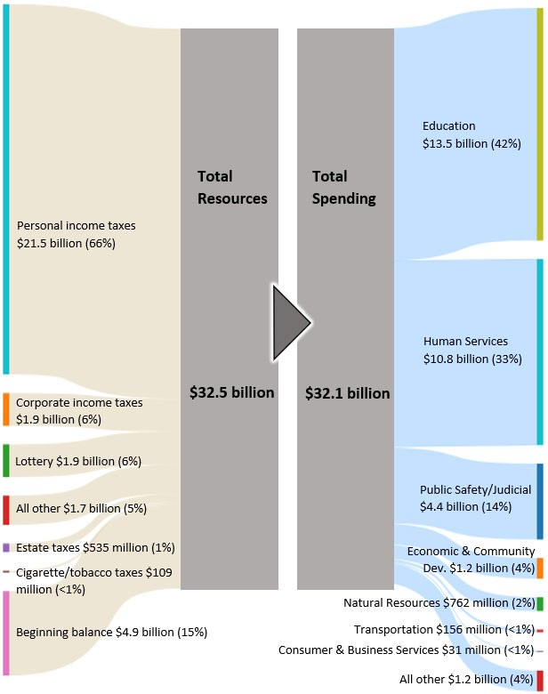
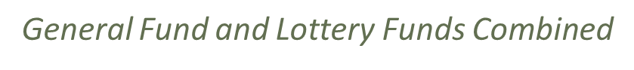

Slide 3
Governor’s Office
Mission Focused Priorities
Increasing Housing and reducing Homelessness
Improving access to Mental Health and Addiction Services
Improving Early Literacy, Childcare & K‐12 Education outcomes

Slide 4
Budget Basics
Covers July 1- June 30 of two fiscal years
Is submitted in even years
Additional funds or limitation
Additional positions
Notes:
and starts the following odd year .

Slide 5
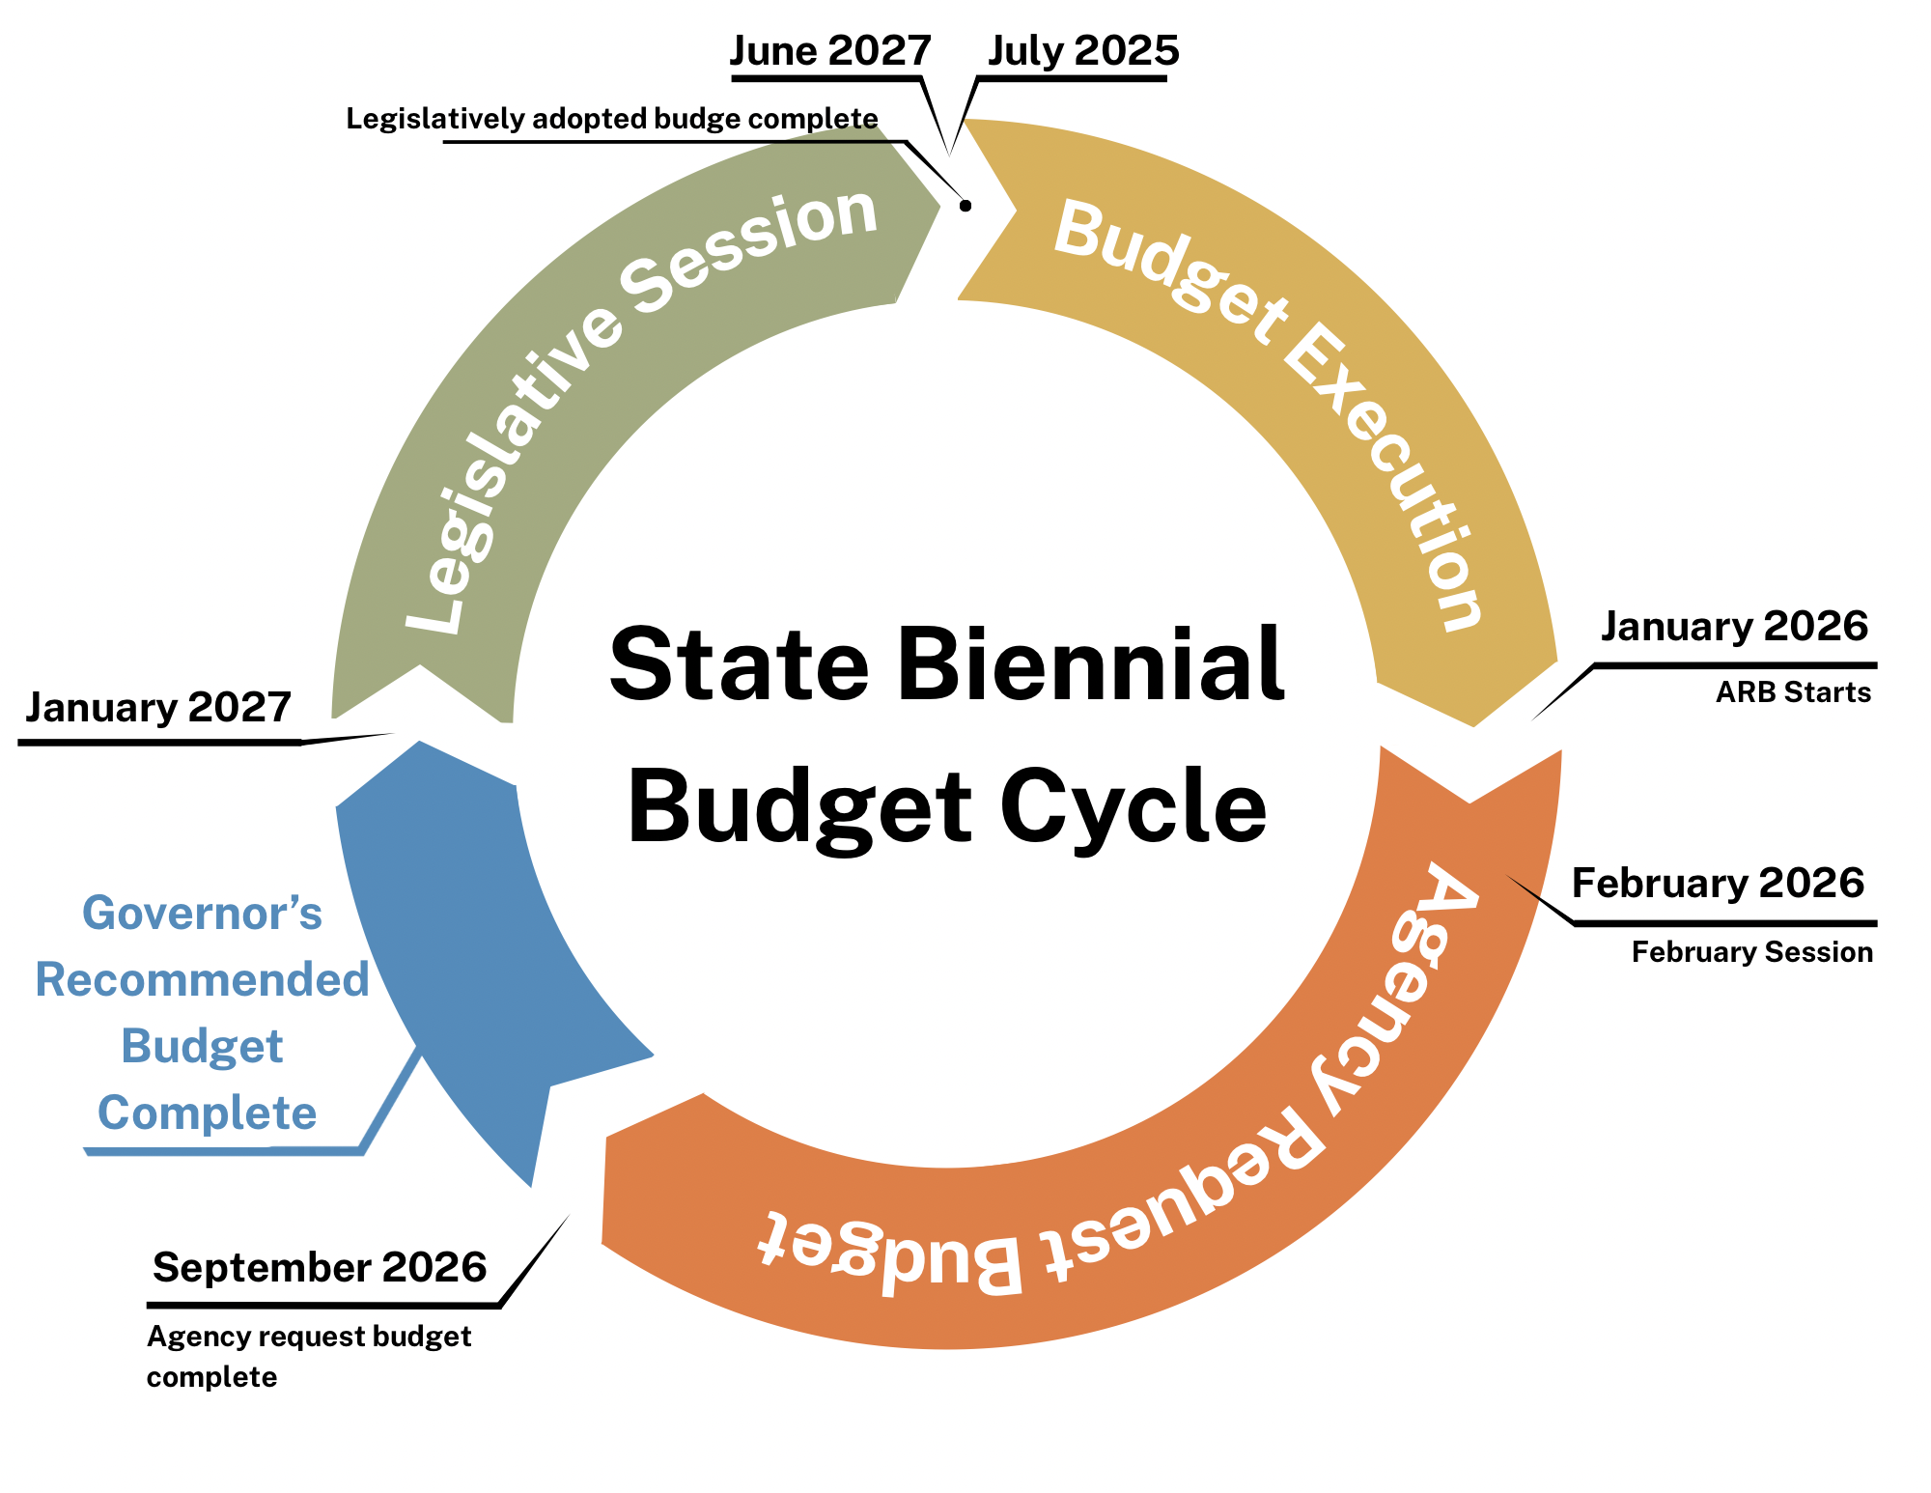

Slide 6
Budget Tools
Assessment Formula
Policy Option Package
Legislative Concepts
Legislation

Slide 7
Duties of State Library
The State Library helps state government with research and information.
Provides library services for people with print disabilities, working with the Library of Congress and other partners.
Supports local libraries with funding, advice, and staff training.
Gives state grant money to local libraries for children’s and youth programs.
Manage access to state government publications.
Every two years, report to the Legislature on how library services are working.
Carry out other activities to improve library services across Oregon.
It loans books for free to Oregonians through their local libraries.
Notes:
ORS 357.008 – State Library duties; free book loans

Slide 8
AY27 Funding
LSTA 2025
  $2,593,238 (one year)
Assessment
  $9,45,429
General Fund
  $5,421,047
Donation
  $357,155
Notes:
State Budget Execution, or the spending of the current funds, is done based on the Legislatively Adopted Budget (LAB)

Slide 9
Restrictions
Assessment Fund spending must align with the framework for the assessment
Federal Fund spending must align with the LSTA 5 Year plan and IMLS certifications
Donation Fund spending must align with the donor’s intentions, and the reason we gave when raising the money
There is also a hard and fast rule, no matter what the funding source, that prevents shifting money between Personal Services and Services & Supplies.
Notes:
State spending is also done with restrictions

Slide 10
General Fund
For AY27, the State Library has $5,421,047 in General Fund:
$1,722,902 in Ready to Read grants
$2,717,320 in Personal Services
$969,798 in Services & Supplies
  ($291,193) in State Government Services charges
  ($282,470) in Rent
  $396,135 that the State Library directs the spending of
Notes:
General Fund dollars are the most flexible spending that the State Library has. General Fund is used in Library Support, Operations, and Talking Books.

Slide 11
LSTA Funding
AY27 Budget Impacts
  Potential for loss of funding in FY27
  25% of State Library Budget
  6.72 FTE in Library Support and Operations
Short Session
Emergency Board

Slide 12
Other impacts
Federal-Impact-HR1-Initial-Analysis.pdf
Report #2-25
Revenue Forecast on 8/27
Possibility for General Fund reductions
Notes:
Two weeks ago, the State Fiscal Office released this report detailing the loss of federal funding from various state agencies. It includes the potential $2.5M LSTA funds from the State Library starting in FY27. This is one of many scenarios playing out right now; as shared previously the Senate has started the process to add LSTA funding back into the federal FY26 budget. We may not know the final outcome for several months.

Slide 13
Next Steps
Internal budget development
CFO Budget Instructions
  Fall 2025
State Library Board approval
  January 2026
Agency Request Budget
  July 31, 2026

Slide 14
Questions?

