Slide 1
Let’s Talk About P-Y-D: How Positive Youth Development May Influence Sexual Health Outcomes in Latino Youth
LaShanda N. Eller, MPH
Lindsay Weaver, MPH
Jessica E. A. Duke, MPH

Slide 2





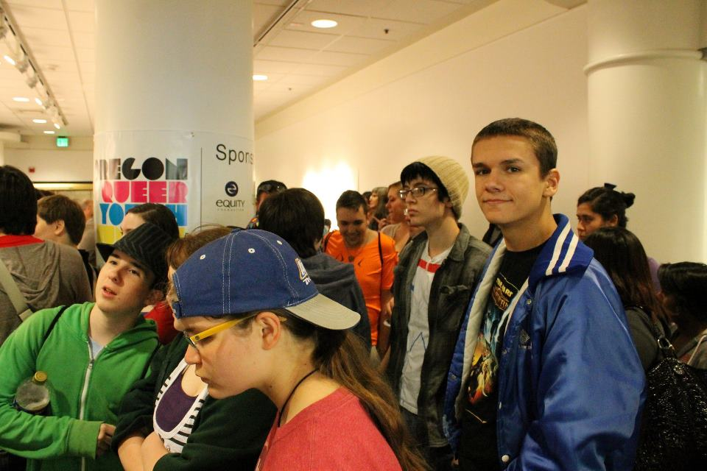

Slide 3
Learning Objectives
Examine elements of Positive Youth Development (PYD) that can foster positive sexual health outcomes for Latino youth.
Discuss significant PYD relationships from the ¡Cuídate! implementation dataset and potential implications of the data.

Slide 4
Key Elements of PYD
Positive Youth Development
Promoting Healthy Lifestyles
Supporting Development
Engaging Youth
Fostering Relationships
Supportive Environments & Opportunities
Source: http://www.adph.org/teenpregnancyprevention/assets/blueprint.htm
Notes:
Providing youth with:
safe and supportive environments
opportunities to pursue their interests and focus on their strengths
opportunities for youth to show that they care—about others and about society
a safety net in times of need
Fostering relationships between youth and caring adults who can mentor and guide them.
Supporting the development of youths' knowledge and skills in a variety of ways, including study, tutoring, sports, the arts, vocational education, and service-learning.
Engaging youth as active partners and leaders who can help move communities forward.
Promoting healthy lifestyles and teaching positive patterns of social interaction.
“Positive youth development is an approach toward all youth that builds on their assets and their potential and helps counter the problems that may affect them.

Slide 5
Benefits of PYD
Youth who feel connected to their families and communities are less likely to engage in risky behaviors such as high-risk sexual behavior
Youth who volunteer and participate in their communities gain valuable skills and experience that may increase their marketability in adulthood
Youth who received aspects of PYD are more likely to build confidence and self-awareness

Slide 6
PYD in Oregon
Surveillance/Evaluation
Authentic Youth Engagement Strategies
Policy
Shifting the paradigm from a risk-based approach to a strength-focused approach
Notes:
Surveillance – PYD Questions
Policy – Working to develop institutional policies that seek and honor youth voice. For example - human resources policies around hiring youth. Financial support for youth input (paying focus group participants).
Authentic Youth Engagement – Adolescent and School Health Program has undertaken three youth participatory action research projects (in sexual health, mental health and nutrition) to bring youth voice to identify issues and solutions.

Slide 7
PYD Indicators
Consists of a suite of 6 questions
Asked on the Oregon Healthy Teens (OHT) Survey since 2006
Asked on the ¡Cuídate! Baseline Survey
Individual indicators can be analyzed alone or together as a benchmark
  Defined as answering 5/6 questions positively

Slide 8
PYD Indicators and Scales
Scale
Indicator
I can do most things if I try.
Excellent
Scale
Indicator
Very Much True
Would you say that in general your physical health is…
Very Good
There is at least one teacher or adult in my school that really cares about me.
Pretty Much True
Would you say that in general your emotional and mental health is…
Good
I volunteer to help others in my community.
A Little True
Fair
I can work out my problems.
Not at all True
Poor
Response DID NOT count toward meeting PYD benchmark
Response counted toward meeting PYD benchmark

Slide 9

¡Cuídate!
Seeks to improve health outcomes among Latino youth ages 13-18 by lowering unintended pregnancy and STI/HIV transmission rates
Uses identified Latino cultural values to increase knowledge and efficacy about practicing abstinence or negotiating safer sex behaviors
Includes role plays, interactive games and a condom demonstration

Slide 10
PYD Benchmark and Sexual Health Indicators among Latino ¡Cuídate! Participants

Slide 11
PYD Benchmark by Latino Origin
There was not a significant difference between Latino and non-Latino participants who met the PYD benchmark
Notes:
This could indicate that there are equal opportunities for Latino youth in Oregon to have PYD experiences as their non-Latino counterparts
χ² (1, n=2171) = .152, p>0.05

Slide 12
PYD Benchmark by Age Group among Latino Participants n=952
* Chi-squared significant, p<0.001
Notes:
χ² (1, n=952) = 47.65, p<0.001.
PYD Benchmark
10-14 no significant difference
15-18+ significant at 0.023

Slide 13
PYD and Safer Sexual Behaviors Knowledge at Program Entry among Latino Participants
Indicator | Met Benchmark | Did Not Meet Benchmark
1. Anyone can have sexually transmitted disease* | True (94%) | True (86%)
2. One can only be infected by HIV coming into contact with infected blood, semen, breast milk or vaginal secretions.* | True (88%) | True (81%)
3. A girl can get pregnant the first time she has sex.* | True (91%) | True (84%)
4. Abstinence is the surest way to prevent unintended pregnancies, STDs and HIV infection.* | True (85%) | True (76%)
5. I know where to get or buy condoms.* | True (96%) | True (71%)
6. I know how to put on a condom correctly.* | True (100%) | True (0%)
* Chi-squared significant, p<0.001
Notes:
This data is true for each of the following age groups:
10-14 years x2 (1, n=680)=680, p<0.001
15-18+ years x2 (1, n=843)=843, p<0.001
Non-Latino Participants
Indicator
Met Benchmark
Did Not Meet Benchmark
Anyone can have sexually transmitted disease – p=0.02
True (92%)
True (98%)
2. One can only be infected by HIV coming into contact with infected blood, semen, breast milk or vaginal secretions.(not significant)
True (83%)
True (77.9%)
3. A girl can get pregnant the first time she has sex.p=0.00
True (89%)
True (97%)
4. Abstinence is the surest way to prevent unintended pregnancies, STDs and HIV infection. – not significant
True (89%)
True (92%)
5. I know where to get or buy condoms.p=0.00
True (61%)
True (96%)
6. I know how to put on a condom correctly.* p=0.00
True (100%)
True (0%)

Slide 14
PYD Benchmark and Perceived Ease of Condom Negotiation among Latino Participants (n=1,433)
* Chi-squared significant, p<0.001
Notes:
Non-Latino participants
Easy/very easy
Met PYD benchmark – 86%
Did not meet PYD benchmark- 77.8%
Significant at 0.020.

Slide 15
Final Thoughts
More PYD work could be done with Latino youth aged 14 years and younger.
Meeting the PYD benchmark across all ages was significant in Latino youth answering most sexual health knowledge questions correctly.
Latino youth who met the PYD benchmark are significantly more likely to report it would be “easy” or “very easy” to negotiate condom use with their partner(s).
The negotiation of safer sex behaviors among Latino youth in Oregon could result in reducing unintended pregnancy and STI rates.
Notes:
This is true for six out of eight indicators
Indicators that were not significant
STDs always have symptoms
Boys should take steps to prevent unintended pregnancy

Slide 16
References
Find Youth Info (2012). Positive Youth Development. Retrieved October 1, 2013 from http://findyouthinfo.gov/youth-topics/positive-youth-development.
Markham, C.M., et al (2003). Family connectedness and sexual risk-taking among urban youth attending alternative high schools. Perspectives on Sexual Health and Reproductive Health, 35(4), 174-179.
United States Department of Health and Human Services. (2002). Toward a Blueprint for Youth: Making Positive Youth Development a National Priority. Retrieved October 1, 2013, from Administration for Children and Families: http://www.adph.org/teenpregnancyprevention/assets/blueprint.htm.
Villarruel, A. M., Jemmott, J. B., & Jemmott, L. S. (2006). A randomized controlled trial testing an HIV prevention intervention for Latino youth. Archives of Pediatric Adolescent Medicine, 160, 1-6.
Villarruel, A. M., Jemmott, L. S., & Jemmott, J. B. (2005). Designing a culturally based intervention to reduce HIV sexual risk for Latino adolescents. Journal of the Association of Nurses in AIDS Care, 16, 23-31.
Photos courtesy of: American Leadership Forum of Oregon, Benjamin Garcia, Clarity Digital Group, Oregon Queer Youth Summit

Slide 17
Thank You!
LaShanda N. Eller, MPH, Research Analyst
lashanda.n.eller@state.or.us
Lindsay Weaver, MPH, Program Coordinator
lindsay.weaver@state.or.us
Jessica E.A. Duke, MPH, Youth Sexual Health Coordinator
jessica.duke@state.or.us

