Slide 1




SSP Partner Meeting
June 12, 2025
James Barta
Engagement Strategies Coordinator
Notes:
James
We’ll have a short presentation and then get to your questions:

Slide 2

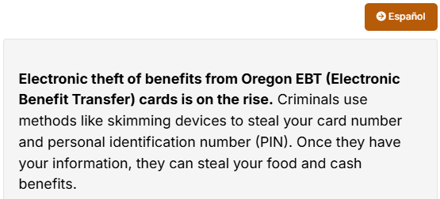
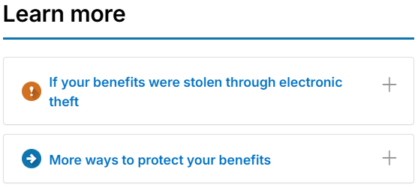
New tools to keep EBT benefits safe
Electronic theft of benefits from Oregon EBT (Electronic Benefit Transfer) cards is increasing.
Helpful information is available at our new Protect Your EBT Card and Benefits webpage
Encourage SNAP clients to use the www.ebtedge.com website to
Block out-of-state and online purchases
Freeze their card when not using it
Notes:
Encourage SNAP clients to use the www.ebtedge.com website to
Find information at the new Protect Your EBT Card and Benefits webpage: https://www.oregon.gov/odhs/benefits/Pages/protect.aspx
At the bottom of the page expand the “More Ways to protect your benefits” for materials to share with your clients. A flyer, brochure and wallet card — are designed to be accessible, easy to understand and empowering. They explain the risks and offer simple steps people can take to protect their benefits.

Slide 3
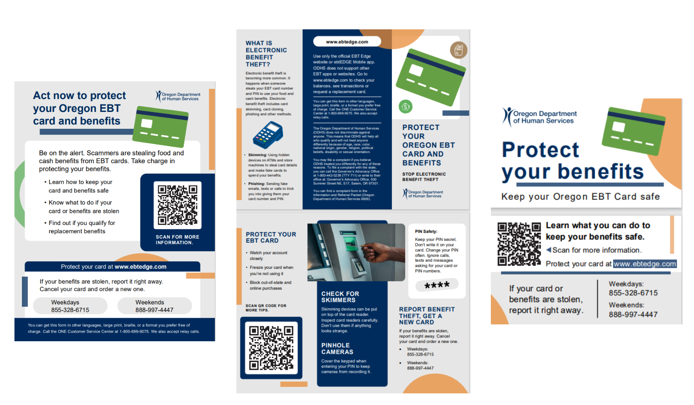
New tools to keep EBT benefits safe
Brochure
Flyer
Wallet card
Notes:
Electronic theft of benefits from Oregon EBT (Electronic Benefit Transfer) cards is increasing. Criminals are using tactics like skimming devices to collect card numbers and PINs, allowing them to steal critical food and cash benefits from individuals and families.
We recognize the significant impact this has on the people we serve — many of whom are already navigating complex and stressful life situations. That's why the ODHS Office of Communications has created outreach tools to help raise awareness and support prevention.
These materials — a flyer, brochure and wallet card — are designed to be accessible, easy to understand and empowering. They explain the risks and offer simple steps people can take to protect their benefits.
Access Now: While these resources are being translated into additional languages, the English and Spanish tools are posted to the ODHS/OHA Publications and Forms webpage and on the Protect Your EBT Card and Benefits webpage. Local offices
can order prints through Publications and Creative Services (PCS).
English forms
Brochure: de-1020950
Flyer: de-1020973
Wallet card: de-1021252
Spanish
Brochure: ds-1020950
Flyer: ds-1020973
Wallet card: ds-1021252

