Slide 1

Supporting Families In-home: Together, Stable & Safe
SSP Partner meeting

Slide 2
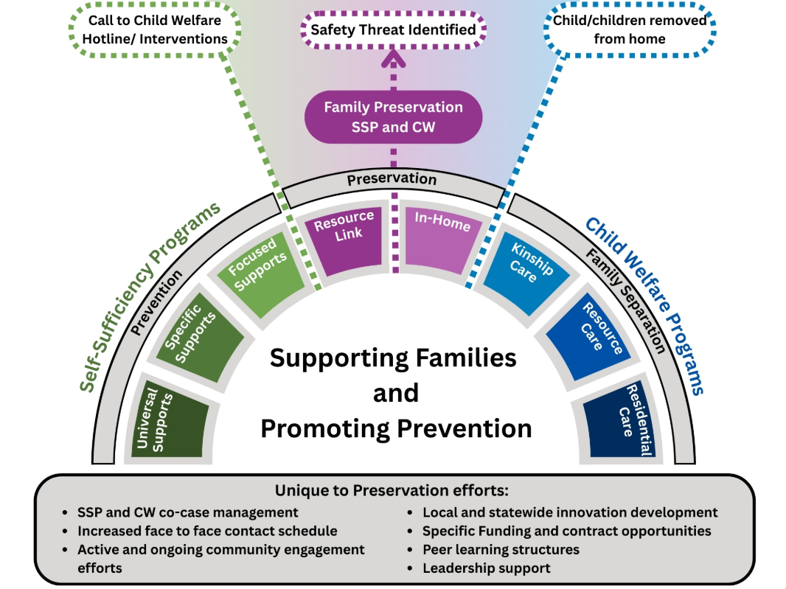
Notes:
This slide shows you the current work we are taking on in family preservation. On the left-hand side, you can see where SSP is. We work with families in SSP around universal supports, concrete supports and stability of families and individuals.
On the far right, you see the more traditional CW role where foster care, kinship care (with relatives) and all the way to adoption.
The middle area here (point mouse at area) is our current work in family preservation. A call comes into the hotline. CW has identified a safety threat. While working with the family, They are able to mitigate safety, build a safety plan and keep kids in home. This is where we assign a FC, no matter what benefits look like or even no benefits.
That’s where co case management begins and families get frequent home visits (often finding that weekly contact helps support challenges in the safety plan before they become more serious. We wrap community around etc.

Slide 3

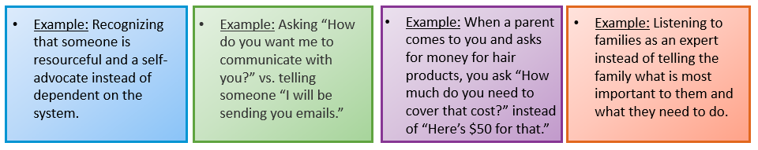
Values-Based Relationships
Notes:
Values-Based Relationships: this is not new- it’s the work FCs are already doing and key to the work.
We are focused on building relationships with families, with communities focusing on 4 core values: Strengths-based, trauma-informed, culturally responsive, and family driven / youth guided. Strengths-based: Focusing on the children and families’ strengths. Letting these strengths (self-identified by families if possible) lead/direct goals, conversations, and your own mindset/heartset.
Example: dependent on the system, verses resourceful and self advocate.
Trauma-informed: A trauma-informed approach to care is based on an understanding of the experience and implications of trauma for individuals, families, and communities. Important skill for fostering resilience and rebuilding relationships with families that have experienced trauma, specifically systems-trauma.
Example: “I will be sending you this information via email verses “How do you want me to communicate with you?”
Culturally Responsive: Creating interactions, connections, and environments in which culture and identities are valued as assets and valuable resources (including race, ethnicity, linguistic assets, & additional characteristics)
Mom comes to you and asked for money for hair products and you ask “how much do you need to cover that cost? ” verses “Here’s the standard 50.00 for that need.”
Family Driven / Youth Guided: Person-centered approach: Focusing services on the needs of the individual/family. Ensuring people’s preferences, needs, and values guide decisions. Providing services that is respectful & responsive to families that we serve. Listening to families as an expert verses telling the family what’s most important for them and what they need to do.

Slide 4
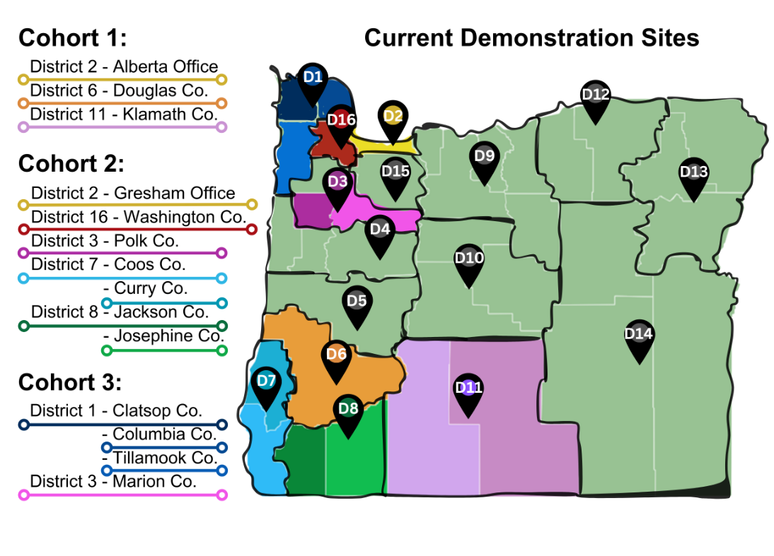

Slide 5

2025 Family Preservation Cohort 3 Implementation Timeline
 | March 2025 - 1 | April 2025 - 2 | May 2025 - 3 | June 2025 - 4 | July 2025 - 5 | August 2025 - 6 | September 2025 – 7 | October 2025 - 8 | November 2025 - 9
FPT | Scheduling for next few months Review Site Selection docs, available data/information for baseline snapshot Current innovations Current meeting structures Review FP dashboards for new sites Review SSP data Collect any protocols in place Understand community engagement Current roles: RD, CPC, etc. TR: what Tribes are in the area, contacts Identify and reach out to Champions Get updated contact list | Review and document processes related to FP (transfer, assessment, collab btw SSP/CW, etc.) Review data re: OSM fidelity Review new sites in dashboard Review disproportionality data Leadership Workshop: Intro to FP for staff Comms: comms with Tribes, preferred comms with internal and external folks | CW/SSP 101 Train the Trainer for CTS, ES, Consult, Champions Workshop: Intro to FP for staff Comms: preferred comms with internal and external folks | CW/SSP 101 for staff FP Procedure and SSP Guide for CTS, ES, Champions Workshop: Intro to FP for staff Role in FP for CPCs, RDs, CPCs Comms: Develop and send internal comms, draft of external comms (pamphlet?) | Communicate about ISCD Training for staff (web based) VBR: Part 1 Continue to discuss CE with leadership: plan for introducing FP to community & Tribes | Procedure and SSP Guide Training for Staff Train: Supervising to FP for Leadership, Sups, OMs, CTS, Ess, Champions Monthly data pull first try | Train: CE for Everyone for all roles Observe structures/meetings in local offices for FP components Monthly data pull with site data folks | Catch up trainings/meetings/etc. | OFFICIAL DATA PULLS START
Champions | Support setting up reoccurring meetings for this team | First meeting: Intros, intro to FP, roles, planning | Planning for OSM supports for Safety Threshold, IHC Attend Staff FP Workshop Help plan for 101s | Plan for Procedure and SSP Guide for staff What would a monthly data pull look like? How to support culture/mindset shifts? | Plan for Supervising to FP Draft monthly data pull Draft a culture/mindset shift plan | Plan for CE for Everyone Activities re: culture/mindset shift | Activities re: culture/mindset shift | What still needs to be done?
Leadership | Jennifer reach out to DMs, PMs to schedule initial & monthly call | Intro Workshop: DMs, PMs, OMs, Sups, PSU, FPT Identify roles: how we will work together District overall goals Overview of Timeline Intro Toolkit & Dashboards Go over baseline info: What are district strengths/challenges Monthly DM/PM check in | Workshop: DMs, PMs, OMs, Sups, PSU, FPT Mentor guide PSU Eval Culture/Values Procedure/SSP Guide Funding/contracts (Shari) Attend FP staff workshop to intro FP Monthly DM/PM check in Funding/contracting (Shari) | Workshop: DMs, PMs, OMs, Sups, PSU, FPT Collaborative spaces Role of CE staff Leading CE Community Engagement strengths/needs: planning Attend FP Staff Workshop for intro Monthly DM/PM check in | Workshop: DMs, PMs, OMs, Sups, PSU, FPT Conversation continued Culture Innovations: concepts and examples Attend FP Staff Workshop for intro Monthly DM/PM check-in | Workshop: DMs, PMs, OMs, Sups, PSU, FPT Leading & Supervising to FP 6-month check-in (Culture, Innovations, Funding & contracting) Attend FP Staff Workshop for intro Monthly DM/PM check in | Workshop: DMs, PMs, OMs, Sups, PSU, FPT Look at Data Equity & disproportionality Culture: bias Attend FP Staff Workshop for intro Monthly DM/PM check in | Workshop: DMs, PMs, OMs, Sups, PSU, FPT Plus/Delta How are we doing? Attend FP Staff Workshop for intro Monthly DM/PM check in | Workshop: DMs, PMs, OMs, Sups, PSU, FPT Plus/Dela How are we doing? Attend FP Staff Workshop for intro Monthly DM/PM check in
Staff |  |  | Attend Intro to FP Workshop: all staff (SSP & CW) Intros/connector The WHY & Goals Toolkit Attend CE Workshop: RDs, CPCs, CDCs meet with FP: what is your current role? Desired outcomes | Attend FP Workshop: all staff (SSP & CW) Relationship Building: CW/SSP, Perm/Safety, FPT HV & Info sharing Danger of a single story Introduce Procedure/SSP Guide Attend CE Workshop: RDs, CPCs, CDCs meet with FP: role in FP Attend CW/SSP 101 | Attend FP Workshop: all staff (SSP & CW) Purpose of calls/meeting spaces (SL, PL, Drop-in) VBR: Part 1 Complete ISCD Training (webinar) 1:1 for CDC, RD, CPC with FPT Attend CW/SSP 101 | Attend FP Workshop: all staff (SSP & CW) Procedure/SSP Guide 6-month check-in 1:1 for CDC, RD, CPC with FPT Attend SL, PL calls Complete ISCD Training (webinar) VBR | Attend FP Workshop: all staff (SSP & CW) Community Engagement – all roles Culture: bias 1:1 for CDC, RD, CPC with FPT Attend SL, PL calls | Attend FP Workshop: all staff (SSP & CW) Staff supports for FP Catch Up 1:1 for CDC, RD, CPC with FPT Attend SL, PL calls | Attend FP Workshop: all staff (SSP & CW) Staff supports for FP Catch-up 1:1 for CDC, RD, CPC with FPT Attend SL, PL calls
Tribe
Community

Slide 6
Thank you!!
https://dhsoha.sharepoint.com/teams/Hub-ODHS-FPP (Internal - ODHS staff)
https://www.oregon.gov/odhs/family-preservation/pages/default.aspx (External - community)

