Slide 1
HB 2402 Free Birth Certificate Program Overview

Slide 2
Agenda
1. Program Overview
2. New Contracts
3. Changes This biennium
4. Q&A

Slide 3
Program Overview
The Oregon Health Authority (OHA) received funding through legislation passed in the 2017 Legislative Session under House Bill (HB) 2402. HB 2402 charges OHA with establishing “a grant program for the purpose of allowing an ‘individual who is homeless’ to obtain a certified copy of the individual’s record of live birth at a reduced rate or free of charge.”
In general, for purposes of fulfillment of HB 2402, the term “individual who is homeless” means –
An individual who lacks a fixed, regular, and adequate nighttime residence
An individual will imminently lose their housing, including housing they own, rent, or live in
An unaccompanied youth who has experienced persistent instability as measured by frequent moves over such a period
Any individual who is fleeing, or is attempting to flee, domestic violence, dating violence, sexual assault, stalking, or other dangerous or life-threatening conditions in the individual’s current housing situation, who has no other residence and lacks the resources or support networks to obtain other permanent housing.

Slide 4
How to Participate
Fill out a request form and send to the BHI Team
BHI team reviews the request and creates a Grant Agreement
Both Parties, BHI and the provider organization, sign the Grant Agreement.
Upon grant execution, after sending in an invoice, the recipient receives an agreed-upon lump sum amount
Provider Organization sends quarterly reports

Slide 5

Program Overview
Birth Certificates can be ordered:
By mail, internet, phone, or in person
For people living in Oregon or out of Oregon
Using expedited means

Slide 6
Program Overview
Reporting
Each quarterly report should contain the following information from the previous reporting quarter:
Name of organization that ordered the birth certificate.
Method utilized to order a birth certificate, such as by telephone, mail, internet, drop-box, or in-person.
Count of individuals helped to request a birth certificate and the number of individuals who received the birth certificate, if able to verify.
Associated dollar amount expended for birth certificates and fees paid by the organization. (Example: Long form for Tribal members equates to $30, and Short form for all others equates to $25 for mail-in requests).
Dollar amount paid to the admin assisting this program (up to 12% of total awarded funding for biennium allowed)
Success stories regarding how the birth certificate program helped an individual, such as whether they were able to obtain work or housing after receipt of the birth certificate.

Slide 7
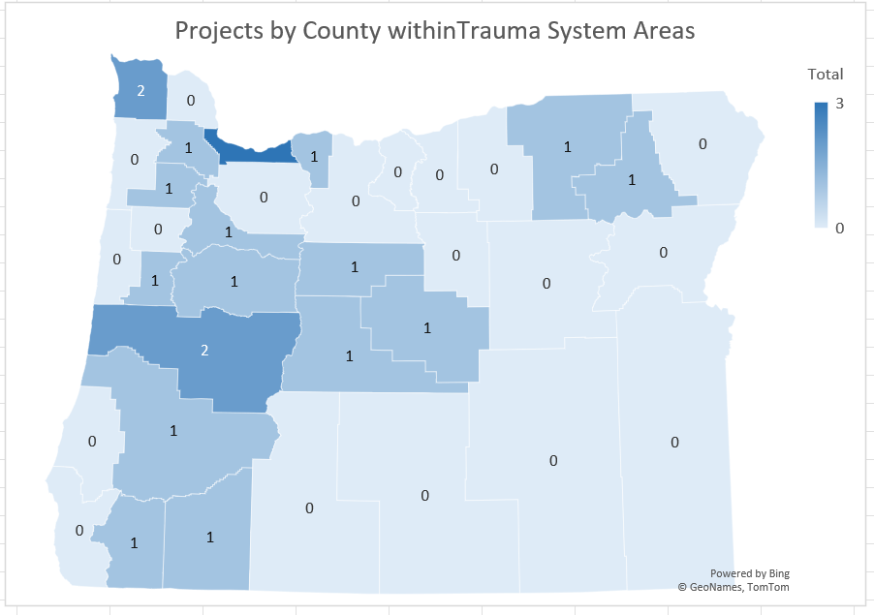
Program Overview
Counties Missing Program Support
Baker | Lincoln
Clackamas | Malheur
Columbia | Morrow
Coos | Polk
Curry | Sherman
Gilliam | Tillamook
Grant | Wallowa
Harney | Wasco
Klamath | Wheeler
Lake

Slide 8

New Contracts
Please send in a request to participate in the 2025-2027 biennium, which will end June 30, 2027.
New Grant Agreements will be issued once unexpended funds from 2021-2025 are returned.
For returning grantees, new award amounts will be based on previous expenditures.
For new grantees, award amounts will be based on projected expenditures.
Additional funds may be requested throughout the duration of the contract if funds are nearing depletion.
Once your contract is signed, send in an invoice to receive your award amount.

Slide 9
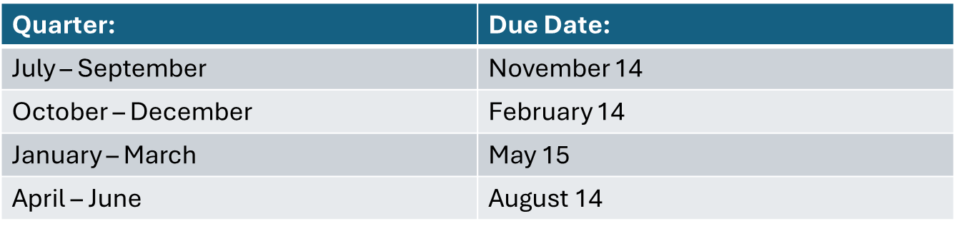
Reporting
Reports are due within 45 days after the quarter ends.
Send reports to: OHA.BHITeam@OHA.Oregon.Gov
Reminder emails will be sent shortly after the due dates.

Slide 10

Changes This Biennium
12% of the award money can be used for administrative costs.

Slide 11

Questions?

Slide 12
Thank you all!
Please contact oha.bhiteam@oha.oregon.gov if you have any questions!

