Slide 1
State of Oregon Law Library Resources
Emily Donnellan JD/MLIS
Reference Librarian, SOLL

Slide 2
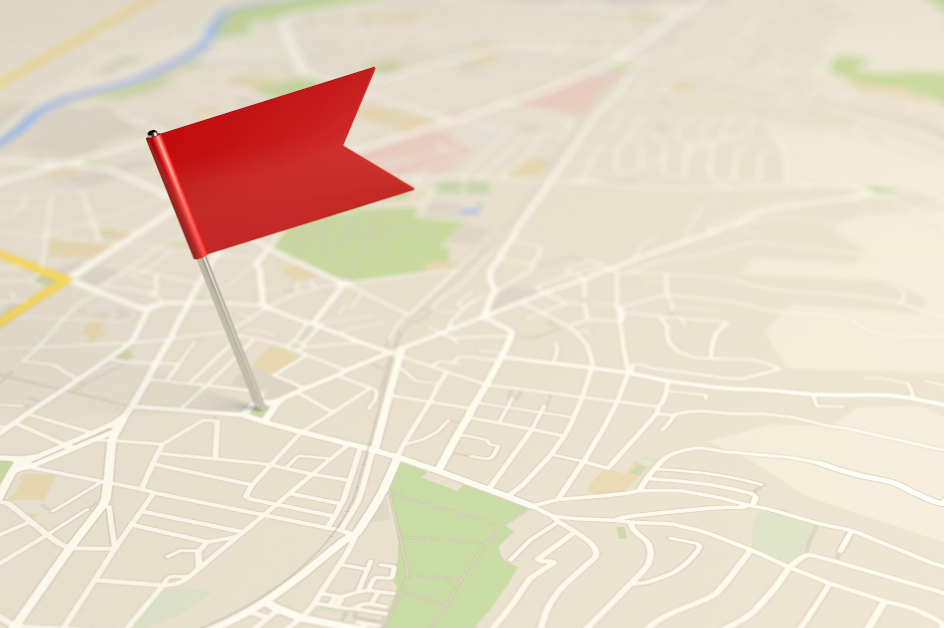
Roadmap
Introduction to State of Oregon Law Library (SOLL)
SOLL Collection Highlights
SOLL Created Databases
Remote Databases
In-Library Resources
Other State Government Resources
State Library
Oregon Archives
Oregon Legislature
Legislative History*
Rombauer Method

Slide 3







Meet the SOLL Library Team
Cathryn Bowie
State Law Librarian
Emily Donnellan
Reference Librarian
Lynne Palombo
Communications Librarian
Amanda Duke
Tech Services Librarian
Melissa Beer
Research Analyst
Mary Yunker
Publications
Jess Davison
Publications
Desiree Perry
Library Assistant
3

Slide 4
SOLL Stats
35,000+ Electronic Titles
96,000 Unique Catalog Entries
Over 100,000 Volumes!
Collection Highlights

Slide 5
Popular Print
Oregon Materials
ORS
Session Laws
(1853-Current) + Online
Oregon Reporters
OR*, OR APP*, BOLI, LUBA
Admin Rules
Compilation 1995ish-
Oregon Bulletin
Reference Materials
Dictionaries, Secondary Sources
Rare Books

Slide 6
Library In-House Content
Appellate opinions (SC, COA, Tax Court)
Appellate briefs (2004-Early 2020)
Chief Justice Orders
ORVL - Oregon Reports in PDF. For in-house use only.
Governor Executive Orders
District Attorney Public Records Orders (2019-Current)
Oregon AG Public Records Orders (1981-Current)
Oregon ELRB Final Orders
Oregon Historic Court Rules
Oregon LUBA Final Orders & Opinions
Oregon County Law Library Surveys
New!
12/11/2025
6

Slide 7

SOLL Remote Resources

Slide 8
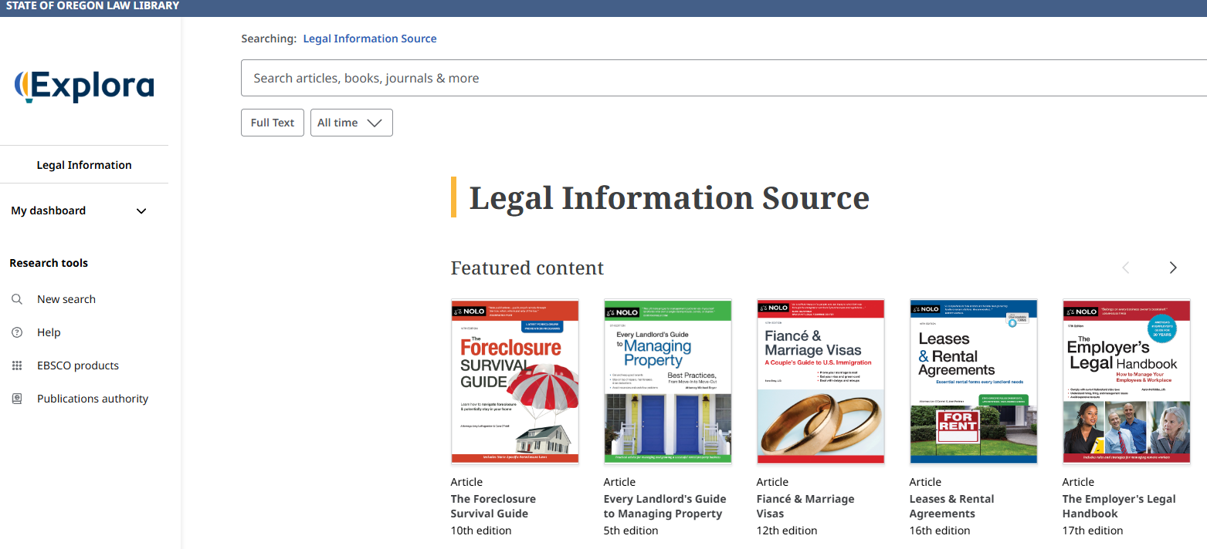
Legal Information Source – NOLO
Notes:
Similar to the “for dummy’s series”, has generic forms and information. A great starting spot.

Slide 9

Oregon State Bar Books
Oregon Specific
49 Books (on all legal topics)
Searchable
Downloadable PDF’s
Forms

Slide 10
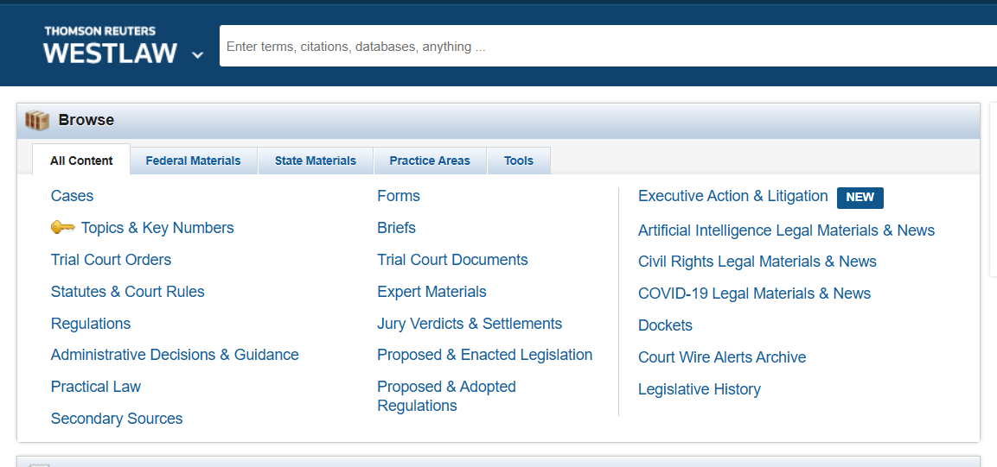
Westlaw Pro Se

Slide 11
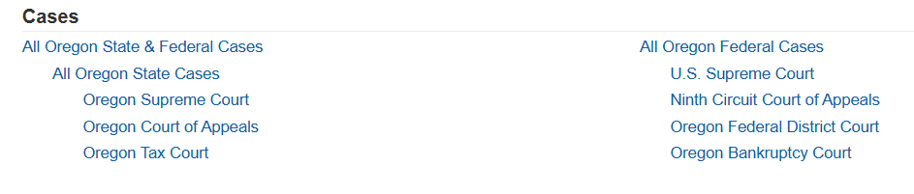
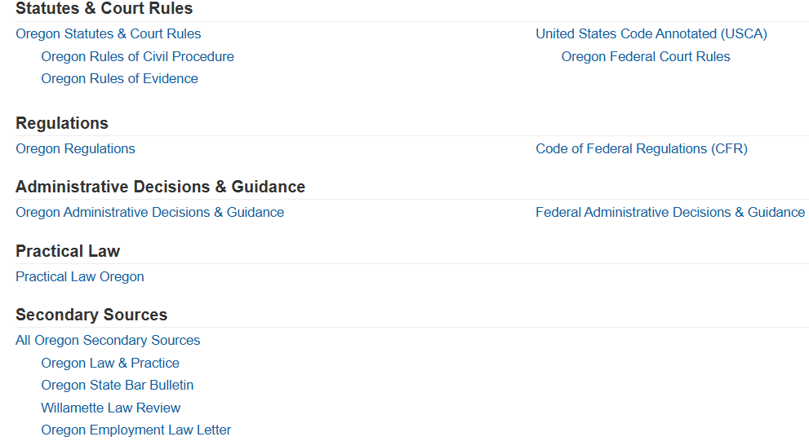

Slide 12
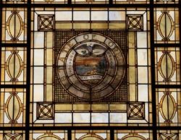
In-Library Access
HeinOnline*
Lexis Plus
Westlaw Precision*
Bloomberg Law
VitalLaw
Merriam-Websters
Stedman’s Online
Chicago Manual of Style

Slide 13

HeinOnline
Session Laws
State Statutes Historical Archive
Spinelli’s Law Library Reference Shelf
Law Library Journal
US Federal Materials
Resources from Hein are linked in the Law Library Catalog

Slide 14
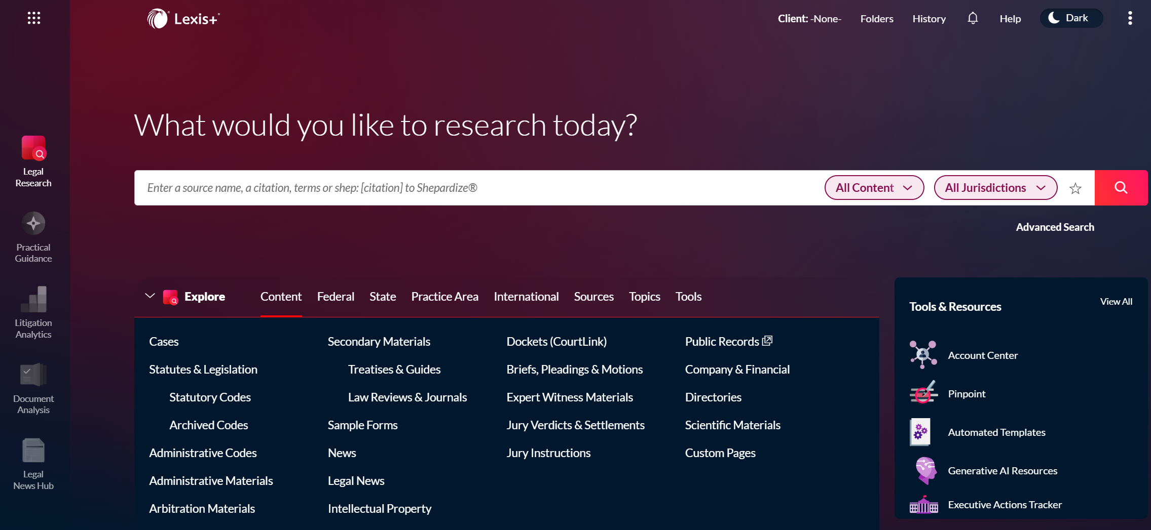
Lexis +
Notes:
Oregon Evidence is on Lexis y'all
99% similar content to Westlaw

Slide 15
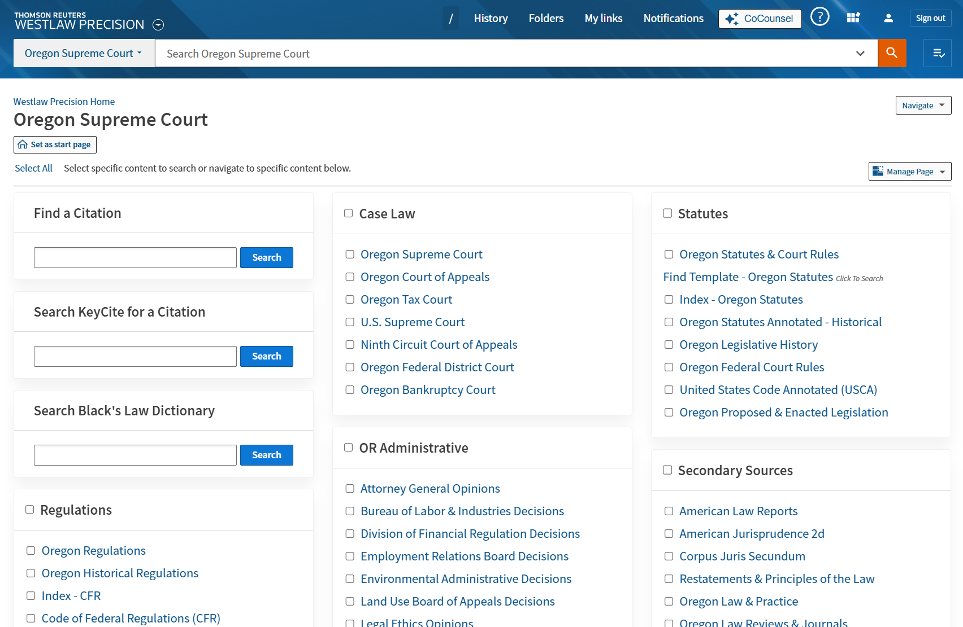

Westlaw Precision*
Notes:
I created this homepage focusing on Oregon content. I’m glad to send to anyone interested. This is your traditional Westlaw platform – great searching. Really the gold standard for legal research.

Slide 16
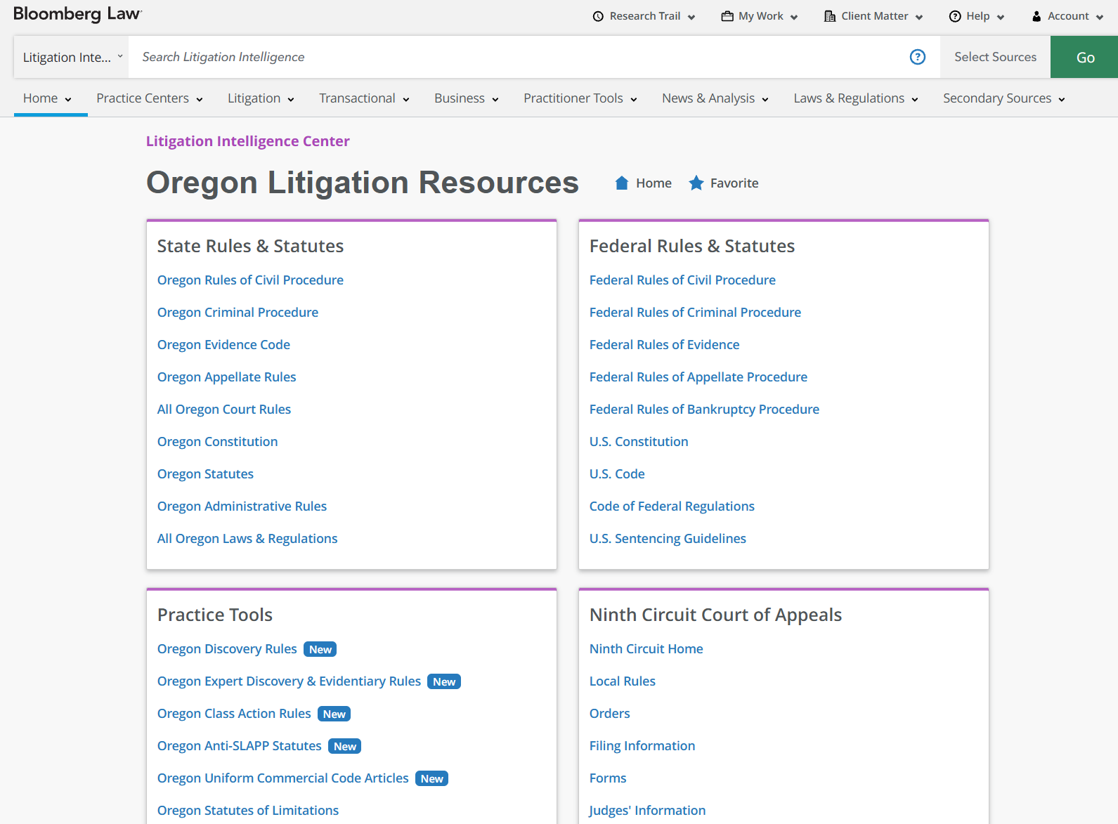

Bloomberg Law
Notes:
Best Federal Docket searching outside of Pacer.

Slide 17

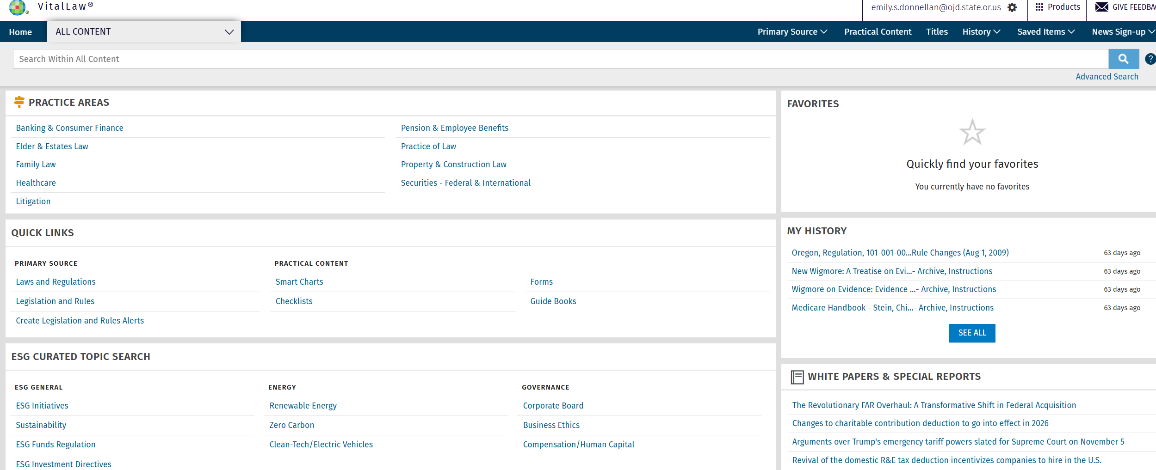
VitalLaw
Notes:
Owned by Wolters Kluwer. Used to be called Cheetah back in the day. Very much a book-like resource rather than a searching database.

Slide 18
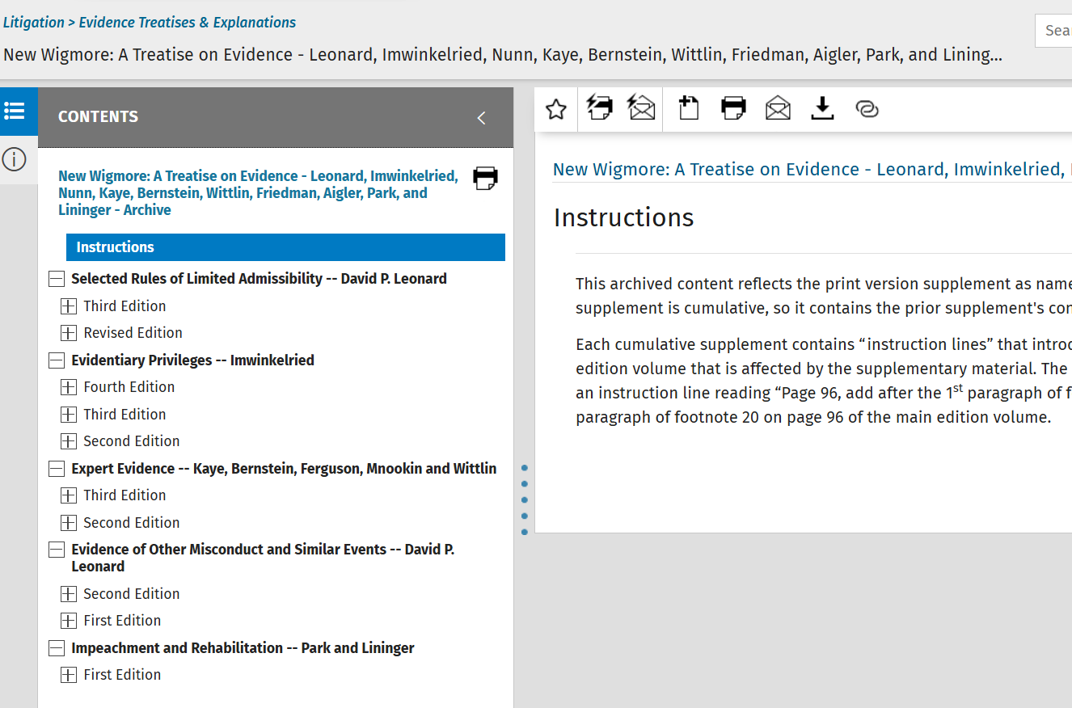
Notes:
Unlike other databases VitalLaw keeps superseded editions like the popular Wigmore.
Farnsworth on contracts also here.

Slide 19
Merriam-Webster Online (& Print)
WFH?
Request a scan!
Webster’s Online
Dictionary Scan Requests
Indicate year and dictionary title
2002 Edition is the one named in the court style guide.

Slide 20
Stedman’s Medical Dictionary Online Print - 1950’s

Slide 21
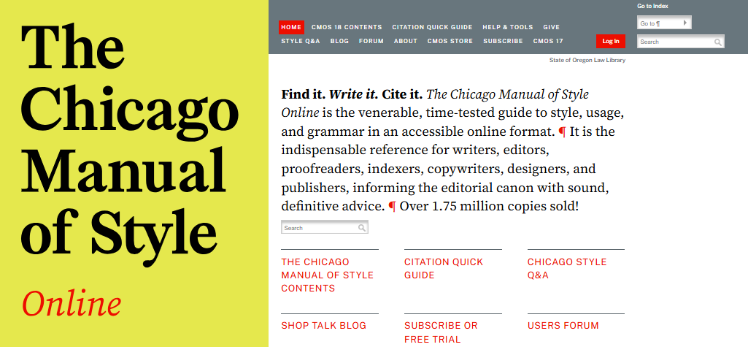
Chicago Manual of Style

Slide 22
Questions about SOLL Resources?

Slide 23
State Government Legal Resources
Notes:
We’re not your only resource! You also have access to other state gov resources.

Slide 24
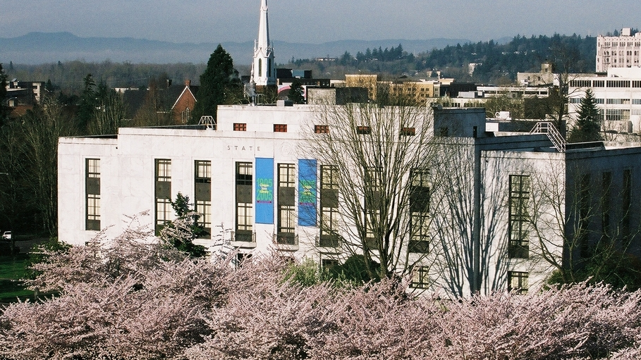
State Library
Oregon Documents
Voters Pamphlets
State Agency Publications
Oregoniana
Like Americana…but for Oregon

Slide 25
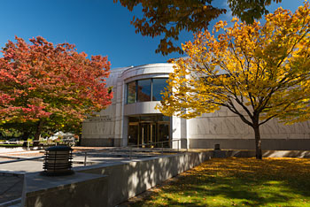
Oregon State Archives
Original Oregon Documents
Legislative History
Oregon Administrative Rules
2018-2025 Compilations

Slide 26
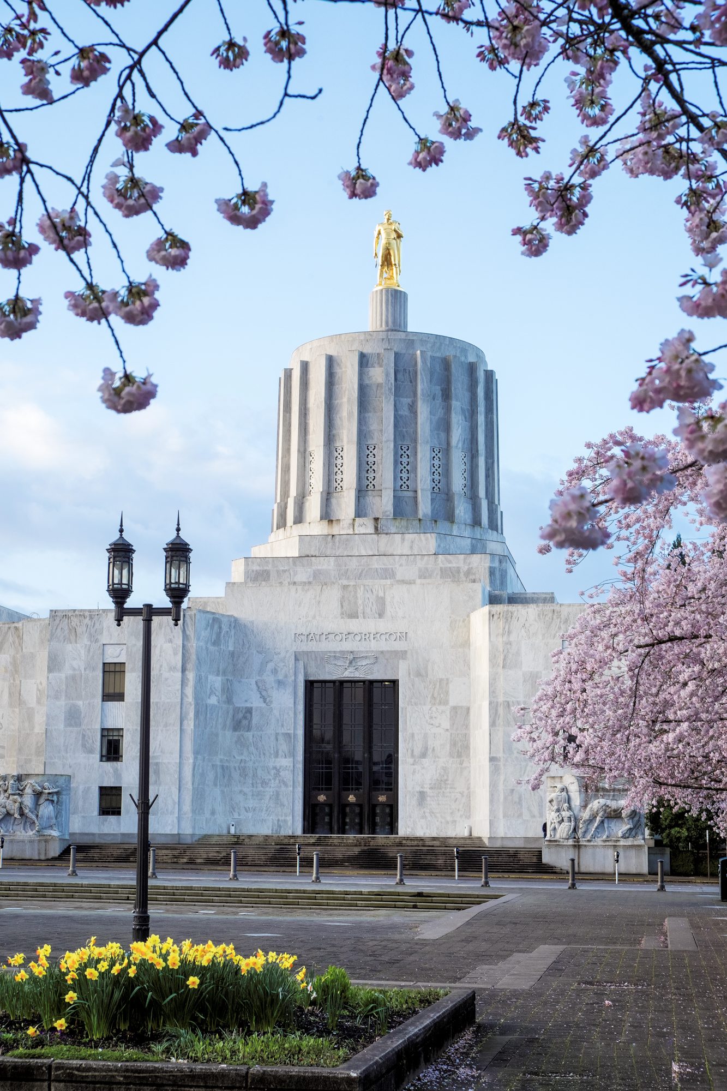
Oregon Legislature
Oregon Revised Statutes 1953-Current
OR Laws (session laws) from 1999-2024
HeinOnline
Newer Leg History
Previous Session Details 2006ish-Current
Example: SB 406 2023
Notes:
Not my favorite gov website – does have a wealth of information.

Slide 27
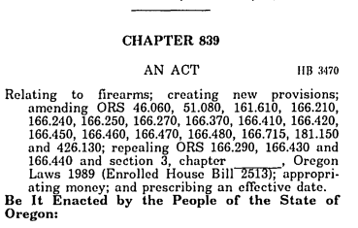
Leg History (older stuff)
ORS 166.272
(1) A person commits the crime of unlawful possession of a machine gun, short-barreled rifle, short-barreled shotgun or firearms silencer if the person knowingly possesses any machine gun, short-barreled rifle, short-barreled shotgun or firearms silencer.(2) Unlawful possession of a machine gun, short-barreled rifle, short-barreled shotgun or firearms silencer is a Class B felony.(3) A peace officer may not arrest or charge a person for violating subsection (1) of this section if the person has in the person's immediate possession documentation showing that the machine gun, short-barreled rifle, short-barreled shotgun or firearms silencer is registered as required under federal law.(4) It is an affirmative defense to a charge of violating subsection (1) of this section that the machine gun, short-barreled rifle, short-barreled shotgun or firearms silencer was registered as required under federal law. 1989 c.839 §13a; 1997 c.749 §8; 1997 c.798 §1
Session Law (OR LAW) for 1989 c. 839 → HB 3470 1989
https://records.sos.state.or.us/ORSOSWebDrawer/Search
https://records.sos.state.or.us/ORSOSWebDrawer/RecordView/8928372
Legislative Committee Records Inventory

Slide 28
Leg History (older stuff)
Session Law (OR LAW) for 1989 c. 839 → HB 3470 1989
Legislative Tracing MUST SEARCH IN THIS FORMAT YEAR_HB_3470*
https://records.sos.state.or.us/ORSOSWebDrawer/RecordView/8928372
Legislative Committee Records Inventory

Slide 29

Questions?

Slide 30

Starting your research
Now you know where the resources are...How do you know when to consult what?
Notes:
Any questions? We’re now going to pivot

Slide 31
How do I begin my research?
Rombauer Method
Preliminary Analysis
Secondary Sources
Codified Law
Hierarchy of authority
Binding Precedent & Persuasive Authority
Refine, Double Check & Update

Slide 32
Preliminary Analysis
Facts
Words & Phrases
Issue
Jurisdiction
What do you already know

Slide 33
Secondary Sources
I start my research here.
What is a secondary source?
Discuss, explain, analyze and critique the law
Examples of Secondary Sources
Treatises (Nimmer on Copyright)
Hornbooks
Encyclopedias (AmJur & CJS)
Dictionary's (Blacks)
Law Reviews
ALR Articles

Slide 34
Codified Law Law
Constitutions
Statutes
Regulations
Court Rules

Slide 35
Case Law
What law school focuses on and likely what you’re familiar with
Binding authority
Remember your hierarchy of authority
Trial Court
Court of Appeals
Court of last resort
Persuasive Authority
Cases from other jurisdictions
Statutes from other states
50 State surveys

Slide 36
Refine, Double-Check, Update
Refine
Have you answered the question?
Double-check
Not feeling confident in your answer?
Update
Shepardize, Keycite, whatever you need to do to make sure you’re relying on good law.

Slide 37

Final thoughts?

Slide 38
Get ahold of us! Website Oregon.gov/soll 503-986-5640 State.Law.Library@ojd.state.or.us

